Slide 1
Interrupts
Professor Yasser Kadah – www.k-space.org

Slide 2
Recommended Reference
Embedded Programming with Field Programmable Mixed Signal μController, M.T. Chew and G.S. Gupta.

Slide 3
Interrupts
Introduction
Interrupt organization
Interrupt summary
Enabling and disabling interrupts
Interrupt priority
Interrupt pending flags
External interrupts
Interrupt SFRs
Notes:
In this lecture we will look at the interrupt organization of C8051F020, how interrupts may be enabled or disabled and how to prioritize the interrupts. We will look at the polling sequence and learn about the interrupt pending flags for various interrupt sources. Also, we will discuss the external interrupts available in C8051F020.

Slide 4
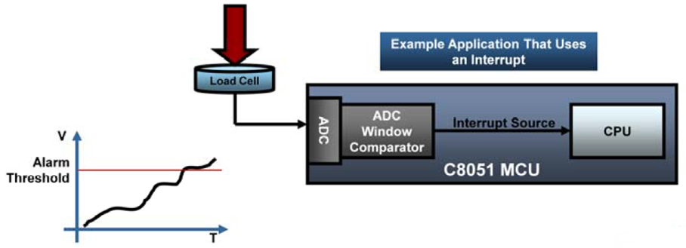
Introduction
An interrupt is the occurrence of a condition that causes a temporary suspension of a program while the condition is serviced by another (sub) program
Interrupts are important because they allow a system to respond asynchronously to an event and deal with the event while in the middle of performing another task
An interrupt driven system gives the illusion of doing many things simultaneously
The (sub) program that deals with an interrupt is called an interrupt service routine (ISR) or interrupt handler
Notes:
Interrupt mechanism allow a system to respond asynchronously to an event and deal with the event while another is executing. The program that is executed when an interrupt occurs is called an interrupt service routine (ISR) or interrupt handler.

Slide 5
Introduction
The ISR executes in response to the interrupt and generally performs an input or output operation to a device
When an interrupt occurs, the main program temporarily suspends execution and branches to the ISR
The ISR executes, performs the desired operation, and terminates with a “return from interrupt” (RETI) instruction
The RETI instruction is different from the normal “RET” instruction
Notes:
When an interrupt occurs, the main program temporarily suspends execution and branches to the ISR. The ISR executes, performs the operation, and terminates with a “return from interrupt” (RETI) instruction.

Slide 6
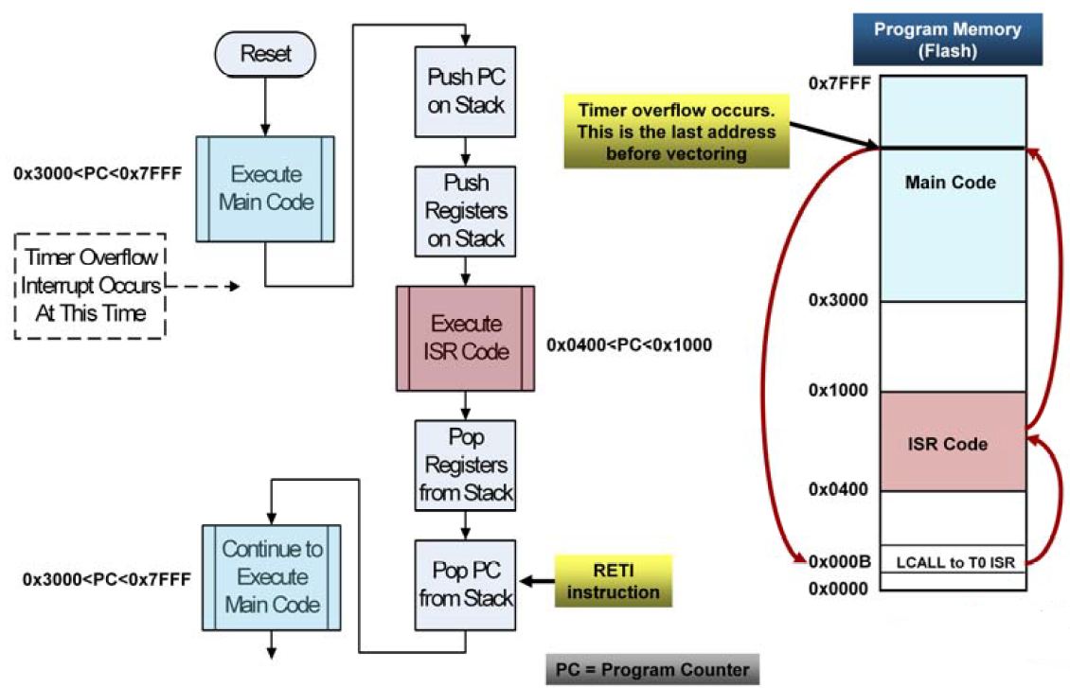
Execution Flow
Notes:
The execution of the main program is suspended while ISR code is executed. Context is saved before executing ISR code, and restored after executing ISR code.

Slide 7
Interrupt Organization
The C8051F020 supports 22 interrupt sources, including:
4 external interrupts (/INT0, /INT1, Interrupt 6 and Interrupt 7)
5 timer interrupts (Timer 0 through 4 Overflow)
2 serial port interrupts (UART0, UART1)
Each interrupt source has one or more associated interrupt-pending flag(s) located in an SFR
When a peripheral or external source meets a valid interrupt condition, the associated interrupt-pending flag is set to 1
These interrupt flags are “level sensitive” in that if the flag is not cleared in the ISR by either hardware or software, the interrupt will trigger again, even if the event that originally caused the interrupt did not occur again
All interrupts are disabled after a system reset and enabled individually by software
Notes:
The C8051F020 supports 22 interrupt sources. Each interrupt source has one or more associated interrupt-pending flag(s) located in an SFR. In general, when a peripheral or an external source meets a valid interrupt condition, the associated interrupt-pending flag is set to 1.

Slide 8
Interrupt Summary
Interrupt Source | Interrupt Vector | Priority Order | Pending Flag | Enable Flag | Priority Control
Reset | 0000 | Top | None | Always Enabled | Always Highest
External Interrupt 0 (/INT0) | 0003 | 0 | IE0 (TCON.1) | EX (IE.0) | PX0 (IP.0)
Timer 0 Overflow | 000B | 1 | TF0 (TCON.5) | ET0 (IE.1) | PT0 (IP.1)
External Interrupt 1 (/INT1) | 0013 | 2 | IE1 (TCON.3) | EX1 (IE.2) | PX1 (IP.2)
Timer 1 Overflow | 001B | 3 | TF1 (TCON.7) | ET1 (IE.3) | PT1 (IP.3)
UART0 | 0023 | 4 | RI0 (SCON0.0) TI0 (SCON0.1) | ES0 (IE.4) | PS0 (IP.4)
Timer 2 Overflow | 002B | 5 | TF2 (T2CON.7) | ET2 (IE.5) | PT2 (IP.5)
Serial Peripheral Interface | 0033 | 6 | SPIF (SPI0CN.7) | ESPI0 (EIE1.0) | PSPI0 (EIP1.0)
SMBus Interface | 003B | 7 | SI (SMB0CN.3) | ESMB0 (EIE1.1) | PSMB0 (EIP1.1)
ADC0 Window Comparator | 0043 | 8 | AD0WINT (ADC0CN.2) | EWADC0 (EIE1.2) | PWADC0 (EIP1.2)
Notes:
This table shows you the list of all the interrupt sources. They have been listed in the order of decreasing priority in the polling sequence. The associated interrupt pending flag is also shown. For example, when the Timer 0 overflows, the corresponding interrupt pending flag TF0 (which is bit 5 in TCON SFR) will be set. An interrupt will be generated if it has been enabled. For Timer 0 Overflow to generate an interrupt, the enable flag ET0 (which is bit 1 of IE SFR) must be set. The priority of the Timer 0 Overflow interrupt may be set to high or low by programming the bit PT0 (which is bit 1 of IP SFR).

Slide 9
Interrupt Summary
Interrupt Source | Interrupt Vector | Priority Order | Pending Flag | Enable Flag | Priority Control
Programmable Counter Array | 004B | 9 | CF (PCA0CN.7) CCFn (PCA0CN.n) | EPCA0 (EIE1.3) | PPCA0 (EIP1.3)
Comparator 0 Falling Edge | 0053 | 10 | CP0FIF (CPT0CN.4) | ECP0F (EIE1.4) | PCP0F (EIP1.2)
Comparator 0 Rising Edge | 005B | 11 | CP0RIF (CPT0CN.5) | ECP0R (EIE1.5) | PCP0R (EIP1.5)
Comparator 1 Falling Edge | 0063 | 12 | CP1FIF (CPT1CN.4) | ECP1F (EIE1.6) | PCP1F (EIP1.6)
Comparator 1 Rising Edge | 006B | 13 | CP1RIF (CPT1CN.5) | ECP1R (EIE1.7) | PCP1F (EIP1.7)
Timer 3 Overflow | 0073 | 14 | TF3 (TMR3CN.7) | ET3 (EIE2.0) | PT3 (EIP2.0)
ADC0 End of Conversion | 007B | 15 | AD0INT (ADC0CN.5) | EADC0 (EIE2.1) | PADC0 (EIP2.1)
Timer 4 Overflow | 0083 | 16 | TF4 (T4CON.7) | ET4 (EIE2.2) | PT4 (EIP2.2)
ADC1 End of Conversion | 008B | 17 | AD1INT (ADC1CN.5) | EADC1 (EIE2.3) | PADC1 (EIP2.3)
External Interrupt 6 | 0093 | 18 | IE6 (P3IF.6) | EX6 (EIE2.4) | PX6 (EIP2.4)
External Interrupt 7 | 009B | 19 | IE7 (P3IF.7) | EX7 (EIE2.5) | PX7 (EIP2.5)
UART1 | 00A3 | 20 | RI1 (SCON1.0) TI1 (SCON1.1) | ES1 (EIE2.6) | PS1 (EIP2.6)
External Crystal OSC Ready | 00AB | 21 | XTLVLD (OSCXCN.7) | EXVLD (EIE2.7) | PXVLD (EIP2.7)
Notes:
RESET has the highest priority, and cannot be disabled.

Slide 10
Interrupt Organization
In the event of two or more simultaneous interrupts or an interrupt occurring while another is being serviced, there is both a fixed priority order and two programmable priority levels to schedule the interrupts
Notes:
What happens when two or more interrupts occur simultaneously or an interrupt occurring while another is being serviced? To schedule the interrupts there is both a fixed priority order and a two-level priority scheme. The fixed priority order is pre-determined, but the interrupt priority level is programmable.

Slide 11
Enabling and Disabling Interrupts
Each of the interrupt sources is individually enabled or disabled through the SFRs IE, EIE1 and EIE2
In addition to individual enable bits for each interrupt source, there is a global enable/disable bit, EA (IE.7) that is cleared to disable all interrupts or set to turn on all enabled interrupts
Typically, two bits must be set to enable an interrupt:
the individual enable bit
the global enable bit
Some interrupts need more than two bits to enable
The RESET interrupt (interrupt 0) cannot be turned off, and always the highest priority
Notes:
There are three SFRs- IE, EIE1 and EIE2 – which are used to individually enable or disable each of the interrupt sources. There is also a global enable/disable bit, EA (IE.7) that is cleared to disable all interrupts or set to turn on all interrupts. Thus to enable any interrupt, two bits must be set - the corresponding individual enable bit and the global enable bit. If interrupts are disabled, the interrupt pending flags are ignored by the hardware and program execution continues as normal.

Slide 12
Programmable Interrupt Priority Levels
Each interrupt source can be individually programmed to one of two priority levels, low or high, through an associated interrupt priority bit in the SFRs IP, EIP1 and EIP2
These three SFRs are cleared after a system reset to place all interrupts at low priority by default
The two priority levels allow an ISR to be interrupted by an interrupt of higher priority than the current one being serviced
A low priority ISR is pre-empted by a high priority interrupt
A high priority interrupt cannot be pre-empted.
Notes:
There are three SFRs - IP, EIP1 and EIP2 – which can be used to individually program the priority levels (low or high) of each interrupt source. These three SFRs are cleared after a system reset so that all the interrupts are placed at low priority by default. The two priority levels allow an ISR to be interrupted by an interrupt of higher priority than the current one being serviced. A low priority ISR is pre-empted by a high priority interrupt. A high priority interrupt cannot be pre-empted.

Slide 13
Programmable Interrupt Priority Levels
Having two priority levels is useful because some events require immediate action, while some other events can tolerate some delay in the response time
Example: Radio Controlled (RC) Car
The current to the motor driving the wheels has to be adjusted periodically
This is done on a Timer overflow interrupt that is set to high priority because a delay in response can cause the motor to be damaged due to high current
Whenever user commands such as forward/reverse are received, the MCU has to take action
This can wait for a few extra milliseconds because that delay is small enough to be unnoticed by a user
This keypad interrupt is set to low priority
Notes:
Programmable priority levels allow the programmer to choose which event should receive immediate action, and which one can wait a little while.

Slide 14
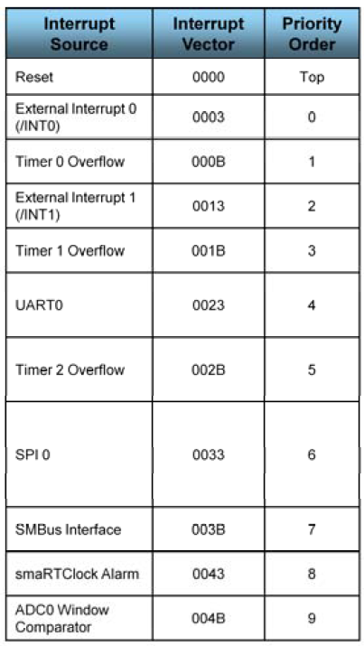
Fixed Priority Order
If two interrupts are recognized simultaneously, the interrupt with the higher priority level is serviced first
If both interrupts have the same priority level, the fixed priority order determines which is serviced first
Refer to priority order column in the Interrupt Summary table
Notes:
If two interrupts occur simultaneously, the interrupt with the higher priority level is serviced first. If both the interrupts have the same priority level, then the fixed priority order determines which is serviced first.

Slide 15
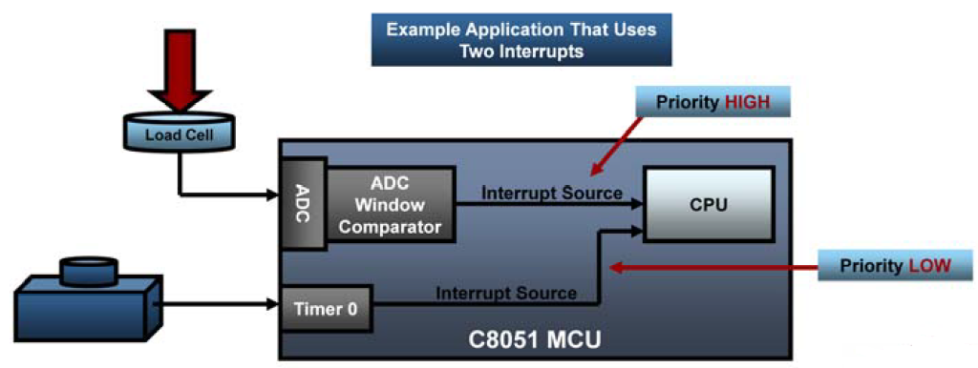
Interrupt Priority Example
High priority tasks: critical tasks
Safety critical systems
Low priority tasks
Human user input
Display

Slide 16
Interrupt Pending Flags
Some interrupt pending flags are automatically cleared by the hardware when the CPU vectors to the ISR
However, most are not cleared by the hardware, and must be cleared by software before returning from the ISR
If an interrupt pending flag remains set after the CPU completes the RETI instruction, a new interrupt request will be generated immediately and the CPU will re-enter the ISR after the completion of the next instruction
If an interrupt is disabled, the interrupt pending flag is ignored by the hardware and program execution continues as normal
Notes:
Some interrupt pending flags are automatically cleared by the hardware when the CPU vectors to the ISR. However, most are not cleared by the hardware and must be cleared by software before returning from the ISR. If an interrupt pending flag remains set after the CPU completes the RETI instruction, a new interrupt request will be generated immediately and the CPU will re-enter the ISR after the completion of the next instruction.

Slide 17
External Interrupts: /INT0 and /INT1
Pins for the two external interrupt sources (/INT0 and /INT1 ) are allocated and assigned by the crossbar
They are configured by bits IT0 (TCON.0) and IT1 (TCON.2)
IE0 (TCON.1) and IE1 (TCON.3) serve as the interrupt-pending flags
They are enabled using bits EX0 (IE.0) and EX1 (IE.1)
The external interrupt sources can be programmed to be level-activated (low) or transition-activated (negative edge) on /INT0 or /INT1.
If a /INT0 or /INT1 external interrupt is configured as edge-sensitive, the corresponding interrupt-pending flag is automatically cleared by hardware when the CPU vectors to the ISR
When configured as level sensitive, the interrupt-pending flag follows the state of the external interrupt's input pin
The external interrupt source must hold the input active until the interrupt request is recognized
It must then deactivate the interrupt request before execution of the ISR completes, or else another interrupt request will be generated
Notes:
The two external interrupt sources (/INT0 and /INT1 ) do not have dedicated pins on the microcontroller, they are allocated and assigned by the digital crossbar by configuring bits IT0 (TCON.0) and IT1 (TCON.2). These external interrupt sources can be programmed to be level-activated (low) or transition-activated (negative edge).

Slide 18
TCON Register
Bit | Symbol | Description
7 | TF1 | Timer 1 Overflow Flag Set by hardware when Timer 1 overflows. This flag can be cleared by software but is automatically cleared when the CPU vectors to the Timer 1 interrupt service routine (ISR). 0: No Timer 1 overflow detected 1: Timer 1 has overflowed
6 | TR1 | Timer 1 Run Control 0: Timer 1 disabled 1: Timer 1 enabled
5 | TF0 | Timer 0 Overflow Flag Same as TF1 but applies to Timer 0 instead. 0: No Timer 0 overflow detected 1: Timer 0 has overflowed
4 | TR0 | Timer 0 Run Control 0: Timer 0 disabled 1: Timer 0 enabled
3 | IE1 | External Interrupt 1 This flag is set by hardware when an edge/level of type defined by IT1 is detected. It can be cleared by software but is automatically cleared when the CPU vectors to the External Interrupt 1 ISR if IT1=1. This flag is the inverse of the /INT1 input signal’s logic level when IT1=0
2 | IT1 | Interrupt 1 Type Select 0: /INT1 is level triggered 1: /INT1 is edge triggered
1 | IE0 | External Interrupt 0 Same as IE1 but applies to IT0 instead.
0 | IT0 | Interrupt 0 Type Select 0: /INT0 is level triggered 1: /INT0 is edge triggered
Notes:
It is kind of strange, but external interrupts /INT0 and /INT1 are controlled by the TCON register (which you would have thought is for Timer control !!). This is still maintained even in new 8051 derivatives to preserve backward compatibility with the original 8051 architecture.

Slide 19
External Interrupts—Interrupt 6 and 7
Port pins P3.6 and P3.7 can be used as inputs for the other 2 external interrupts—Interrupts 6 & 7
They are edge-sensitive inputs and can be configured to trigger on a positive or negative edge
The interrupt-pending flags and configuration bits for these interrupts are in the port 3 interrupt flag register (P3IF)
When an active edge is detected on P3.6 or P3.7, the corresponding external interrupt flag (IE6 or IE7) will be set to logic 1 in the P3IF register
If the associated interrupt is enabled, an interrupt will be generated and the CPU will vector to the associated interrupt vector location
Notes:
The other 2 external interrupts - Interrupts 6 & 7 – are on port pins P3.6 and P3.7. These are edge-sensitive inputs and can be configured to trigger on a positive or negative edge by programming the IE6CF and IE7CF bits in the Port 3 Interrupt Flag Register (P3IF). The interrupt-pending flags, IE6 and IE7, are also in the P3IF register.

Slide 20
External Interrupts—P3IF Register
Bit | Symbol | Description
7 | IE7 | External Interrupt 7 Pending Flag 0: No falling edge has been detected on P3.7 since this bit was last cleared. 1: This flag is set by hardware when a falling edge on P3.7 is detected.
6 | IE6 | External Interrupt 6 Pending Flag 0: No falling edge has been detected on P3.6 since this bit was last cleared. 1: This flag is set by hardware when a falling edge on P3.6 is detected.
5-4 | - | UNUSED. Read = 00, Write = don’t care
3 | IE7CF | External Interrupt 7 Edge Configuration 0: External Interrupt 7 triggered by a falling edge on the IE7 input. 1: External Interrupt 7 triggered by a rising edge on the IE7 input.
2 | IE6CF | External Interrupt 6 Edge Configuration 0: External Interrupt 6 triggered by a falling edge on the IE6 input. 1: External Interrupt 6 triggered by a rising edge on the IE6 input.
1-0 | - | UNUSED. Read = 00, Write = don’t care
Notes:
We looked at this table once before while on the topic of System Clock, Crossbar and GPIO (Lecture 6). When an active edge is detected on P3.6 or P3.7, the corresponding External Interrupt Flag (IE6 or IE7) will be set to logic 1 in the P3IF register. If the associated interrupt is enabled, an interrupt will be generated and the CPU will vector to the associated interrupt vector location.

Slide 21
IE—Interrupt Enable
Bit | Symbol | Description
7 | EA | Enable All Interrupts 0: Disable all interrupt sources. 1: Enable each interrupt according to its individual mask setting.
6 | IEGF0 | General Purpose Flag 0 This is a general purpose flag for use under software control.
5 | ET2 | Enable Timer 2 Interrupt 0: Disable Timer 2 Interrupt. 1: Enable interrupt requests generated by TF2 (T2CON.7).
4 | ES0 | Enable UART0 Interrupt 0: Disable UART0 Interrupt. 1: Enable UART0 Interrupt.
3 | ET1 | Enable Timer 1 Interrupt 0: Disable Timer 1 Interrupt. 1: Enable interrupt requests generated by TF1 (TCON.7).
2 | EX1 | Enable External Interrupt 1 0: Disable external interrupt 1. 1: Enable interrupt request generated by the /INT1 pin.
1 | ET0 | Enable Timer 0 Interrupt 0: Disable Timer 0 Interrupt. 1: Enable interrupt requests generated by TF0 (TCON.5).
0 | EX0 | Enable External Interrupt 0 0: Disable external interrupt 0. 1: Enable interrupt request generated by the /INT0 pin.
Notes:
IE register is one of the three SFRs that are used to enable/disable interrupt sources. The other two SFRs are EIE1 and EIE2. EA bit is used to globally enable/disable interrupts. It is a good idea to globally disable interrupts before all the initialization routines (for system clock, port I/O, timers, UARTs, ADC/DAC etc) are executed and then enabled at the end.

Slide 22
EIE1—Extended Interrupt Enable 1
Bit | Symbol | Description
7 | ECP1R | Enable Comparator1 (CP1) Rising Edge Interrupt 0: Disable CP1 Rising Edge interrupt. 1: Enable interrupt requests generated by CP1RIF (CPT1CN.5).
6 | ECP1F | Enable Comparator1 (CP1) Falling Edge Interrupt 0: Disable CP1 Falling Edge interrupt. 1: Enable interrupt requests generated by CP1FIF (CPT1CN.4).
5 | ECP0R | Enable Comparator0 (CP0) Rising Edge Interrupt 0: Disable CP0 Rising Edge interrupt. 1: Enable interrupt requests generated by CP0RIF (CPT0CN.5).
4 | ECP0F | Enable Comparator0 (CP0) Falling Edge Interrupt 0: Disable CP0 Falling Edge interrupt. 1: Enable interrupt requests generated by CP0FIF (CPT0CN.4).
3 | EPCA0 | Enable Programmable Counter Array (PCA0) Interrupt 0: Disable all PCA0 interrupts. 1: Enable interrupt requests generated by PCA0.
2 | EWADC0 | Enable Window Comparison ADC0 Interrupt 0: Disable ADC0 Window Comparison Interrupt. 1: Enable Interrupt request generated by ADC0 Window Comparisons.
1 | ESMB0 | Enable System Management Bus (SMBus0) Interrupt 0: Disable all SMBus interrupts. 1: Enable interrupt requests generated by SI (SMB0CN.3).
0 | ESPI0 | Enable Serial Peripheral Interface (SPI0) Interrupt 0: Disable all SPI0 interrupts. 1: Enable interrupt requests generated by SPIF (SPI0CN.7).

Slide 23
EIE2—Extended Interrupt Enable 2
Bit | Symbol | Description
7 | EXVLD | Enable External Clock Source Valid (XTLVLD) Interrupt 0: Disable XTLVLD interrupt. 1: Enable interrupt requests generated by XTLVLD(OXCXCN.7)
6 | ES1 | Enable UART1 Interrupt 0: Disable UART1 Interrupt. 1: Enable UART1 Interrupt.
5 | EX7 | Enable External Interrupt 7 0: Disable external interrupt 7. 1: Enable interrupt request generated by the External Interrupt 7 input pin.
4 | EX6 | Enable External Interrupt 6 0: Disable external interrupt 6. 1: Enable interrupt request generated by the External Interrupt 6 input pin.
3 | EADC1 | Enable ADC1 End of Conversion Interrupt 0: Disable ADC1 End of Conversion interrupt. 1: Enable interrupt requests generated by the ADC1 End of Conversion Interrupt.
2 | ET4 | Enable Timer 4 Interrupt 0: Disable Timer 4 Interrupt. 1: Enable interrupt requests generated by TF4 (T4CON.7).
1 | EADC0 | Enable ADC0 End of Conversion Interrupt 0: Disable ADC0 End of Conversion interrupt. 1: Enable interrupt requests generated by the ADC0 End of Conversion Interrupt.
0 | ET3 | Enable Timer 3 Interrupt 0: Disable Timer 3 Interrupt. 1: Enable interrupt requests generated by TF3 (TMR3CN.7).

Slide 24
IP—Interrupt Priority
Bit | Symbol | Description
7-6 | - | UNUSED. Read=11, Write=don’t care
5 | PT2 | Timer 2 Interrupt Priority Control 0: Timer 2 interrupt priority determined by default priority order. 1: Timer 2 interrupts set to high priority level.
4 | PS0 | UART0 Interrupt Priority Control 0: UART0 interrupt priority determined by default priority order. 1: UART0 interrupts set to high priority level.
3 | PT1 | Timer 1 Interrupt Priority Control 0: Timer 1 interrupt priority determined by default priority order. 1: Timer 1 interrupts set to high priority level.
2 | PX1 | External Interrupt 1 Priority Control 0: External Interrupt 1 interrupt priority determined by default priority order. 1: External Interrupt 1 interrupts set to high priority level.
1 | PT0 | Timer 0 Interrupt Priority Control 0: Timer 0 interrupt priority determined by default priority order. 1: Timer 0 interrupts set to high priority level.
0 | PX0 | External Interrupt 0 Priority Control 0: External Interrupt 0 priority determined by default priority order. 1: External Interrupt 0 set to high priority level.
Notes:
IP register is one of the three SFRs that are used to set the priority level (default or high) of interrupt sources. The other two SFRs are EIP1 and EIP2

Slide 25
EIP1—Extended Interrupt Priority 1
Bit | Symbol | Description
7 | PCP1R | Comparator1 (CP1) Rising Interrupt Priority Control 0: CP1 Rising interrupt set to low priority level. 1: CP1 Rising interrupt set to high priority level.
6 | PCP1F | Comparator1 (CP1) Falling Interrupt Priority Control 0: CP1 Falling interrupt set to low priority level. 1: CP1 Falling interrupt set to high priority level.
5 | PCP0R | Comparator0 (CP0) Rising Interrupt Priority Control 0: CP0 Rising interrupt set to low priority level. 1: CP0 Rising interrupt set to high priority level.
4 | PCP0F | Comparator0 (CP0) Falling Interrupt Priority Control 0: CP0 Falling interrupt set to low priority level. 1: CP0 Falling interrupt set to high priority level.
3 | PPCA0 | Programmable Counter Array (PCA0) Interrupt Priority Control 0: PCA0 interrupt set to low priority level. 1: PCA0 interrupt set to high priority level.
2 | PWADC0 | ADC0 Window Comparator Interrupt Priority Control 0: ADC0 Window interrupt set to low priority level. 1: ADC0 Window interrupt set to high priority level.
1 | PSMB0 | System Management Bus (SMBus0) Interrupt Priority Control 0: SMBus interrupt set to low priority level. 1: SMBus interrupt set to high priority level.
0 | PSPI0 | Serial Peripheral Interface (SPI0) Interrupt Priority Control 0: SPI0 interrupt set to low priority level. 1: SPI0 interrupt set to high priority level.

Slide 26
EIP2—Extended Interrupt Priority 2
Bit | Symbol | Description
7 | PXVLD | External Clock Source Valid (XTLVLD) Interrupt Priority Control 0: XTLVLD interrupt set to low priority level. 1: XTLVLD interrupt set to high priority level.
6 | EP1 | UART1 Interrupt Priority Control 0: UART1 interrupt set to low priority level. 1: UART1 interrupt set to high priority level.
5 | PX7 | External Interrupt 7 Priority Control 0: External Interrupt 7 set to low priority level. 1: External Interrupt 7 set to high priority level.
4 | PX6 | External Interrupt 6 Priority Control 0: External Interrupt 6 set to low priority level. 1: External Interrupt 6 set to high priority level.
3 | PADC1 | ADC1 End of Conversion Interrupt Priority Control 0: ADC1 End of Conversion interrupt set to low priority level. 1: ADC1 End of Conversion interrupt set to high priority level.
2 | PT4 | Timer 4 Interrupt Priority Control 0: Timer 4 interrupt set to low priority level. 1: Timer 4 interrupt set to high priority level.
1 | PADC0 | ADC0 End of Conversion Interrupt Priority Control 0: ADC0 End of Conversion interrupt set to low priority level. 1: ADC0 End of Conversion interrupt set to high priority level.
0 | PT3 | Timer 3 Interrupt Priority Control 0: Timer 3 interrupt set to low priority level. 1: Timer 3 interrupt set to high priority level.

Slide 27
www.silabs.com/MCU
Labs and Problem Sets available at:
www.k-space.org

