Slide 1

Digital-to-Analog Converters and Analog Comparators
Professor Yasser Kadah – www.k-space.org

Slide 2

Recommended Reference
Embedded Programming with Field Programmable Mixed Signal μController, M.T. Chew and G.S. Gupta.

Slide 3

DACs and Comparators
What is a DAC?
Types of DACs
12-bit DACs (DAC0 and DAC1)
  Output scheduling
  Output scaling
  Programming the DACs
Analog comparators
  Functional block diagram
  Hysteresis plot
  Comparator output
Notes:
In this lecture we will learn all about programming the DACs and the Analog Comparators.

Slide 4
What is a DAC?
DAC is the acronym for digital-to-analog converter
A DAC takes a digital value as an input, and produces an analog signal (voltage or current) at its output
Notes:
By “digital value” we mean some number between 0 and a maximum limit. For each digital input value, there’s one corresponding output value.

Slide 5
Different Types of DACs
There are a few different types of common DACs:
  Voltage DACs:
    Produce a voltage level proportional to the digital input
    Use a voltage reference
    Voltage is held steady at the output, current may vary
  Current DACs:
    Produce a current proportional to the digital input
    Use a current reference
    Current is held steady at the output, voltage may vary
    Two types: current sourcing and current sinking

Slide 6
C8051F020 12-Bit DACs (DAC0 and DAC1)
The DAC subsystem consists of two 12-bit voltage DACs
  DAC0 and DAC1
The two DACs are functionally identical and each is configured via the respective control registers, DAC0CN and DAC1CN
The DACs have an output swing of 0 V to VREF for a corresponding input code range of 000H to FFFH
Notes:
The DAC subsystem consists of Two 12-bit DACs (DAC0 and DAC1). The two DACs are functionally identical and each is configured via the respective control registers, DAC0CN and DAC1CN. The DACs have an output swing of 0 V to VREF for a corresponding input code range of 000H to FFFH.

Slide 7
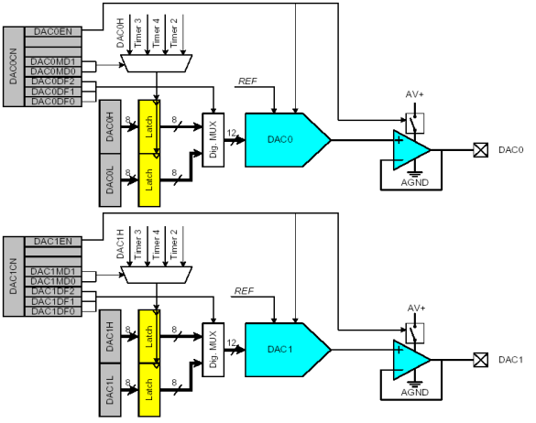
12-bit DACs (DAC0 and DAC1)
Output Buffers
Notes:
This diagram shows the functional block and the SFRs of the DAC. The outputs of the DACs go through output buffer amplifiers. Only two SFRs are involved – DACxCN and DACx (DACxL and DACxH). The VREFD pin provides the reference voltage for the DACs.

Slide 8
Output Scheduling
The DACs have four modes of output scheduling:
  Output on demand (writing to high byte of DACx data word register, DACxH)
  Timer 2 overflow
  Timer 3 overflow
  Timer 4 overflow
The output on demand mode is the default mode
  In this mode, the DAC output is updated when DACxH is written to
Writes to DACxL are held and have no effect on the output until DACxH is written to
  To write a 12-bit data word at full resolution to DACx, the write sequence should be DACxL followed by DACxH
Notes:
The DACs have four modes of output scheduling - Output on Demand (i.e. by Writing to high byte of DACx data word register, DACxH), Timer 2 Overflow, Timer 3 Overflow and Timer 4 Overflow.
The Output on Demand mode is the default mode. In this mode, the DAC output is updated when DACxH is written to. Writes to DACxL are held and have no effect on the output until DACxH is written to. Therefore, to write a 12-bit data word at full resolution to DACx, the write sequence should be DACxL, followed by DACxH.

Slide 9
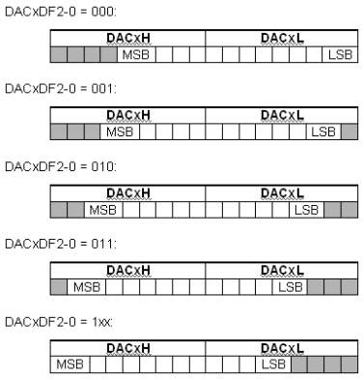
Output Scaling
The format of the 12-bit data word in the DACxH and DACxL registers can be configured by setting the appropriate DACxDF bits (DACxCN.[2:0])
The five data word orientations are →
Notes:
This slide shows the five different orientations of the data word in the DACx register. The DACxDF2-0 bits in the DACxCN register decides the data format.

Slide 10
Programming the DACs
DACx can be programmed through the following sequence:
  Step 1: configure the voltage reference (REF0CN)
  Step 2: set the appropriate output scheduling mode and data word format, and turn on DACx (DACxCN.7)
  Step 3: load the data word registers with the desired 12 bit digital value (DACxL then DACxH if default on demand mode is used)
  Step 4: set up and run the appropriate timers, if applicable
Notes:
The steps to program the DACx are enumerated in this slide.

Slide 11
DAC0CN—DAC0 Control Register
Bit | Symbol | Description
7 | DAC0EN | DAC0 Enable Bit 0: DAC0 disabled. DAC0 is in low power shutdown mode and the output pin is in a high impedance state. 1: DAC0 enabled. DAC0 is operational and the output pin is active.
6-5 | - | UNUSED. Read=00, Write=don’t care
4-3 | DAC0MD1-0 | DAC0 Mode Bits 00: DAC output updates occur on write to DAC0H. 01: DAC output updates occur on Timer 3 overflow. 10: DAC output updates occur on Timer 4 overflow. 11: DAC output updates occur on Timer 2 overflow.
2-0 | DAC0DF2-0 | DAC0 Data Format Bits. 000: The most significant 4 bits of the DAC0 Data Word are in DAC0H[3:0], while the least significant 8 bits are in DAC0L[7:0]. 001: The most significant 5 bits of the DAC0 Data Word are in DAC0H[4:0], while the least significant 7 bits are in DAC0L[7:1]. 010: The most significant 6 bits of the DAC0 Data Word are in DAC0H[5:0], while the least significant 6 bits are in DAC0L[7:2]. 011: The most significant 7 bits of the DAC0 Data Word are in DAC0H[6:0], while the least significant 5 bits are in DAC0L[7:3]. 1xx: The most significant 8 bits of the DAC0 Data Word are in DAC0H[7:0], while the least significant 4 bits are in DAC0L[7:4].
Notes:
The DACx can be enabled/disabled by setting/resetting the DACxEN bit in the DAC0CN (DAC0 Control) Register. The output scheduling mode is decided by the DACxMD1-0 bits. The DACxDF2-0 bits decides the data format.

Slide 12
DAC1CN—DAC1 Control Register
Bit | Symbol | Description
7 | DAC1EN | DAC1 Enable Bit 0: DAC1 disabled. DAC1 is in low power shutdown mode and the output pin is in a high impedance state. 1: DAC1 enabled. DAC1 is operational and the output pin is active.
6-5 | - | UNUSED. Read=00, Write=don’t care
4-3 | DAC1MD1-0 | DAC1 Mode Bits 00: DAC output updates occur on write to DAC1H. 01: DAC output updates occur on Timer 3 overflow. 10: DAC output updates occur on Timer 4 overflow. 11: DAC output updates occur on Timer 2 overflow.
2-0 | DAC1DF2-0 | DAC1 Data Format Bits. 000: The most significant 4 bits of the DAC1 Data Word are in DAC1H[3:0], while the least significant 8 bits are in DAC1L[7:0]. 001: The most significant 5 bits of the DAC1 Data Word are in DAC1H[4:0], while the least significant 7 bits are in DAC1L[7:1]. 010: The most significant 6 bits of the DAC1 Data Word are in DAC1H[5:0], while the least significant 6 bits are in DAC1L[7:2]. 011: The most significant 7 bits of the DAC1 Data Word are in DAC1H[6:0], while the least significant 5 bits are in DAC1L[7:3]. 1xx: The most significant 8 bits of the DAC1 Data Word are in DAC1H[7:0], while the least significant 4 bits are in DAC1L[7:4].
Notes:
The DACx can be enabled/disabled by setting/resetting the DACxEN bit in the DAC0CN (DAC0 Control) Register. The output scheduling mode is decided by the DACxMD1-0 bits. The DACxDF2-0 bits decides the data format.

Slide 13
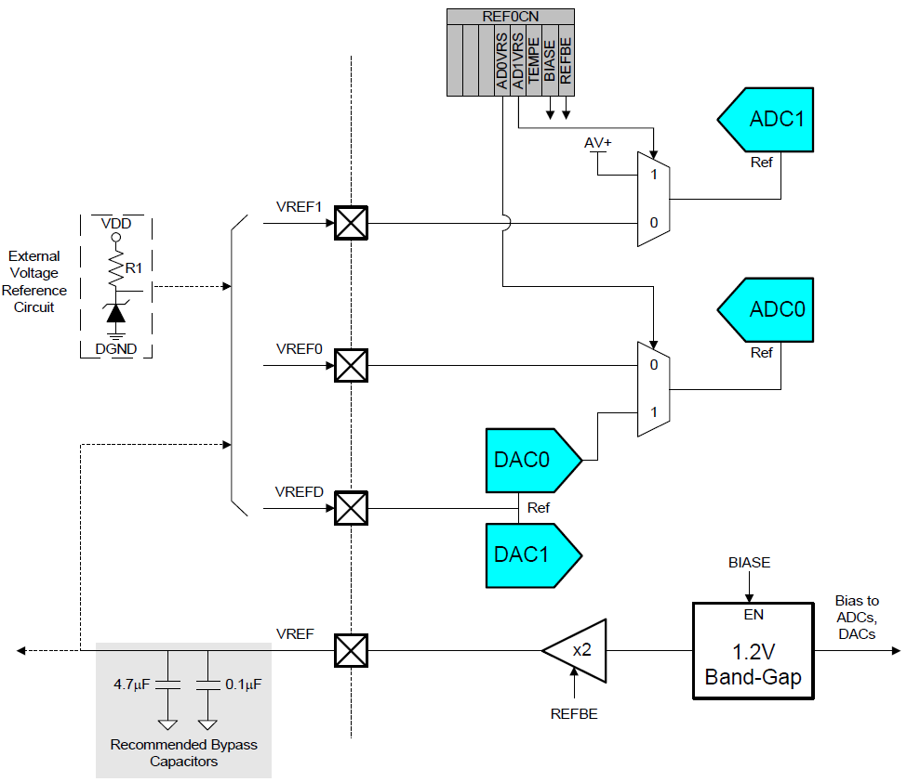
Voltage Reference

Slide 14
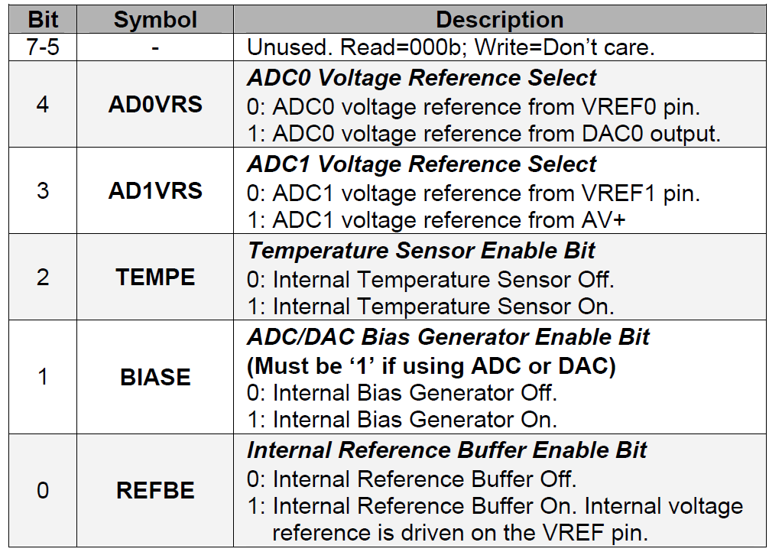
Voltage Reference SFR: REF0CN

Slide 15
What is a Comparator?
A simple analog device that compares two analog voltages
A comparator generates an output of high (1) or low (0) based on which of the inputs is greater than the other
Notes:
There are two voltage comparators, with programmable hysteresis, which have dedicated pins available at the package. The output of each comparator is optionally available at the package pins via the crossbar. Each comparator output can be programmed to operate in open drain or push-pull modes.
Comparator Control Registers (CPT0CN and CPT1CN) are used to program the comparators. A comparator can be considered as a 1-bit ADC.

Slide 16
Comparators—Introduction
There are two voltage comparators which may be enabled or disabled individually
The inputs of each comparator are available at the package pins
  The input range is: -0.25 V to [ (AV+) + 0.25 V ]
The output of each comparator is optionally available at the package pins via the crossbar
Each comparator output can be programmed to operate in open drain or push-pull modes
Comparator control registers (CPT0CN and CPT1CN)
are used to program the comparators
Notes:
There are two voltage comparators, with programmable hysteresis, which have dedicated pins available at the package. The output of each comparator is optionally available at the package pins via the crossbar. Each comparator output can be programmed to operate in open drain or push-pull modes.
Comparator Control Registers (CPT0CN and CPT1CN) are used to program the comparators.

Slide 17
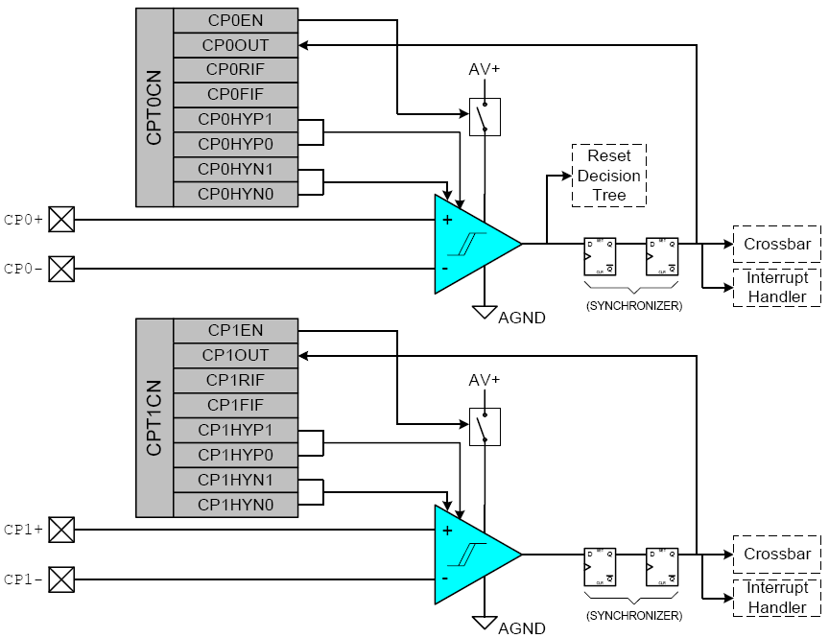
Comparators—Functional Block Diagram
Notes:
This diagram shows the functional blocks and SFRs of the two comparators. The two comparators are functionally identical.

Slide 18
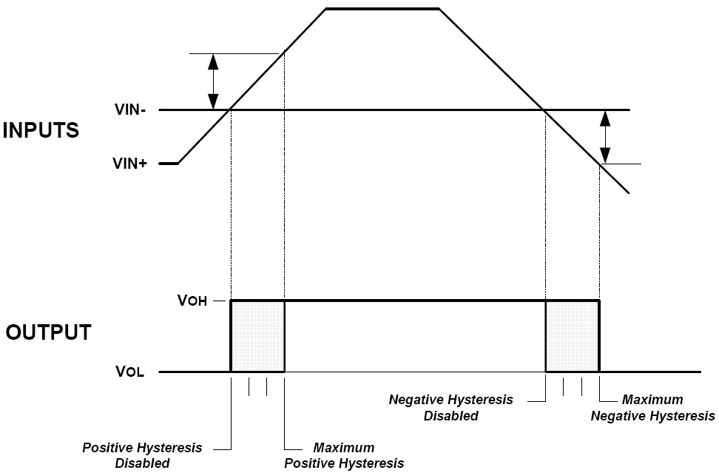
Comparators—Hysteresis Plot
Positive Hysteresis Voltage (CP0HYP bits)
Negative Hysteresis Voltage (CP0HYN bits)
Notes:
The hysteresis of each comparator is software programmable using the Comparator Control Registers (bits 3-0). The positive and negative hysteresis can be programmed separately. CPxHYN bits for negative hysteresis (bits 1-0) and CPxHYP bits for positive hysteresis (bits 3-2). The hysteresis may also be disabled. The hysteresis value can be 2mV, 4mV or 10mV.
When VIN₊, the input at the positive input (CP0+/CP1+), is greater that the (VIN₋ + Hysteresis), the comparator output goes high. Likewise, when VIN₊ is less that the (VIN₋ - Hysteresis), the comparator output goes low. VIN₋ is the input at the negative input (CP0-/CP1-).

Slide 19
Comparators—Hysteresis
Hysteresis is useful to eliminate repetitive on-off output transitions, which can happen when both the input values of the comparator are close to each other
The hysteresis of each comparator is software programmable using the comparator control registers
(bits 3-0):
  Amount of hysteresis
  Positive- and negative-going symmetry around the threshold voltage
    CP0HYN (CP1HYN) bits for negative hysteresis (bits 1-0)
    CP0HYP (CP1HYP) bits for positive hysteresis (bits 3-2)

Slide 20
Comparator Output
The output of the comparator can be polled in software or can be used as interrupt source
The output state of a comparator can be obtained any time by reading the CP0OUT (CP1OUT) bit
Comparator interrupts can be generated on rising-edge and/or falling-edge output transitions:
  The CP0FIF (CP1FIF) flag is set upon a comparator falling-edge interrupt
  The CP0RIF (CP1RIF) flag is set upon a comparator rising-edge interrupt
  Once these flags are set, they remain set until cleared by software
Notes:
The output state of a comparator can be obtained any time by polling the CPxOUT bit. The CPxOUT bit is set if the voltage on CPx+ > CPx- and reset if CPx+ < CPx-
Comparator interrupts can also be generated on rising-edge and/or falling-edge output transitions. The CPxFIF flag is set upon a comparator falling-edge interrupt. The CPxRIF flag is set upon a comparator rising-edge interrupt. Once these flags are set, they remain set until cleared by software.

Slide 21
Comparator Interrupts
Interrupt Source | Interrupt Vector | Priority Order | Pending Flag | Enable Flag | Priority Control
Comparator 0 Falling Edge | 0053 | 10 | CP0FIF (CPT0CN.4) | ECP0F (EIE1.4) | PCP0F (EIP1.2)
Comparator 0 Rising Edge | 005B | 11 | CP0RIF (CPT0CN.5) | ECP0R (EIE1.5) | PCP0R (EIP1.5)
Comparator 1 Falling Edge | 0063 | 12 | CP1FIF (CPT1CN.4) | ECP1F (EIE1.6) | PCP1F (EIP1.6)
Comparator 1 Rising Edge | 006B | 13 | CP1RIF (CPT1CN.5) | ECP1R (EIE1.7) | PCP1F (EIP1.7)
Notes:
This table summarizes the Interrupt Pending Flags, Interrupt Enable Flag and the Priority Control bits for the four interrupts associated with the comparators.
When interrupts are enabled, the corresponding ISR will be executed when the interrupts occur.

Slide 22
www.silabs.com/MCU
Labs and Problem Sets available at:
www.k-space.org

