Slide 1
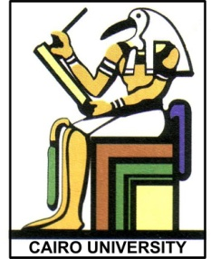
ARM Microcontroller: System Overview
Prof. Yasser Mostafa Kadah – www.k-space.org

Slide 2
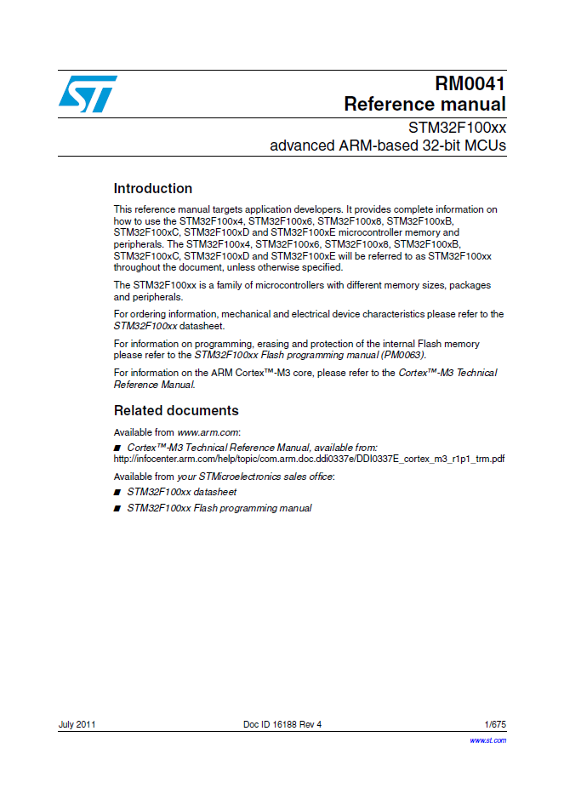
Recommended Reference
STM32F100xx Advanced ARM-Based 32-Bit MCUs, RM0041 Reference Manual, ST Microelectronics (Available Online)

Slide 3
Lecture Contents
Course Goals
Course Prerequisites
Microprocessor and Microcontroller
Microcontroller Architecture
STM32 ARM Platform
Value Line Discovery Development Kit
ARM Demo Project
Assignments

Slide 4
Course Goals
At the end of this course, you should be able to:
Understand the architecture of one of the most popular microcontroller (MCU) families
Use an integrated development environment (IDE) to program and debug an MCU
Program an MCU using C language
Understand and use peripherals integrated into an MCU
Interface an MCU to simple external components
Use example timers in various modes
Understand and use interrupts
Understand and use analog to digital converters (ADC) and digital to analog converters (DAC)

Slide 5
Course Prerequisites
A course in Electric Circuits that includes understanding basic electronic components such as resistors, capacitors, diodes and transistors
A course in basic digital logic design that includes logic gates and Boolean arithmetic
Ability to program in a high-level programming language such as C or C++

Slide 6
Microprocessors and Microcontrollers
Microprocessor: general-purpose CPU
Emphasis is on flexibility and performance
Generic user-interface such as keyboard, mouse, etc.
Used in a PC, PDA, cell phone, etc.
Microcontroller: microprocessor + memory on a single chip
Emphasis is on size and cost reduction
The user interface is tailored to the application, such as the buttons on a TV remote control
Used in a digital watch, TV remote control, car and many common day-to-day appliances

Slide 7
Microcontroller Architectures
Microcontroller architecture refers to the internal hardware organization of a microcontroller
Each hardware architecture has its own set of software instructions called assembly language that allows programming of the microcontroller
Some of the popular microcontroller architectures
Intel 8051
Zilog Z80
Atmel AVR
Microchip PIC
ARM

Slide 8
Harvard and von Neumann Architectures
Harvard Architecture—a type of computer architecture where the instructions (program code) and data are stored in separate memory spaces
Example: Intel 8051 architecture
von Neumann Architecture—another type of computer architecture where the instructions and data are stored in the same memory space
Example: ARM and Intel x86 architecture (PC processors)
Notes:
Basic difference between two of the most common types of architectures.

Slide 9
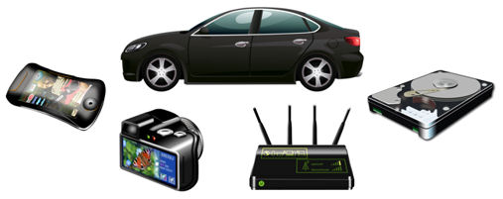
ARM Processors
ARM: Advanced RISC Machines
Previously “Acorn RISC Machines”
ARM1: 1985
Now: ARM11, ARM Cortex A, ARM Cortex R, ARM Cortex M

Slide 10
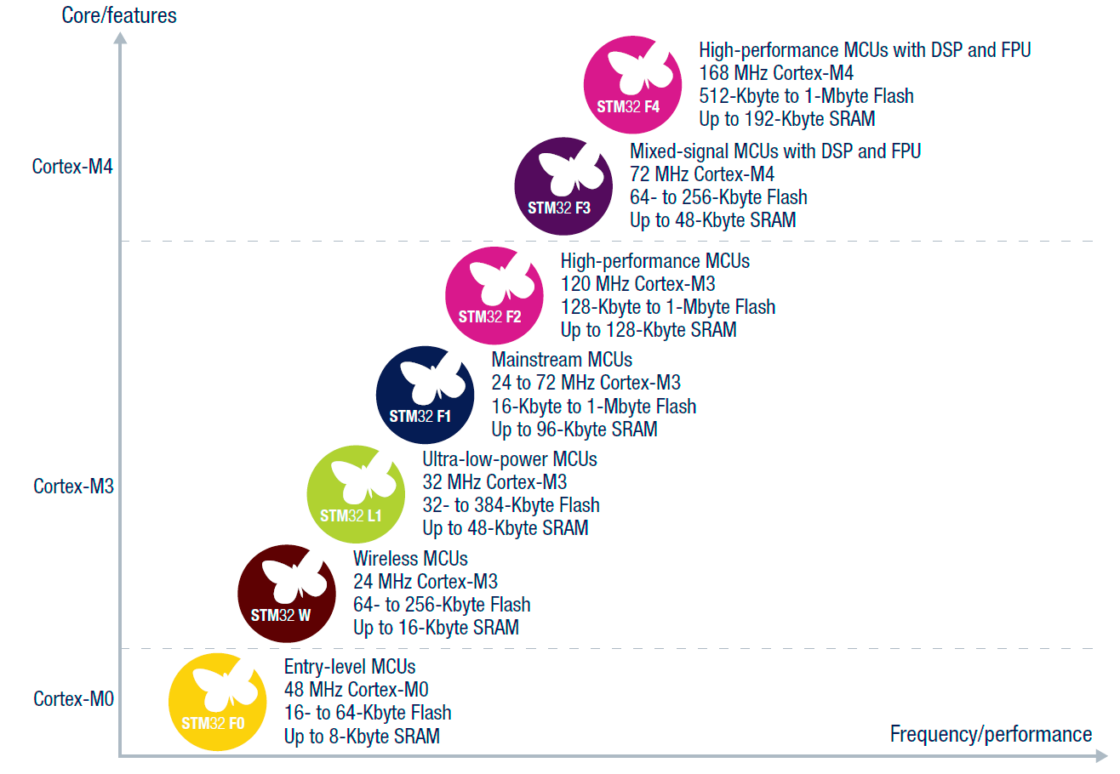
STM32 Platform

Slide 11
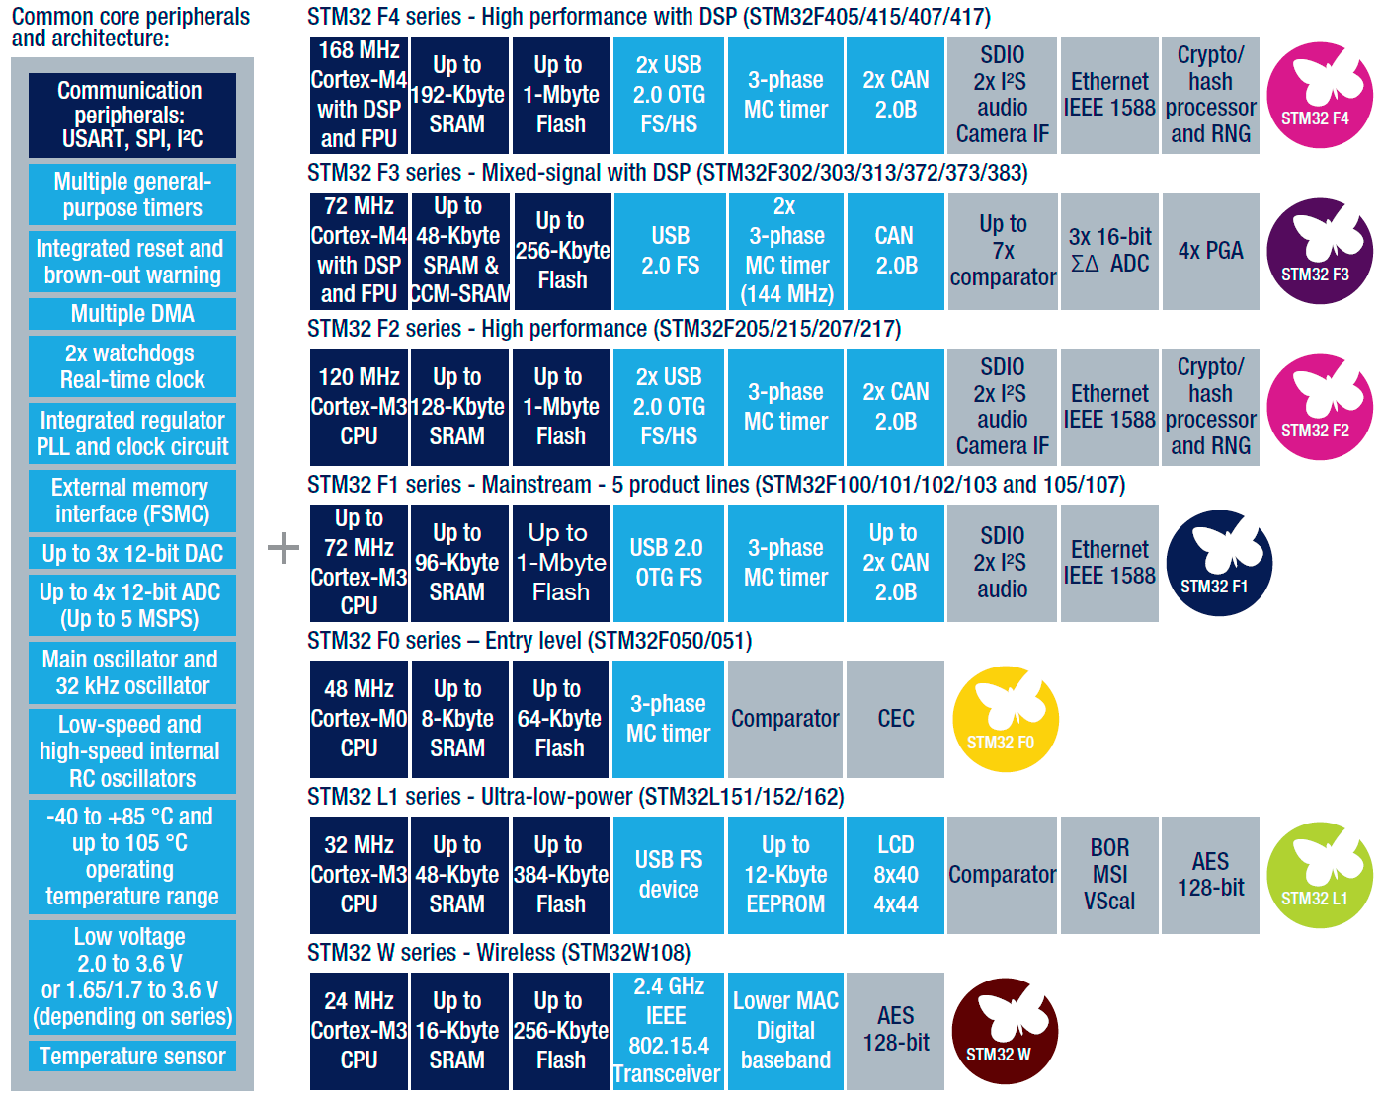
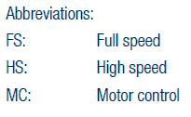
STM32 Product Lines

Slide 12
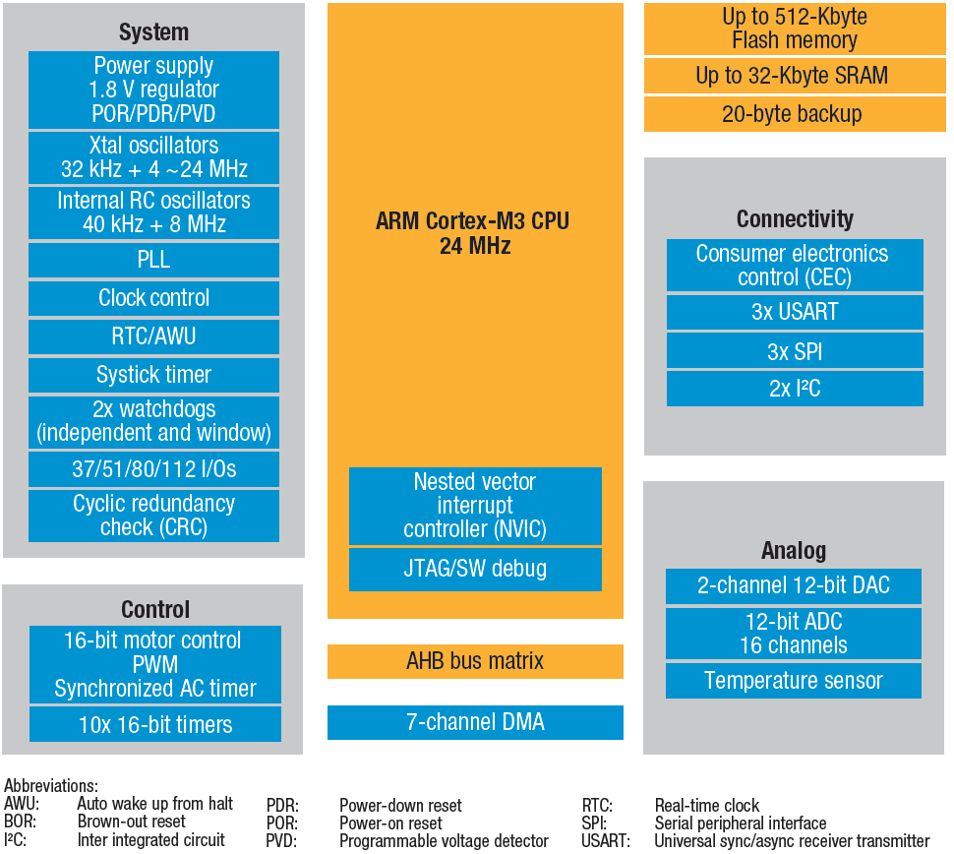
STM32 Value Line Block Diagram

Slide 13
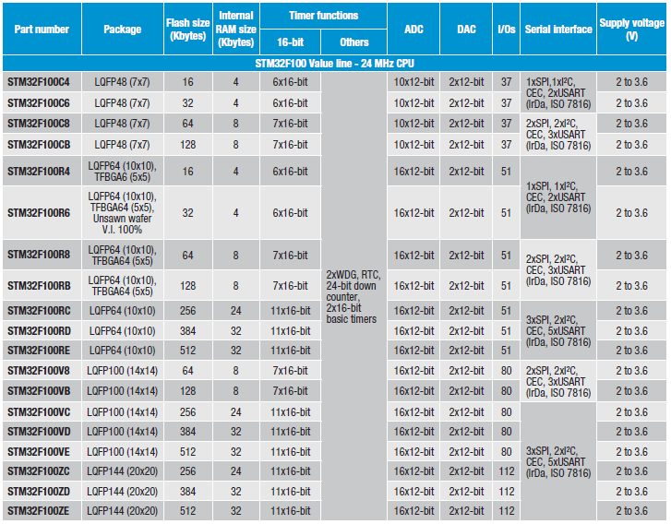
STM32 Value Line Devices

Slide 14
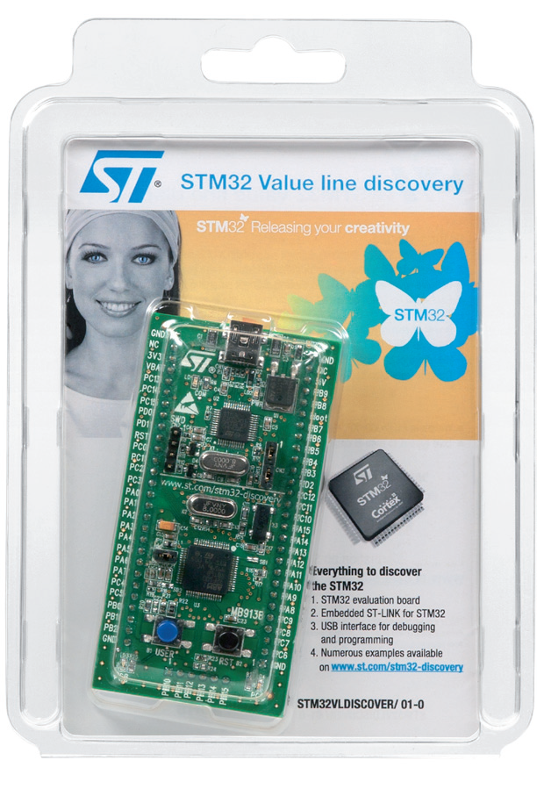
STM32 Value line Discovery Kit
The cheapest and quickest way to discover the STM32 Value line family
Embedded ST‑LINK or ST‑LINK/V2 included to debug applications
Works with several popular IDEs
MDK-ARM (Keil)
EWARM (IAR)

Slide 15
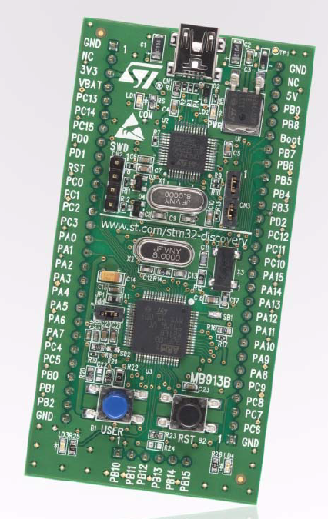
Kit Features
STM32F100RBT6B microcontroller, 128 KB Flash, 8 KB RAM in 64-pin LQFP
On-board ST-Link (for programming and debugging)
Two red LEDs; LD1 for USB communication, LD2 for 3.3 volts power on
Designed to be powered by USB or an external supply of 5 V or 3.3 V
Can supply target application with 5 volts and 3 volts
Two user LEDs, LD3 and LD4 (green and blue)
Two push buttons (User and Reset)
Extension header for all QFP64 I/Os for quick connection to prototyping board or easy probing

Slide 16
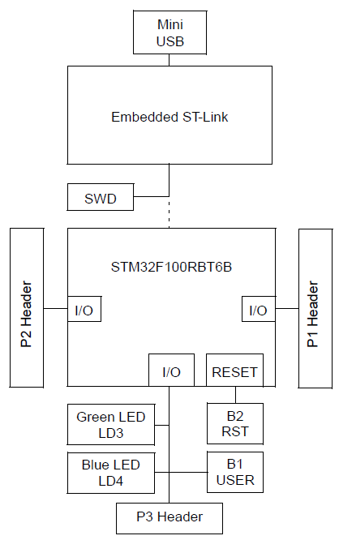
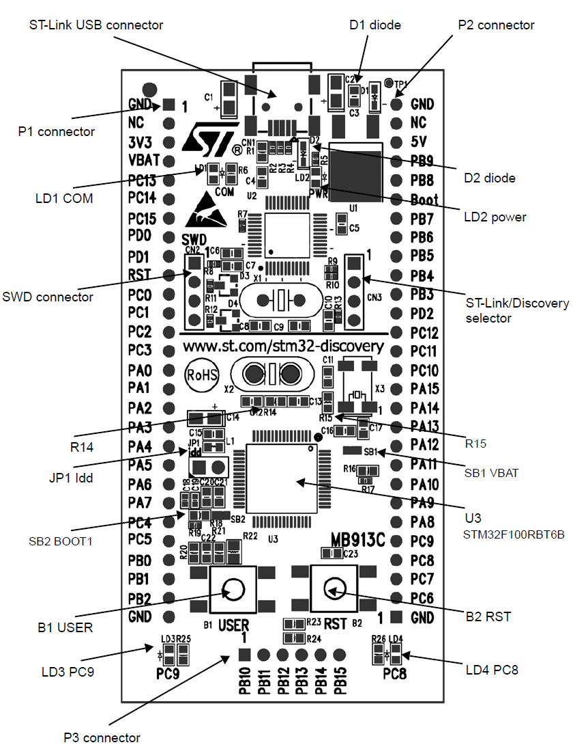
Kit Hardware Block Diagram

Slide 17
Demo Project

Slide 18
Assignments
Explain the differences between MIPS and DMIPS.
Compare the major ARM processor families available today from the points of view of processing power, cost, applications. (Hint: focus on ARM11 and ARM Cortex series processors)
Install the MDK-ARM Evaluation Version and compile and link the kit’s demo software available from ST web site.
Revision of C programming.

