Slide 1
Basic Electronics Part 2: Power Supply Design
Prof. Yasser Mostafa Kadah – www.k-space.org

Slide 2
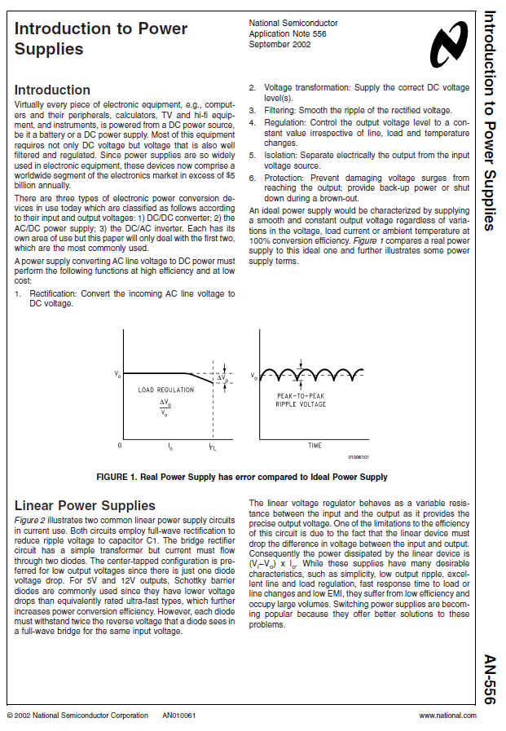
Recommended Reference
Introduction to Power Supplies, National Semiconductors Application Note AN-556.

Slide 3
Power Conversion Circuit Basics
There are three types of electronic power conversion devices in use today which are classified as follows according to their input and output voltages
AC/DC power supply
DC/DC converter
DC/AC inverter.
We will focus in this lecture on first two types

Slide 4
AC/DC Power Supply
Rectification
Convert the incoming AC line voltage to DC voltage
Voltage transformation
Supply the correct DC voltage level(s)
Filtering
Smooth the ripple of the rectified voltage
Regulation
Control the output voltage level to a constant value irrespective of line, load and temperature changes
Isolation
Separate electrically the output from the input voltage source
Protection
Prevent damaging voltage surges from reaching the output; provide back-up power or shut down during a brown-out

Slide 5
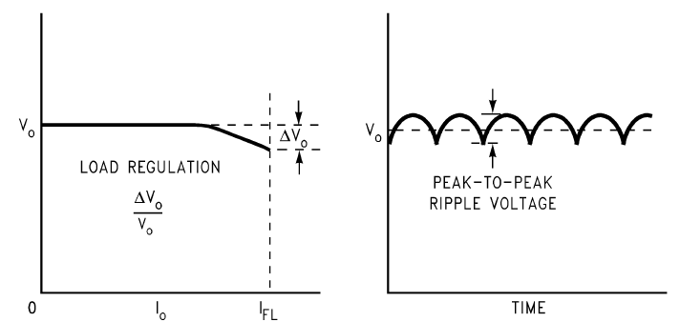
AC/DC Power Supply
An ideal power supply would be characterized by supplying a smooth and constant output voltage regardless of variations in the voltage, load current or ambient temperature at 100% conversion efficiency

Slide 6
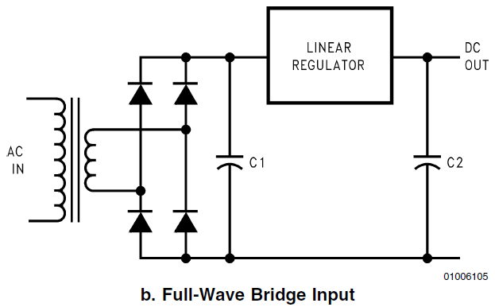
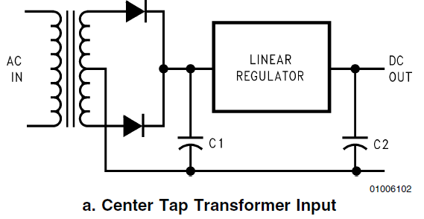
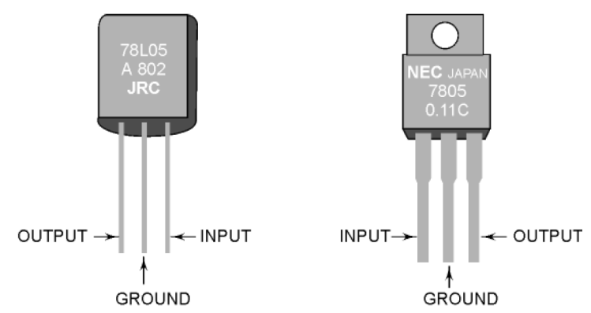
Linear AC/DC Power Supplies
Linear voltage regulator behaves as a variable resistance between the input and the output as it provides the precise output voltage.
Limitations: low efficiency, large in size

Slide 7
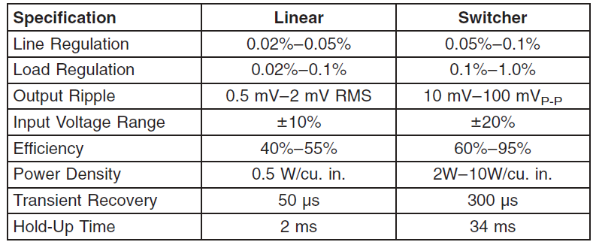
Linear vs. Switching Power Supplies (SMPS)

Slide 8
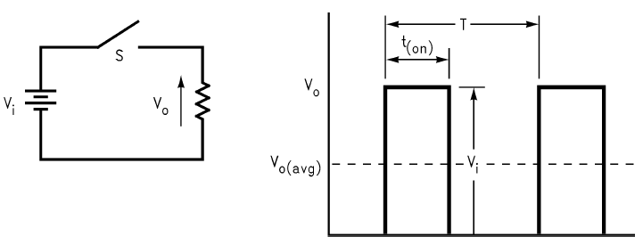
Switching Power Supply: Pulse Width Modulation
The average voltage seen by the load resistor R is equal to:
V_{o(avg)} = (t_{(on)}/T) × V_{i}
Reducing t_{(on)} reduces V_{o(avg)}
This method of control is called pulse width modulation (PWM)

Slide 9
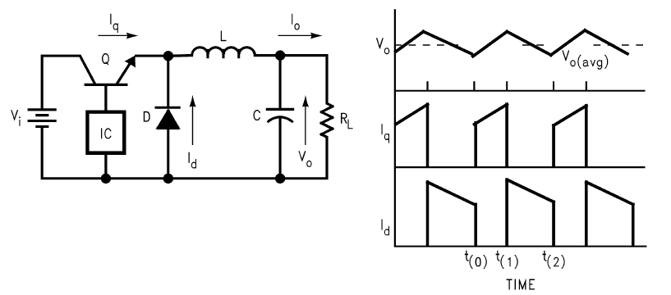
Buck Regulator
Simple step-down regulator
IC senses output voltage and switches Q on/off

Slide 10
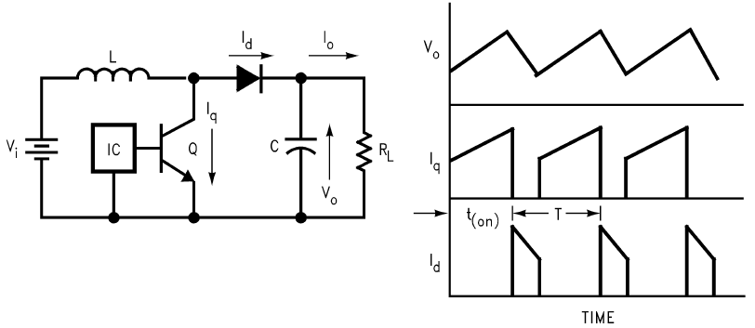
Boost Regulator
Step-up regulator
IC senses output voltage and switches Q on/off

Slide 11
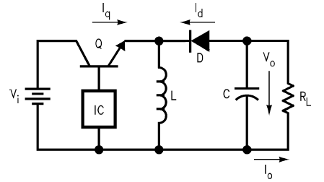
Inverting Regulator
Output voltage with opposite polarity of input voltage
Works in the same fashion as the boost converter but with exchanging positions of transistor and inductor
also known as a buck-boost regulator since the absolute magnitude of output voltage can be higher or lower than input voltage depending upon the ratio of on-time to off-time

Slide 12
Flyback Converter
The three previous regulators are suitable for low voltage control when no electrical isolation is required.
However in off-line switchers operating from 110V/220V mains, electrical isolation is an absolute must.
This is achieved by using a transformer in place of the inductor.

Slide 13
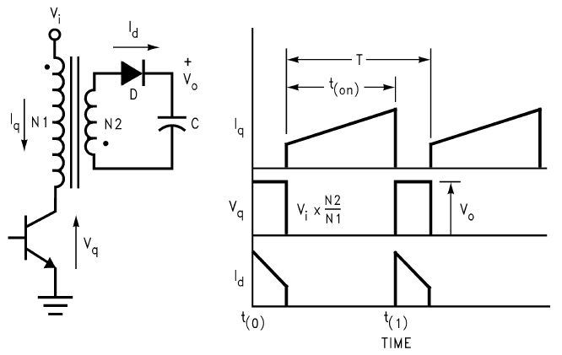
Flyback Converter

Slide 14
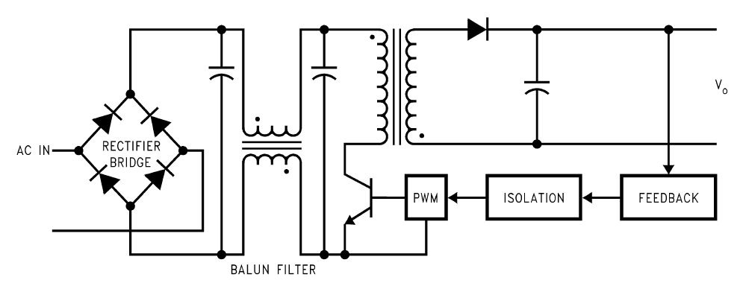
Off-Line Flyback Switching Supply
Called “off-line” because the DC voltage to the switch is developed right from the AC line
Feedback is usually opto-isolated

Slide 15
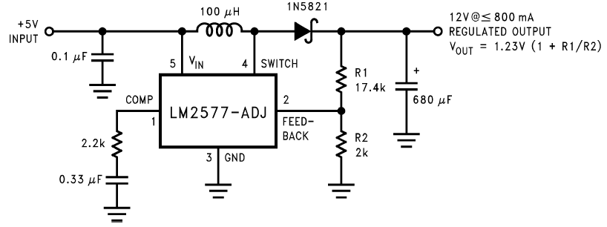
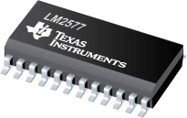
Example: Adjustable 5V to 12V SMPS

Slide 16
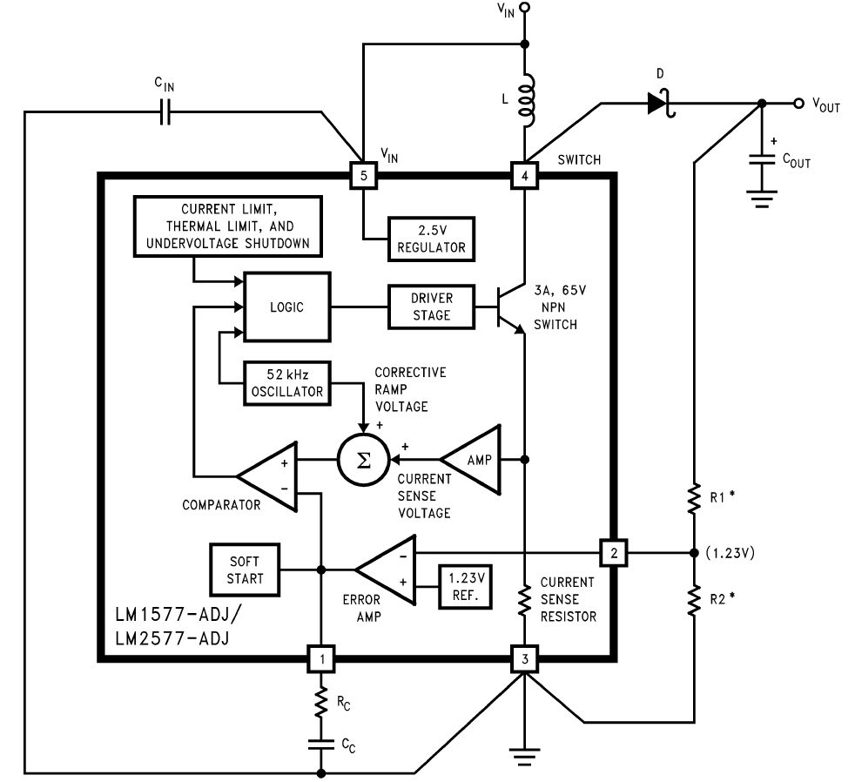
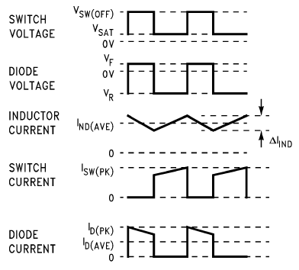
Example: Adjustable 5V to 12V SMPS

Slide 17
Assignments
Design an AC to 5V linear power supply
Design a 12V to 5V switching power supply
Design a 5V to 12V switching power supply
Design a 5V to -5V switching power supply
Design an AC to 5V switching power supply
Lab: Inspect ripples from a PC power supply
Lab: Implement a power supply of your choice

