Slide 1
Basic Electronics Part 3: Multiplexer, Timer and Optocoupler
Prof. Yasser Mostafa Kadah – www.k-space.org

Slide 2
Recommended References
Data sheets for cited integrated circuits

Slide 3
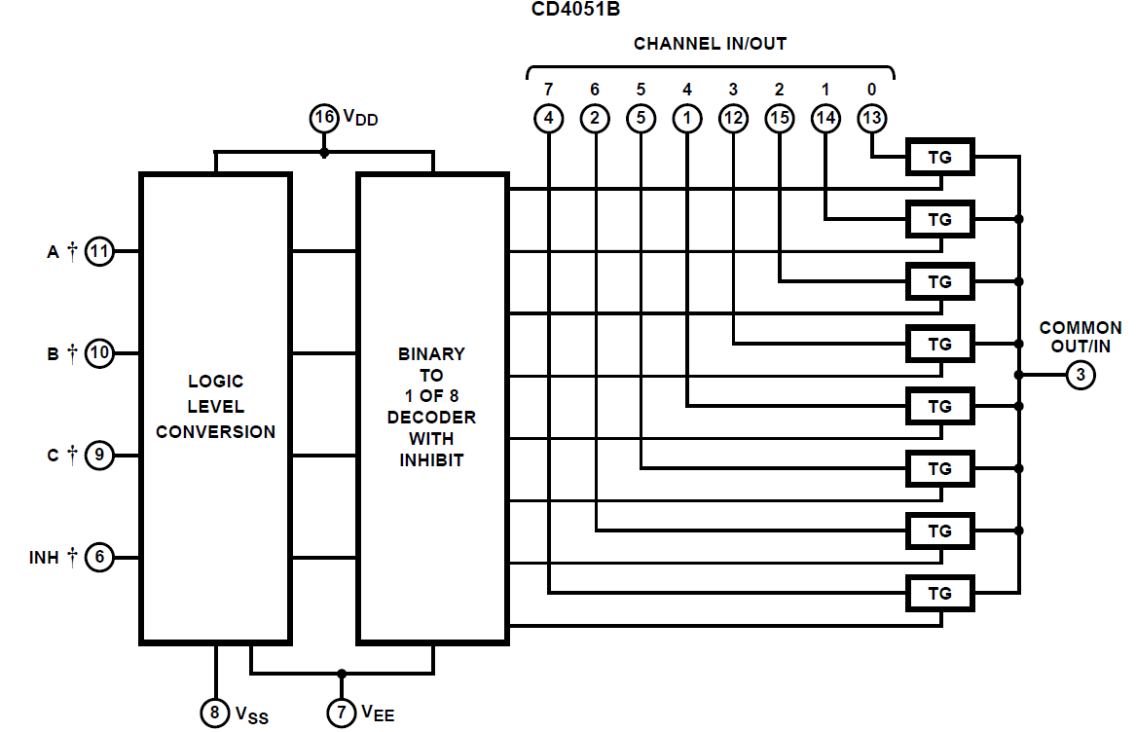
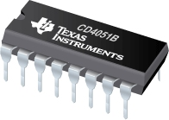
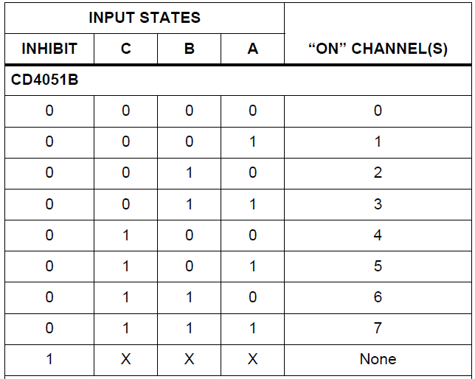
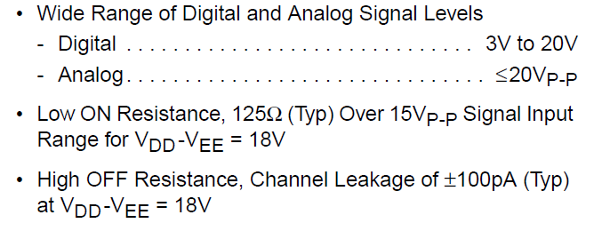
Analog Multiplexer/Demultiplexer

Slide 4
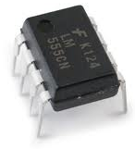
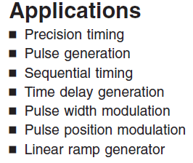
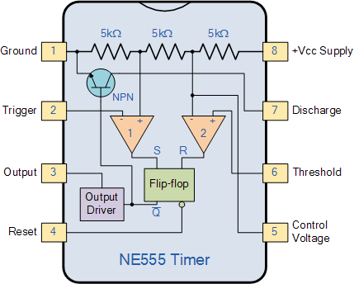
The 555 Timer
http://www.electronics-tutorials.ws/waveforms/555_timer.html

Slide 5
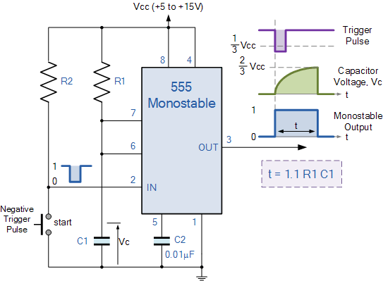
555 Timer: Monostable Operation
Trigger input cause a change of output for a time determined by component values
http://www.electronics-tutorials.ws/waveforms/555_timer.html

Slide 6
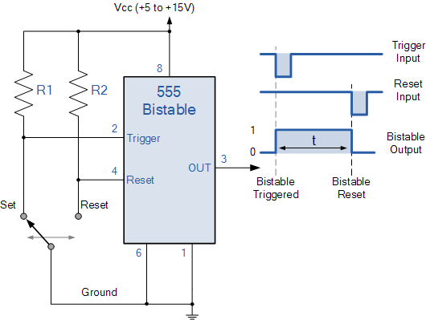
555 Timer: Bistable Operation
Two stable states
Switching by Trigger and Reset inputs
http://www.electronics-tutorials.ws/waveforms/555_timer.html

Slide 7
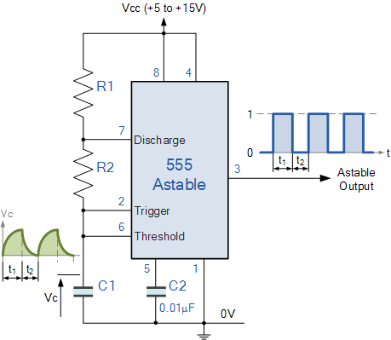
555 Timer: Astable Operation
Free running oscillator
http://www.electronics-tutorials.ws/waveforms/555_timer.html

Slide 8
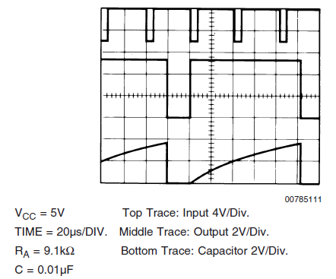
555: Frequency Divider
Same as monostable operation circuit
Adjustment of period to be long enough

Slide 9
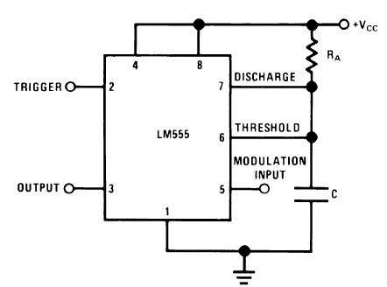
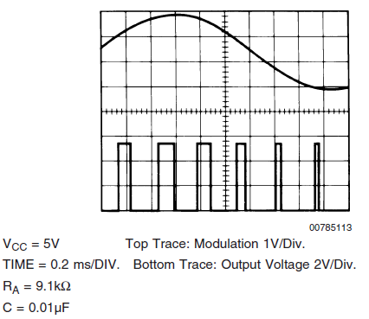
555: Pulse Width Modulator

Slide 10
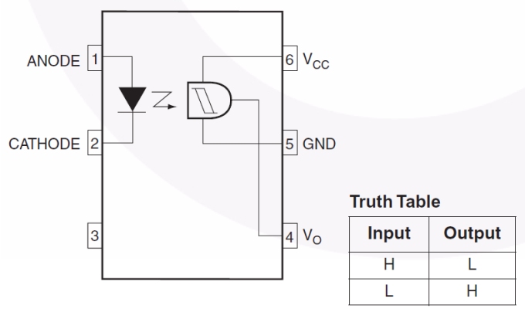
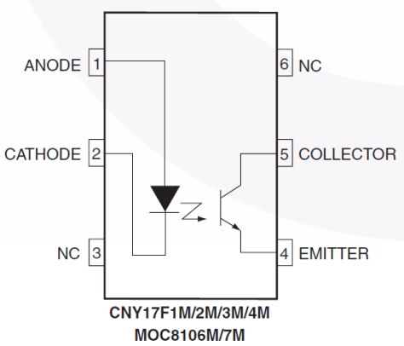
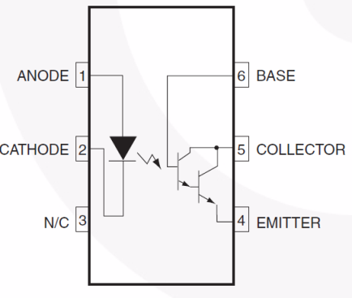
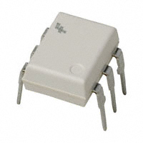
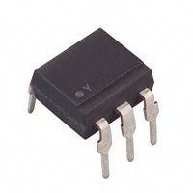
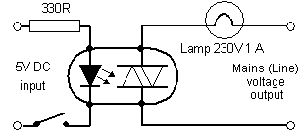
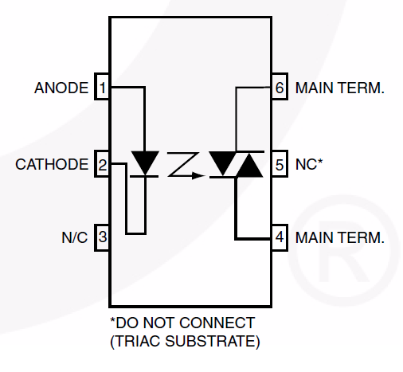
Optocoupler/Optoisolator/Optotriac
Digital
Transistor
Triac

Slide 11
Assignments
Assemble a 4051 analog multiplexer circuit and test it in the lab.
Using a 555 timer chip, assemble and test the monostable, astable and pulse width modulation circuits.
Test the operation of an optoisolator in the lab.

