Slide 1
Basic Electronics Part 7: Actuators
Prof. Yasser Mostafa Kadah – www.k-space.org

Slide 2
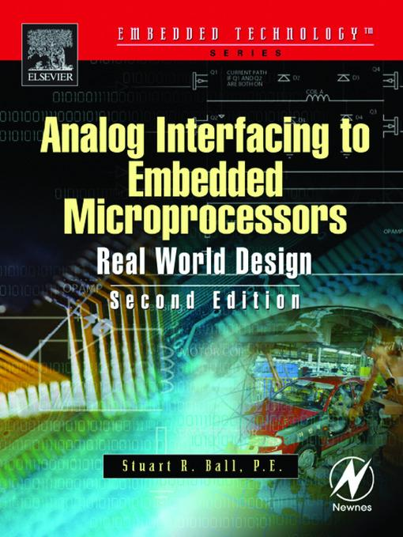
Recommended Reference
Analog Interfacing to Embedded Microprocessors: Real World Design, by Stuart Ball

Slide 3
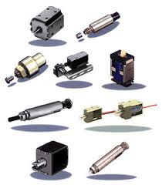
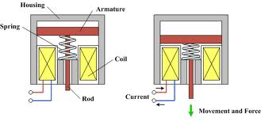
Solenoids
A solenoid is an electromagnet that activates a mechanical function
Solenoids are used to latch safety covers closed so they can’t be opened while a machine is in operation, or to unlock the doors in your car when you push the keyless entry button on the remote.
There are two basic varieties:
Continuous-duty solenoids designed to be energized all the time
Pulse-duty solenoid designed for intermittent operation

Slide 4
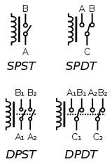
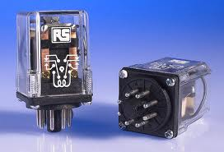
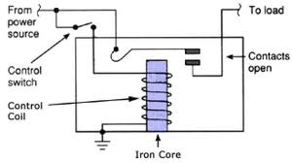
Relays
A relay is a solenoid that operates electrical contacts. When the relay is energized, the contacts are shorted or opened, just like a mechanical switch

Slide 5
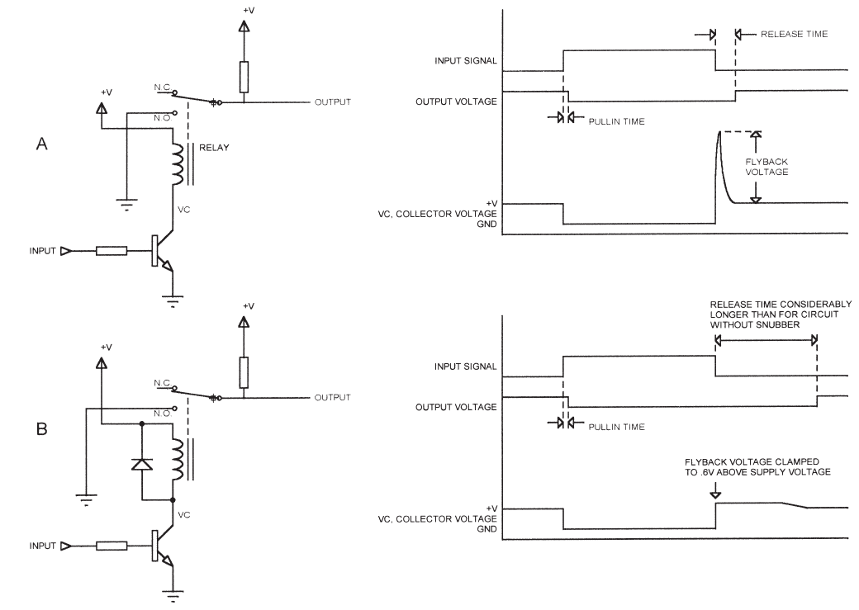
Interfacing to Solenoids and Relays
Diode Snubber

Slide 6
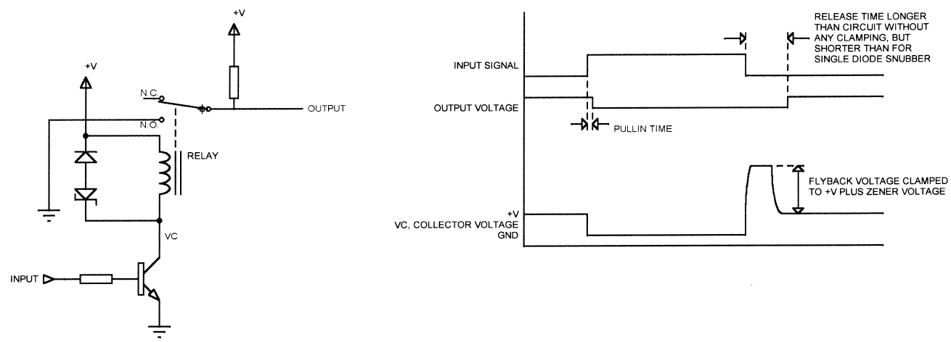
Interfacing to Solenoids and Relays
Problems with diode clamping
Results in a current surge into the supply: Noise spike
Slows the release time down
Solution: Zener diode clamp

Slide 7
Solenoid Pick/Hold Current
DC current drawn by a relay has to be high enough to pull relay contacts from one end of its travel to the other
However, current needed to hold that position is much lower—typically 50% of the pull-in (or pick) voltage
Smaller power supply can be used if the current is reduced once the relay contacts are pulled in, especially if several relays are to be activated at once
Using a lower hold current decreases the release time

Slide 8
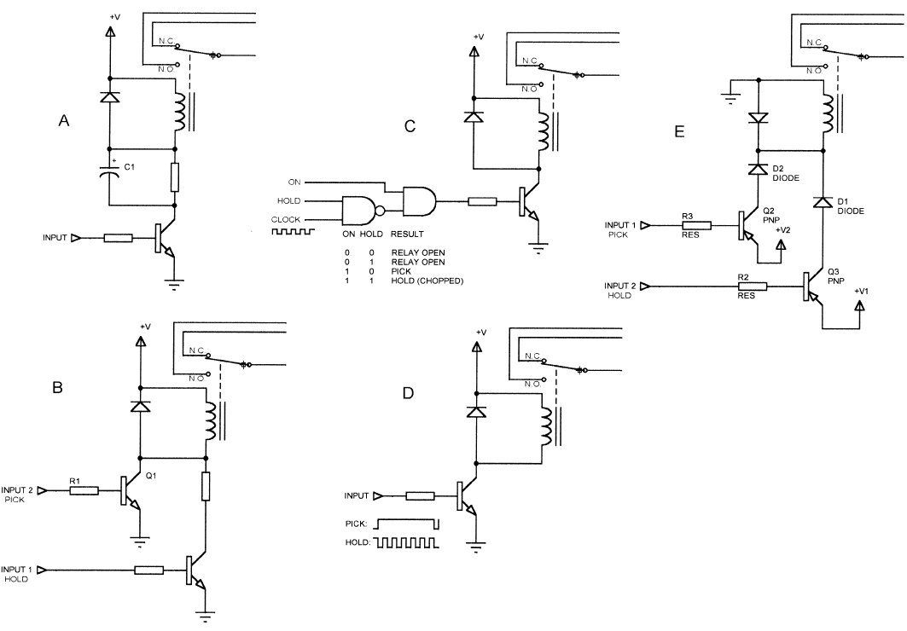
Solenoid Pick/Hold Current

Slide 9
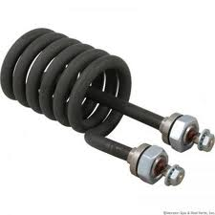
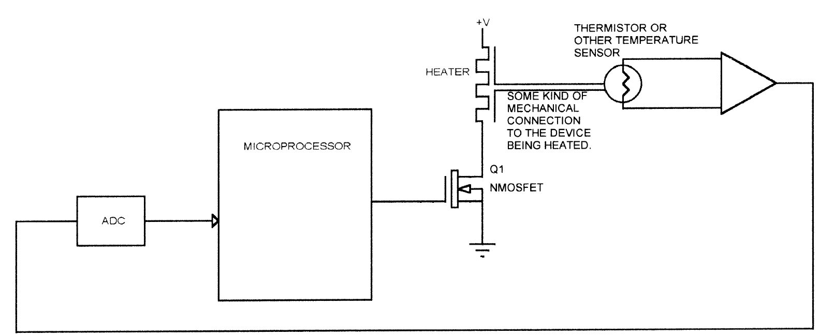
Heaters
A heater is driven much like a solenoid, usually using a transistor.
Most heaters have negligible inductance, so the clamping diodes are not necessary.
Controlled by a feedback loop, with a temperature sensor mounted somewhere to measure temperature

Slide 10
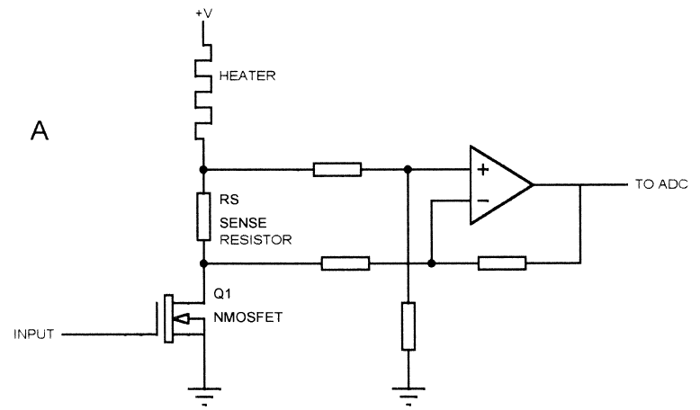
RTD Heater
RTD heater is a special type of heater that is composed of an RTD material, usually iron-nickel.
Heater element doubles as the temperature sensor
Since a thermistor is not required, overall cost is lower

Slide 11
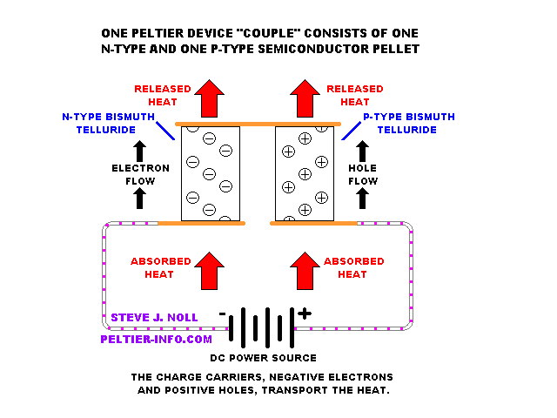
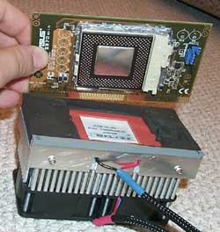
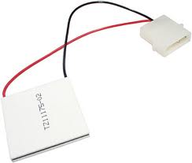
Solid-State (Peltier) Cooler
Consists of a series of PN junctions that can draw heat from one side and exhaust heat on other side
A Peltier cooler can be controlled much like a heater, using a thermistor to measure the temperature
PWM is used with minimum PWM frequency is usually recommended, typically around 2kHz to avoid thermal stress on the semiconductor elements

Slide 12
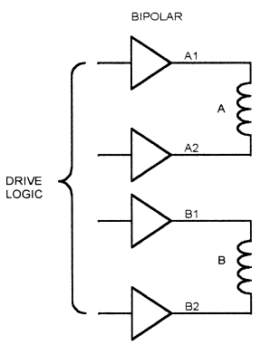
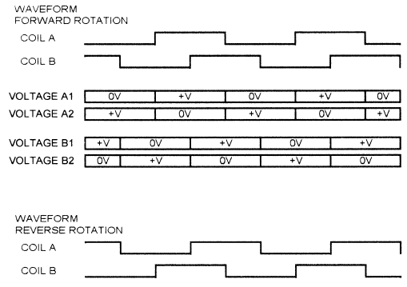
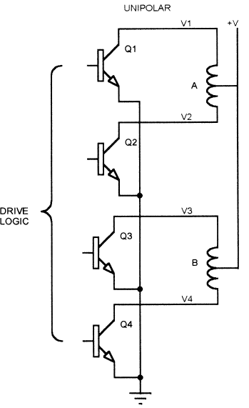
Stepper Motors

Slide 13
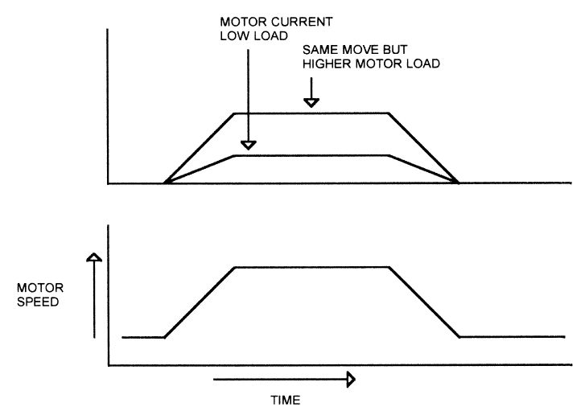
DC Motors
DC motors are better for applications with large load variations
Dynamic Braking: If you short the motor terminals while motor is running, it quickly comes to a halt

Slide 14
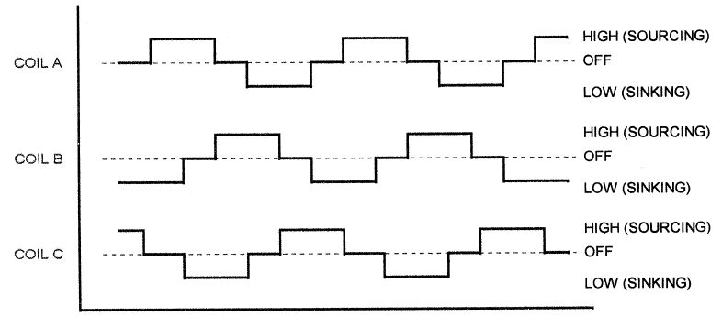
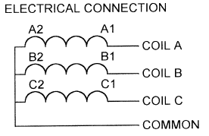
Brushless DC Motors
Works much like stepper motor
More efficient than a brushed DC motor

Slide 15
Trade-Off Between Motors
Stepper motors require no encoder and no feedback system to determine motor position. Position of shaft is determined by the controller, which produces step pulses to the motor.
This can also be a disadvantage. If the load is too high, the stepper may stall and there is no feedback to report that condition to the controller. A system using a DC motor with an encoder can tell when this condition occurs.
A stepper can produce full torque at standstill, if the windings are energized. This can provide the ability to hold the rotor in a specific position.
A stepper can produce very low rotation speed with no loss of torque. A DC motor loses torque at very low speeds because of lower current

Slide 16
Trade-Off Between Motors
Steppers have no brushes, so they produce less EMI.
DC motors deliver more torque at higher speeds than an equivalent stepper.
Because there is no feedback, a stepper-based system has no means to compensate for mechanical backlash.
Brushless DC motors require electronic commutation, which is more complex than the drive required for brushed DC motors. However, the availability of driver ICs for brushless DC motors makes this less of a concern

Slide 17
Assignments
Obtain real part numbers and data sheets for example actuator types
Implement example circuits in the lab (e.g., to control a relay, a motor, etc.)

