Slide 1
Computer Aided Diagnosis: CAD overview
Prof. Yasser Mostafa Kadah – www.k-space.org

Slide 2
Recommended Reference
Digital Mammography, by U. Bick and F. Diekmann (Eds.), Springer, 2010.

Slide 3
Computer Aided Diagnosis (CAD)
Computer-aided diagnosis (CAD) is defined as a diagnosis made by a radiologist who uses the output of a computer analysis of the images when making his/her interpretation
Computer-aided detection (CADe)
Used with “Screening Radiology”
Identify and mark suspicious areas in an image
Goal of CADe is to help radiologists avoid missing a cancer
Computer-aided diagnosis (CADx)
Used with “Clinical Radiology”
CADx help radiologists decide if a woman should have a biopsy or not
Report the likelihood that a lesion is malignant

Slide 4
Goals of CAD
Improving radiologists’ performance
Reduce intra- and inter-variability of radiologists
It is also hoped that CAD can improve radiologists’ productivity
Estimating the risk of a woman to develop breast cancer (?)

Slide 5
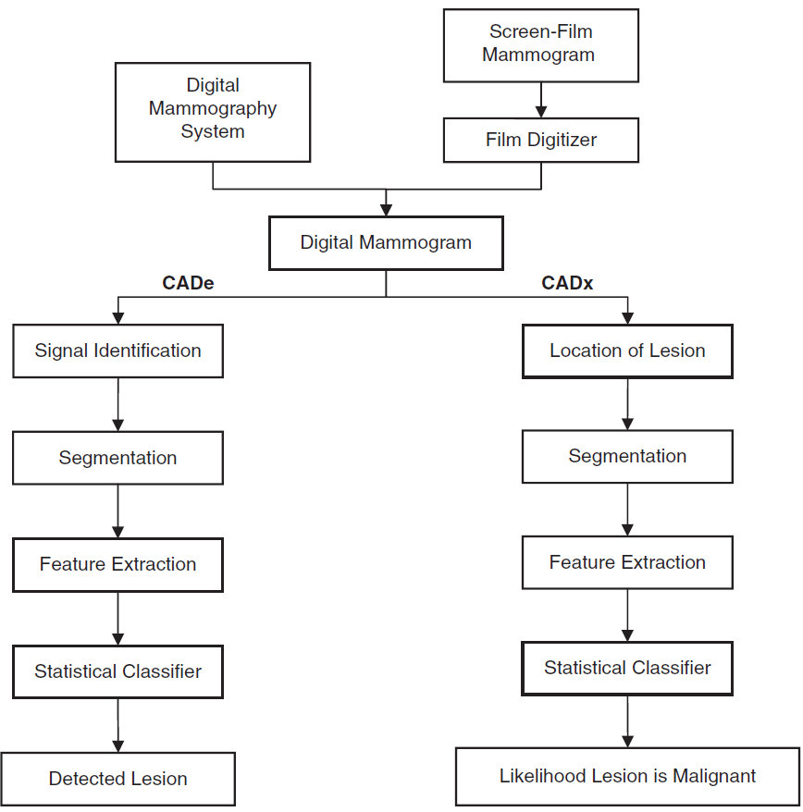
Methodology

Slide 6
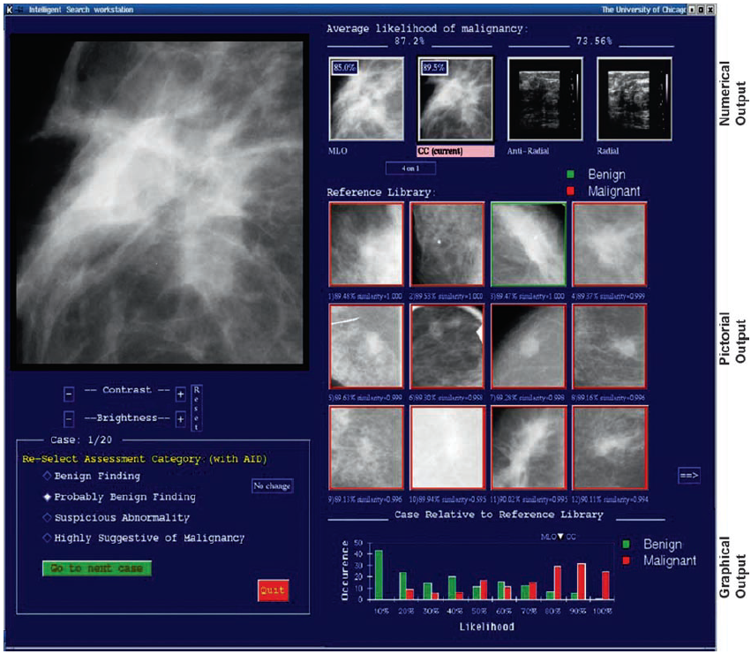
Example CADx User Interface

Slide 7
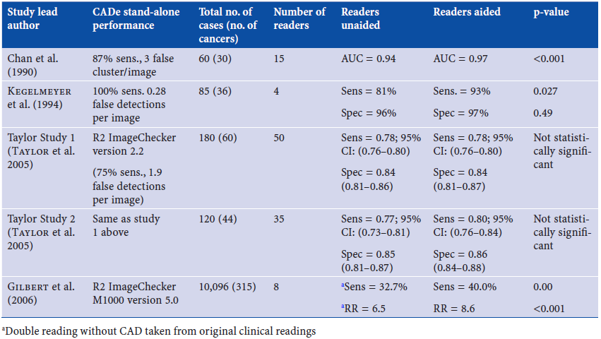
Clinical Studies for CADe

Slide 8
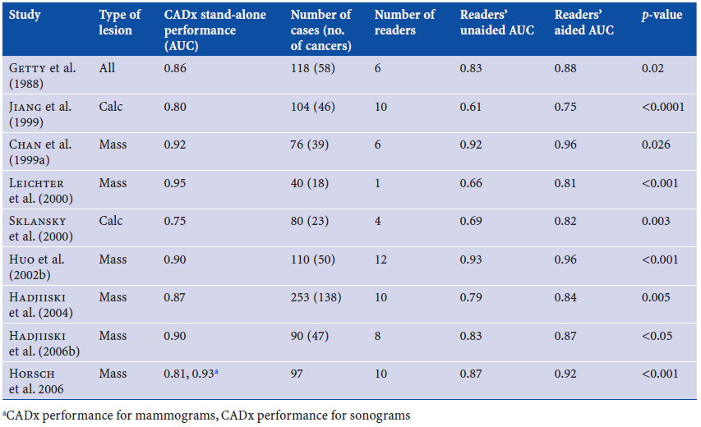
Clinical Studies for CADx

Slide 9
Required Pixel Size
Quality of digital image will affect the performance of CAD
Two image sources for CAD
Digitized film mammograms
Full field digital mammograms (FFDM)
Most important factor is the pixel size
Consistent with pixel size in full digital mammograms, film mammograms are digitized for CAD with pixels ranging from 50-100 μm
It is generally believed that pixel size is only important for microcalcifications and not for masses

Slide 10
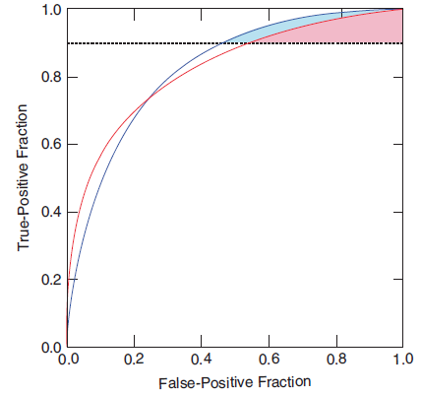
Evaluation of CAD Systems
Graph shows two ROC curves with equal AUC, but the curves cross
One system is superior if high sensitivity is desirable, while the other system would be preferred for high specificity
“Partial area under ROC” (pAUC), where it is assumed that high sensitivity is desirable is shown in color for _{0.9}AUC

Slide 11
CADe as Pre-Screening
As the performance of CADe schemes has improved, the number of false detections has decreased while the sensitivity has improved or remained the same
The performance of clinical CADe systems is now at the point where it may be possible to use CADe as a pre-screener of screening mammograms
That is, before the cases are reviewed by a radiologist, a CADe scheme is run and cases without any detections are considered normal and not read by the radiologist
Goal here is to reduce the radiologists’ workload
CADe scheme will pre-screen out “easy” cases
Problem: radiologists may become more exhausted, as every case will be “difficult”

Slide 12
Concurrent Reading with CADe
Currently, CADe is used as a second reader, where the radiologist first reads the images without CADe and then re-reads with the knowledge of the CADe findings
An alternative paradigm is to have CADe as the first reader and have the radiologist verify (i.e., accept or reject) each CADe prompt
For this to be effective, the sensitivity of the CADe system must be very high
For clustered microcalcification detection, sensitivity is approximately 98%
At this level of performance, it is conceivable that CADe could be the first reader, which is sometimes referred to as concurrent reading
CADe finds clustered microcalcifications at very high rate

Slide 13
Interactive CADe
Instead of presenting all CADe detections to the radiologist, radiologist can mark suspicious area on softcopy display and if area was identified by the computer, the computer’s likelihood that the area contains a cancer is given
This information can be used by the radiologist in two ways:
If CADe scheme has high NPV, then if area selected by radiologist has low likelihood of malignancy or if computer did not select region as suspicious, then radiologist may have selected a region that does not contain actual cancer
If CADe scheme has high PPV and if area selected by radiologist has high likelihood of malignancy, then there is a high probability that selected region contains a cancer
Researchers achieved high PPV by operating the CADe scheme at a low false detection rate of 0.1 per image
It was shown previously that at this false detection rate, performance of CADe scheme was comparable with that of the radiologists, if analysis was restricted to detections that were considered suspicious by radiologists

Slide 14
CAD for Tomosynthesis and Breast CT
Like other modalities, X-ray imaging of breast is becoming 3D
Breast tomosynthesis and breast CT are emerging technologies that have a large potential to improve screening and diagnosis
One of the potential drawbacks of these technologies is that a large volume of images is produced per breast
Screening mammogram produces two images of each breast, while a tomosynthesis exam could produce more than 100 images of each breast with large amount of data that the radiologist needs to review
CAD may play an important role in assisting radiologists, so that they do not overlook a cancer.

Slide 15
Assignments
Read Chapter 6 entitled “Computer-aided Detection and Diagnosis” by Robert M. Nishikawa
Read the following paper and think about how to implement the first- and second-order grey level parameters using built-in Matlab/Octave functions and also the kNN classifier:
Kadah et al., "Classification algorithms for quantitative tissue characterization of diffuse liver disease from ultrasound images," IEEE Trans. Medical Imaging, vol. 15, no. 4, pp. 466-478, August 1996.

