Slide 1
Computer Aided Diagnosis: Feature Extraction
Prof. Yasser Mostafa Kadah – www.k-space.org

Slide 2
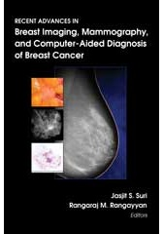
Recommended Reference
Recent Advances in Breast Imaging, Mammography, and Computer-Aided Diagnosis of Breast Cancer, Editors: Jasjit S. Suri and Rangaraj M. Rangayyan, SPIE Press, 2006.

Slide 3
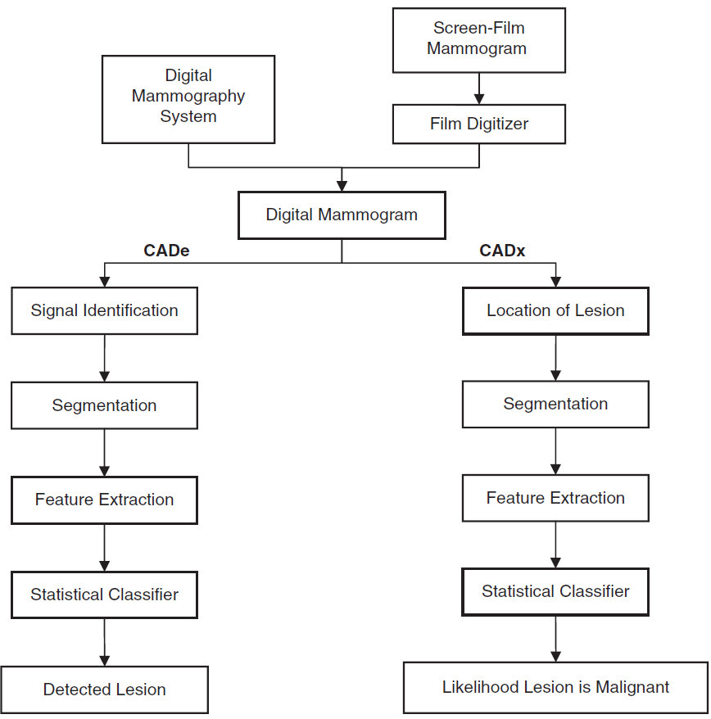
CAD

Slide 4
Feature Categories
Features are quantitative measures of texture that describe salient characteristics in the image
Spatial domain features
First order statistical or histogram-based features
Higher order statistical features
Transform domain features
Fourier descriptors
Wavelet features

Slide 5
First Order Statistical Features
Dependent only on pixel values and independent of spatial distribution of pixels
Example: images below have same first order features (e.g., mean)

Slide 6
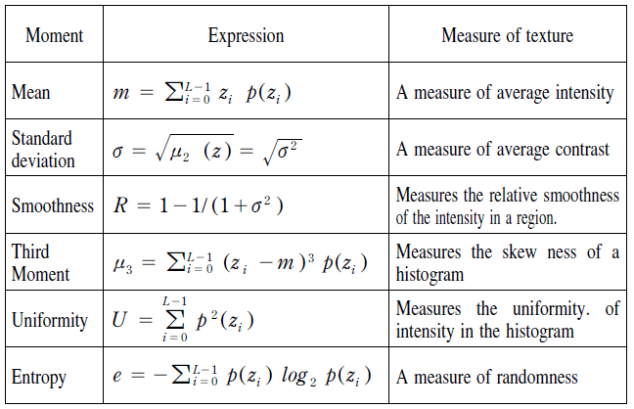
First Order Feature Examples
Example features:

Slide 7
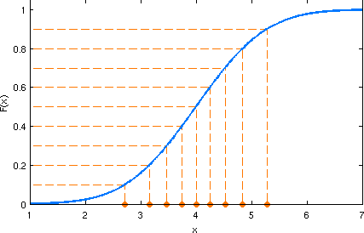
First Order Feature Examples: Quantiles or Percentiles
Quantiles (or percentiles) are points taken at regular intervals from cumulative distribution function (CDF) of random variable
Dividing ordered data into essentially equal-sized data subsets is the motivation for q-quantiles; quantiles are the data values marking the boundaries between consecutive subsets
Common to use 0.1, 0.2, …, 0.9 as features
0.5-quantile is the median
Matlab function “quantile(data,p)”:
Returns quantile of the values in “data” for the cumulative probability or probabilities “p” in the interval [0,1]

Slide 8
Higher Order Statistical Features
Depend on both pixel values and spatial inter-relationships
Example: Co-occurrence matrix (GLCM) features
GLCM is a tabulation of how often different combinations of pixel brightness values (grey levels) occur in an image
GLCM(m,n) is constructed by observing the count of pairs of image cells of gray levels m and n that are separated by a predefined shift apart
Different realization depending on shift (distance and angle)
Matlab function “graycomatrix”:
Create gray-level co-occurrence matrix from image

Slide 9
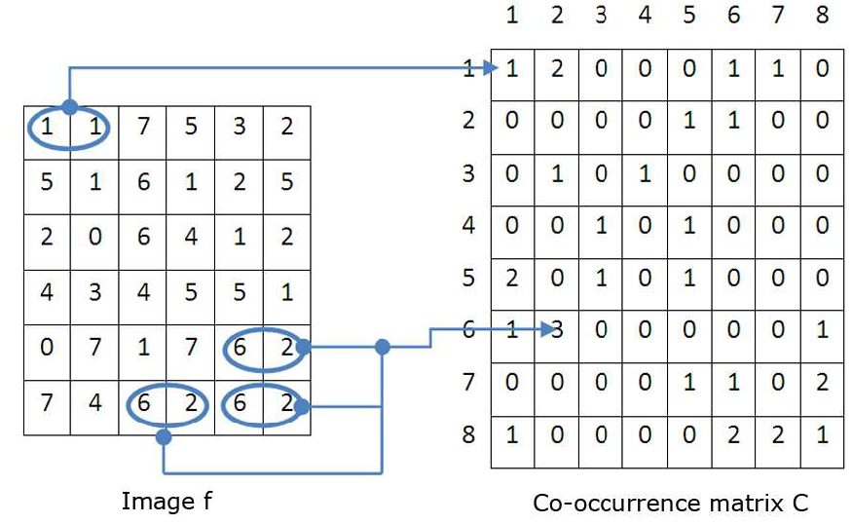
Co-occurrence Matrix Example
Shift= [1 0] (distance=1 , angle=0)

Slide 10
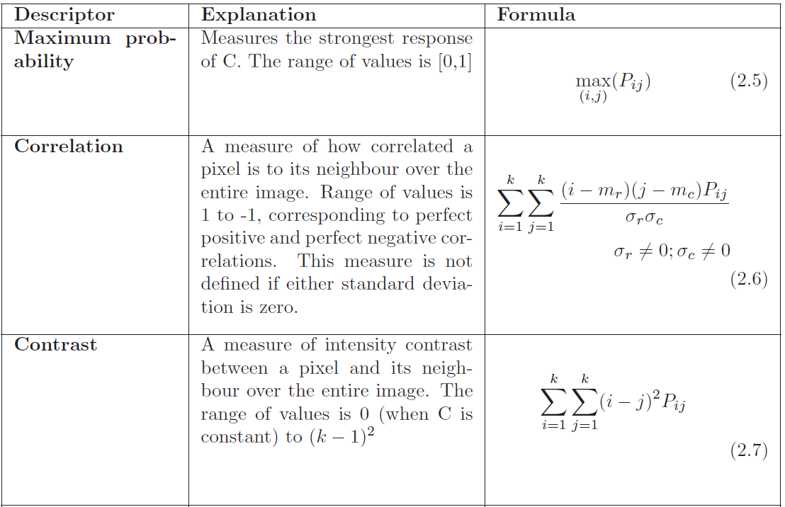
Co-occurrence Matrix Features

Slide 11
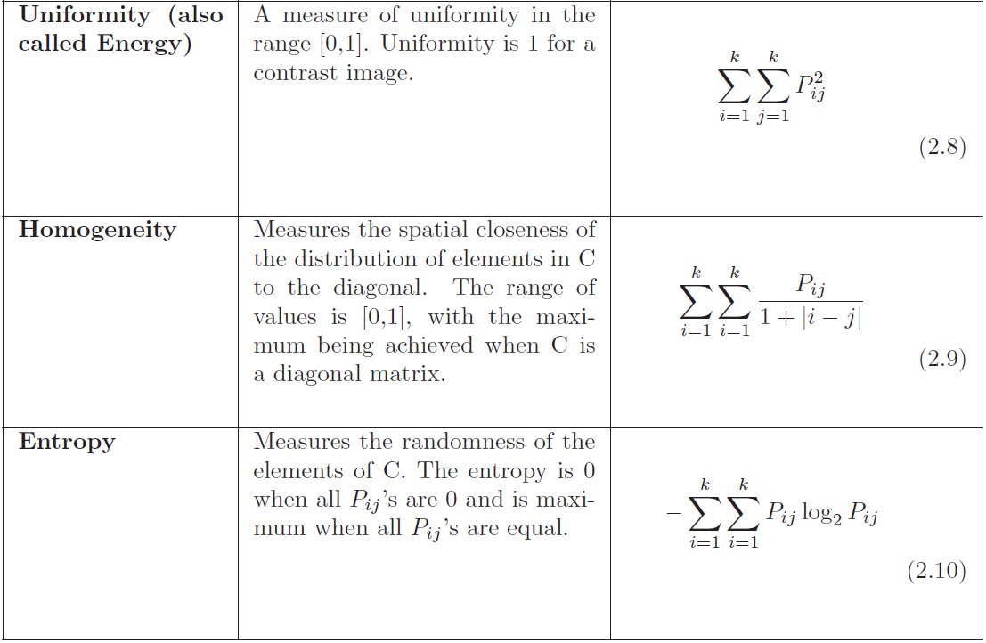
Co-occurrence Matrix Features

Slide 12
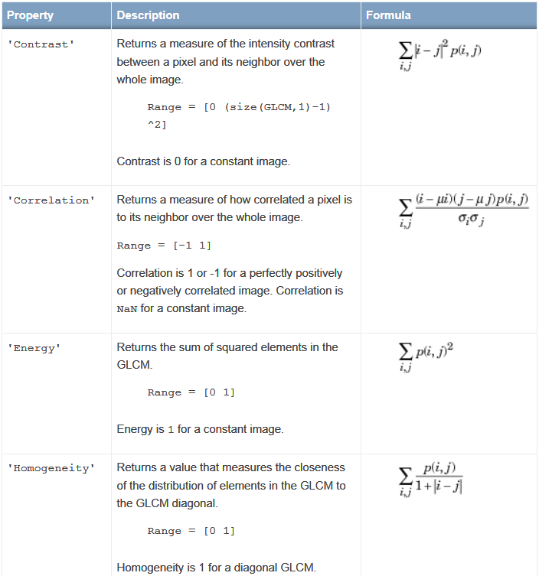
Co-occurrence Matrix Features
Matlab “graycoprops”
Properties of gray-level co-occurrence matrix

Slide 13
Transform Domain Features
Features computed AFTER transformation to another domain
Discrete Fourier transform
Discrete cosine transform
Discrete wavelet transform
Image
Image Transformation
Spectrum
Feature Extraction
Transform Domain Features

Slide 14
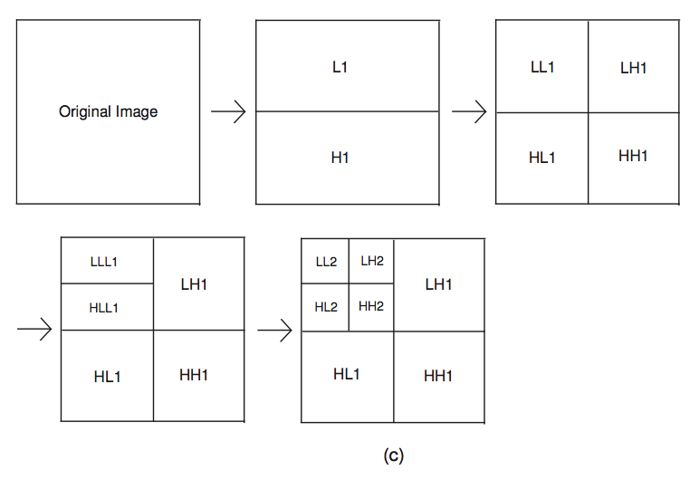
Transform Domain Features
Example: Wavelet decomposition
Selection of basic wavelet type and size and number of levels

Slide 15
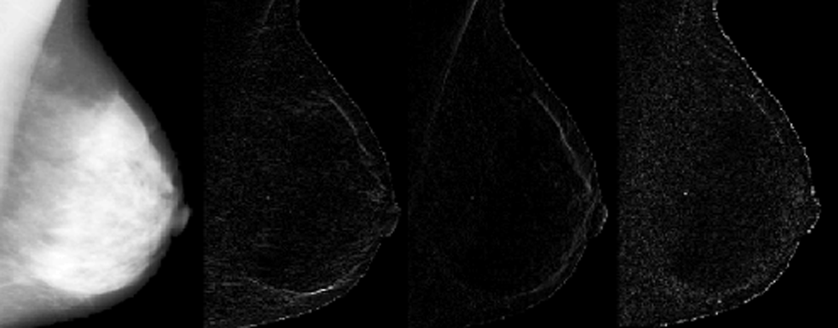
Transform Domain Features
Wavelet decomposition of a mammogram
Different details in different scales
Consider each as a spatial image and proceed with spatial feature extraction

Slide 16
Final Feature Extraction Notes
Newer features based on image modeling
Markov random model
ARMA models
Fractal models
Next step: feature selection
Not all features are correlated with disease
Must include only relevant features to avoid misclassification
Normalization of feature values is necessary preprocessing step before training classifiers

Slide 17
Assignments
Read the thesis titled “Texture Descriptors applied to Digital Mammography” (Google search to download it)
Start with the miniMIAS database and select 10 images with masses and 10 with normal texture.
Consider ROI size of 32x32
Create an array of 30 ROIs for normal and abnormal pathologies (statistical unit: lesion NOT patient)
Compute at least 20 features for each ROI

