Slide 1
Computer Aided Diagnosis: Feature Selection
Prof. Yasser Mostafa Kadah – www.k-space.org

Slide 2
Recommended Reference
Recent Advances in Breast Imaging, Mammography, and Computer-Aided Diagnosis of Breast Cancer, Editors: Jasjit S. Suri and Rangaraj M. Rangayyan, SPIE Press, 2006.

Slide 3
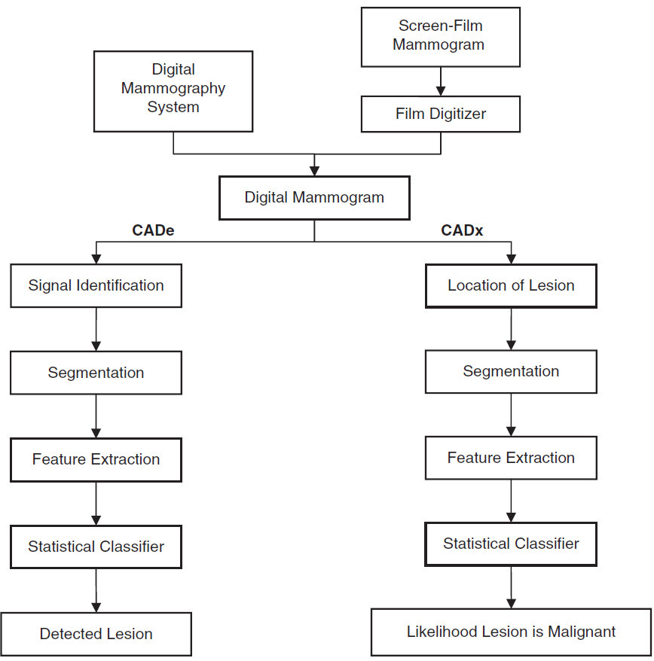
CAD

Slide 4
Feature Extraction and Selection
Feature extraction and selection in pattern recognition are based on finding mathematical methods for reducing dimensionality of pattern representation
A lower-dimensional representation based on independent pattern descriptors is important
Plays crucial role in determining separating properties of pattern classes
The choice of features, attributes, or measurements to be included has an important influence on:
Accuracy of classification
Time needed for classification
Number of examples needed for learning
Cost of performing classification

Slide 5
Feature Selection
Features extracted from images need not represent significant information to diagnosis
May describe aspects of no relevance to the pathology of interest
May vary a lot with acquisition settings (pose, processing, etc.)
Several problems should be mitigated in feature selection
Features that do not correlate with pathology
Features that are not independent
Building classifiers with features not properly selected will:
Cause problems in the training phase
Will not yield the best overall classification accuracy

Slide 6
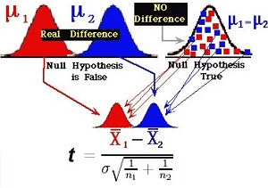
Statistical Significance of Features
Idea: if the feature changes consistently with pathology, then the hypothesis of a statistically significant difference between the set of values for normal and abnormal cases will be true
Inferential Statistical tests like Student t-test should detect a difference

Slide 7
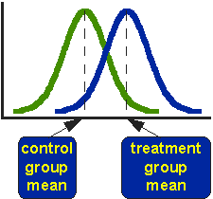
Statistical Significance of Features
Student t-test steps:
Consider a particular feature of interest
Divide the values into two sets for normal and abnormal cases
Compute the mean and standard deviation for both sets
Use the t-test to compute the p-value of the null hypothesis that both sets do not have a statistically significant difference
The feature is suitable if the p-value is small (e.g., 0.05, 0.01, etc.)

Slide 8
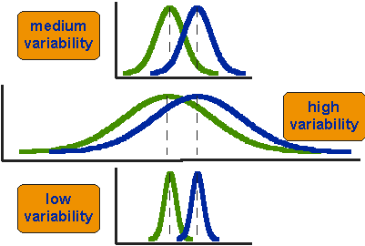
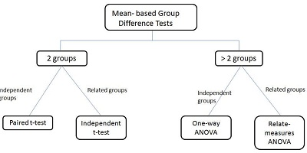
Statistical Significance of Features
Important to keep in mind that large difference in value does not mean statistical significance
Data dispersion is a key factor
General form: multiple groups
Diagnosis not detection
More general inferential statistics
Nonparametric methods
Kolmogorov-Smirnov test
Wilcoxon signed rank test

Slide 9
Assessment of Feature Independence
Some features may end up being dependent
Example: feature computed as a constant factor of another
Only one of them should be included in the input to classification stage
Several methods can help identify such dependence
Pearson’s linear correlation coefficient
Principal component analysis

Slide 10
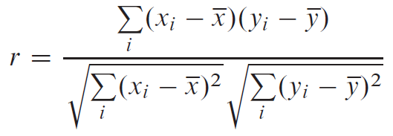
Pearson’s linear correlation coefficient
Computes the correlation between a given pair of features
Computing formula:
The value of r lies between -1 and 1, inclusive
Value of 1 is called “complete positive correlation”: straight line y = c x
Value of -1 is called “complete negative correlation”: straight line y= -c x
Value of r near zero indicates that the variables x and y are uncorrelated

Slide 11
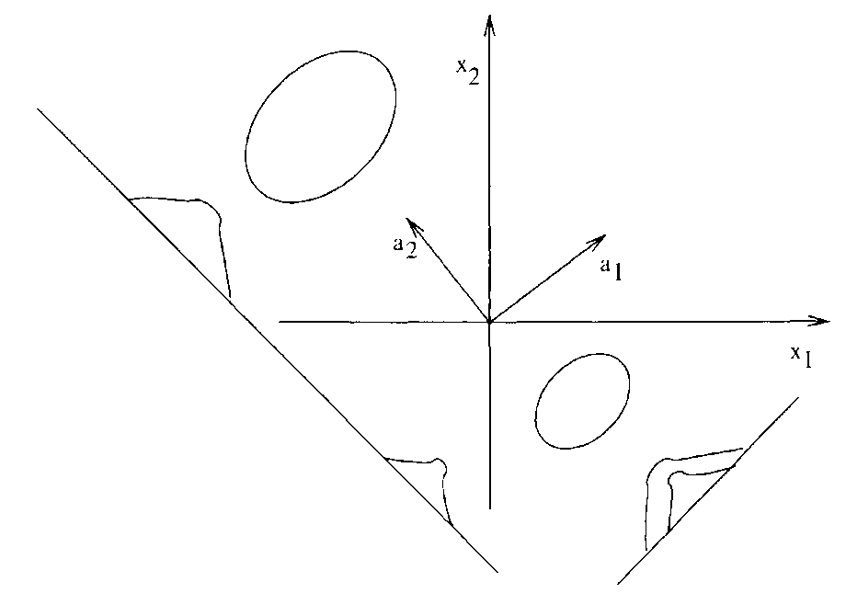
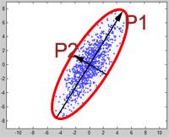
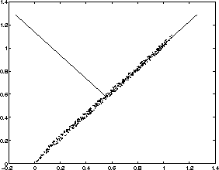
Principal Component Analysis
Computes the eigenvalue decomposition of the matrix of features
Rank of matrix = number of independent features
Directions of principal components may have different performance in classification

Slide 12
Retrospective Assessment of Features
Retrospective: evaluation after seeing the classification results based on these features
Basic idea: use for classification and then choose the features that produce the best results
Exhaustive search
Branch and Bound Algorithm
Max-Min Feature Selection
Sequential Forward and Sequential Backward Selection
Fisher's Linear Discriminant

Slide 13
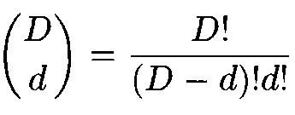
Exhaustive Search
Let y with y = [y₁,y₂, … , y_{D}] be a pattern vector, exhaustive search selects the d best features out of the maximal available features D as to minimize the classification error
The resulting number of total combinations is:
Main advantage: guaranteed best answer
Main disadvantage of exhaustive search is that the total number of combinations increases exponentially with the dimension of the feature vector

Slide 14
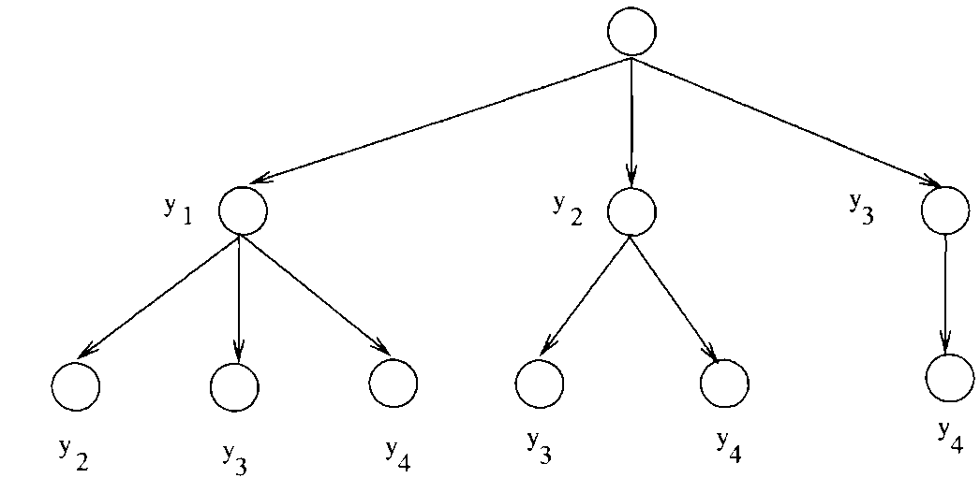
Branch and Bound Algorithm
Solves the problem of huge computational cost associated with the exhaustive search
New technique to determine the optimal feature set without explicit evaluation of all possible combinations of d features
This technique is applicable when the separability criterion is monotonic:
Combinatorial optimization
Efficient computation

Slide 15
Assignments
Apply 2 feature selection methods to the features obtained from previous tasks and compare their results
Add a random data vector as a feature to your extracted features and report how your feature selection strategy was able to detect that it is irrelevant
Add a new feature as the sum of two existing features to your extracted features and report how your feature selection strategy was able to detect that this new feature is dependent

