Slide 1
Computer Aided Diagnosis: Classification
Prof. Yasser Mostafa Kadah – www.k-space.org

Slide 2
Recommended Reference
Recent Advances in Breast Imaging, Mammography, and Computer-Aided Diagnosis of Breast Cancer, Editors: Jasjit S. Suri and Rangaraj M. Rangayyan, SPIE Press, 2006.

Slide 3
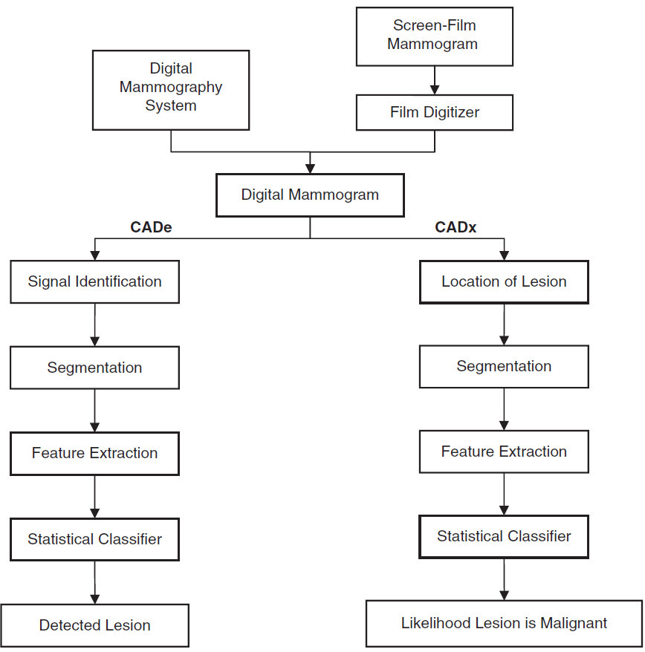
CAD

Slide 4
Classification Assumptions
There is a visible difference between normal and abnormal images
If you cannot see consistent differences, you cannot program a CAD system to see them
Training set with normal and abnormal cases of interest
Features selected describe such difference effectively
Irrelevant features will only confuse and misguide the CAD system
Normal and abnormal cases form distinct clusters that are somewhat apart according to a distance measure
Cases from the same pathology are represented by points in feature space that with smaller distance separation than with cases from other pathologies
“Intra-cluster” distance is significantly smaller than “Inter-cluster” distance

Slide 5
Classifiers: Model
Parametric classification
Assumed a certain distribution for data clusters (e.g., Gaussian)
Estimates model parameters from the data
Uses this a priori information to design the classification method and estimate its parameters
Good if model is correct but bad if not (difficult to know ahead)
Non-Parametric classification
Does not assume or impose any model on the data
“Model-Free” or “Data-Dependent”

Slide 6
Classifiers: Learning
Supervised classifiers
Classifiers are trained with data samples of known labels
Number of clusters known a priori and cannot be changed
Relies on “trainer” to provide the correct information
Unsupervised classifiers
Classifiers are trained with data samples with unknown labels
Discover underlying clusters according to particular criteria
Interesting to identify new clusters representing sub-classes within large normal or pathological classes

Slide 7
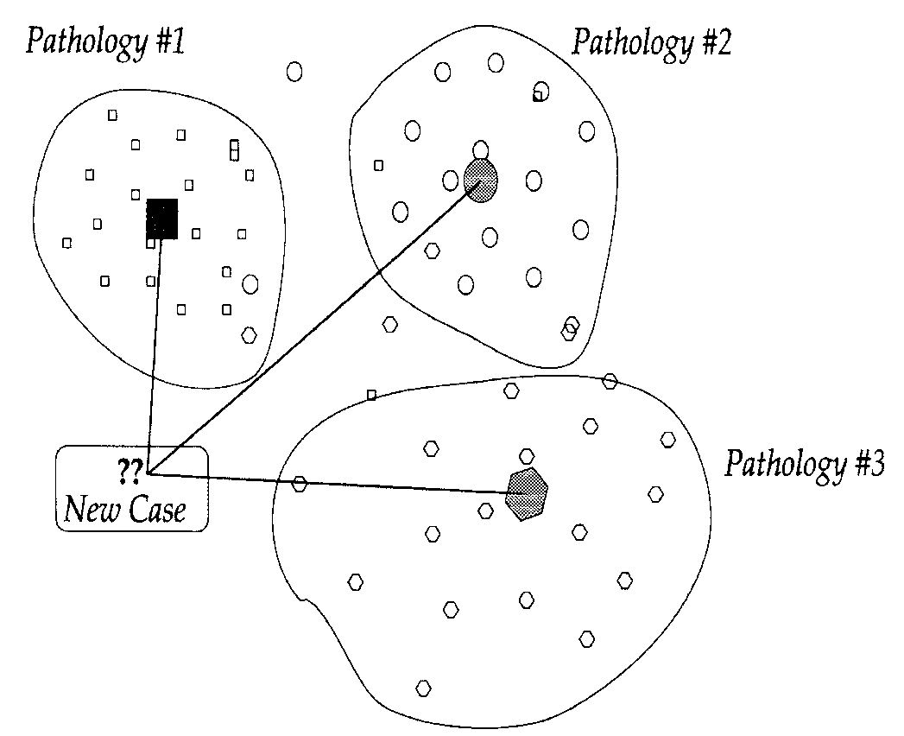
Minimum Distance Classifier
Idea: Compute the distance between unknown case and the center of known clusters and assign the case to the closest cluster
How to compute cluster centers
Distance computation
Simple but not good in many cases

Slide 8
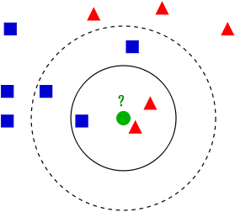
K-Voting Nearest Neighbor
Assumption: an unknown case is likely to belong to the class of its neighbors in space
Idea: Find the K neighbors of the unknown case and make a majority vote among them and assign the case to the pathology of the majority
Select K in such a way to avoid “ties”: e.g., odd number for binary classification
Special case: K=1 – Nearest Neighbor Classifier
Matlab function “knnclassify”

Slide 9
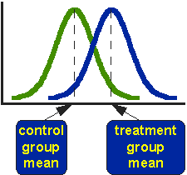
Naïve Bayesian Classifier
Idea: Assign the unknown case to the class of largest posterior probability
P(y) is the a priori probability of y
P(x | y) is the likelihood function;
P(x) is the marginal probability
P(y | x) is the a posteriori probability
Classified
as Normal
Classified
as Abnormal
Poster Probability
Normal
Group
Abnormal
Group

Slide 10
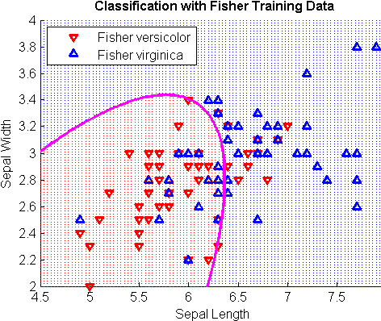
Discriminant Analysis
Idea: Find the best separation surface between clusters
Generalization of Naïve Bayesian classifier
Linear: LDA
Quadratic: QDA
Matlab function “classify”

Slide 11
Other Important Classifiers
Support vector machine (SVM) classifier
Neural Network classifier
Fuzzy logic classifier
K-means clustering
Biclustering
Features
Subjects

Slide 12
Things to Watch for
Feature normalization is important and can improve training and classification results
Independent training and testing data is a must
Half and half for example
Leave-one-out cross validation can be used for small data sets

Slide 13
Assignments
Apply 2 classification methods to the selected features obtained from previous tasks and compare their results

