Slide 1

Clinical analytical instrumentation
Prof. Yasser Mostafa Kadah
EE 471

Slide 2
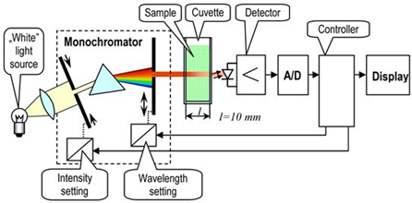
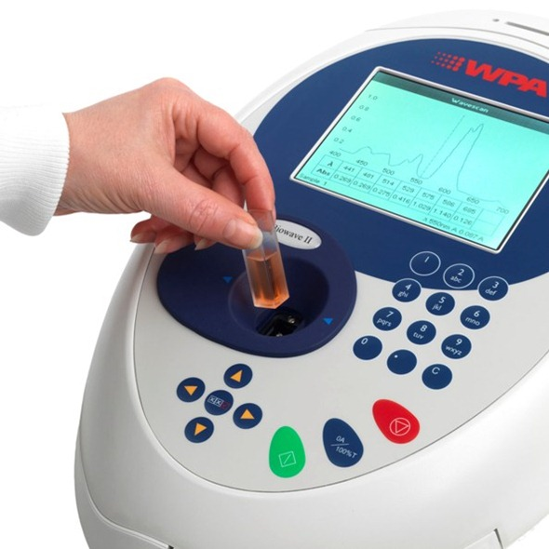
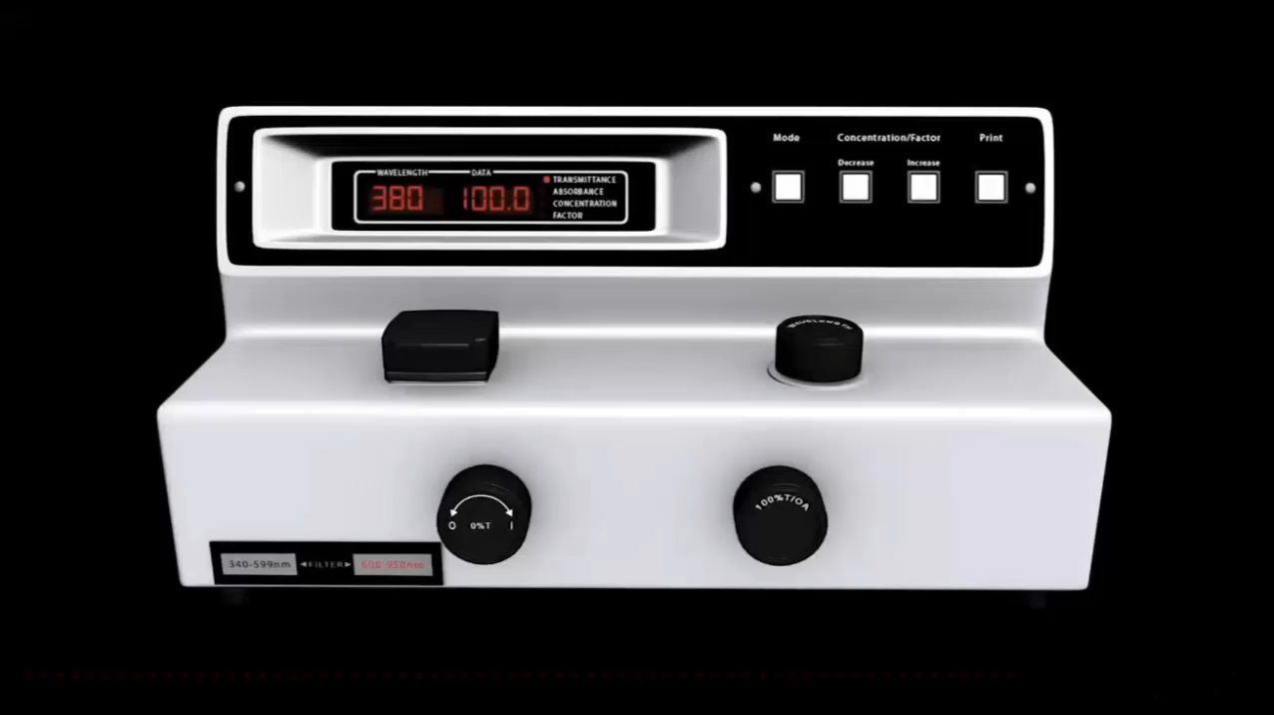
Spectrophotometer
Single Channel
Multi-Channel

Slide 3
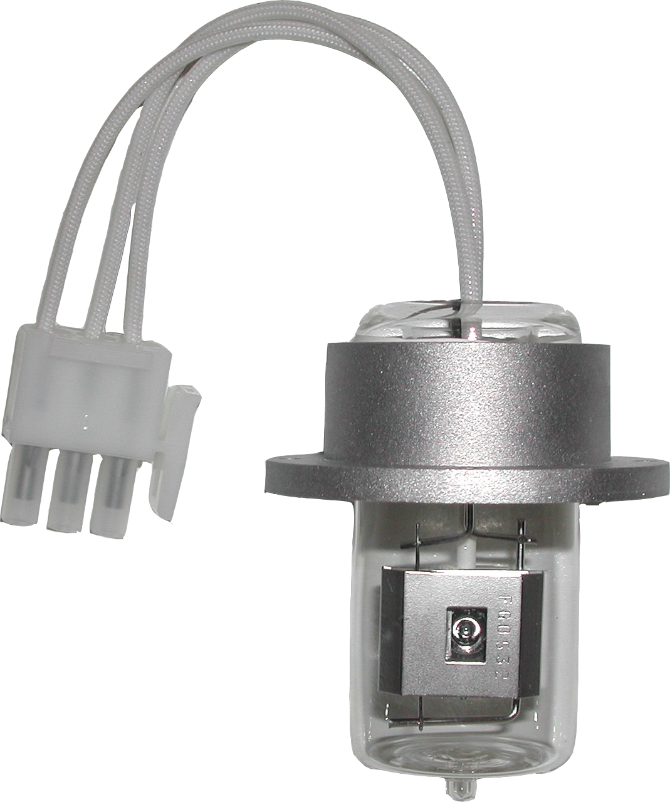
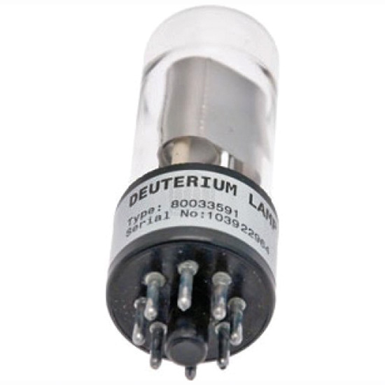
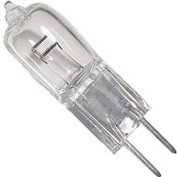
Source
Deuterium lamps are commonly used as UV radiation source in range 200–400 nm
Tungsten incandescent lamps as sources for visible and NIR regions covering range 400–2500 nm
  For NIR, source operated at 2500–3000 K: more intense radiation

Slide 4
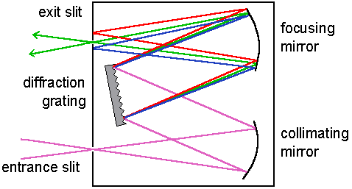
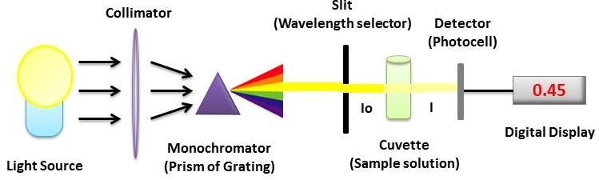
Discriminator
Monochromator is usually used as wavelength selector
Components: dispersing medium to separate wavelengths of polychromatic radiation from source, slits to select narrow band of wavelengths of interest and lenses or mirrors to focus chosen radiation
  Dispersing medium can be diffraction grating(+), prism or optical filter
  Interferometers more common in Fourier Transform (FT) instruments: more effective at longer wavelengths (IR and NIR) and also used for UV–Vis

Slide 5

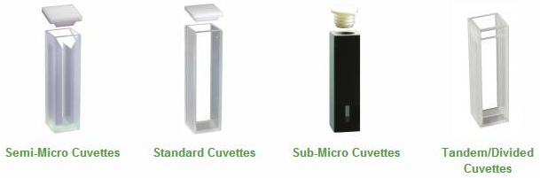
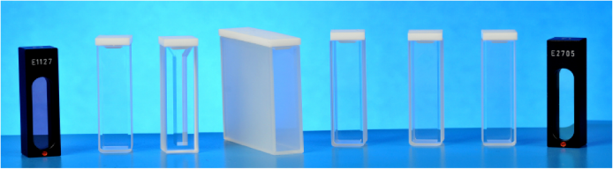
Sample Holder
Sample holder must be transparent in wavelength region being measured
  Quartz cuvettes are normally used for UV–Vis and NIR measurements
  Flow-through, cylindrical, micro and thermal cells can also be used
For UV–Vis absorbance, cuvettes are usually 1 cm in path length in laboratory based instruments, but shorter path lengths can be employed
For NIR, longer path lengths of 5–10 cm used in short wavelength NIR (750–1100 nm) and shorter path lengths of 0.1–2 cm used for the long wavelength NIR (1100–2500 nm)
Cuvettes and cells should be handled carefully to avoid leaving fingerprints
Sample compartment must prevent stray light and dust from entering
  Adversely affect the absorbance readings if allowed

Slide 6
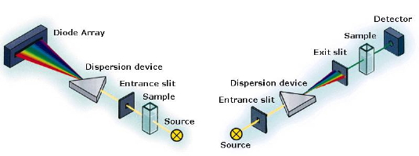
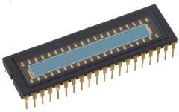
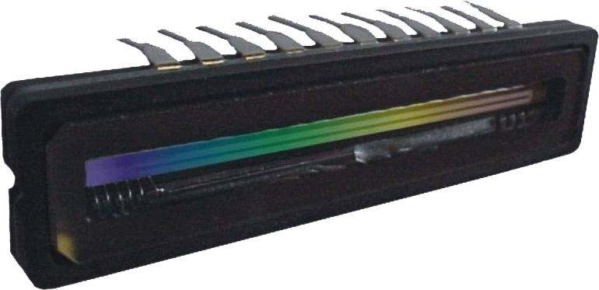
Detectors
Typically photomultiplier tube (PMT), photodiode array (PDA) or charge-coupled device (CCD)
Mono-channel systems use one detector (one wavelength at a time)
  Measures intensity of one at a time as monochromator slowly scan through spectrum
Multi-channel systems use array detector (many wavelengths measured simultaneously)
  Two advantages: Multichannel advantage (SNR↑), and throughput advantage (single deuterium source for whole UV–Vis range - no monochromator)

Slide 7
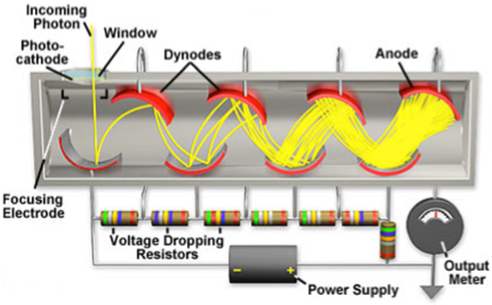
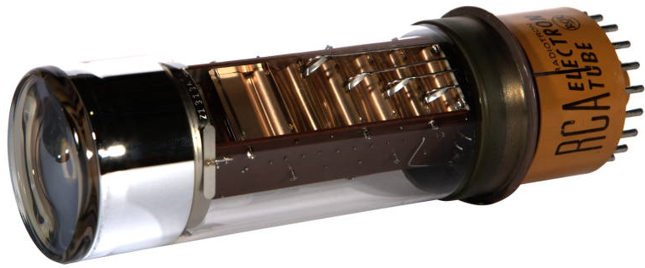
Photomultiplier Tube (PMT)
Popular monochannel detector
Consist of photosensitive surface and series of electrodes (dynodes), each at increased potential compared to one before
When photon strikes photosensitive surface, primary electron is emitted and accelerates towards first dynode
Electron impacts dynode and causes release of number of secondary electrons, which hit next electrode and so on, until the signal is amplified many times over
  Typical gain: 10⁶
  Can detect extremely small signals

Slide 8
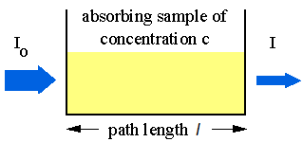
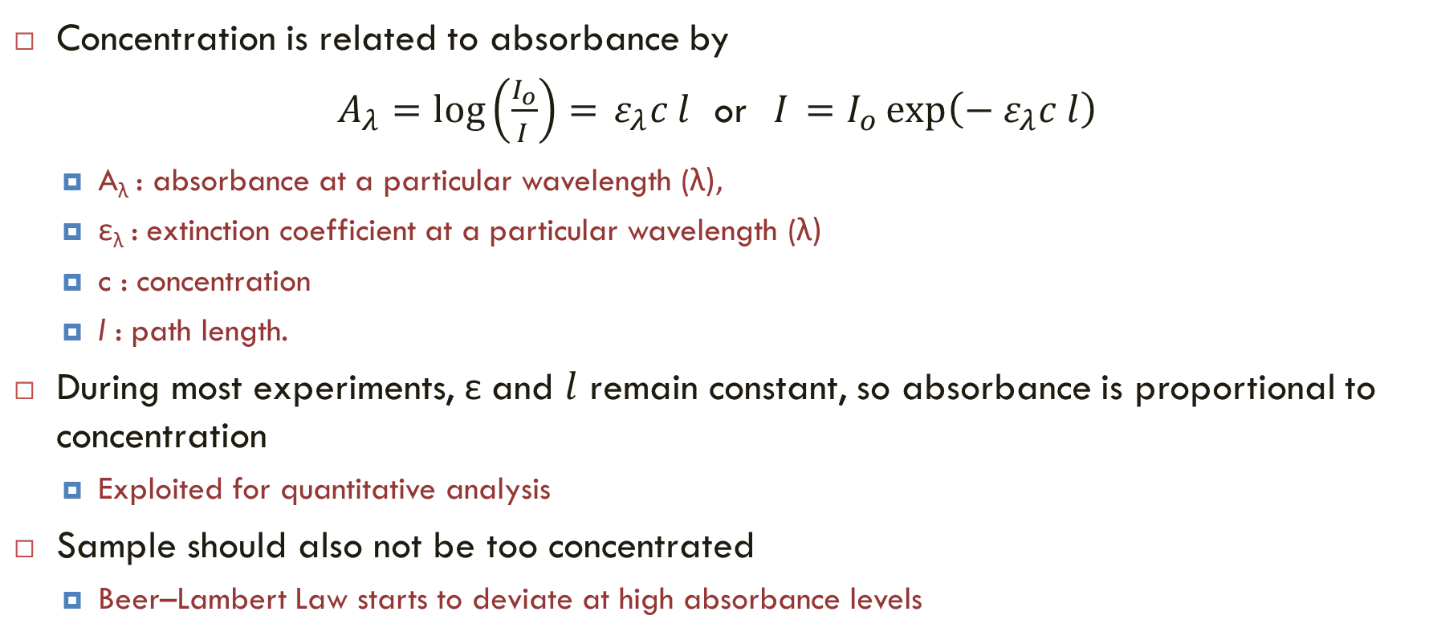
Beer–Lambert Law
Concentration is related to absorbance by
$A_{λ}=\log\left(\frac{I_{o}}{I_{ }}\right)= ε_{λ}c l$ or ${I_{ }=I_{o}\exp\left({− ε}_{λ}c l\right)}$
  A_{λ} : absorbance at a particular wavelength (λ),
  ε_{λ} : extinction coefficient at a particular wavelength (λ)
  c : concentration
  l : path length.
During most experiments, ε and $l$ remain constant, so absorbance is proportional to concentration
  Exploited for quantitative analysis
Sample should also not be too concentrated
  Beer–Lambert Law starts to deviate at high absorbance levels

Slide 9
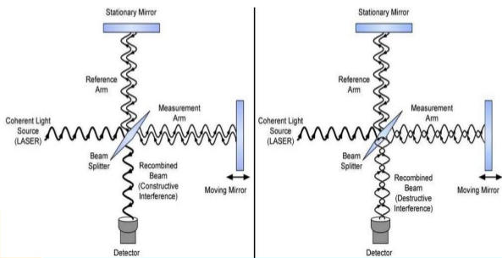
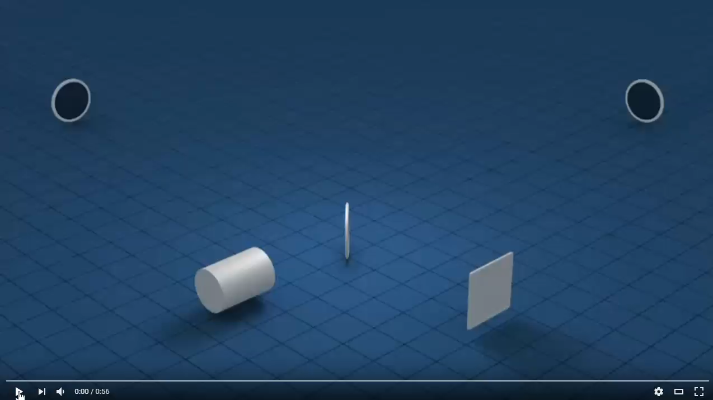
Michelson Interferometer
Selection of wavelength
  Moving mirror position
  Based on constructive interference
  Scanning all wavelengths

Slide 10
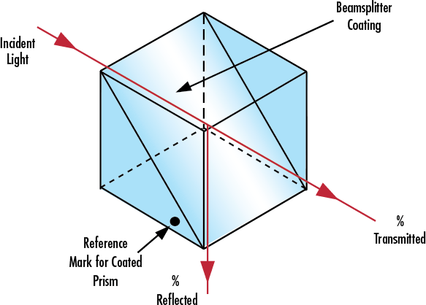
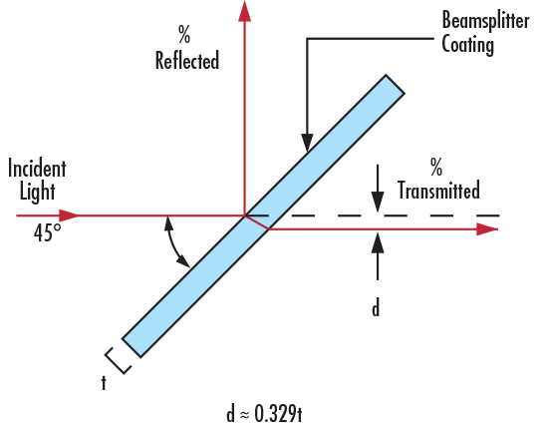
Beam Splitters
Optical components used to split incident light at designated ratio into two separate beams
Can also be used in reverse to combine two different beams into a single one
Classified according to their construction into cube or plate

Slide 11
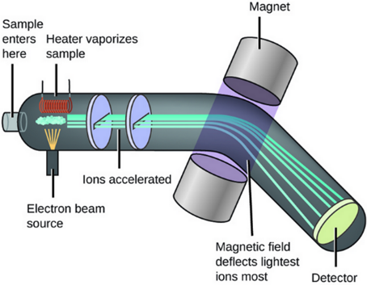
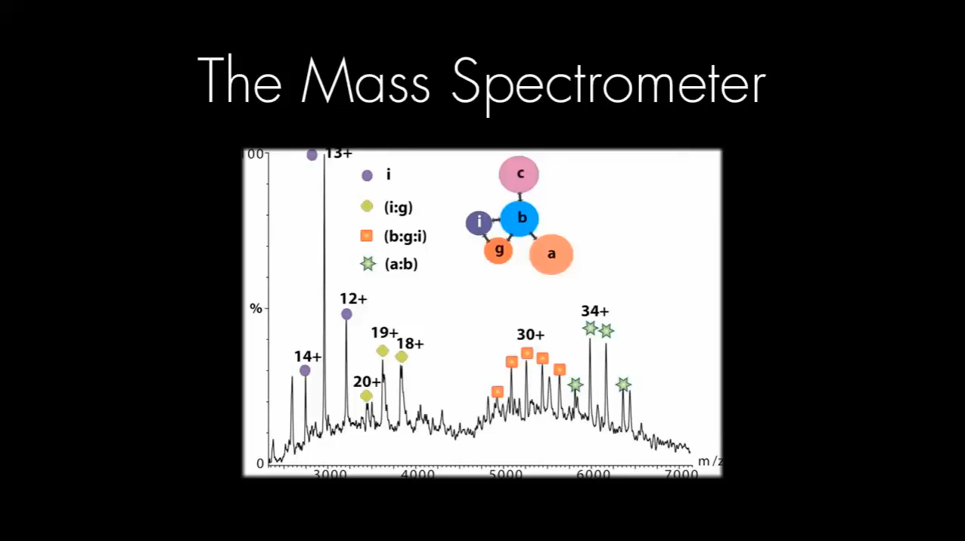
Mass Spectrometer
Mass spectrometry is based on generating ions in gaseous state, separating them according to their mass-to-charge ratio (m/z) and detecting them
  In fact, MS provides more information about composition and structure of compound from less sample than any other analytical technique

Slide 12
Separation Instruments
Separation instrumentation is based mainly on chromatography, which is a procedure for separating the analyte(s) of interest from interferences (matrix) and other compounds in sample mixture
Chromatographic techniques depend on differing distributions of individual compounds between two immiscible phases – mobile and stationary
  Stationary phase is fixed in a column or on a solid surface
  Sample mixture is added to one end of stationary phase and mobile phase then passes through or over it carrying the sample
  Mixture of compounds is eluted, compound appearing first at the end of stationary phase being that which has the smallest distribution into stationary phase
  As separated compounds appear at the end of stationary phase they are detected
  Actual identification and quantitation of separated compounds are made by detector
Several types of chromatography including thin layer, gas and liquid

Slide 13
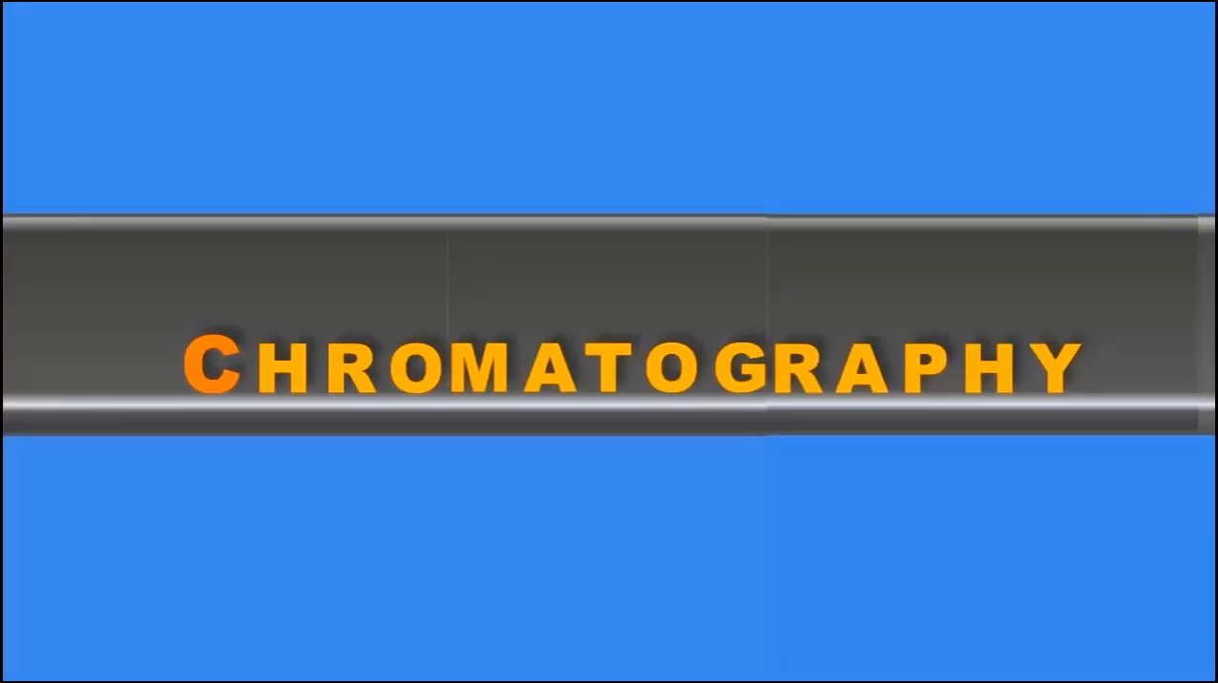
Basic Experiment in Chromatography
(a) Ingredients – C: column, SP: stationary phase, MP: mobile phase, and S: sample
(b) Introduction of sample
(c) Start of elution
(d) Recovery of products following separation

Slide 14
Analysis by Chromatography
Essential recording obtained for each separation is called chromatogram
  It corresponds to diagram traced on chart paper or screen that reveals variations of composition of eluting mobile phase as it exits column
  order of appearance of compounds corresponds to relative position of each constituent on column

Slide 15
Reading Assignment
Read Chapter 2 and 3 of Analytical Instrumentation

