Slide 1

Anesthesia Machine
Prof. Yasser Mostafa Kadah
EE 471

Slide 2
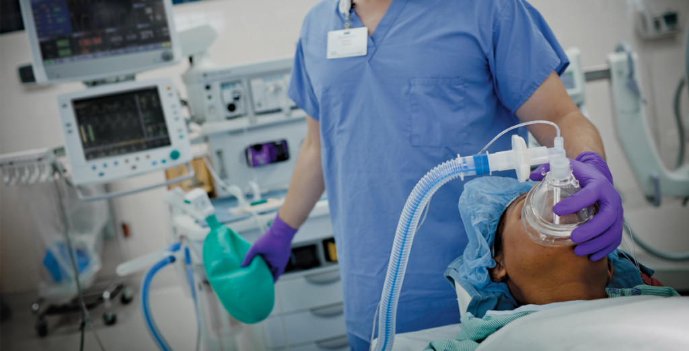
Scope
Anesthesia devices are used in operating rooms in hospitals by medical staff to ensure that operative and diagnostic procedures can be performed on a patient without pain in an unconscious and relaxed state
  Achieved by administering inhalation anesthetics
  Surgery “Without Perception” rather than “Without Sensation”

Slide 3
Inhalation Anesthetics
Produce loss of awareness and neuromuscular blockade
  Vital physiologic functions (e.g., breathing) continue to function
Cause reduction in nerve transmission at synapses
  Precisely how inhalational anesthetics inhibit synaptic neurotransmission is not yet fully understood
Different properties for each type
  Onset and duration of action
  Mechanism of clearance
  Safety
  flammability

Slide 4
Functional Diagram

Slide 5
Diagram of Anesthesia Gas Mixing
1. O₂: 13,700 kPa, N₂O: 4400 kPa
2. Pipeline: about 400 kPa
3. O₂ supply failure alarm activated at <250 kPa
4. Regulated gas supply at 400 kPa
5. O₂ flush 45 l/min at about 400 kPa
6. Back-bar pressure 1–10 kPa
Note: 1 bar = 100 kPa

Slide 6
Components of Anesthesia Machine
Drug dosing
  Mixing O₂ and N₂O: Flow Control Valve and Flowmeter
  Administration of inhalational anesthetics: Vaporizers
Ventilator with breathing system
  Same as ICU ventilators but allows rebreathing
Monitoring unit consisting of 3 subunits:
  Device monitoring: drug dosing and ventilator
  Patient monitoring: patient’s vital signs
  Anesthesia effect monitoring: depth of anesthesia

Slide 7
Drug Dosing
Two principles are used for delivering O₂, air, and N₂O, namely mechanical metering valves and electronic mixers

Slide 8
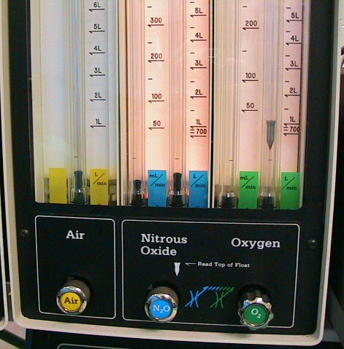
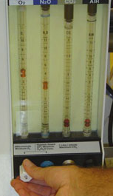
Flow Control Valve and Flowmeter
Idea: Constriction causes significant pressure drop
  Needle valve

Slide 9
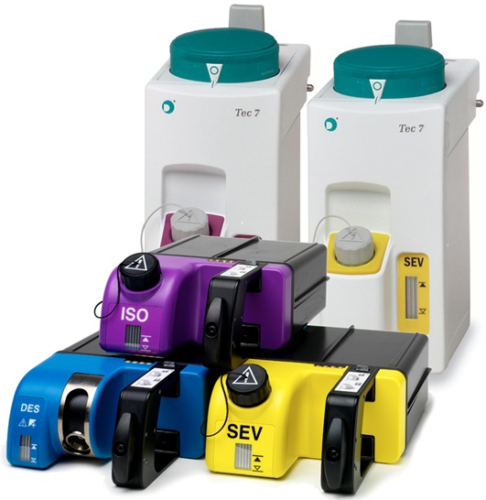
Anesthetic Agent Vaporizers
Volatile anesthetic agents are used to achieve unconsciousness
  Exhalable and evaporate quickly (for example, isoflurane and sevoflurane)
Anesthetic agent vaporizer converts anesthetic agent from liquid to vapor and mix it with fresh gas at preset concentration
Concentration of saturated agent vapor is much higher (20 fold) than therapeutically necessary
  Vaporizer is primarily designed to reduce high saturation concentration of ~30% to concentration required during anesthesia of ~2%

Slide 10
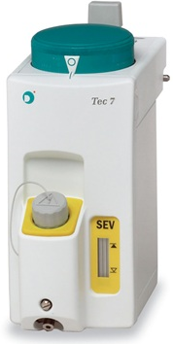
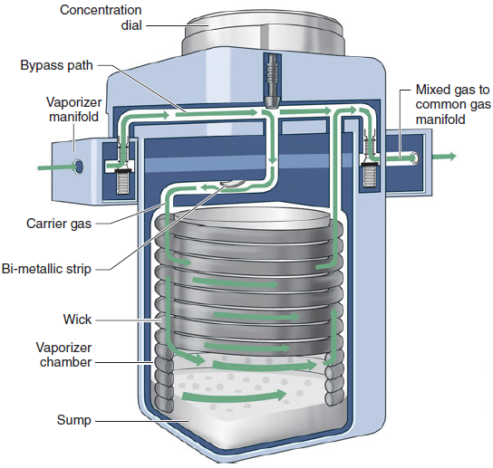
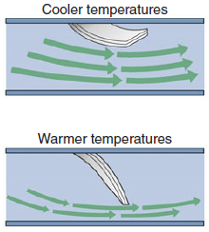
Mechanical Vaporizer

Slide 11
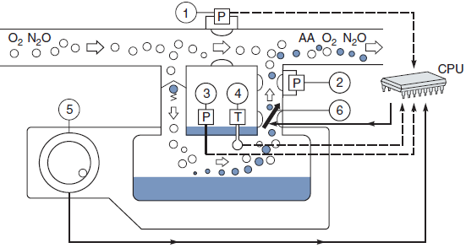
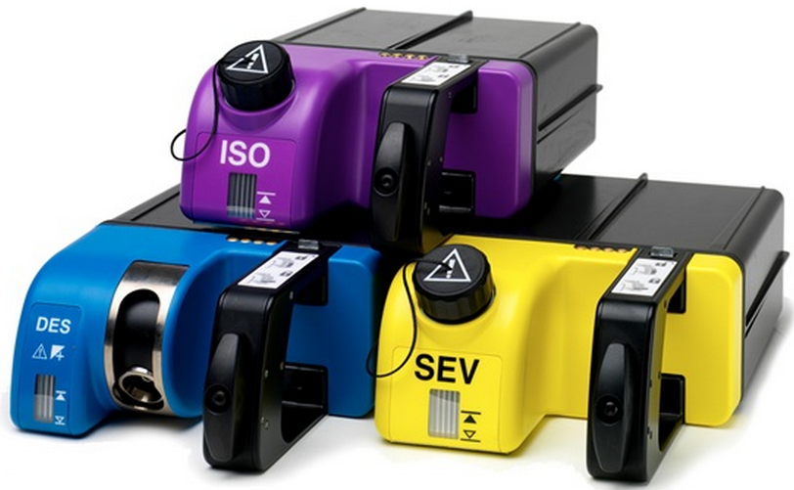
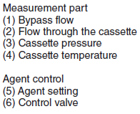
Electronic Vaporizer

Slide 12
Emergency O₂ Flush
Flow of about 35–75 l/min at pressure of about 400 kPa
  Purge contents of any other gases and anesthetic agents
Activated by non-locking button using self-closing valve

Slide 13
Scavenging System
Chronic exposure to low concentrations of inhaled anesthetics may pose a health hazard to operating room personnel
Scavenging is the collection and subsequent removal of vented gases from the operating room
  Active system: connected to vacuum system and gases are drawn from machine by vacuum
  Passive system: connected to ventilation duct and waste gases flow out of machine on their own
Adequate operating room ventilation is still necessary
  Air should be exchanged at least 15 times per hour by the operating room ventilation system

Slide 14
Anti-Hypoxic Safety Features
Designed to prevent delivery of gas mixtures with O₂< 21% (air O₂ concentration)
O₂ analyzer: continuous measurement of O₂ concentration
Mechanical means: linking O₂ and N₂O flow control valves
  Oxygen Failure Protection Device (OFPD)

Slide 15
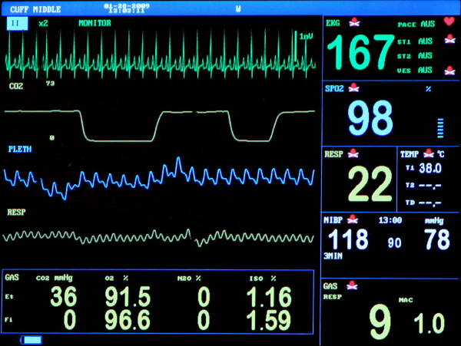
Monitoring in Anesthesia
Nine variables should be continuously monitored during anesthesia
Device monitoring (5 variables)
  O₂ concentration
  CO₂ concentration
  Anesthetic agent concentration
  Pressure
  Flow rate/Volume
Patient monitoring (4 signals)
  Electrocardiogram (ECG)
  Noninvasive blood pressure (NIBP)
  Oxygen saturation (SpO₂)
  Body temperature

Slide 16
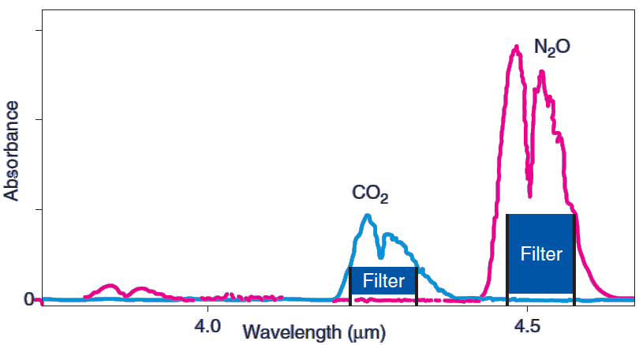
CO₂, N₂O, and Anesthetic Agent Sensors
Infrared absorption spectroscopy
  Polyatomic gases absorb infrared radiation at characteristic frequencies
  Concentrations can be determined from absorption Beer-Lambert law

Slide 17
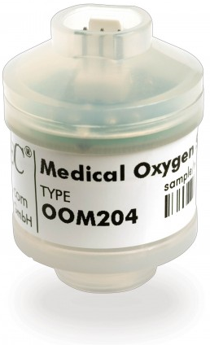
Oxygen Sensor: Fuel Cell or Galvanic Cell
Diffusion of oxygen starts chemical reactions
Flow of current depends on uptake of oxygen at the anode (Faraday’s first law of electrolysis)
  Voltage output is proportional to oxygen partial pressure
Response time (~20-30 s) and depleted by continuous exposure to oxygen because of exhaustion of the cell (less than 1 year lifespan)

Slide 18
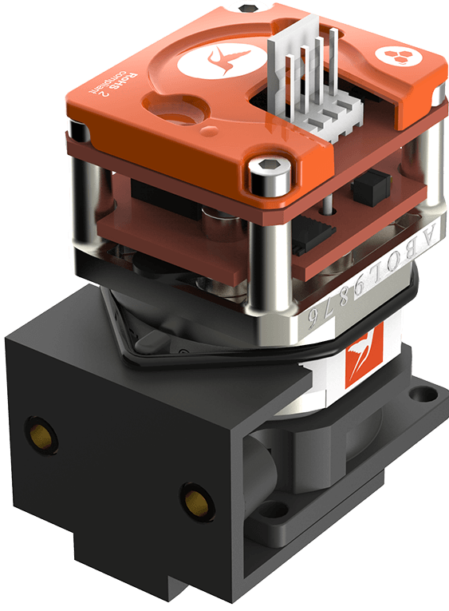
Oxygen Sensor: Paramegnetic
Oxygen is paramagnetic while other gases are diamagnetic
Magnetic field causes oxygen molecules to be attracted and agitated
  Pressure difference proportional to oxygen partial pressure
Very accurate, highly sensitive and fast response
  Allows continuous monitoring
Long lifespan with no service requirements

Slide 19
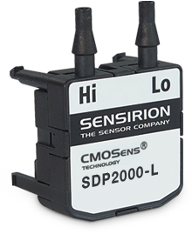
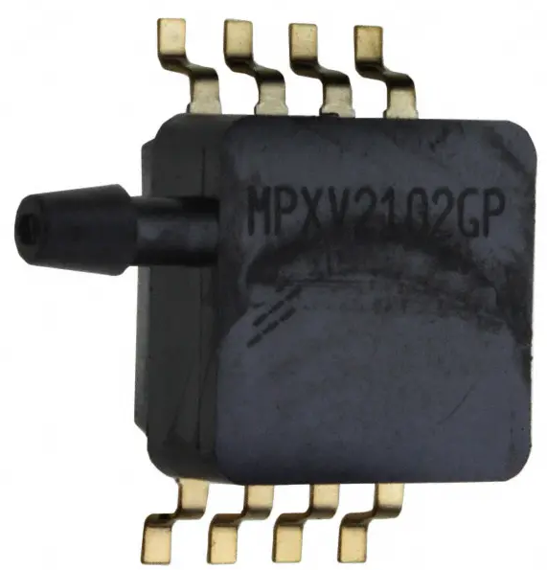
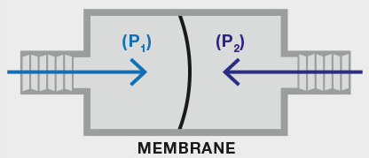
Pressure Sensor
Piezoresistive Sensor
  Solid-state device whose electrical resistance depends on strain of membrane (and hence, pressure)
  Can be designed to be absolute or differential
  Can be selected to have very fast response time
Resistive strain gauge

Slide 20
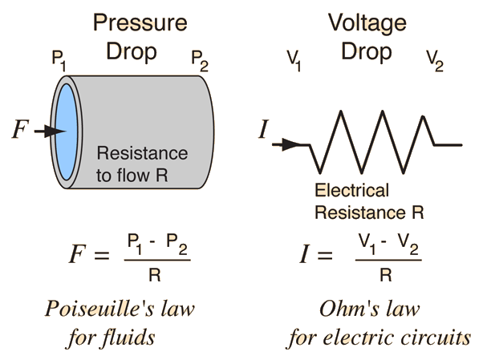
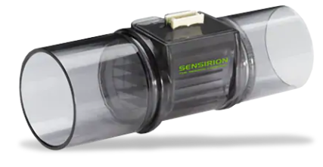
Flow Sensor: Pneumotachograph
Sensing change in pressure across fixed resistance through which gas flow is laminar to calculate flow rate
  Analogous to measuring current through resistance in electric circuits
  Bidirectional operation

Slide 21
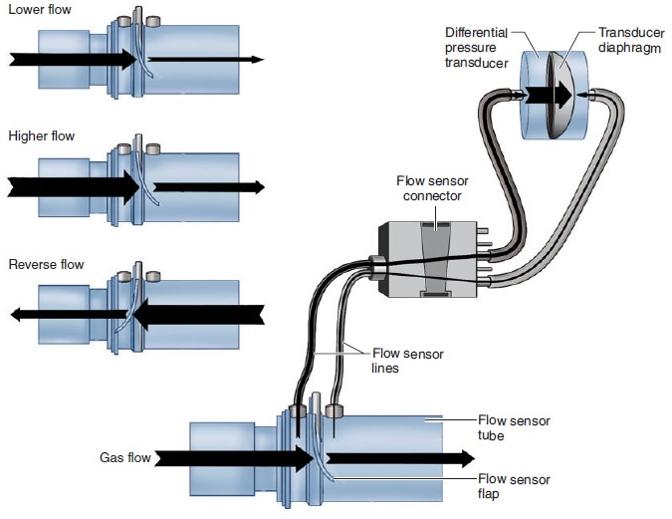
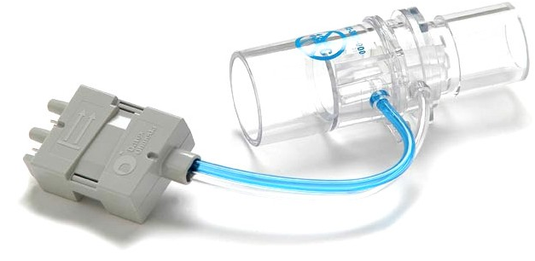
Flow Sensor: Variable Orifice Flowmeter
Pressure measurement across flow-dependent resistance (flap)
  As gas flow increases, flap opens more, reducing resistance to gas flow
  One-to-one correspondence between flow rate and pressure drop
  Bidirectional operation

Slide 22
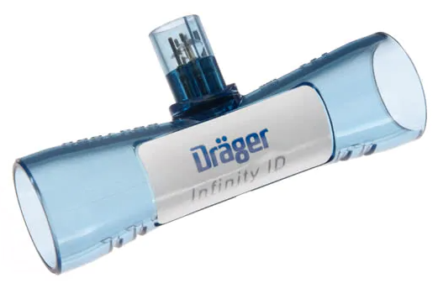
Flow Sensor: Hot-Wire Anemometer
Resistive wire is placed in flow path and heated using electric current
  Resistance increases linearly with temperature
Flow cools down wire and changes its resistance
  Resistance change can be measured and used to estimate flow rate
Fast and accurate but direction insensitive

Slide 23
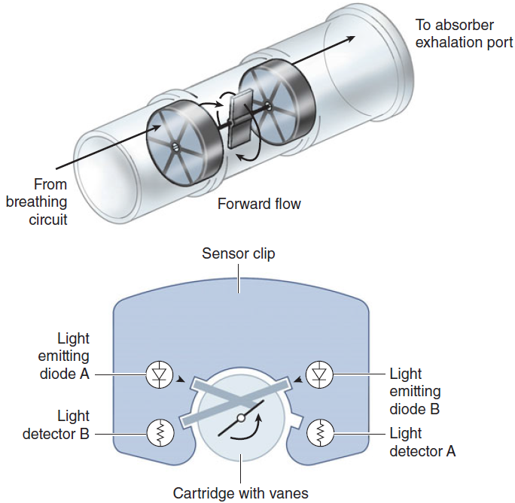
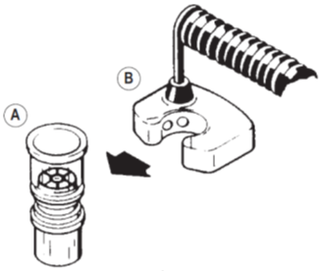
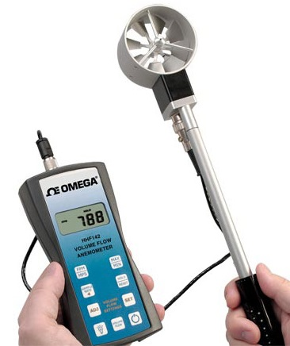
Flow Rate Sensor: Spirometer
Used to measure exhaled tidal volume in breathing circuit typically near exhalation valve
  Example: Vane Anemometer

Slide 24
Depth of Anesthesia Monitoring
Nerve Stimulator: assessment of neuromuscular blockade
  Supramaximal stimulus is administered to a motor nerve
  Motor response evoked measured by accelerometry or kinemyography

Slide 25
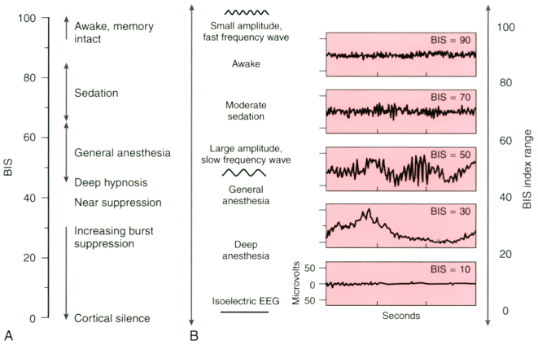
Depth of Anesthesia Monitoring
Burst suppression ratio (BSR): fraction of time in an epoch in which the EEG is suppressed and is usually averaged over 60 s
Bispectral index (BIS): EEG-derived variable from both time and frequency features including BSR

Slide 26
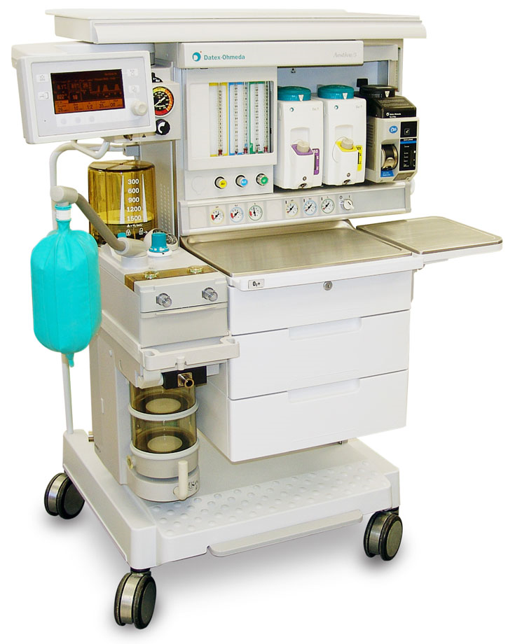
Modern Anesthesia Machine - Front

Slide 27
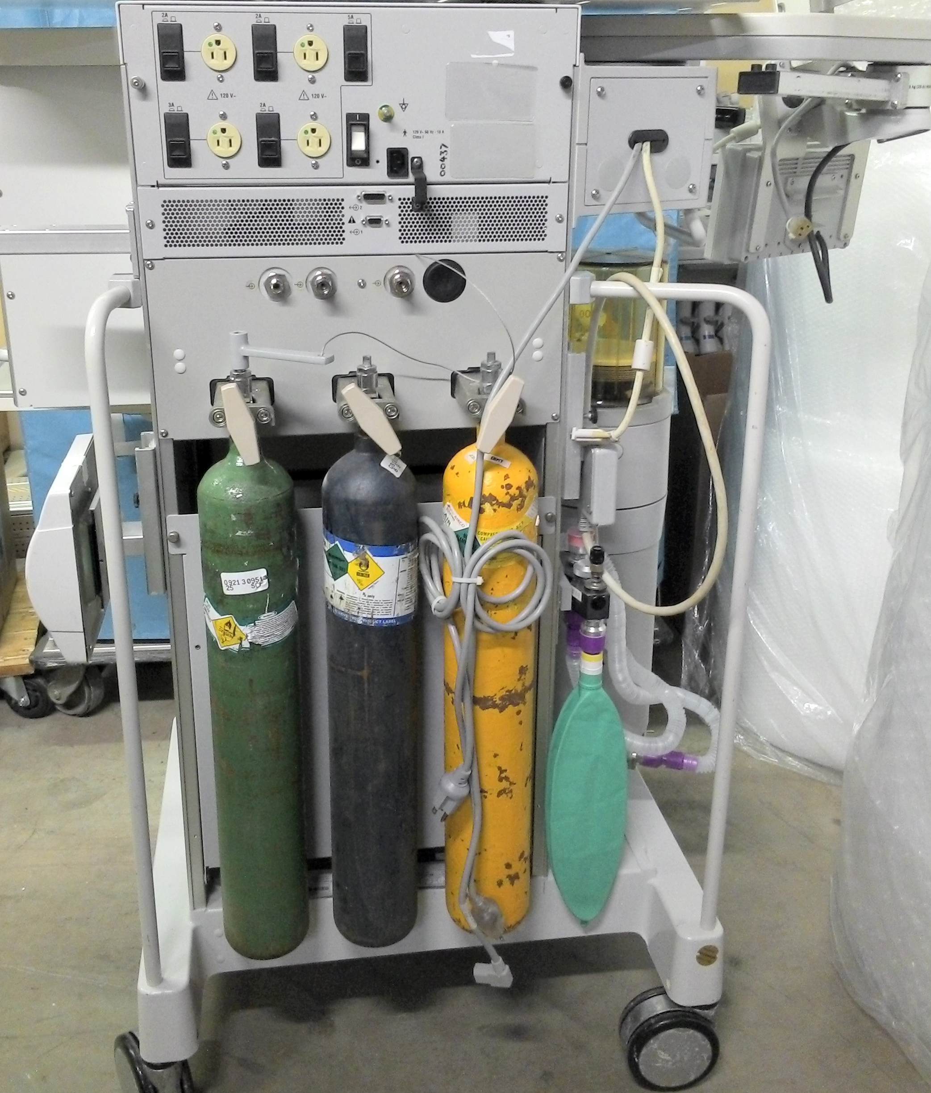
Modern Anesthesia Machine - Back

Slide 28
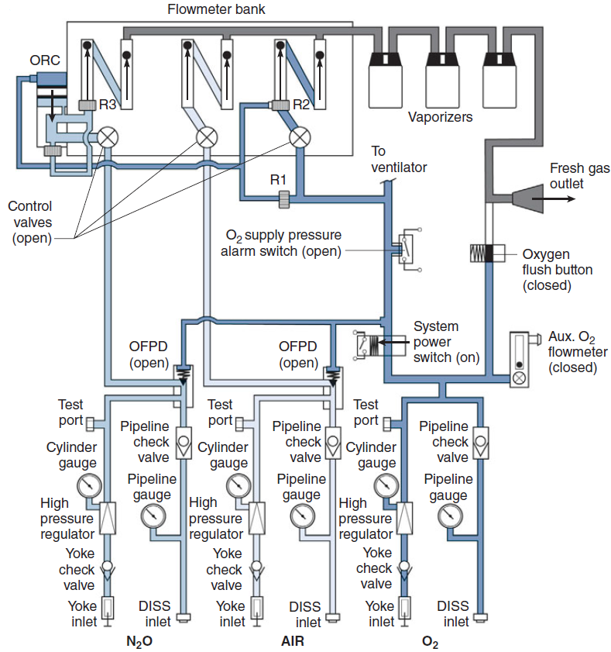
Internal Schematic Examples

Slide 29



Recommended Textbook
John F. Butterworth IV, David C. Mackey and John D. Wasnick, Morgan & Mikhail’s Clinical Anesthesiology, 5th Ed., McGraw-Hill Education, New York, 2013.
  Chapter 4
Rüdiger Kramme, Klaus-Peter Hoffmann, Robert S. Pozos (Eds.), Springer Handbook of Medical Technology, Springer-Verlag, Berlin, 2011.
  Chapter 30
Baha Al-Shaikh and‎ Simon G. Stacey, Essentials of Anaesthetic Equipment, 4th Ed., Churchill Livingstone, 2013.
  Chapter 2 (supplementary)

