Slide 1
Biopotential Amplifiers
EE 471
Prof. Yasser Mostafa Kadah

Slide 2
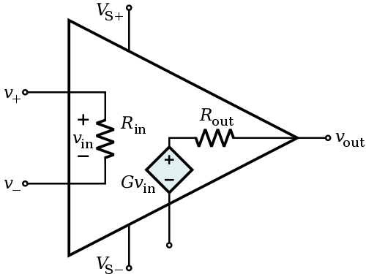
Op Amp Basics
Op Amp is a high-gain differential amplifier
Ideal Op Amp characteristics:
Gain is infinite
Input impedance is infinite
Output impedance is zero
Bandwidth is infinite
Ideal Op Amp rules for circuit design:
V⁺ = V– (input terminals have same voltage)
i+ = i– = 0 (no current through input terminals)
Basic design approach: design Op Amp circuit using ideal rules then check practical issues

Slide 3
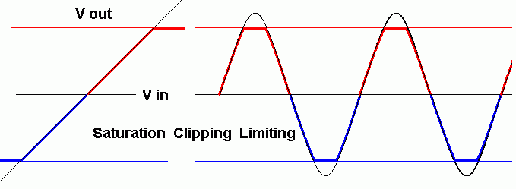
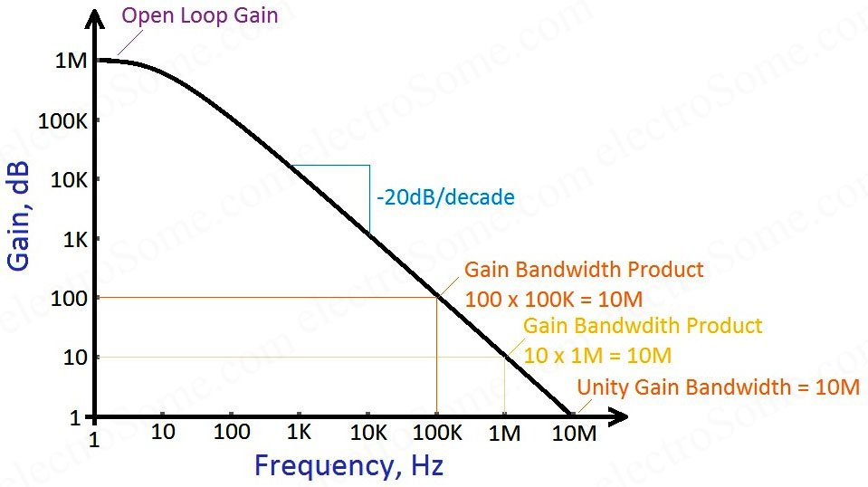
Practical Issues
Linear range limitations (saturation)
Depends on power supply range (slightly less) and Op Amp type
Gain-Bandwidth Product = Constant for a given Op Amp
Maximum gain determined by bandwidth of signal for a given Op Amp

Slide 4
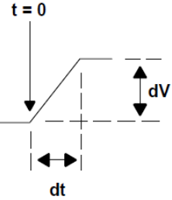
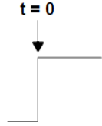
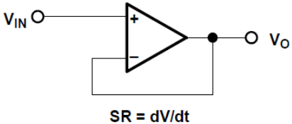
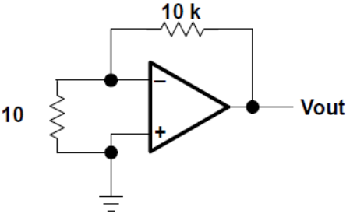
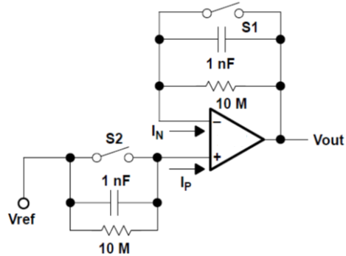
Practical Issues
Slew Rate: rate of change of voltage output per time
Identify maximum input frequency and amplitude applicable
to amplifier such that output is not significantly distorted
Offset voltage: small voltage between V⁺ and V–
Offset nulling available in some Op Amps
May also drift with time
Bias Current: small currents flowing into i+ and i–
Always use DC coupling for input terminals

Slide 5
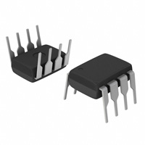
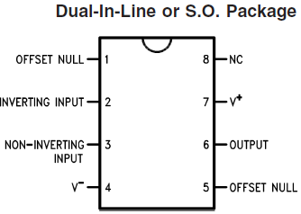
Practical Example: 741 Op Amp

Slide 6
Example Basic Op Amp Circuits

Slide 7
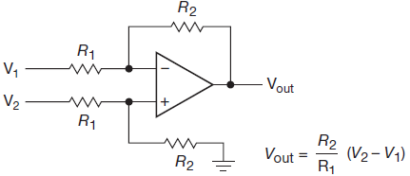
Example Basic Op Amp Circuits

Slide 8
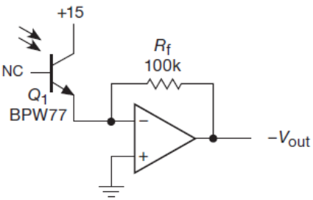
Photodiode/Transistor Amplifier

Slide 9
Comparator
Op Amp without Feedback
Schmitt Trigger

Slide 10
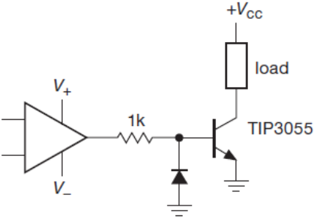
Power Switching
Note: Diode snubber is needed if load is inductive

Slide 11
Active Half-Wave Rectifier

Slide 12
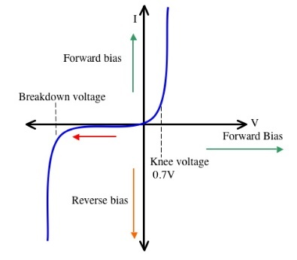
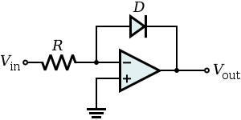
Absolute-Value and Log Amplifiers
Active full-wave rectifier
Logarithmic Amplifier: add output stage with diode feedback
Ebers-Moll relation: $I_{D}=I_{o}\exp\left(\frac{V_{D}}{nV_{T}}\right)−I_{o}$
Valid for $V_{D}$>0

Slide 13
Instrumentation Amplifier

Slide 14
Practical Example: AD620

Slide 15
Final Notes for Op Amp Circuits
Check practical limitations to ensure validity of Op Amp rules
Feedback must be arranged so that it is negative
Must not mix up inverting and noninverting inputs
There must always be feedback at DC in op-amp circuit
Otherwise, op-amp is guaranteed to go into saturation

Slide 16
Active Filters
Detection of a wanted signal may be impossible if unwanted signals and noise are not removed sufficiently by filtering
Electronic filters allow some signals to pass, but stop others
To be more precise, filters allow some signal frequencies applied at their input terminals to pass through to their output terminals with little or no reduction in signal level
Passive Filters: Rely on passive R, L, and C components only
Active Filters: Involve Op Amps
Ideal Filter Response

Slide 17
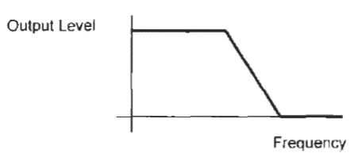
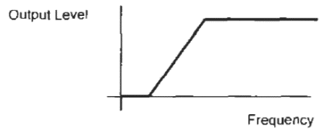
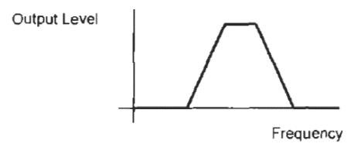
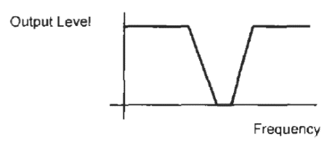
Practical Filter Response
Lowpass
Highpass
Bandpass
Bandstop

Slide 18
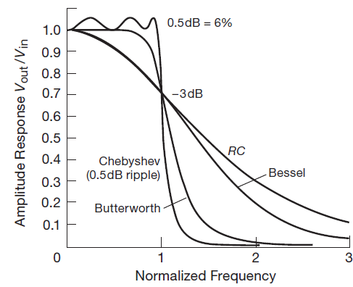
Common Filter Response Functions
Butterworth filter
Chebyshev filter
Bessel filter
Elliptic function (Cauer) filter

Slide 19
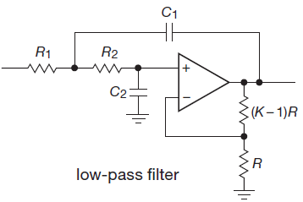
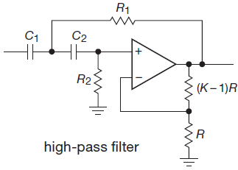
Sallen-Key Filters
Simple Sallen-Key Filters: Gain=1 and 2 poles (2nd order)
Voltage Controlled Voltage Source (VCVS) filters: Gain=K > 1
Low-pass filter
High-pass filter

Slide 20
VCVS Filter Design Using Table
To construct n-pole filter, cascade n/2 VCVS sections
Within each section, R₁=R₂=R, and C₁=C₂=C
Set gain K of each stage according to table entries
To calculate values for R and C:
Butterworth: use RC= 1/2πf_{c}
Chebyshev/Bessel: use RC= 1/2πc_{n}f_{c}
Example

Slide 21
Design of VCVS Other Filter Responses
Same low-pass filter design table is used for all filter types
To design high-pass filter, interchange R and C components
Butterworth: everything else remains unchanged
Bessel and Chebyshev: K values remain same, but normalizing factors c_{n} must be inverted (i.e., 1/c_{n})
To design band-pass filter, cascade overlapping lowpass and high-pass filters
To design band-reject filter, sum outputs of two non-overlapping low-pass and high-pass filters

Slide 22
Reading Assignment
Read Chapters 4, 5.15, 6 of Art of Electronics

