Slide 1

Cardiovascular monitoring
Prof. Yasser Mostafa Kadah
EE 471

Slide 2
Scope
Cardiovascular monitoring covers monitoring of heart and circulatory functions
It makes it possible to commence interventions quickly in the event of any impairment
Measurements are used to assess the condition of the patient, reach a diagnosis, decide on therapy, and monitor therapy
Covers cardiac function in the form of electrical phenomenon (ECG) and its mechanical effects including pressure build-up and volume delivery, contractility, preload, and afterload

Slide 3
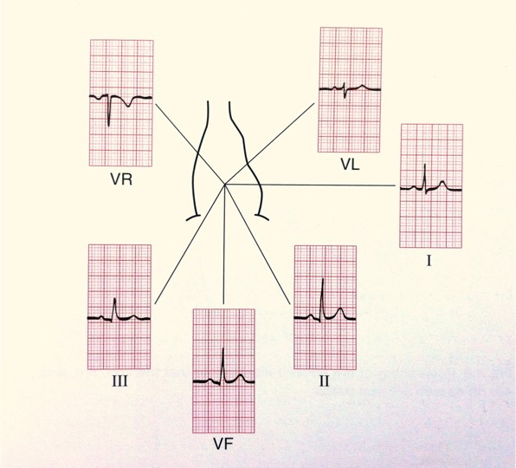
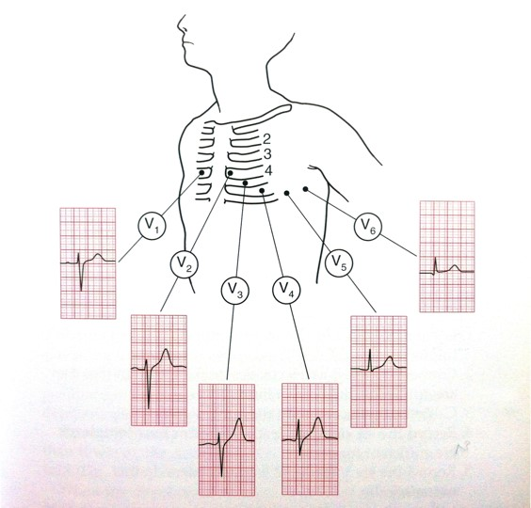
Electrocardiogram (ECG)
ECG provides information about heart rate and rhythm, excitation, conduction, and repolarization and disturbances in these functions
ECG does NOT provide any direct information about pumping capacity of heart
  No direct information about mechanical cardiac function

Slide 4
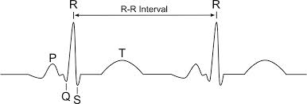
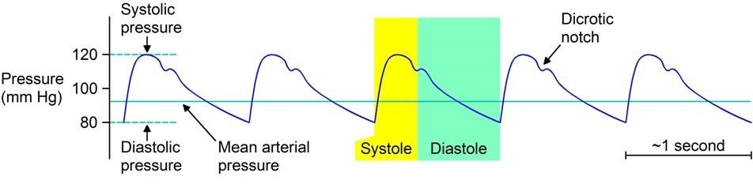

Heart Rate (HR)
Alternative to ECG that can be used when there are interferences in ECG
  Example: During cauterization in operating room
Basis of heart rate measurement is detection of QRS complexes in ECG and assessment of R-R intervals as the period of ECG waveform
  Determined as moving average over time (e.g., 10s), or specified number of QRS complexes
Can be computed as pulse rate from other signals
  Arterial blood pressure
  Plethysmography (SpO₂)

Slide 5
Hemodynamics
Study of flow of blood in circulatory system driven by pressure generated by heart
Vascular system is functionally divided into two systems connected and driven by heart
  Low-pressure system (small, pulmonary circuit)
  High-pressure system (large, systemic circuit)
Heart generates pressure in its contraction phase (systole), by means of which stroke volume (SV) is expelled from left ventricle into arterial vascular system
  Every stroke volume conveyed generates a pulse wave
  Peak pressure is systolic blood pressure (highest point of pressure curve)
  Pressure at end of relaxation phase (diastole) is referred to as diastolic blood pressure (lowest point)
  Difference between systolic and diastolic pressure is blood pressure amplitude or pulse pressure

Slide 6
Hemodynamics
Pressure that maintains blood flow in vascular system and act as driving force of perfusion is mean pressure
  In systemic circuit mean arterial pressure is termed APm (also MAP)
  In pulmonary circuit mean pulmonary artery pressure is termed PAPm
Stroke volume depends on preload, contractility of myocardium and afterload
  Preload is stretching of myocardium brought about by passive filling of ventricles at end of diastole and is best described by end-diastolic volume
  Afterload is force exerted by cardiac muscles to overcome resistance in outflow tract of left ventricle and peripheral circuit
    Mean arterial pressure and vascular resistance are measures of afterload

Slide 7
Hemodynamics
Several other factors also determine blood pressure behavior
  Elasticity of vascular system components
  Circulating blood volume and
  Peripheral vascular resistance
    influenced by wall tension of vessels (vessel tone) controlled by sympathetic nervous system
Delivery volume of blood per minute is known as Cardiac Output (CO)
  Calculated as product of stroke volume and heart rate
Control mechanisms in human body regulate circulation
  Adjusting cardiac output required to supply oxygen to organs and eliminate carbon dioxide
  Keeping blood pressure largely constant and adjusting circulation in individual organs and tissues

Slide 8
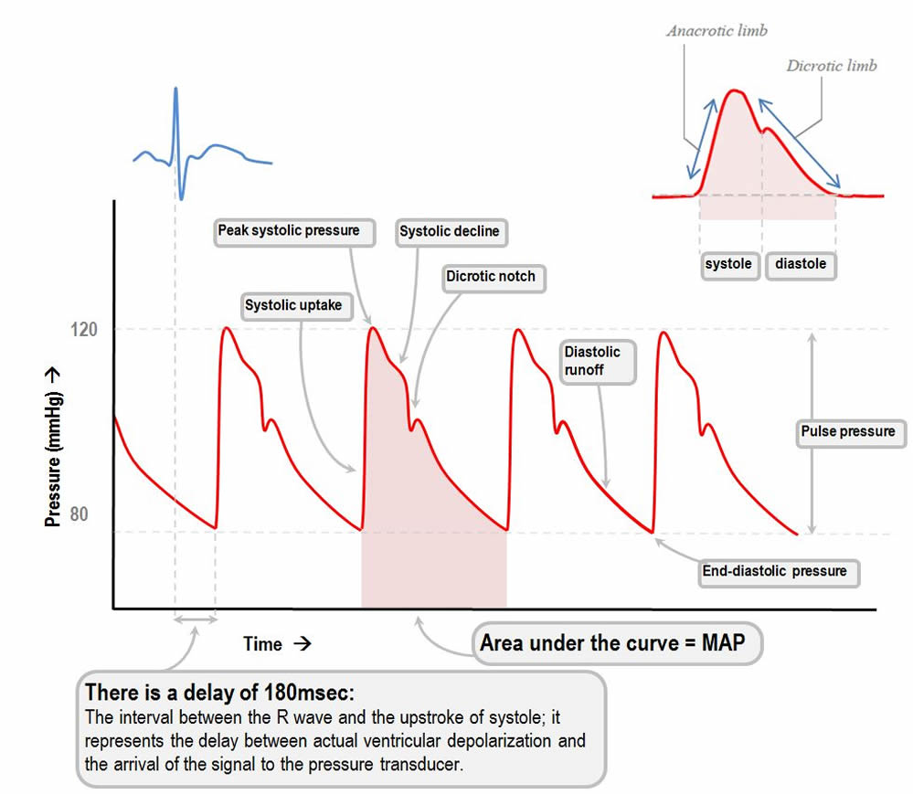
Hemodynamics

Slide 9
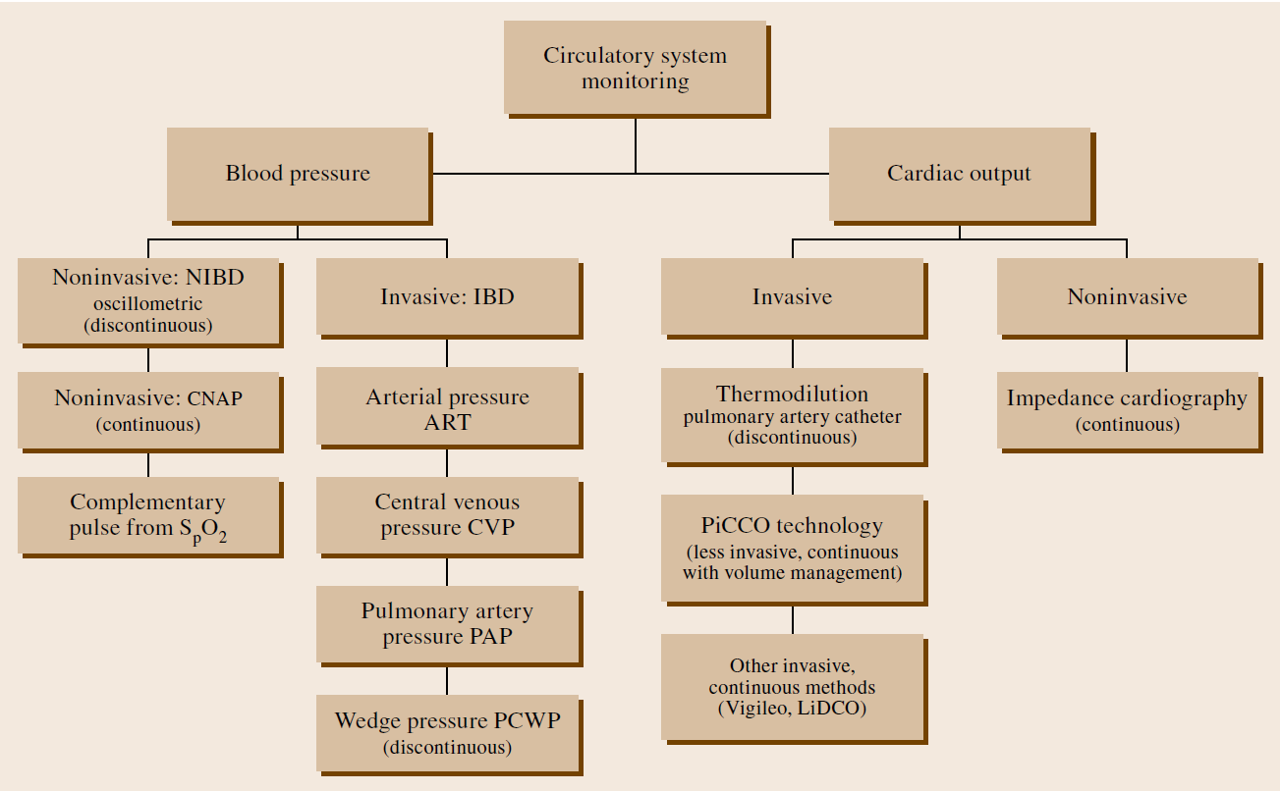
Hemodynamic Monitoring

Slide 10
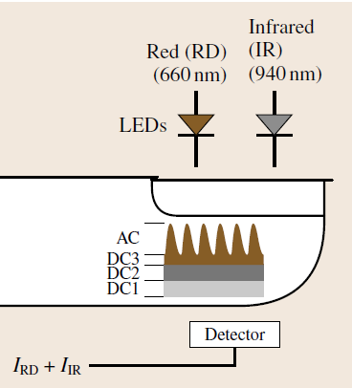
Pulse Monitoring
Pulse monitoring is performed either invasively from the arterial pressure curve or noninvasively from the plethysmogram of pulse oximetry
  Pulse monitoring has particular importance as a safety measure in such condition as monitoring pacemaker patients

Slide 11
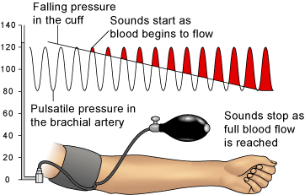
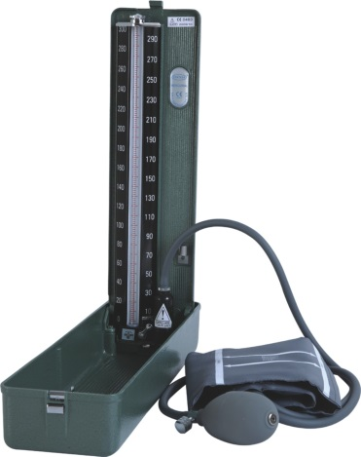
Discontinuous Noninvasive Blood Pressure (NIBP): Auscultatory Method
Sphygmomanometer using Auscultatory Method
  Cuff placed on exposed upper arm at the level of heart with middle of rubber bladder positioned over brachial artery
  After palpating brachial artery, cuff is inflated to ~30 mmHg above pressure at which pulse can no longer be detected
  Stethoscope is placed against brachial artery and cuff pressure is slowly released
  Pulsation that then begins causes knocking noises (Korotkoff sounds phase 1): systolic blood pressure is read off from manometer
  Sounds change until sound can no longer be heard (phase 5) and is measured as diastolic pressure
Note: Pressure in vascular system is highly dependent on activity and position of body (hydrostatic pressure), blood pressure measurements are always taken at rest and at height of heart (right atrium)

Slide 12
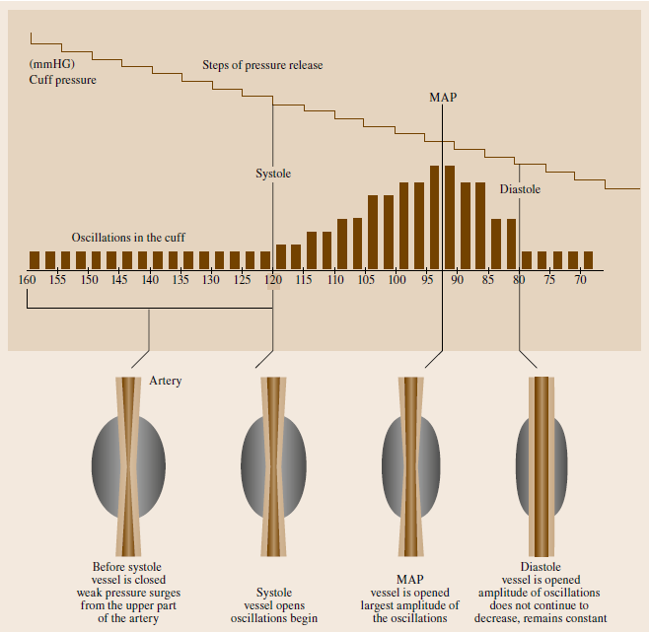
Discontinuous Noninvasive Blood Pressure (NIBP): Oscillometric Method
When cuff pressure is released once the systolic pressure has been reached, the vessel walls begin to oscillate and maintain this behavior until the vessel is no longer occluded
Oscillations are transmitted to air in cuff and are read on the manometer
Today, oscillations are measured electronically using pressure sensors

Slide 13
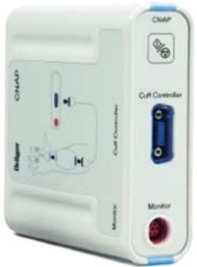
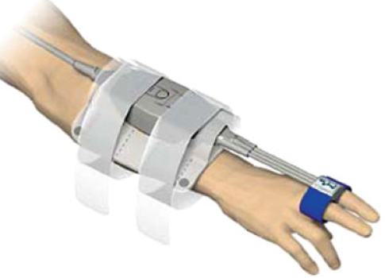
Continuous Noninvasive Arterial Blood Pressure Measurement (CNAP)
Blood pressure is not always constant but can change within a matter of seconds
  In particular, during anesthesia, variations in blood pressure can arise and require immediate action
Noninvasive technique of relaxed arterial wall (vascular unloading technique or volume clamp method) uses optical sensor in small cuff around finger to measure volume pulses due to each heartbeat
  CNAP uses pairs of sensor cuffs, which are placed on adjacent fingers with one cuff used for measurement at any time and periodically automatically switched
    Venous stasis that naturally occurs during measurement on finger very quickly decreases after switch
Great advantage: calibration of continuous measurement with normal NIBP measurement
  Correct values are displayed even when fingers are not level with heart: Advantages of both NIBP and CNAP

Slide 14
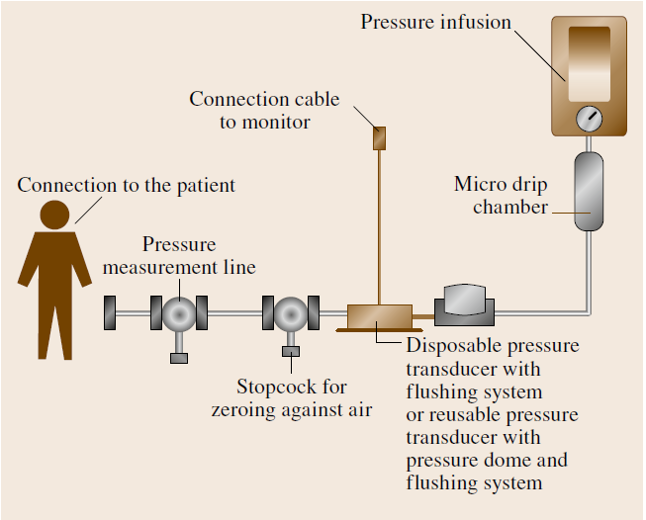
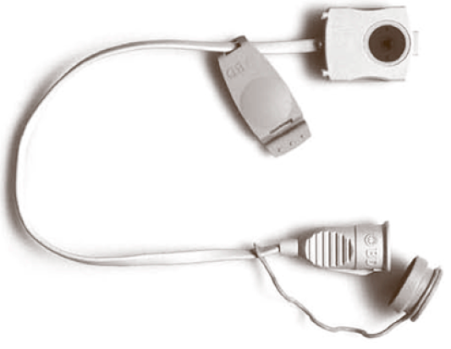
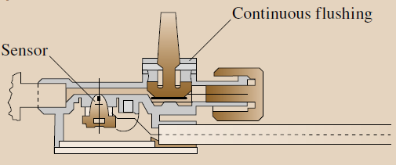
Invasive Pressure Measurement in High-Pressure System
Continuous availability of measurement signal (pressure curve) and pressure values
  Provides possibility of triggering alarm if predefined limit values violated and of further signal processing of measurement data
Connection is set up by means of intra-arterial catheter between intravasal blood column and liquid-coupled pressure transducer

Slide 15
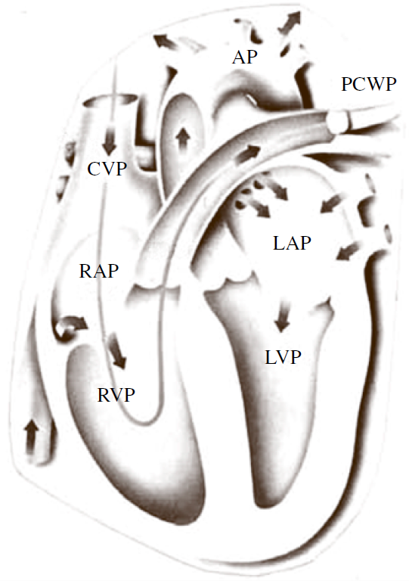
Invasive Pressure Measurement in Low-Pressure System
Aim is to obtain information about right ventricular function, pulmonary circuit, and filling of vascular system
  Central Venous Pressure (CVP)
  Pulmonary Artery Pressure (PAP)
  Pulmonary Capillary Wedge Pressure (PCWP)

Slide 16
Central Venous Pressure (CVP)
Measurement of the central venous pressure is by means of a liquid manometer or a pressure sensor using central venous catheter (CVC) placed in superior vena cava at the entrance to the right atrium
Pressure transducers have the advantage that measurement information is available continuously and certain signal characteristics of the CVP curve are additionally available
Because of small pressure values, it is important that pressure measurement system is situated level with heart (correct zero-point positioning) in order to avoid errors
  Hydrostatic pressure difference can cause incorrect measurements

Slide 17
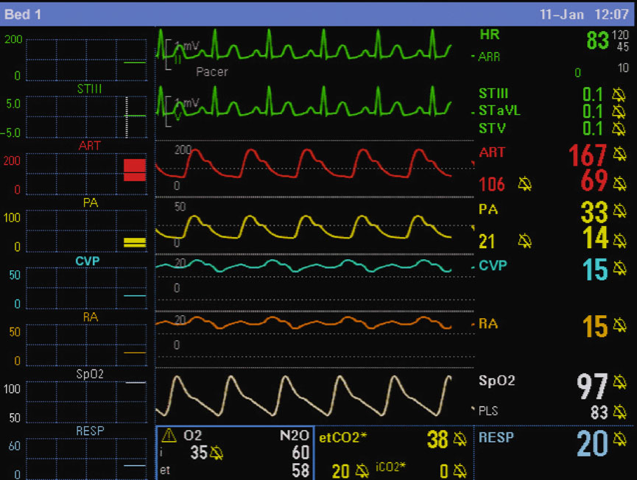
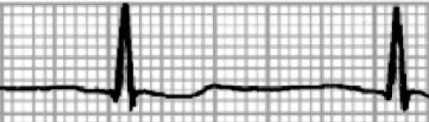
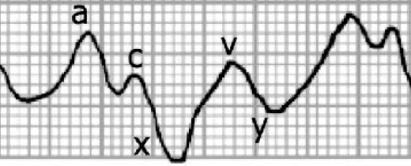
Central Venous Pressure (CVP)
Progression of CVP curve shows:
  Atrial contraction (a-wave)
  Beginning of the ventricular contraction (c-wave)
  Relaxation phase (v-wave)
Influenced by capacity of vascular system, cardiac output, blood volume, compliance of myocardium, and afterload of right ventricle

Slide 18
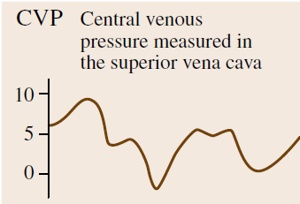
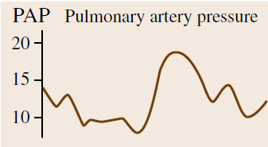
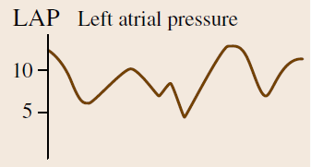
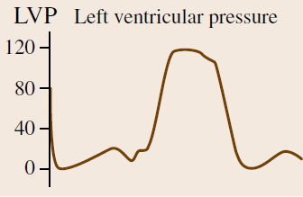
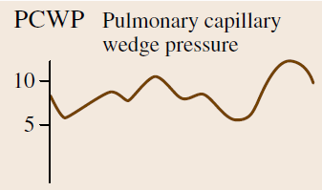
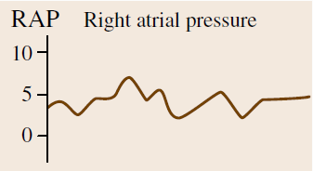
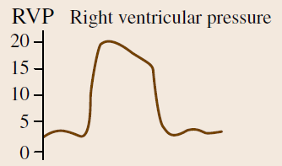
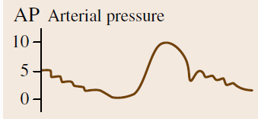
Pulmonary Artery Pressure (PAP) and
Pulmonary Capillary Wedge Pressure (PCWP)
To monitor hemodynamics of right ventricle, balloon catheter is pushed through venous system into right atrium, right ventricle, and then through pulmonary valve into arteria pulmonalis
  Path of catheter is followed from different typical pressure curves

Slide 19
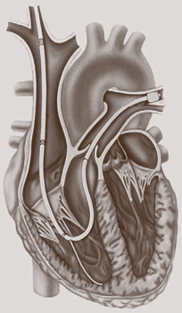
Pulmonary Artery Pressure (PAP) and
Pulmonary Capillary Wedge Pressure (PCWP)
Correct catheter position is reached once in wedge position
  That is, once inflated balloon of the catheter blocks off the pulmonary artery branch
If tip of catheter rests against wall of pulmonary artery (pseudo-wedge), this causes damping of pressure curves when balloon is filled and there is continuous rise in pressure
Although catheter is in right ventricle, in wedge position pressure in left atrium can be inferred via distal lumen
  PCWP value corresponds in first approximation to left atrial pressure (LAP) and thus to end-diastolic filling pressure in left ventricle
  Left atrium, pulmonary capillaries, and pulmonary artery under normal conditions form common pressure connection during diastole

Slide 20
Balloon Catheters
Using balloon catheters, CVP, PAP, and core body temperature can be measured simultaneously, and PCWP and CO can be measured intermittently
  Pulmonary artery catheters or Swan–Ganz catheters with different length and thickness, number of lumina, position of lumen exit sites, and other characteristics;
    Specialized balloon catheters provide additional possibilities such as intracardial ECG measurement, supraventricular and ventricular stimulation, measurement of mixed venous oxygen saturation SvO₂ with integration of fiber optics, transluminal stimulation probe, or additional infusion lumina
Balloon catheters are not free of risks and can cause complications
  Supraventricular and ventricular arrhythmias
  Ventricular tachycardia or ventricular fibrillation (rarely)
  Venous thrombosis (particularly with a low CO)
  Sepsis (risk rises as the duration of catheterization increases)
  Pulmonary infarction (due to catheter occlusion of peripheral pulmonary artery)
  Pulmonary artery rupture (by balloon inflation or the catheter tip).

Slide 21
Indicator-Dilution Method: Continuous Infusion
When given quantity m_{o} of indicator is added to volume V, resultant concentration C=m_{o}/V
When additional quantity m of indicator is then added, incremental increase in concentration is ΔC= m/V
When fluid volume in measured space is continuously removed and replaced as in flowing stream, we must add fixed quantity of indicator per unit time to maintain fixed change in concentration ΔC= (dm/dt)/(dV/dt)
Hence, flow rate can be given as

Slide 22
Determining Cardiac Output (CO) with Fick Method
Cardiac output is volume of blood conveyed per minute (l/min)
Classical way of determining CO is by Fick Method (O₂ as indicator)
  CO is ratio of oxygen consumption (VO₂) in the body and difference in oxygen content (avDO₂) between arterial blood flowing to the body and mixed venous blood returning from body
Example: Calculate CO given the following data:
Spirometer O₂ consumption: 250 ml/min
Arterial O₂ content: 0.2 ml/ml
Venous O₂ content: 0.15 ml/ml
Practical Problem: O₂ consumption cannot be measured with sufficient accuracy in clinical environment

Slide 23
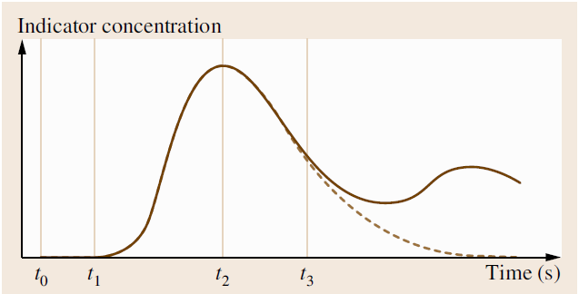
Indicator-Dilution Method: Rapid (Bolus) Injection
Bolus of indicator is rapidly injected into vessel and variation in downstream centration of indicator is measured until bolus has passed
  Implemented with dye, cold, ions, radioisotopes dilution methods
Introduction of thermistor catheter by Swan and Ganz (1970s) made thermodilution by means of pulmonary artery catheter established as leading method for clinical use

Slide 24
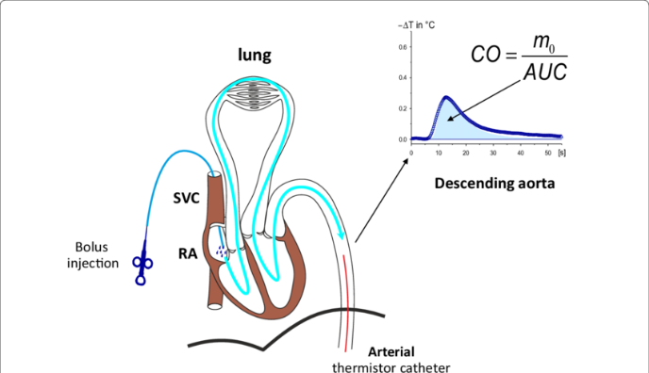
Thermodilution Method
Defined amount of saline solution at a temperature of 0–25 ◦C is injected into right atrium via proximal port of the multi-lumen pulmonary artery catheter
  The lower the temperature, the more accurate the measurement
Because injected fluid is mixed with warm flowing blood (37 ◦C) and is therefore diluted, change in temperature in blood stream can be measured by thermistor situated close to tip of catheter
  Shape and area of dilution curve change with cardiac output
With known temperature of injected fluid and blood as well as known volume of injected fluid, measuring system determines CO from the area of thermodilution curve

Slide 25
Thermodilution Disadvantages
Need for pulmonary artery catheter with its associated risks
  Connors et al. (JAMA, 1996): “RHC is associated with increased mortality and increased utilization of resources”!
Discontinuity of measurements
  This was overcome by emitting heat pulses to the blood using special pulmonary artery catheter and by evaluating their dilution curve
  Since heat pulses can be applied at very short intervals (30–60 s), this virtually provides continuous measurement

Slide 26
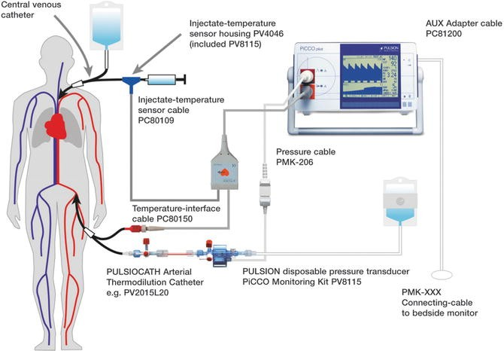
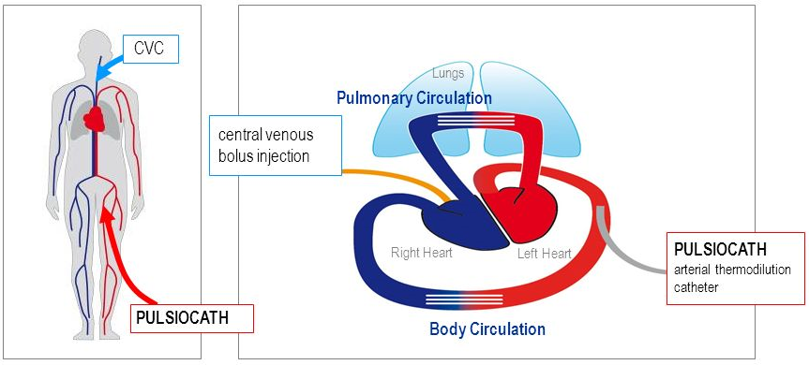
PiCCO (Pulse Contour Cardiac Output) Technology
Thermodilution can in principle be done transpulmonarily
  Cold bolus passes through lungs with thermistor placed in arterial system
Cold bolus is injected into right atrium as in normal thermodilution except with normal central venous catheter (more common)
  Temperature profile is measured in arteria femoralis
Advantage of this method: less invasive
  Omission of pulmonary artery catheter and its risks

Slide 27
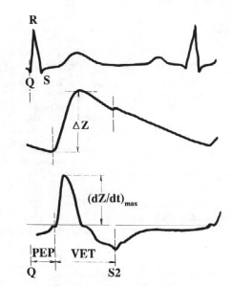
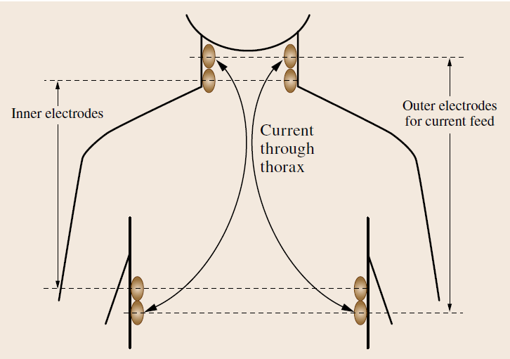
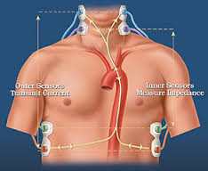
Impedance Cardiography
It has long been known that blood volume expelled with each heartbeat (stroke volume) leads to measurable variations in thoracic impedance
  Estimation of stroke volume and CO from variations in thoracic electrical bioimpedance (TEB)
Weak high-frequency current (e.g., 2.5mA, 70 kHz) is passed through thorax by means of external ring electrodes (or special double electrodes) arranged on neck and thorax
  Current seeks path of least resistance, which is essentially blood-conducting aorta and voltage drop is measured by inner measuring electrodes
Offers several advantages
  Completely noninvasive and low risk
  Continuous beat-to-beat measurement
  Easy to apply
Cannot be used in some cases
  Example: septic shock patients
ICG

Slide 28



Calculation of Hemodynamic Variables
Total Peripheral Resistance (TPR), also called Systemic Vascular Resistance (SVR), is resistance of systemic circuit, computed as quotient of propulsive pressure difference (Mean Arterial Pressure APm - Central Venous Pressure CVP) and flow (CO)
Pressure difference in small circuit is Mean Pulmonary Pressure minus Wedge Pressure PCWP (as a measure of the left atrial pressure). The Pulmonary Vascular Resistance (PVR) is given as:

Slide 29
Reading Assignment
Chapter 48 of Springer Handbook of Medical Technology
Sections 8.1-8.2 of Webster’s Medical Instrumentation

