Slide 1

Defibrillator
Prof. Yasser Mostafa Kadah
EE 471

Slide 2
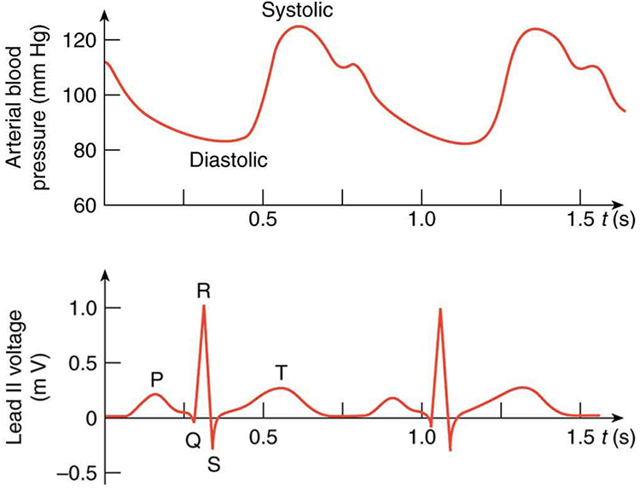
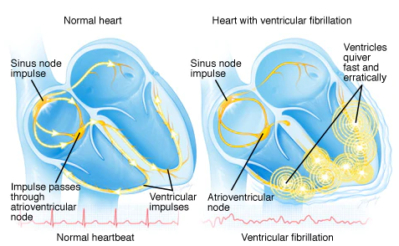
Cardiac Physiology
The heart is a synchronized double pump
  Right part pumps blood to lungs, left part pumps to body organs
  Heart pumps blood effectively only when contractions of all muscle fibers are precisely synchronized
Several conditions compromise the heart’s pumping ability
  Some, like VF and rapid ventricular tachycardia (VT), can be corrected by an electric shock
  Others, like bigeminy, are not shockable – must be avoided by careful reading of ECG before shock

Slide 3
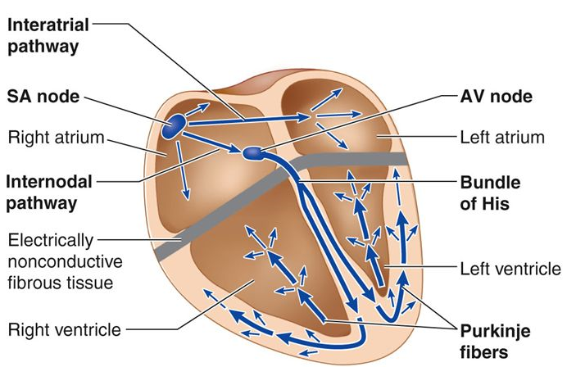
Defibrillator Basics
Defibrillators apply electric shock to establish more normal cardiac rhythm in patients experiencing ventricular fibrillation (VF) or another shockable rhythm
  Brief pulse of energy intended to cause simultaneous depolarization of all myocardial fibers
  Objective: to terminate tachycardic arrhythmias so that SA-node resume primary pacemaker function again
The earlier defibrillation occurs, the better the chances for survival
  For every minute that passes after the onset of VF, the chance of survival decreases by 10%

Slide 4
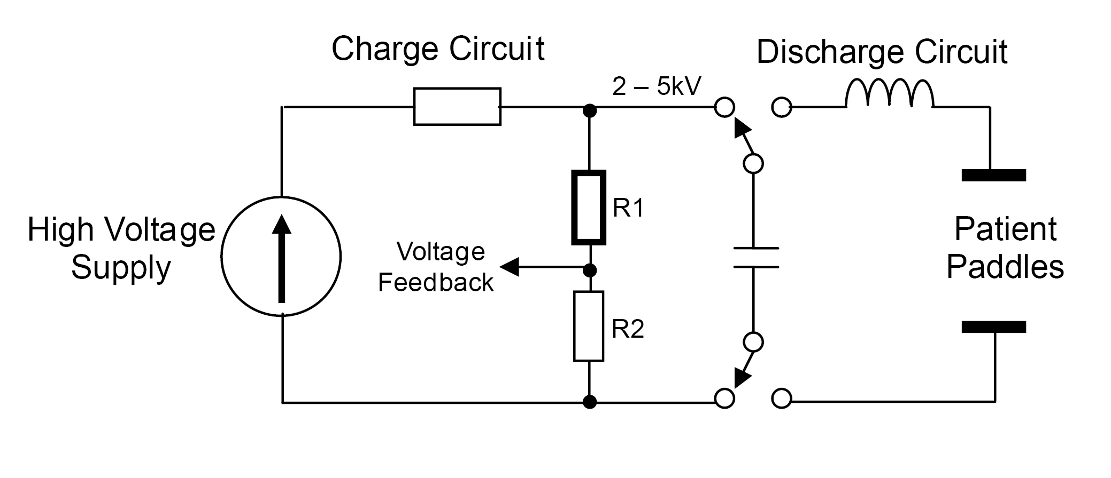
DC Defibrillator Components
Energy supply via rechargeable batteries that are charged by mains connection
Capacitor as energy store (E = ½ C V²)
Charging circuit for capacitor
Discharge circuit to deliver current pulse at different, preselectable energy levels
  Pulse range: 3-8 ms at current of 10–27A (internal) and 22–60A (external)
ECG monitoring and analysis to ensure shock is applied for only shockable arrhythmias

Slide 5
Defibrillator Waveform
Defibrillator waveform is a graph of the current delivered versus time
  Shape of wave dictates how much energy is supplied to patient and over what period this energy is administered
  Optimum amount of energy for defibrillator pulse is amount of energy which causes least myocardial damage
Until recently, all external defibrillators used monophasic waveforms
  Most, if not all, defibrillators entering the market today offer biphasic waveforms

Slide 6
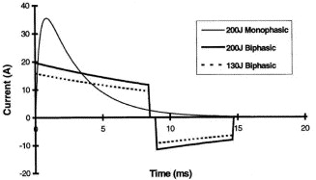
Defibrillator Waveform: Biphasic Advantages
Studies suggest that patients who receive biphasic shocks have a more normal post-shock rhythm than patients who receive monophasic shocks
More effective on first shock and gentler on heart with less dysfunction
Defibrillation success achieved with lower energy and voltage
  Device-dependent amount of energy is 150–200 J for first defibrillation and 200–360 J for all others, whereas it is always 360 J with monophasic wave
Whereas optimum energy flow in monophasic defibrillation is in range 30-40 A, with biphasic shock it is in range 15-20 A

Slide 7
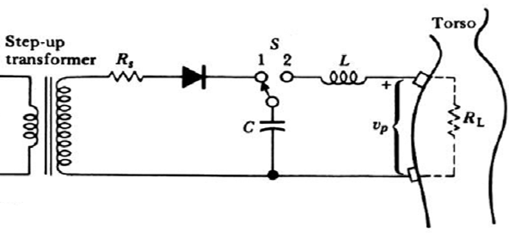
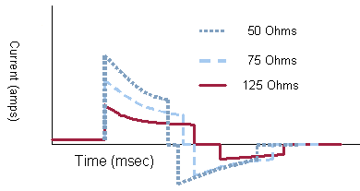
Thoracic Impedance
Definition: resistance in body which opposes energy pulse from defibrillator
Ranges between 15 and 150 Ω; usually it is 70–80 Ω
Must be taken into consideration when necessary energy is administered, as patient’s thoracic impedance is crucial to amount of energy required
Because impedance varies to large degree in humans, dynamic adaptation of energy pulse waveform (e.g., peak-to-peak voltage and pulse duration) is important feature
  Modern devices automatically measure thoracic impedance and take into account before defibrillation to deliver energy more accurately

Slide 8
Defibrillator Types
Divided into manual, semiautomated, and fully automated external defibrillators, in addition to defibrillator implants
  Semiautomated: user is shown defibrillation recommendation, but trigger of pulse is done by user
  Fully automated: everything is done by device

Slide 9
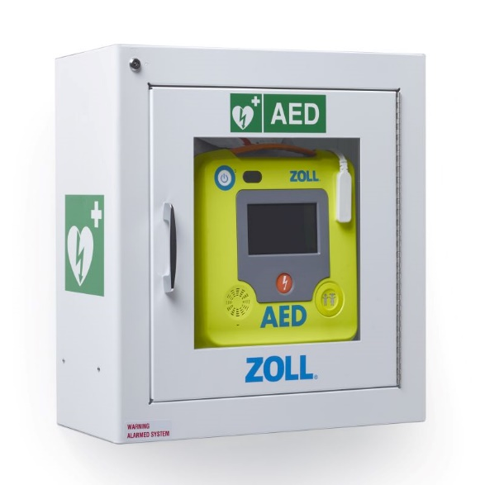
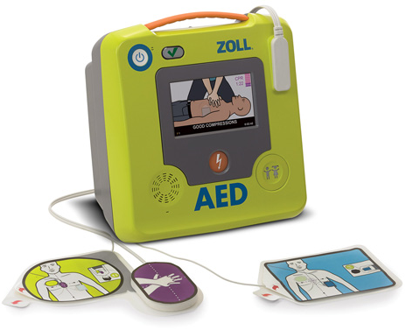
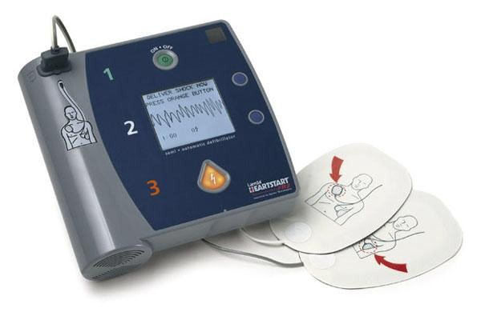
Automatic External Defibrillator (AED)
AEDs differ from conventional manual defibrillators in that AEDs can analyze the ECG rhythm to determine whether defibrillation is necessary
  This eliminates need for user to interpret cardiac rhythm before delivering shock
  AEDs are designed to be used primarily by first responders to cardiac emergencies, who may not be fully trained in cardiac life support
Semiautomated operation
  Device determines defibrillation settings but administration of pulse is triggered by user
Fully automated operation
  Everything is done by device

Slide 10
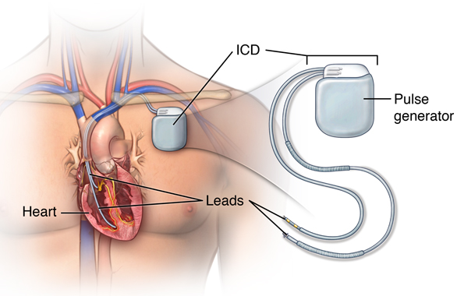
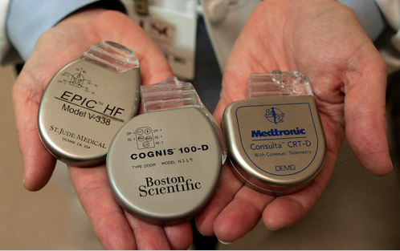
Cardioversion
Operating modes: synchronous and asynchronous operation
  Synchronous: heart’s own pulses are taken into account (QRS triggering)
  Asynchronous: reserved for strictly emergency defibrillations
Synchronized defibrillation is referred to as cardioversion
  Pulse of energy is triggered by R wave in the ECG
  Synchronization is carried out to prevent pulse being delivered in vulnerable phase (T wave) and to prevent risk of ventricular fibrillation being triggered
Application: implantable cardioverter-defibrillator (ICD)

Slide 11
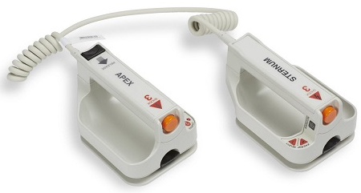
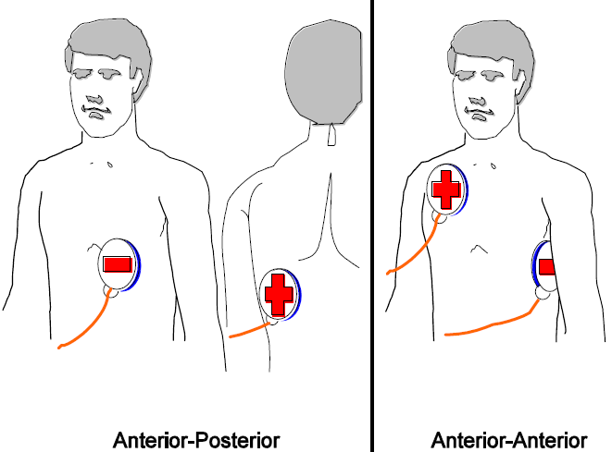
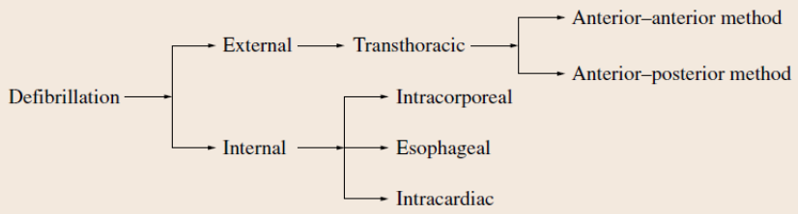
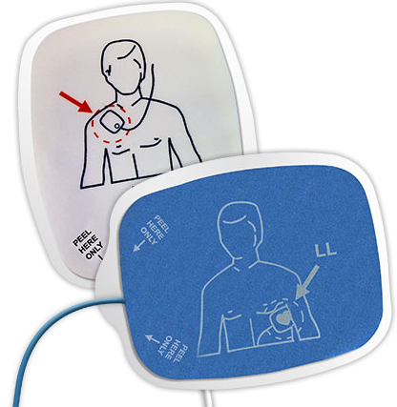
Electrodes and Contact Agents
Adhesive electrodes (pads) preferred
  Quicker to administer the first pulse of energy
  Possible to defibrillate from safe distance and without leaning over patient
  Gel pads: contact gel included – avoid risk of arcing and short circuit
Normal plate electrodes (paddles)
  Contact gel needed between skin surface and metal plate to reduce skin impedance and better electrical contact and to prevent burns
AAMI standard recommends minimum area of 150 cm²
  Diameter of common electrodes is 8–12 cm for adults

Slide 12
Methodological Notes
All commercially available defibrillators are operated the same
As a rule, visual and/or audible signal generated when defibrillator is operational (when capacitor is charged)
Electrodes (with gel) placed firmly on thorax and pressed on, and preselected energy dose is triggered from handles
Practice of performing defibrillation 3 times within a minute using mono- and biphasic defibrillators is obsolete
  Replaced by delivery of single shock at full energy (one-shock strategy)
  Monophasic: 360 J, Biphasic: at least 150–200 J advised
Following shock, cardiopulmonary resuscitation (CPR) performed for 2 min before administering next shock if necessary
  Monophasic defibrillators: energy level is kept at 360 J
  Biphasic defibrillators: energy level is successively increased

Slide 13
Possible Complications of Defibrillation Use
Induced ventricular fibrillation as a result of incorrect triggering, which can ultimately lead to asystole (cardiac arrest)
  Currents > 10mA flowing through the heart can cause fibrillation in ventricles
Post-defibrillation arrhythmias
  Ventricular and supraventricular extra-systoles and ventricular flutter
Myocardial necrosis (death of heart muscle tissue)
Arterial embolisms
Burns and irritation of the skin, for example, due to insufficient amount of electrode contact paste being used on electrode surface
Injury to lung, collapsed lung, or bleeding in lung cavities
Developing hole in blood vessels

Slide 14
Technical Safety Aspects: Use
Avoid direct contact with electrodes (life-threatening), conductive contact with patients or people (safe distance)
There should be no moisture on patient’s skin (electrical bridge), and patient should also be positioned to be electrically isolated
Avoid using too much electrode contact paste on paddles
  Chance of electrical bridge forming with risk of short circuiting output
Only perform cardioversion if ECG is free from artifacts and if reliable ECG monitoring is possible
All other devices connected to patient must be defibrillation-proof
  Otherwise, they must be disconnected from patient during defibrillation
Caution should be exercised with patients with energized implants
  Functioning of implant may be restricted or suspended
  Implant itself may be damaged or even become unusable.

Slide 15
Technical Safety Aspects: Device
Defibrillators must only be used in explosion-proof atmosphere
Disconnect devices which are not defibrillator proof from patient
  Equipment labeled according to DIN-IEC 601 as defibrillator proof
Maximum energy 360 J
Trigger buttons only on both paddles (connected in series)
Protective circuits: ensure reduced power setting when defibrillator is switched off and ensure energy recovery no later than 1 min after defibrillator charging
Because of their unforeseeable and frequently changing use, defibrillators should always be connected to mains electricity at their device base locations so they are operational and ready for use

Slide 16
Reading Assignment
Read Chapter 28 of Springer Handbook of Medical Technology

