Slide 1

Electrocardiography (ECG)
Prof. Yasser Mostafa Kadah
EE 471

Slide 2
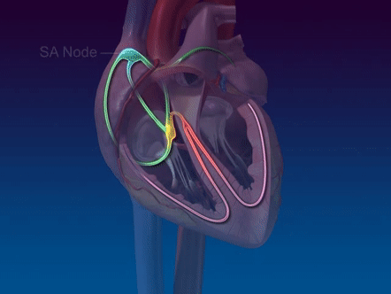
Cardiac Physiology
Heart is a synchronized double pump
  Right part pumps blood with low O₂ and high CO₂ to lungs
  Left part pumps blood with high O₂ and low CO₂ to body organs
Rhythmic contractions of myocardium are triggered by electrical impulses generated within heart and conducted via special conductive system embedded in myocardium
  Thus, heart cells are characterized by rhythmic autonomy or autorhythm

Slide 3
Control by Autonomous Nervous System
Autonomous nervous system can be separated into two antagonistic parts: sympathetic and parasympathetic
  SA-node, AV-node, and atrial myocardium: controlled by both
  Ventricular myocardium: essentially controlled by sympathetic only
Sympathetic activation causes:
  Positive chronotropic effect at SA-node: increase in heart rate
  Positive dromotropic effect at AV-node: shorten conductive delay
  Positive inotropic effect: increase contractility in myocardium
Parasympathetic activation causes opposite effects
  Only atrial myocardium is affected by negative inotropic effect

Slide 4
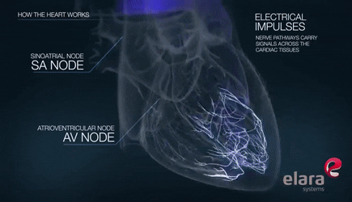
Diagnostic Signals: Vectorcardiogram (VCG)
As excitations spread via fibers in 3D, net magnitude and angle of all electrical excitations in the heart muscle changes
  Generates 3D vector trajectory called VCG
To record 2D projection of vector loop on given plane, two electrode pairs with their lead direction perpendicular to one another are used

Slide 5
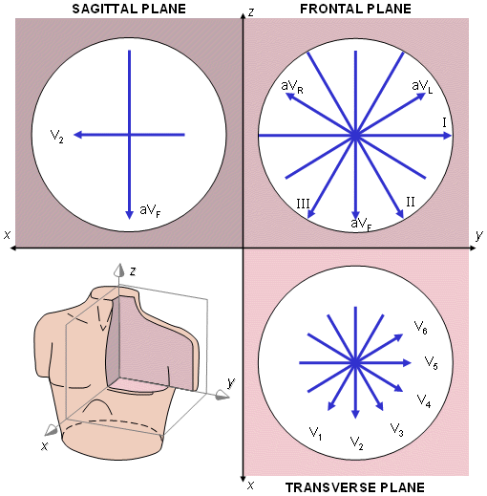
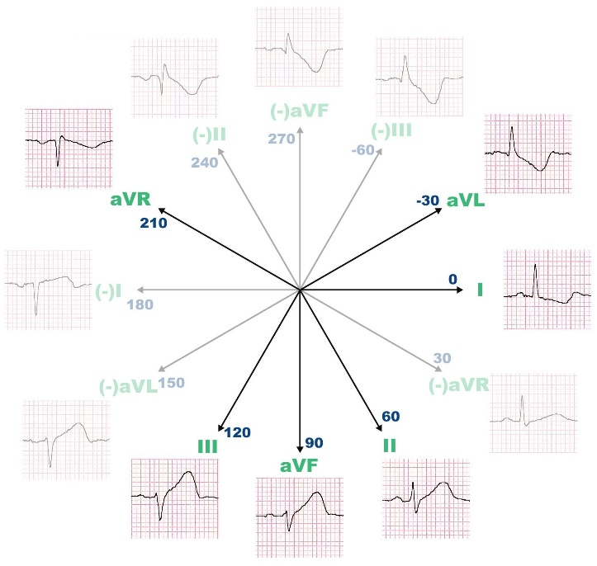
ECG from VCG: ECG Leads
3D VCG can be projected on one axis (lead direction) and represented as a function of time and get ECG
  ECG is 1D projection of VCG onto lead direction as a function of time
  First loop of VCG (atrial excitation): P-wave in ECG
  Second large loop of VCG (ventricular excitation): QRS-complex in ECG
  Third loop (repolarization) in VCG: T-wave in ECG

Slide 6
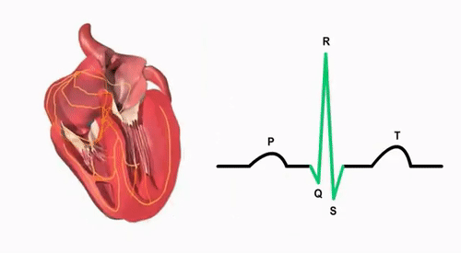
Diagnostic Information in ECG
Each section in ECG waveform corresponds to particular physiological event
  P-wave: atrial excitation
  PQ-segment: conduction of excitation to ventricles
  QRS-complex: spreading of excitation within ventricles up to complete excitation
  ST-segment and T-wave: repolarization of ventricles

Slide 7
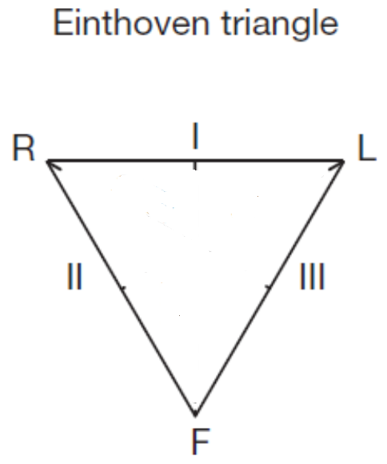
Einthoven Leads (Bipolar Limb Leads)
Positioning two electrodes at transition from thorax to arms (or on wrists) and third one near umbilicus (or on left ankle) yields three recording directions forming triangle in frontal plane of body
  Form Einthoven Triangle leads I, II, and III
  Additional lead, usually right leg, for grounding purposes

Slide 8
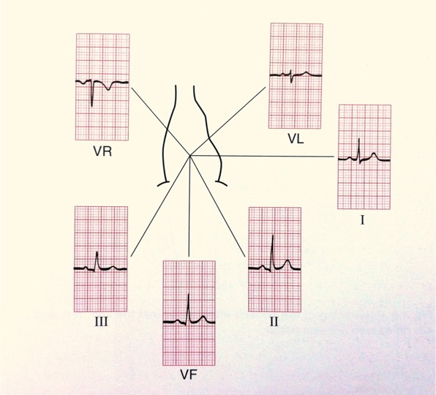
Goldberger Leads (Unipolar Limb Leads)
To ensure easier and more accurate detection of certain pathophysiological conditions, three further limb leads, also in the frontal plane, are often used: Goldberger leads
  Obtained by connecting pairs of Einthoven leads via two equal resistors and recording between third Einthoven lead and mid-point of resistors
  New leads: aVR (augmented voltage right), aVL (augmented voltage left), and aVF (‘augmented’ voltage foot)

Slide 9
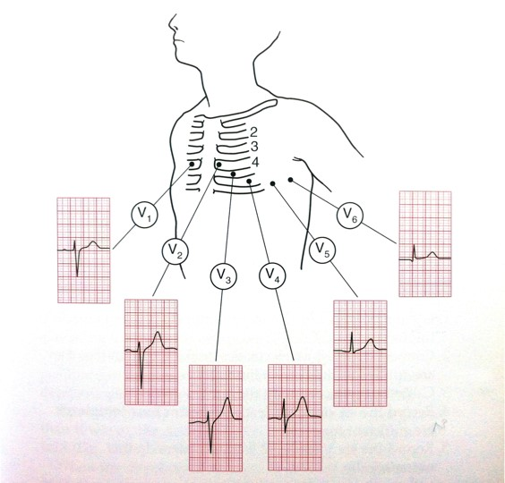
Wilson Leads (Unipolar Chest Leads)
Six further leads termed V1–V6 are used
  Potentials of six definite precordial points on chest surface measured against central reference point, achieved by connecting the three Einthoven electrodes via three identical resistors
  Recordings from Wilson leads are in horizontal plane and supplement information from other six frontal leads

Slide 10
Orthogonal Frank Leads
Three new orthogonal ECG leads Vx, Vy, and Vz using seven recording positions and suitable resistor network
  Now used as basis of more accurate VCG recordings

Slide 11
Normal ECG from 12 Standard Leads

Slide 12
ECG Lead Definitions and Color Code

Slide 13
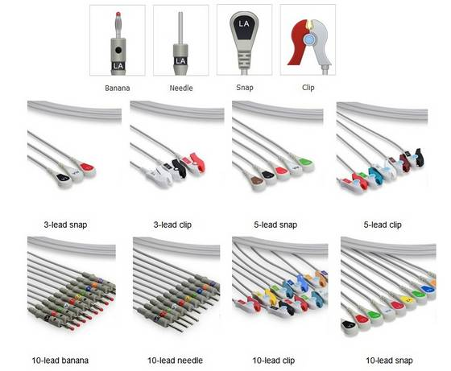
ECG Leads in Practice

Slide 14
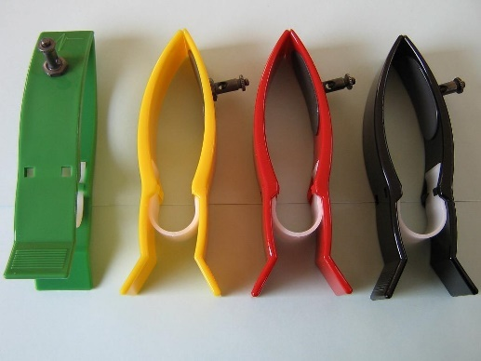
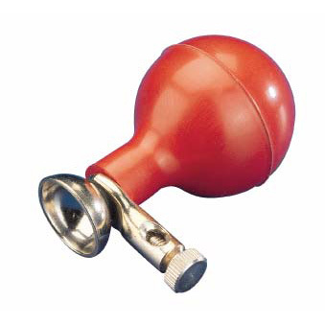
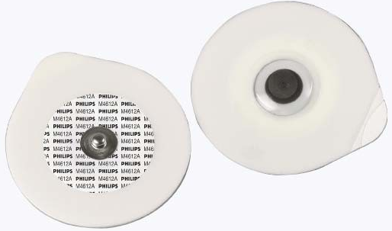
ECG Electrodes
General requirements
  Low electrical interface impedance
  High mechanical resistance
  Low interface (‘reversible’ or ‘half-cell’) potential
  Low distortion of signal
  Low polarization
Different shapes
  Metal-plate electrodes (reusable)
  Suction electrodes (reusable)
  Floating/hydrogel electrodes (disposable)

Slide 15
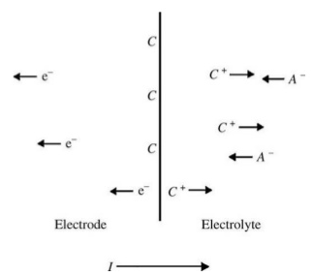
Electrode Operation
Electrode-electrolyte interface: double layer
  Local change in ion concentration near metal surface
  Charge neutrality is not maintained: half-cell potential at no current
Polarizable electrodes pass current between electrode and electrolyte by changing the charge distribution near electrode
  Serious limitations when movement is present and with low frequency biosignals
Non-polarizable electrodes allow current to pass freely across interface without changing charge distribution near electrode
  Preferred in most biomedical applications (e.g., Ag-AgCl electrodes)

Slide 16
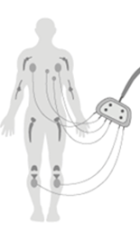
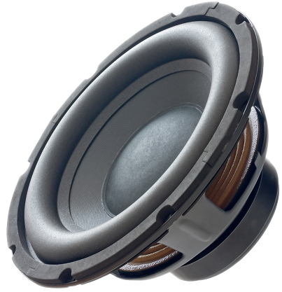
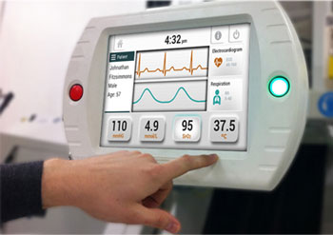
Typical ECG Signal Processing Chain
Inputs
Signal Selection
Signal Isolation
Electrode #1
Protection
Electrode #2
Protection
Signal Conditioning
Analog Filters
…
…
Analog
Signal
Electrode #N
Protection
Selection Lines
Analog
Output
…
ADC
DAC
Control Signals
Computer
Digital
Signal
User
Interface

Slide 17


Protection Circuit
Circuit 1: Limits voltage to within ±0.6 Volts
Circuit 2: Limits voltage to within ±V_{zener} Volts
Current- Limiting Resistance
Current- Limiting Resistance

Slide 18
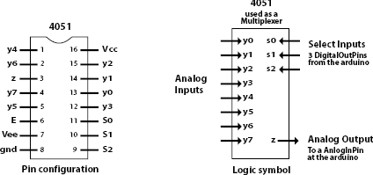
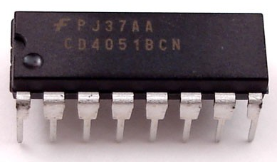
Signal Selection (Multiplexing)
Multiple signals to measure with only one chosen for display
  Example: ECG
Analog multiplexer (MUX) device allows desired signal to be selected from multiple inputs for further processing
  Example: 4051 8-Channel MUX/DeMUX

Slide 19
Signal Conditioning (Analog Front-End)
Biosignals are very weak
  Very low amplitude
  Very High output impedance
Biosignals are differential
  Instrumentation amplifier is required

Slide 20
Analysis of ECG Analog Front End
R_{S1} and R_{S2} are protection resistors
FS are voltage-limiting devices which limit input to amplifier
Diodes limit power supply to operating voltage
R_{S1} and C_{TP} constitute low pass filter eliminating higher noise frequencies induced via the cables
RE provides pathway for bias currents of amplifiers
Common-mode rejection of the circuit is adjusted by P₂
Active shield: Common-mode voltage at point A is connected to shield of cables to reduce effective cable capacitance and may reduce sensitivity of cables to motion artifacts
Active right leg: voltage at point A is also used to influence common-mode voltage itself where amplifier inverts and amplifies it before it is fed back via right leg to body compensating origin of common-mode voltage (e.g., coupling from power line) and also avoids direct connection of patient to ground, which is forbidden for safety

Slide 21
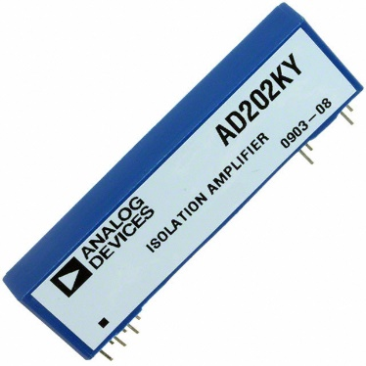
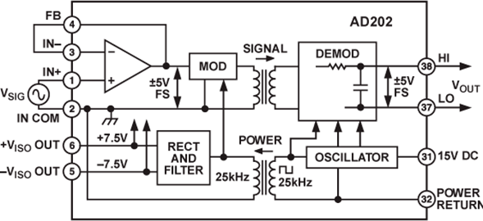
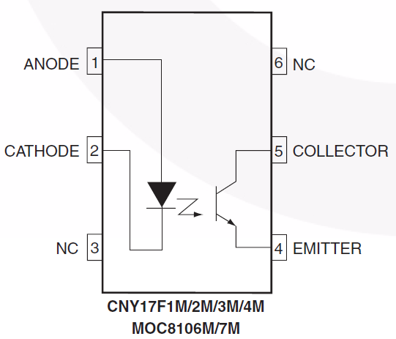
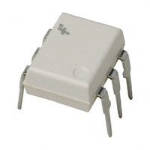
Signal Isolation
Isolation breaks ohmic continuity between patient and AC mains
  Requirement: isolation of both signal and DC power supply and ground
Transformer isolation
Optical isolation

Slide 22
Electric Fields Artifacts
Electric field coupling from nearby power lines to body is frequent cause of unwanted common-mode voltage
  Common-mode voltages UG >100 mV possible with 220–240 V power lines – underlines necessity of common-mode rejection in amplifiers
  Unbalance of electrode contact impedances and existence of common-mode voltage generate differential 50/60 Hz disturbance inputs UD to biopotential amplifier
Minimize by:
  High amplifier input impedance
  Care with selection and application of electrodes
    Cleaning of skin and use of electrode gel to avoid impedance mismatch

Slide 23
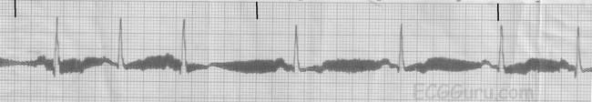
Electromagnetic Fields Artifacts
Alternating magnetic fields from power lines and from high frequency sources (e.g., communication or therapeutic devices) induce parasitic currents
  In combination with imbalanced impedances result in unwanted differential inputs
Minimize by:
  Wires tightly twisted to avoid aerial effect due to large area inductive loops
  Increasing distance from disturbing source
  Shielding magnetic fields
  Optimally choosing position of patient
  Optimally choosing orientation of leads

Slide 24
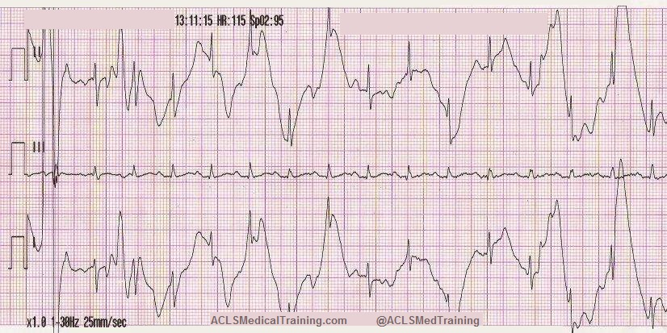
Motion Artifacts
Artifacts are largely due to deformation of skin under electrode
Minimize by:
  Nonpolarizable Ag–AgCl electrodes with low stable contact potentials
  Electrode gel to minimize skin impedance and stabilize skin potential
  Use of amplifiers with input current <10 pA
  Use of lightweight connections, leads, and wires
  Restricting patient movement
    If necessary, for short-term diagnostic applications, ask resting
    patient to stop breathing for a few seconds during measurement

Slide 25
Resistor Noise
All resistors between biosignal source and instrumentation amplifier contribute to noise
  Amplitude of noise is proportional to square of product of bandwidth and resistor value
Amplifier itself may constitute additional noise component
  Depends heavily on applied amplifier technology
Minimize by:
  Larger surface of electrode and use of conductive electrode gel reduce resistances at skin and electrode interface
  Use of low noise amplifiers

Slide 26
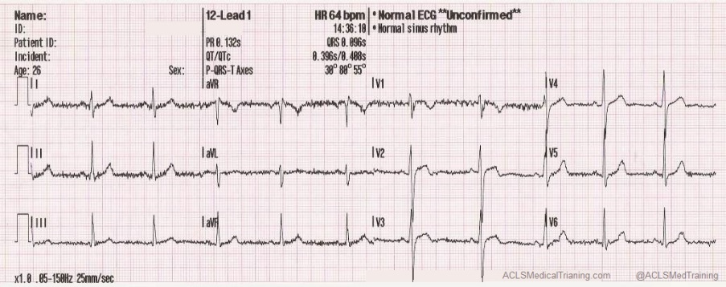
Interference from Other Biosignals
Electrical signals underlying muscle activity (EMG) can disturb ECG as muscles are generally located near ECG recording electrodes
  If possible, patient should not move and should be relaxed during ECG
  If patient movement is required or unavoidable, great care should be taken to choose electrode positions that are minimally influenced by muscle movement
Elimination of EMG-components may be achieved by adequate filtering
  ECG and EMG bandwidths overlap: such filtering can remove important ECG features

Slide 27
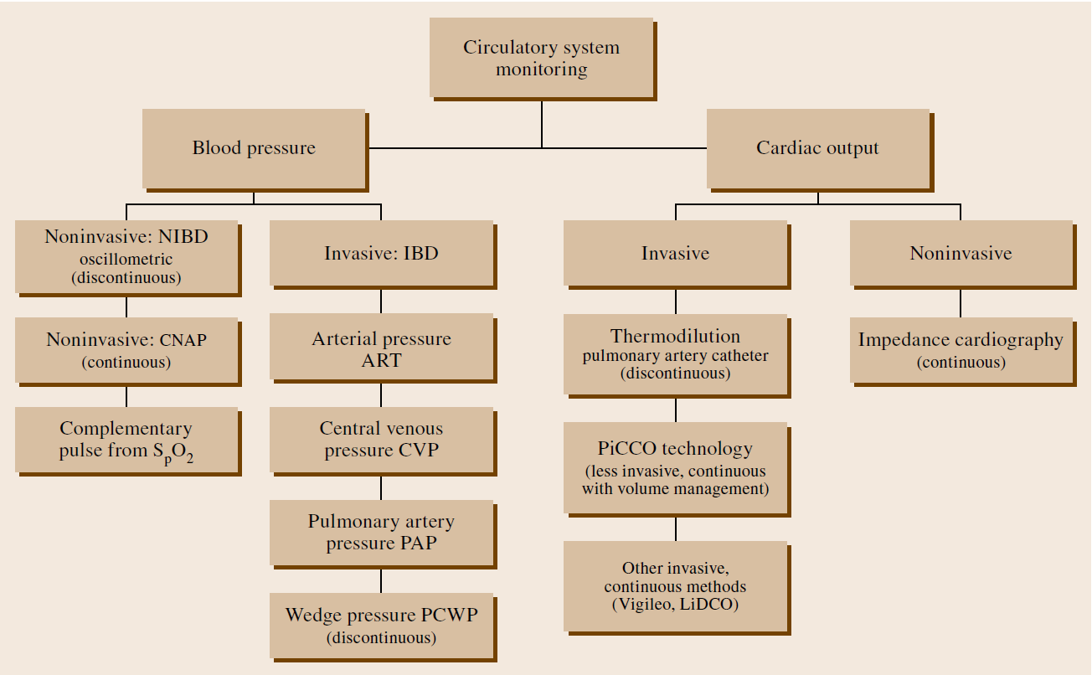
ECG in Context of Cardiovascular Monitoring
ECG provides information about electrical activity in the heart
  No direct information about pumping capacity (mechanical cardiac function)

Slide 28
Reading Assignment
Read Chapter 5.02 of Physics of Physiological Measurements

