Slide 1

High-Frequency Surgery
Prof. Yasser Mostafa Kadah
EE 471

Slide 2
Basics
High-frequency (HF) surgery can be defined as application of electrical energy in surgery for effecting thermally induced change or destruction of tissue cells with aim of hemostasis (stopping bleeding), cutting tissue, or sealing it
In HF surgery, high-frequency alternating current (preferably 0.3–4 MHz) is delivered by special applicators (or active electrodes) to tissue to be treated, where thermal tissue interaction takes place due to electrical resistance of tissue
HF surgery devices have many synonymous names
  HF surgery – RF surgery – radiosurgery – electrosurgery – cautery –electrocautery – diathermy – endothermy – transthermy – electrotomy
Today, HF surgery has become indispensable tool for all surgical disciplines for inpatient or outpatient care

Slide 3
Bioelectrical and Biothermal Effects: Electrolytic Effect
When electric current flows through biological tissue, bioelectrical and biothermal effects occur, depending on the type of current, current intensity, and frequency
With DC and low-frequency AC currents, electrolytic effect dominates where ion migration takes place in tissue
  Positively charged ions travel to the negative pole (cathode) and negatively charged ions to the positive pole (anode)
Effect is used in medicine in ionophoresis for transporting certain drugs into the body
In HF surgery this effect is undesirable as tissue’s cytochemical content can become damaged

Slide 4
Bioelectrical and Biothermal Effects: Faradic Effect
When AC currents with frequency of up to 20 kHz flow through biological tissue, faradic effect occurs
  Currents stimulate nerves and muscle cells, leading to muscle contraction
  Stimulus effect peaks at frequencies between 10 and 100 Hz
In HF surgery, this effect is undesirable as muscle contractions are painful, and possibly even dangerous for patient, and problem for surgeon
Nernst law of electrical nerve stimulus threshold

Slide 5
Bioelectrical and Biothermal Effects: Thermal Effect
With HF alternating currents, both electrolytic and faradic effects are largely prevented in biological tissue, and thus thermal effect dominates
  Frequency of alternating current is then at least 300 kHz
This desired thermal effect is mainly used for two different applications: cutting and coagulation
Amount of heat created in tissue mainly depends on specific resistance of tissue, current density, and duration of exposure
  Thermal effect is achieved through conversion of electrical energy into thermal energy
    Heat Q = I² R t = V² t / R (J)

Slide 6
Thermal Tissue Damage
Regardless of method used to heat tissue (HF current, laser, ultrasound, etc.), thermal effects can be classified qualitatively as follows:

Slide 7
Heat Equations of Coagulation
HF power P_{coag} required for coagulation can be calculated by using both heat quantity Q_{coag} and coagulation time t_{coag}
Heat quantity Q_{coag} depends on mass m_{coag} of tissue to be coagulated, specific heat capacity c_{coag}, and temperature difference Δt_{coag} within coagulum (≈ 37 ◦C to 60–100 ◦C) between start and end of coagulation period
Depending on coagulation technique used, additional quantity of heat Q_{env} also must be taken into account to represent unintentional dissipation of heat in surrounding current-carrying tissues
  Q_{env} is negligibly small for bipolar coagulation in comparison with Q_{coag}
  Q_{env} can at times be very large relative to Q_{coag} in monopolar coagulation
  Q_{env} always poses risk of undesired secondary effects to take into account
  Explains higher power value in monopolar coagulation compared to bipolar

Slide 8
Heat Equations of Coagulation
Heat created within active electrode during coagulation is Q_{AE}
  Temperature of active electrode should not rise during coagulation
    Creates layer of coagulum that can stick to active electrode
  If active electrode directly contacts coagulum, unavoidably heated
Heat balance equation:
  Q_{coag}: heat quantity required for coagulation
  Q_{AE}: heat quantity for active electrode
  Q_{env}: unintended surrounding heat quantity
  Q_{tot}: total heat quantity

Slide 9
Heat Equations of Cutting
HF power P_{S} required for cutting can similarly be calculated by using both heat quantity Q_{S} and the cutting duration t_{S} as:
When cutting, tissue volume proportional to length, average depth, and width of cut is heated so strongly that its water content vaporizes
  Heat quantity required for vaporizing water content in tissue (QS) consists of heat quantity Q₁₀₀ to heat tissue fluid from 37 to 100 ◦C plus heat quantity Q_{D} to evaporate boiling tissue fluid
Heat balance equation:
  Heat quantity Q_{U} for unavoidable heating of tissue not involved in cutting and heat quantity for unavoidable heating of active electrode Q_{AE}

Slide 10
Current Density Effect
Current density J plays key role in HF surgery
  Only if current density is sufficiently high (normal: 1–6 A/cm²) can desired cutting or coagulation effect be achieved
Current density decreases quadratically with distance r
  Temperature increase decreases as r⁴ with distance r

Slide 11
Electrical Model of Biological Tissue
Biological tissue mainly behaves like ohmic resistor
  Specific resistance in muscle tissue and well-vascularized tissue is low
  Specific resistance in tissues with little fluid content such as bones, cartilage, and fat have high specific resistance: low current flow

Slide 12
Monopolar Application Technique
Active and neutral electrodes must be connected to HF surgical device with physical effects produced at active electrode
  Neutral electrode covers far greater skin contact surface area to ensure that current density (current per unit area) remains relatively low
  Active electrode has small contact area to produce high current density
Neutral electrode also called:
  Plate electrode
  Passive return electrode
  Dispersive electrode
  Indifferent electrode
  (incorrectly) grounding electrode

Slide 13
Monoterminal Application Technique
Circuit is closed via the patient’s body capacitive contact to ground
  Special form of monopolar mode with no neutral electrode
  Increase in electromagnetic interference with other devices
Technique safe only for small working currents, hence only suitable for minor surgical interventions, e.g., dentistry and dermatology
  Only units with maximum HF output power of 50W should be used
  Higher output power could cause severe patient burns

Slide 14
Bipolar Application Technique
Both electrodes (active and neutral) in single instrument
  Current flows into tissue via one electrode and back via the other (no neutral electrode)
Advantages compared to monopolar technique:
  Current only flows through tissue held between two electrodes where thermal effect is intended
  Danger of patient burns by touching conductive objects during operation is negligible
  Reduced influence on cardiac pacemakers
  Lower interference with other devices
  No stray currents

Slide 15
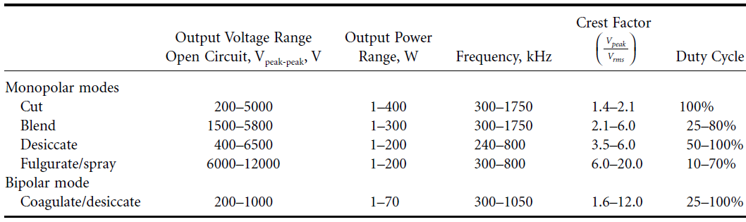
Types of Current and Their Application
HF current effect determined by time, voltage, and modulation

Slide 16
Cutting Currents
Tissue cutting only possible using HF current if voltage between active electrode and tissue is sufficiently high to generate electric sparks
  Distance small enough and minimum voltage of ≈ 200 V exceeded
Quality of cutting depends on several factors
  Size and shape of cutting electrode
    great difference between large-blade electrode or microneedle
  Type of cut and cutting speed
  Whether cutting is superficial or deep, incision speed is fast or slow
  Tissue properties
    Tissues with low electrical resistance (muscles, vessels), output voltage may break down – tissues with high electrical resistance (fat), effect is less

Slide 17
Coagulation Currents
Aim of coagulation is to denature tissue using HF current, or to constrict vessels to an extent where bleeding stops
  Coagulation effect mainly depends on level and form of output voltage, the current density in tissue, tissue resistance, form and size of active electrode, and application time
  To coagulate biological tissue, temperature of ≈ 70 ◦C is required
  At higher temperatures, glucose within coagulate dehydrates and tissue can stick to active electrode, and if higher carbonization of tissue result

Slide 18
Example: Spray Coagulation (Fulguration)
Spray coagulation uses very high pulsed and strongly modulated output voltages of several thousand volts (up to 8 kV) used (crest factor up to 20)
If user approaches tissue with small-area electrode (needle electrode) under spray voltage, air between tip and tissue is ionized at distance of 3–4 mm from tissue
  Via ionized air in electric field, spark discharges to tissue, followed by fur spark discharges spraying energy to tissue surface and coagulating relatively large tissue area
With ball electrode, weaker electric field at same distance
  Increases as distance gets smaller and ionization of air with accompanying spark
  discharge only present at closer distance with ball electrode

Slide 19
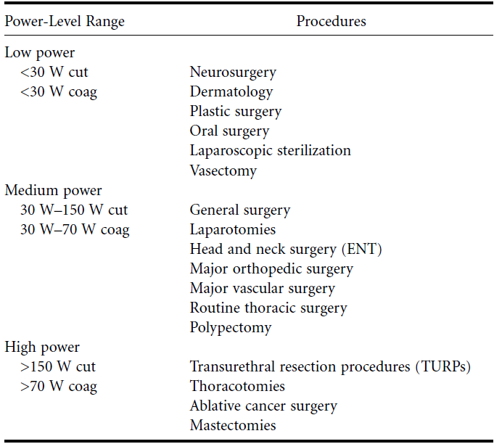
Typical Output Characteristics

Slide 20
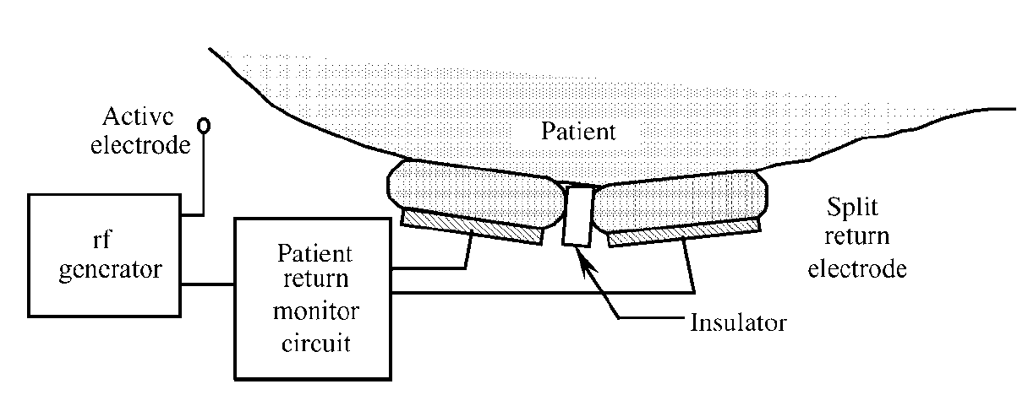
Neutral Electrode (NE)
In monopolar mode, thermal effect required exclusively at active electrode with no thermal reaction underneath (NE)
  To prevent patient burns, potential heating in NE application area must be kept below 6 ◦C
  Correct attachment of NE to make absolutely sure it does not detach during operation
  Advanced systems offer NE monitoring technology that keeps proper NE attachment under constant control and disarms monopolar HF energy delivery if problem detected
Original assumption that return flow of current from deep tissue layers was equally distributed across surface of neutral electrode was not correct
  Current distribution shows distinct current concentration at edges of NE (edge effect).
  Effect caused by layered structure of skin
    Dermis offering good conductivity over poorly conducting fat tissue layer
  If rectangular NE used, edge closest to target site offer least resistance
    Formation of hot spot
    Electrode as round as possible is therefore ideal

Slide 21
Rules for Proper Neutral Electrode Application
Ensure good tissue contact (e.g., shaving hair for proper contact)
Keep fluids away from the NE area, as these can adversely affect both adhesion and electrical properties of NE
Do not reuse disposable (single-use) NE
NE must not be trimmed or reduced in size
Additional contact gel should never be applied to the NE
Bony or uneven surfaces, implant sites, places with thick layers of fat (such as abdomen or buttocks), and scarred tissue are unsuitable for NE application
Use contact quality monitor that requires exclusive use of split Nes

Slide 22
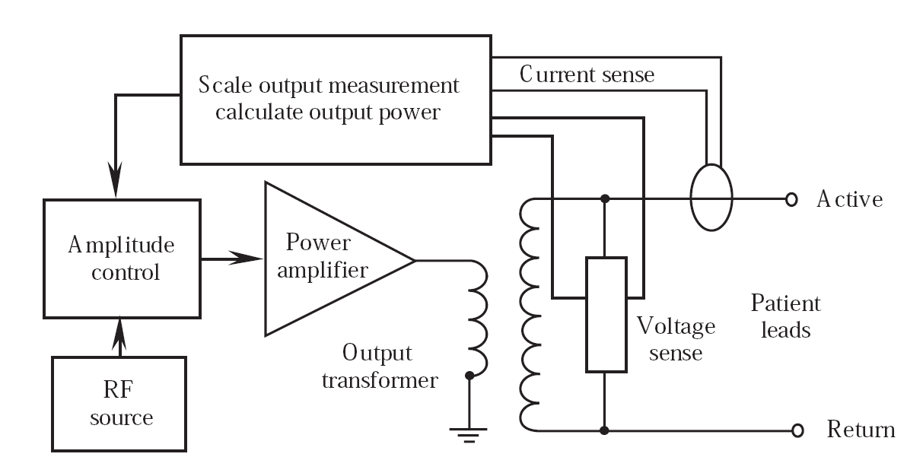
HF Surgery Device Design Example

Slide 23
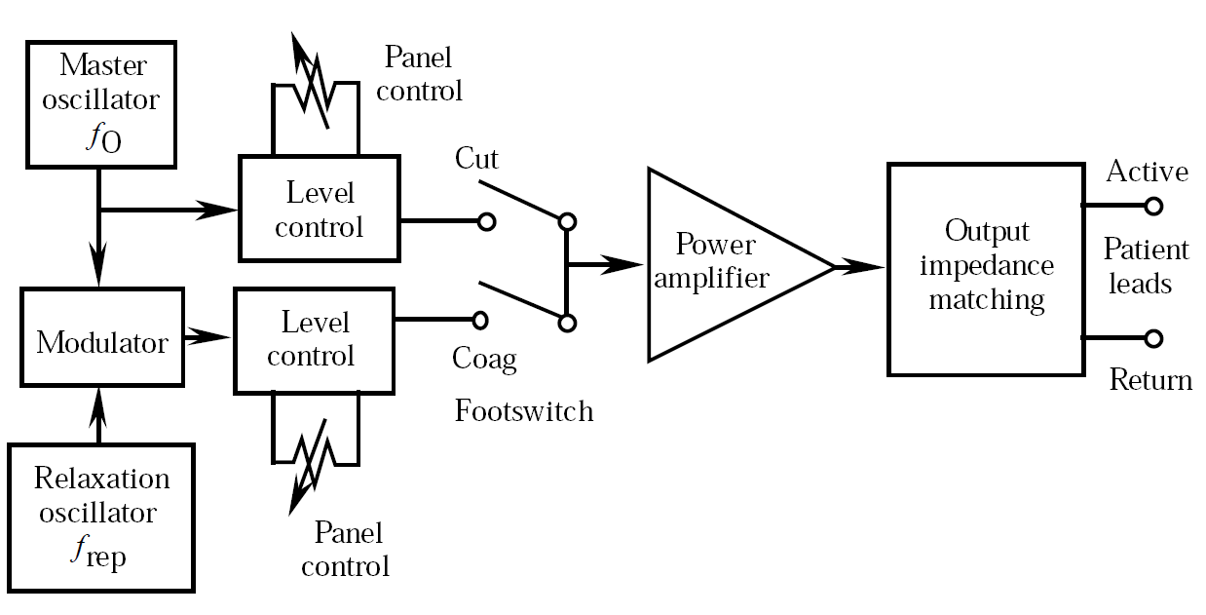
HF Surgery Device Design Example

Slide 24
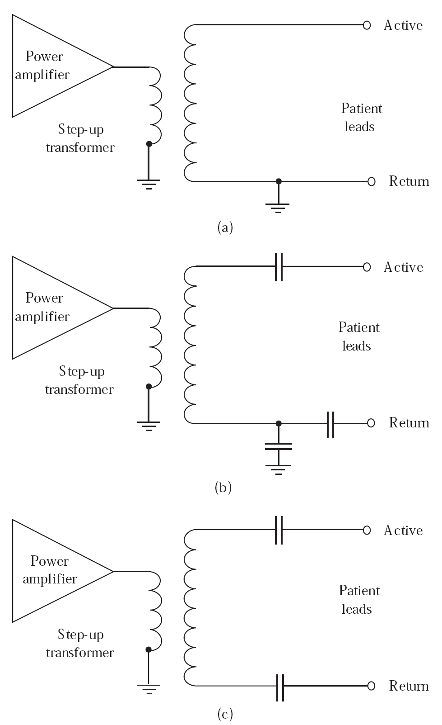
Lead Isolation
Several possible strategies
  Grounded
  Referred to ground
  Isolated
No isolation system is ideal

Slide 25
Reading Assignment
Read Chapter 34 of Springer Handbook of Medical Technology

