Slide 1

hemodialysis machine
Prof. Yasser Mostafa Kadah
EE 471

Slide 2
Renal Physiology

Slide 3
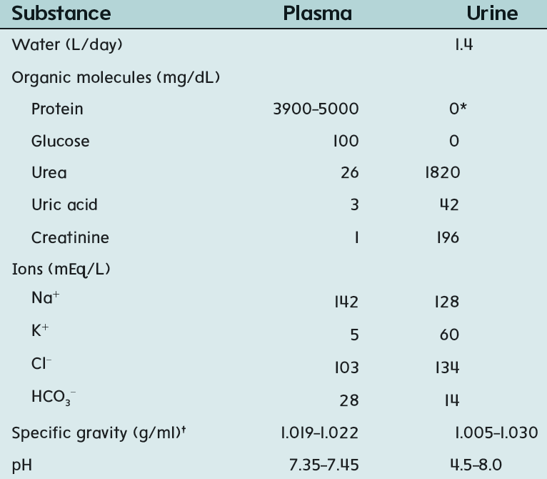
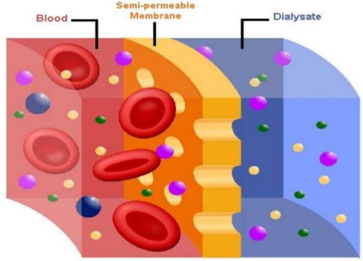
Hemodialysis Machine Function
Delivering patient’s dialysis prescription by controlling blood and dialysate flows through dialyzer
  Removal of waste metabolites
  Removal of water
Monitoring and alarm systems for patient safety
Waste Metabolites
Excess Water

Slide 4
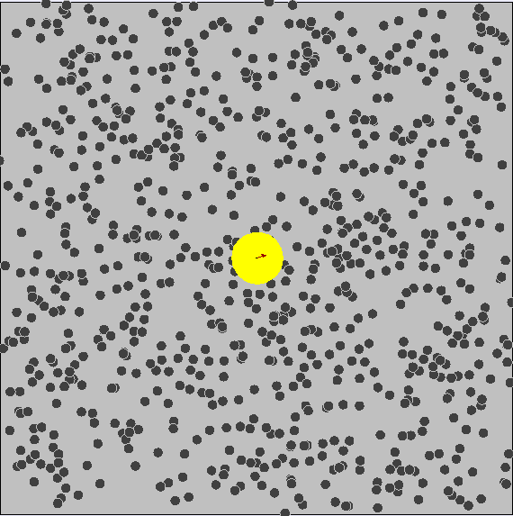
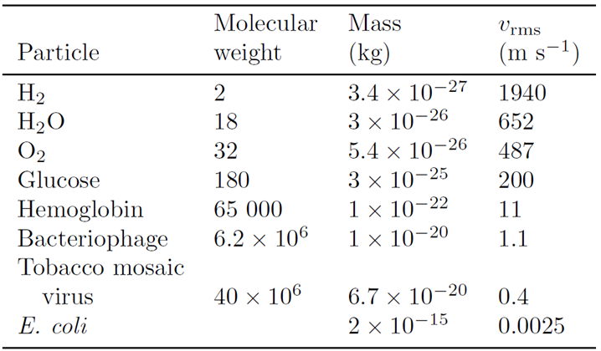
Physics: Brownian Motion
Random motion of particles
  Mean velocity=0 but mean-square velocity≠0
  Kinetic energy depends only on absolute temperature

Slide 5

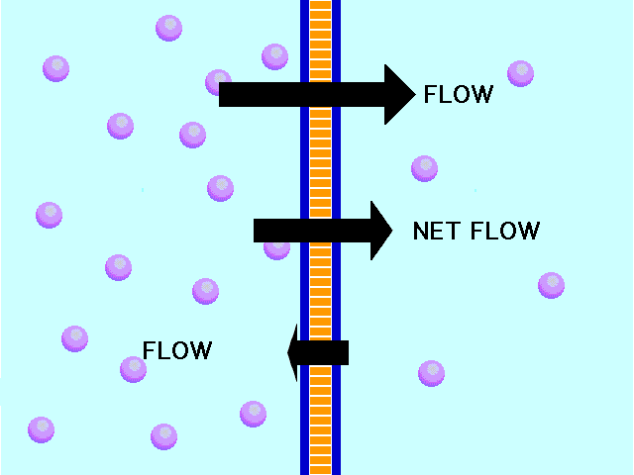
Diffusion
Diffusion: random movement of solute particles from region of higher concentration to region of lower concentration
  Passive: Diffusing particles move independently by Brownian motion
Fick’s First Law: Net flow is proportional to concentration gradient
  Time constant for clearance depends on membrane properties
Blood
Blood
Cocurrent
Countercurrent
Membrane Filter
Dialysate
Dialysate

Slide 6
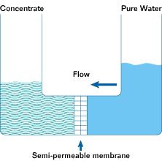
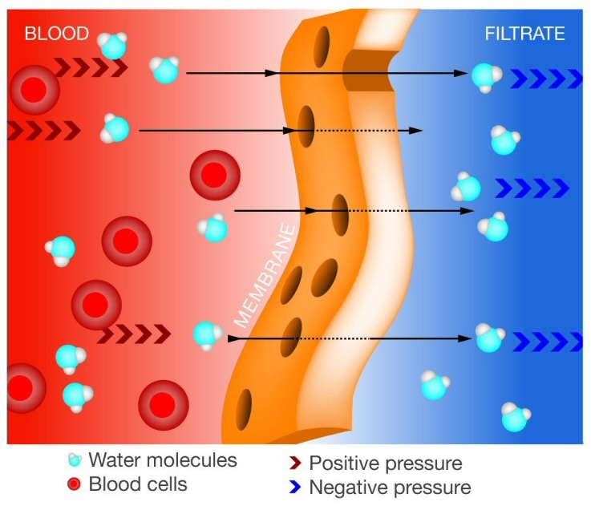
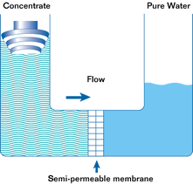
Ultrafiltration
Osmosis vs. reverse osmosis
  Replace positive pressure with negative pressure

Slide 7
Hemodialysis System Components
(C = conductivity monitor, P = pressure monitor, T = temperature monitor)

Slide 8
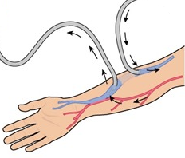
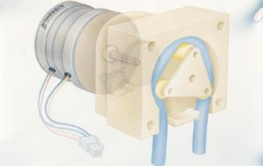
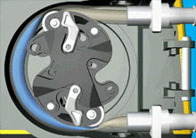
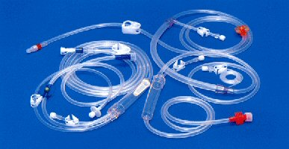
Extracorporeal Blood Circuit
Consists of access device, blood tubing, blood pump, and dialyzer
  Includes pump for continuous administration of heparin during dialysis
Delivers blood to dialyzer at set flow rate and safely return it to patient
  No damage to blood components or loss of circuit integrity
Peristaltic pump
  Safe for blood cells: minimal hemolysis
  No cross-infection: disposable blood line

Slide 9
Water Treatment: Motivation

Slide 10
Water Treatment Unit

Slide 11
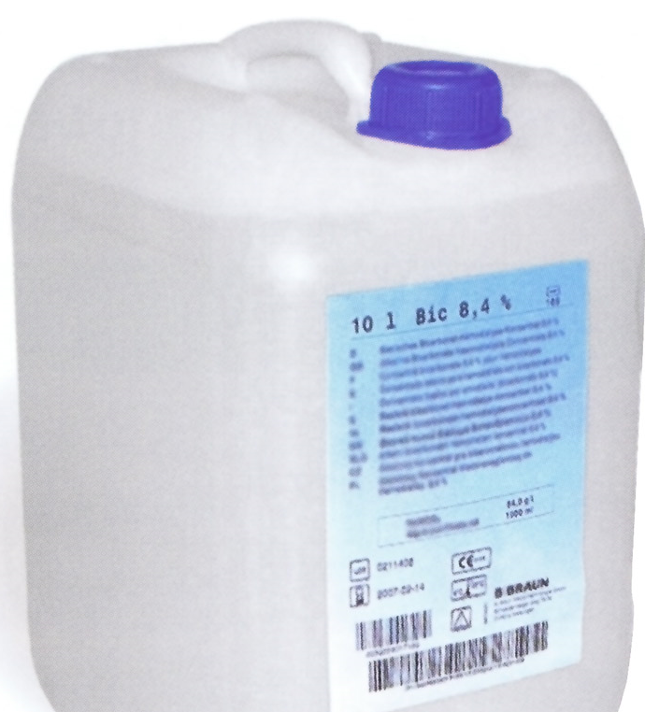
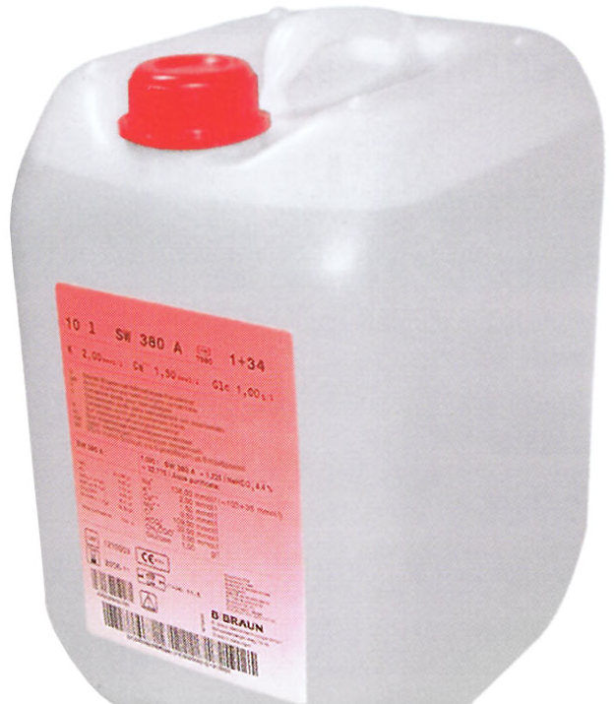
Composition of Dialysate vs. Blood
Dialysate: isotonic solution, osmolality of ~300 ± 20 mOsm/L
  To prevent red blood cell destruction by hemolysis or crenation, osmolality must be close to plasma (280 ± 20 mOsm/L)
Dialysate pH in the range 6.9–7.6 (plasma pH ~7.4)

Slide 12
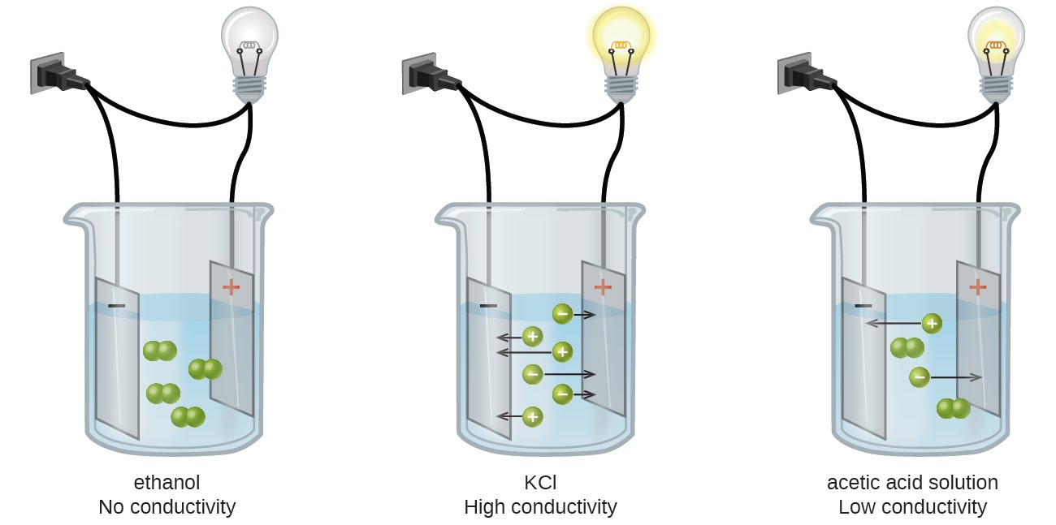
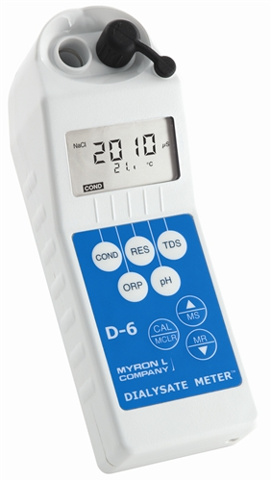
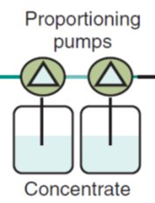
Dialysate Proportioning System
Specific ratio of concentrates to water depending on system
  For example, acid : bicarbonate : water ratio of 1 : 1.225 : 32.775
  Each proportioning ratio requires use of particular concentrates
  Monitoring of correct mixing is done using conductivity measurement
Use of wrong or reversed concentrates can lead to dialysate of correct conductivity but lethal ionic composition
  pH or concentrate pump speed monitoring can detect such problem

Slide 13
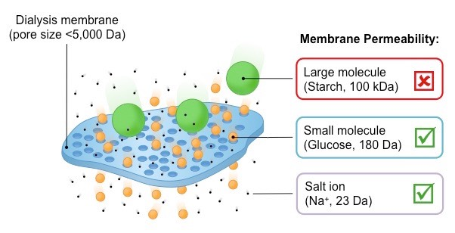
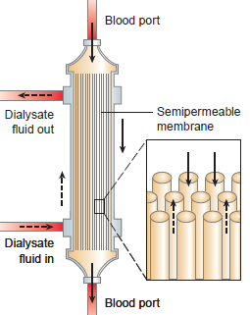
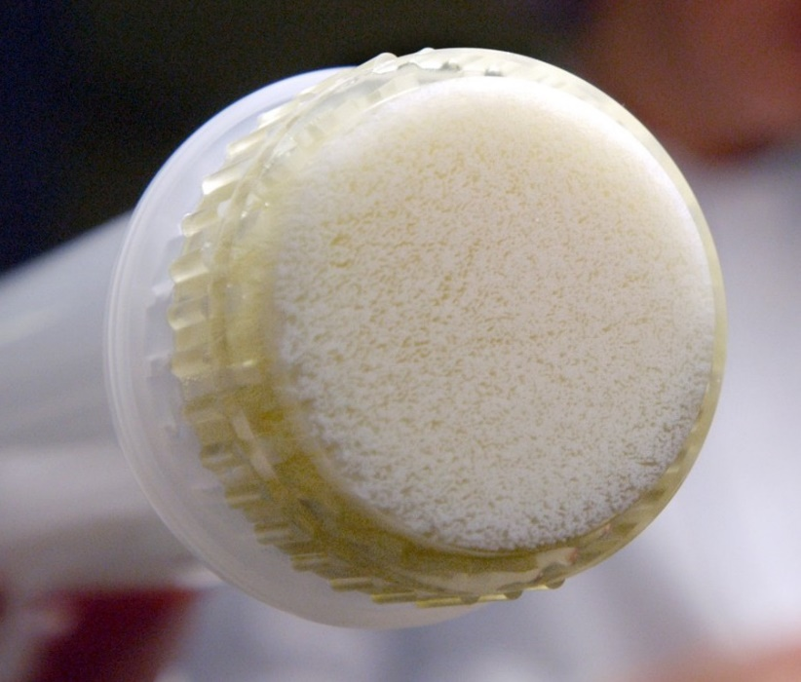
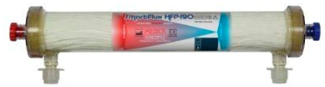
Dialyzer
Hollow fiber technology
  Many fine fiber tubes to allow contact surface area to be large
  Disposable dialyzers: single patient use to prevent cross-infection

Slide 14
Cleaning and Disinfection
Cleaning and disinfection are required to prevent buildup of chemical and bacterial deposits in dialysate flow path
  Such deposits can interfere with conductivity-based monitoring systems and flow-meter–based ultrafiltration control systems
To prevent the chemical buildup of carbonate deposits, machines are rinsed with acetic acid (vinegar) or citric acid
To prevent bacterial buildup, machines must be disinfected at least daily with chemical disinfectant such as bleach
  Some machines also incorporate a hot water disinfection cycle

Slide 15
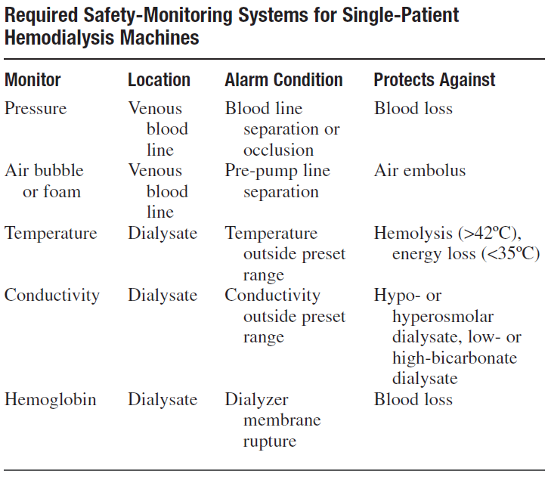
Safety Monitoring

Slide 16
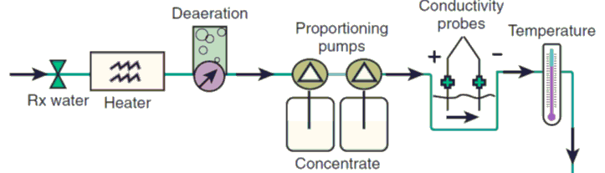
Dialysate Monitoring
Heater monitoring (Thermistor feedback control circuit)
  Normal red blood cells begin to hemolyze at 42°C
  Overheated dialysate has been known to precipitate cardiac arrhythmias
Deaeration monitoring (Observable by eye)
  Relies on vacuum pump and proper interconnects
  Hidden cause of several problems, such as false blood-leak and conductivity alarms, and decreased dialysis efficiency

Slide 17
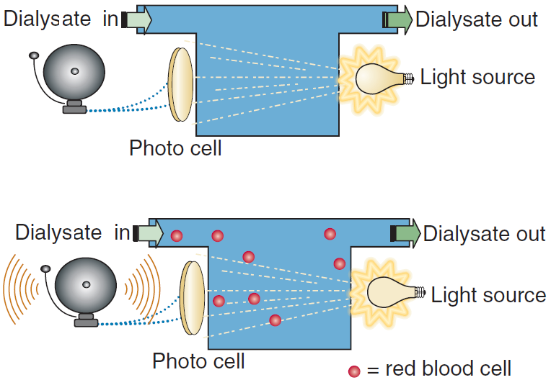
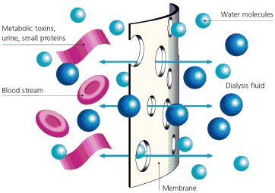
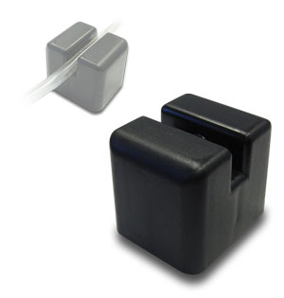

Blood-Leak Detection
Idea: Monitor transmission of light through effluent dialysate
  Tear or leak in dialyzer membrane cause RBCs to leak into dialysate
  Interruption of light transmission by blood triggers alarm

Slide 18
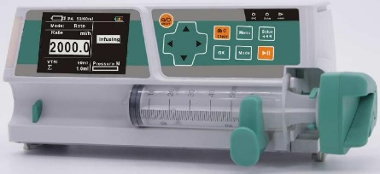
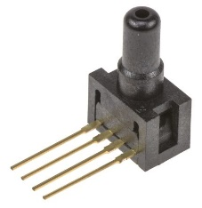
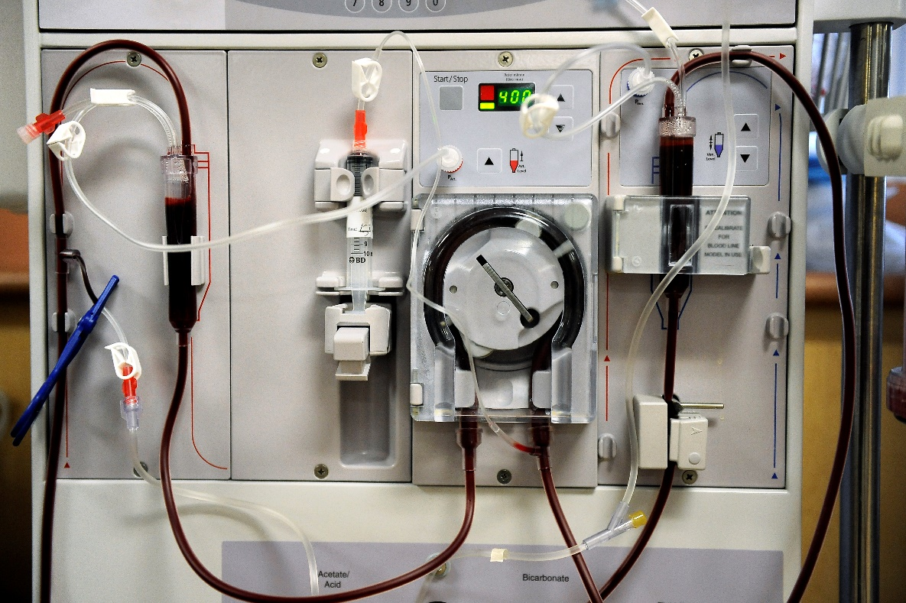
Blood Circuit Monitoring

Slide 19
Monitor Failure
All monitors can fail (mechanical, electrical or combination)
  Murphy’s law: If anything can go wrong, it will
Machine monitors are frequently thought to be fail-safe devices, but they are not
Because all dialysis machine monitors can fail, they should signal a warning when they are out of limits or not working properly
Dual monitoring required: machine monitor device + dialysis personnel
  No machine, computer, or device can replace the continuous surveillance of hemodialysis personnel

Slide 20
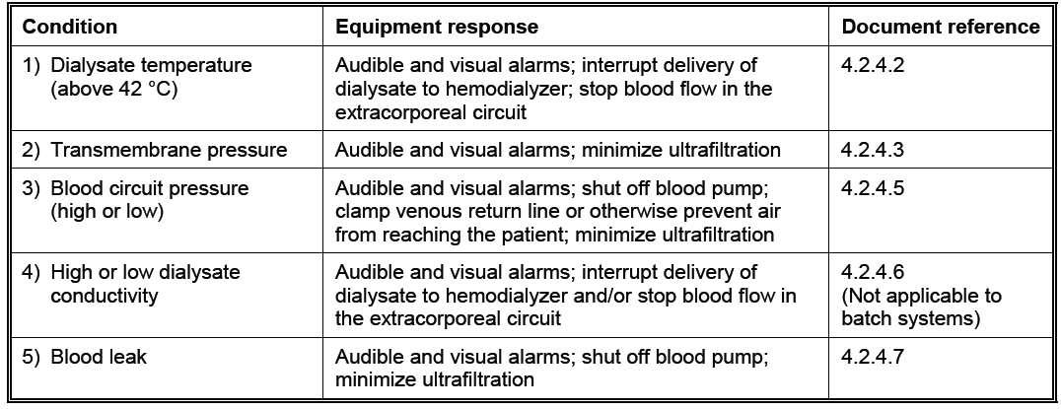
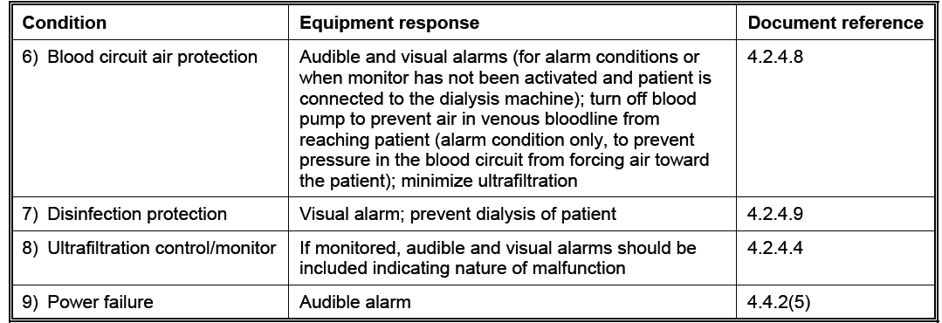

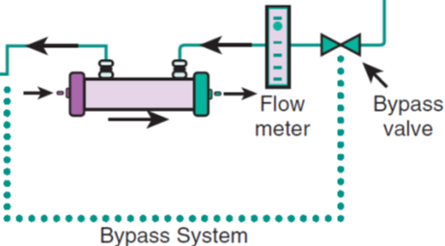
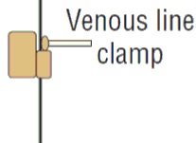

ANSI/AAMI RD5 Equipment Response
Stop blood pump
Activate venous clamp
Activate dialysate bypass
Audible/Visual Alarms

Slide 21
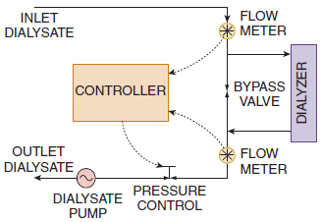

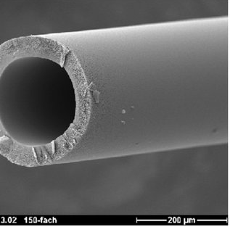
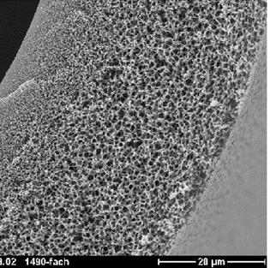
Ultrafiltration Control Design Problem
For device to be considered “ultrafiltration control” system, it must function with overall accuracy of ± 5 % of selected ultrafiltration rate or ± 100 mL/h, whichever is greater, over specified range of operation
Consider design using 2 flowmeters
  UF = Flow2 – Flow1
  Error(UF) (mL/h) = Error(Flow2) (mL/h) + Error(Flow1) (mL/h)
  Flow range in Flow1 & Flow2: 1L/min
  Ultrafiltration range: 1L/hr
  Must have extremely high precision flowmeters
Flow1
Flow2

Slide 22
Dialysis Prescription and Adequacy
Determining how much dialysis is enough, one must define the means by which dialysis outcome can be quantified
Kt/V or single-pool Kt/V (spKt/V): Target 1.2
  K: Urea removal rate, t: treatment time, V: volume of distribution for urea
  R: ratio of postdialysis to predialysis blood urea nitrogen
Urea Reduction Ratio (URR): Target 65%
  BUN: blood urea nitrogen concentration
Ultrafiltration rate limits
  Optimally less than 10 mL/h/kg but certainly no more than 13 mL/h/kg

Slide 23
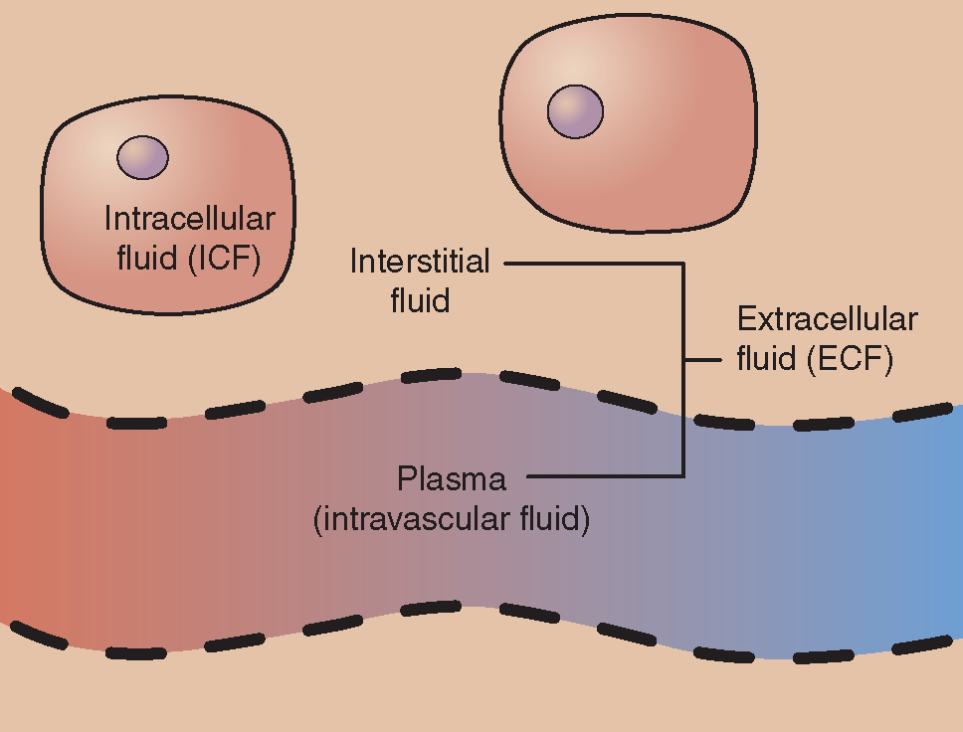
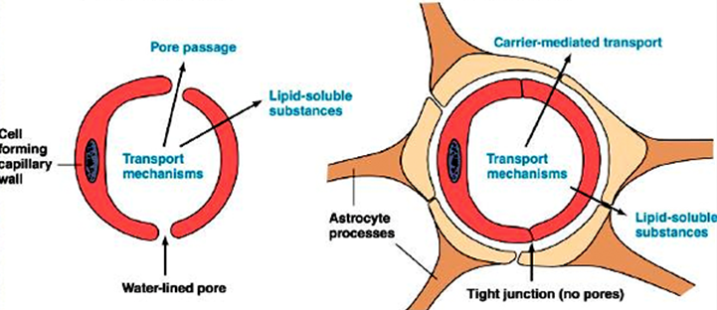
Dialysis Disequilibrium Syndrome
Common symptoms: headache, nausea, and vomiting
  In severe cases, seizures and coma
Explained by osmosis due to blood-brain barrier properties
  Urea concentration in brain higher than blood (slower transport)
  Water from plasma flow into extracellular space causing extra pressure
Prevented by keeping dialysis efficiency as low as needed

Slide 24

Recommended Readings
Allen R. Nissenson and Richard N. Fine (Eds.), Handbook of Dialysis Therapy, 5th ed., Saunders Elsevier, Philadelphia, 2016.
ANSI/AAMI RD5 standard.

