Slide 1

Respiratory Monitoring
Prof. Yasser Mostafa Kadah
EE 471

Slide 2
Scope
Respiratory monitoring includes measurement, evaluation, and monitoring of parameters of respiratory system
Parameters of respiratory mechanics and mechanics of machine-assisted artificial respiration
  Respiration rate, tidal volume, and airway pressure
  Mechanical processes of thorax necessary for ventilation in form of Pressure/volume relationships
  For patients under artificial respiration, airway pressure and tidal volume are of particular interest
  Variables and behavior of parameters depend on compliance (elasticity) of lungs and airway resistance
Parameters of gas exchange
  Oximetry
  Transcutaneous blood gas monitoring
  Capnography

Slide 3
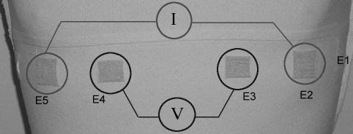

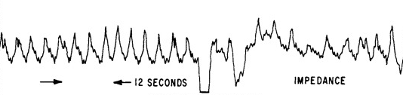
Monitoring of Respiration Rate (RR)
Impedance pneumography (indirect method)
  Changes in thoracic volume linked to respiration lead to changes of impedance of thorax
  To detect this, very low high-frequency constant current (e.g., 10 μA at 40 kHz) is conducted through two thoracic electrodes
  When current is constant, change in impedance causes synchronous change in voltage drop that are measured and displayed as Impedance Pneumogram and used to measure respiration rate
  Signal is highly vulnerable to movement artifacts
    Every movement of body influences thoracic impedance
Capnography (indirect method)
  EtCO₂ module

Slide 4
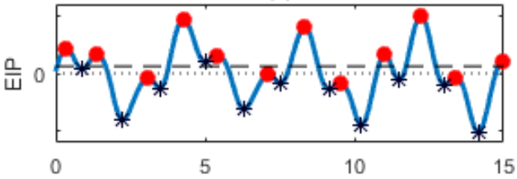
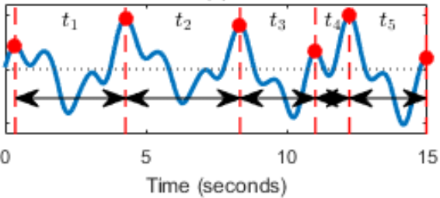


Respiration Rate: Calculation
Running average of breaths counted per minute
In some monitors, respiration waveform must only exceed single adjustable trigger threshold to be classified as valid breath
  Even small artifacts can, therefore, easily lead to miscount
Combination of upper and lower thresholds with adjustable interval in between is better and safer than single trigger threshold
  Upper and lower thresholds span minimum amplitude that must be exceeded by impedance signal in order to intersect both and hence involves depth of respiratory action in valid breath detection

Slide 5
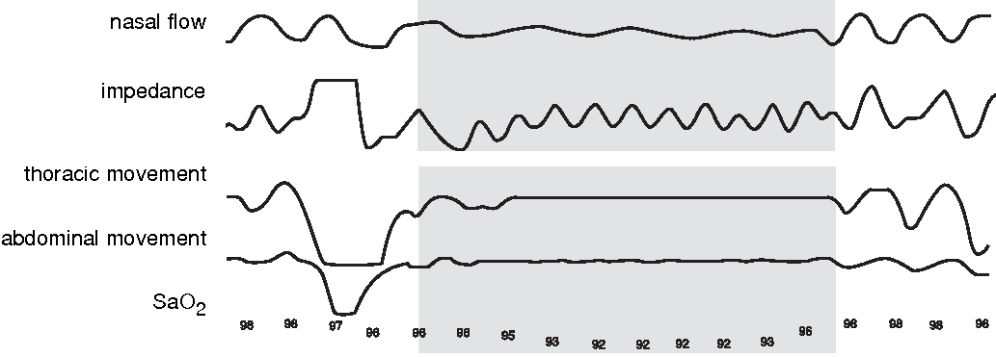
Respiratory Rate: Apnea Monitoring
Apnea is any pause in breathing
If no breath is detected within adjustable apnea time limit, apnea alarm is triggered
It is important to take into account that every heartbeat causes measurable change in impedance of thorax, which may be visible in impedance pneumogram
  If trigger threshold is set too low, then it is not respiration rate that is counted but heart rate
  Cases of apnea can then be overlooked
  In neonatal monitoring mode, monitors are capable of determining whether respiration and heart rates closely resemble one another or are identical and of triggering alarm if this occurs

Slide 6
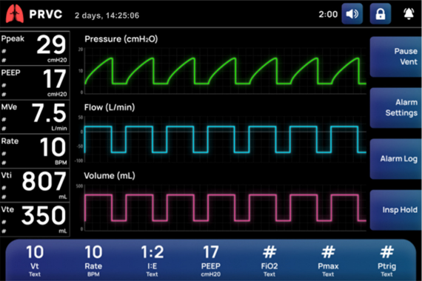
Pressure and Flow
For artificially ventilated patients, such parameters are set on mechanical ventilator
  Not enough to look at set values and actual values must be monitored
    Flow sensor measures inspiratory and expiratory gas flows and volumes in mainstream and airway pressure
Both waveforms of flow, pressure and volume, and also flow-volume (F-V) and pressure-volume (P-V) loops can be displayed on monitor
  Other parameters that can also be displayed and provided in trends include inspiratory and expiratory tidal volumes, minute volumes, maximum flows and airway resistance, maximum and average airway pressure, PEEP (positive end-expiratory pressure), respiration rate and inspiration/expiration ratio (I/E), and lung compliance
  If combined with capnography, CO₂ production, alveolar ventilation as well as anatomical and physiological dead space ratios can also be monitored

Slide 7
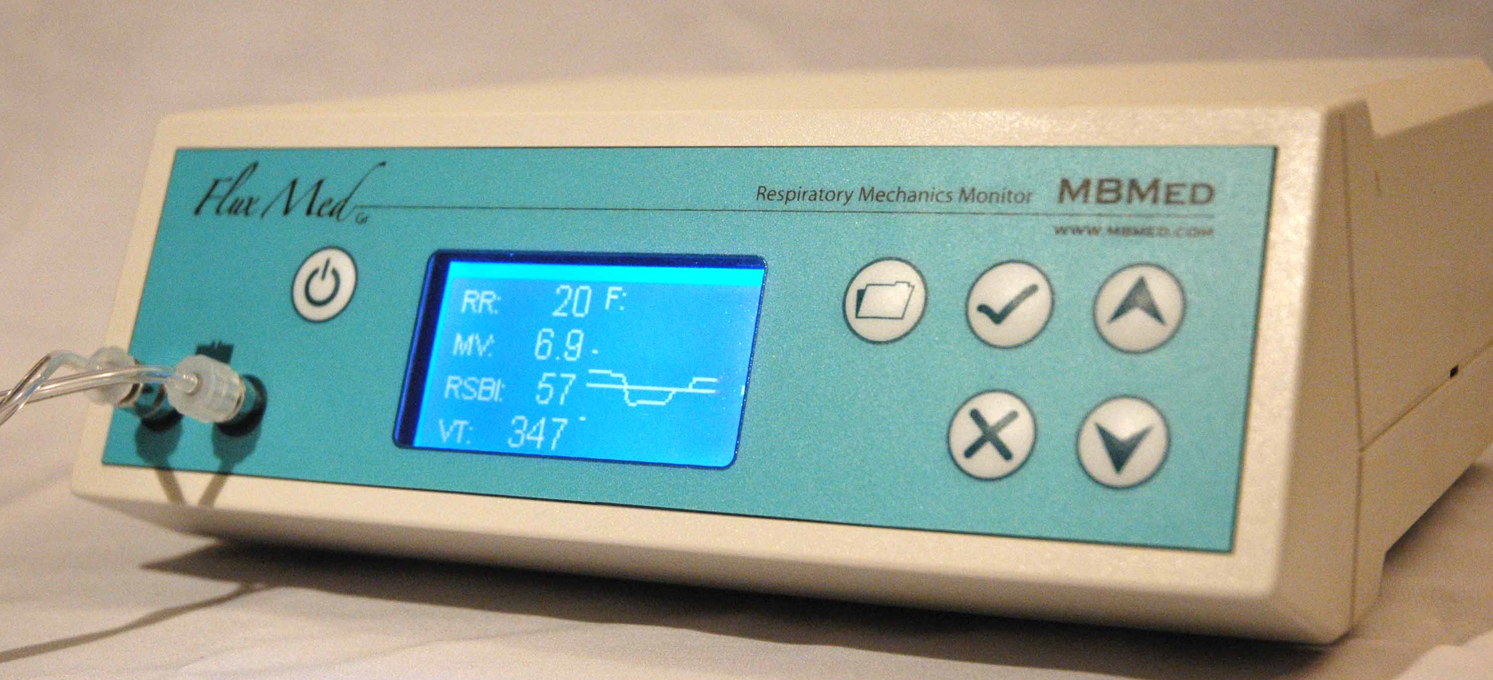
Respiratory Mechanics Module vs. Ventilator
Ventilators generally measure pressure and volume in equipment remote from patient, whereas respiratory mechanics module takes measurements close to patient
  In addition to compliance of ventilation hoses, measuring temperature also plays particularly important role for volumes displayed
Measurements taken directly from patient are at body temperature (≈ 37 ◦C)
  These gas conditions are described as BTPS (body temperature and pressure, saturated)
ATPS (ambient temperature and pressure, saturated) is present in equipment for expiration, and ATPD (ambient temperature and pressure, dry) for inspiration
  Considerable difference in temperature between two measurement points, which leads to noticeable differences in volume

Slide 8
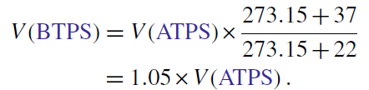
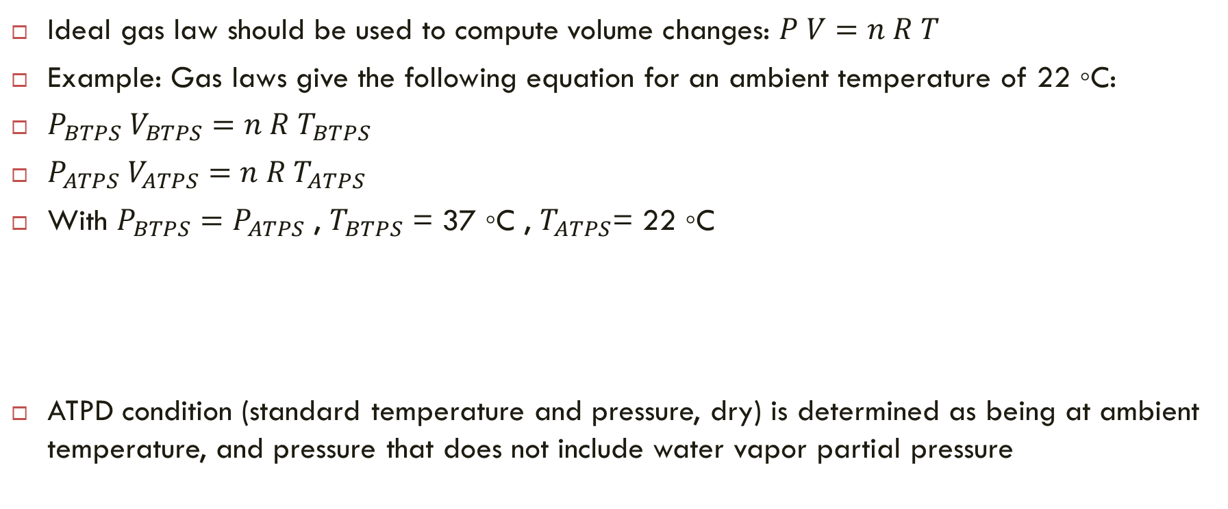
Respiratory Mechanics Module vs. Ventilator
Ideal gas law should be used to compute volume changes: $P V=n R T$
Example: Gas laws give the following equation for an ambient temperature of 22 ◦C:
$P_{BTPS} V_{BTPS}=n R T_{BTPS}$
$P_{ATPS} V_{ATPS}=n R{ T}_{ATPS}$
With $P_{BTPS}=P_{ATPS}$ , $T_{BTPS}$ = 37 ◦C , $T_{ATPS}$= 22 ◦C
ATPD condition (standard temperature and pressure, dry) is determined as being at ambient temperature, and pressure that does not include water vapor partial pressure

Slide 9
Gas Exchange Monitoring
Measurement methods and measurement parameters for respiratory gases, blood gases, and anesthetic gases can be summarized as so-called gas monitoring under generic term gas exchange
Differing conditions under which respiratory gases and blood gases of patient must be monitored
  Spontaneous respiration
  Artificial respiration with or without oxygen enrichment
For anesthetic ventilation, nitrous oxide N₂O or volatile anesthetics are added

Slide 10
Gas Exchange Basics
In pulmonary alveoli, respiratory gases are in contact with blood over short diffusion path via alveolar and capillary walls
Oxygen first dissolves in blood plasma and then diffuses further into red blood cells (RBCs), which contain red blood pigment hemoglobin (Hb) as oxygen-transporting agent
Oxygen is not directly bound to Hb, but is only attached to iron atom of each of four haem groups
  One molecule of Hb can, therefore, transport up to four oxygen molecules and easily release them again when it reaches surrounding tissue structures having lower oxygen partial pressure via bloodstream
  Hb is not oxidized, but rather oxygenated and in turn deoxygenated

Slide 11
Gas Exchange Basics
Carbon dioxide (CO₂) is constantly produced in body as product of metabolism and is likewise partly dissolved in blood plasma, but is mostly transported back to alveoli as bicarbonate chemically bound by attachment to amine (NH₂) group of hemoglobin
Blood gas analysis (BGA) measures O₂ and CO₂ concentrations in blood
Respiratory gases are often measured as concentration in percent by volume (vol%), whereas the blood gases are measured as partial pressures in mmHg (= torr) or kPa
  Both measurements can be converted from one to the other
In principle it would be physiologically meaningful to present partial pressures under BTPS conditions only but historically inspired gases are given as volume concentration of dry gas mixture under standard temperature and pressure dry (STPD)

Slide 12


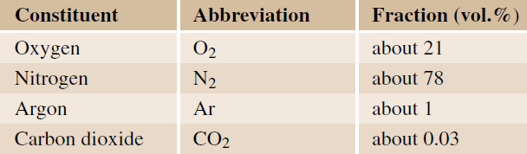
Gas Exchange Basics
In mixture of ideal gases with concentrations c_{i} measured in vol%, partial pressure p_{i} of one component is fraction of total pressure proportional to its concentration
  Total pressure here is always atmospheric pressure p_{baro}
Total pressure is sum of partial pressures of gas components

Slide 13
Gas Exchange Basics
Normal respiratory air with familiar composition is heated to 37 ◦C during inhalation and is mixed with newly added water vapor as result of humidification in airways
At full water vapor saturation, water vapor partial pressure p_{H2O} is entirely dependent on the temperature and is 47mmHg at 37 ◦C, which is 6.2 vol%
  = (47/760)×100 vol% at standard atmospheric pressure p_{baro} = 760 mmHg
With its unchanged composition, respiratory air now takes up only 93.8% of volume
  In this wet gas, oxygen only has concentration of 19.7% (= 0.938 × 21%) or partial pressure of 19.7% × 760 mmHg = 150 mmHg

Slide 14
Gas Exchange Basics
Remaining expiration gas in alveoli mixes with this fresh gas, such that noticeably lower alveolar O₂ partial pressure pAO₂ results, with standard value ≈ 100 mmHg
  Difference in partial pressures of gas is driving force behind diffusion
Venous blood arriving in lungs has comparatively low venous oxygen partial pressure pvO₂, which in capillaries, in ideal ventilation, becomes equal to alveolar partial pressure as result of gas exchange
Because not all blood is involved in gas exchange, in practice there is alveolar-arterial oxygen difference AaDO₂ of 10–20 mmHg
Venous blood transports CO₂ to lungs and inhaled air contains virtually no CO₂ and gas exchange leads to normal alveolar CO₂ partial pressure pACO₂ ≈ 40 mmHg
Spontaneous respiration primarily aims to stabilize CO₂ partial pressure and pH of blood, whereas large fluctuations in O₂ partial pressure are tolerated

Slide 15


Gas Exchange Monitoring
O₂ is mainly transported by RBCs since Hb binds nearly 70 times more O₂ than plasma
  One gram of hemoglobin (Hb) can transport ≈ 1.34 ml of oxygen; solubility factor for 1 ml of oxygen in 1 dl of blood is about 0.003 per mmHg
Amount of oxygen in blood is called the oxygen content (ml O₂ per dl blood)
How much hemoglobin is loaded with oxygen is dependent on O₂ partial pressure in blood and is given as oxygen saturation
  Percentage ratio of oxygenated hemoglobin to total amount of hemoglobin
Arterial and venous oxygen content can be given as:
  SaO₂ arterial and SvO₂ venous oxygen saturation (%), Hb is hemoglobin content of blood (g/dl), paO₂ and pvO₂ arterial and venous oxygen partial pressures (mmHg)

Slide 16
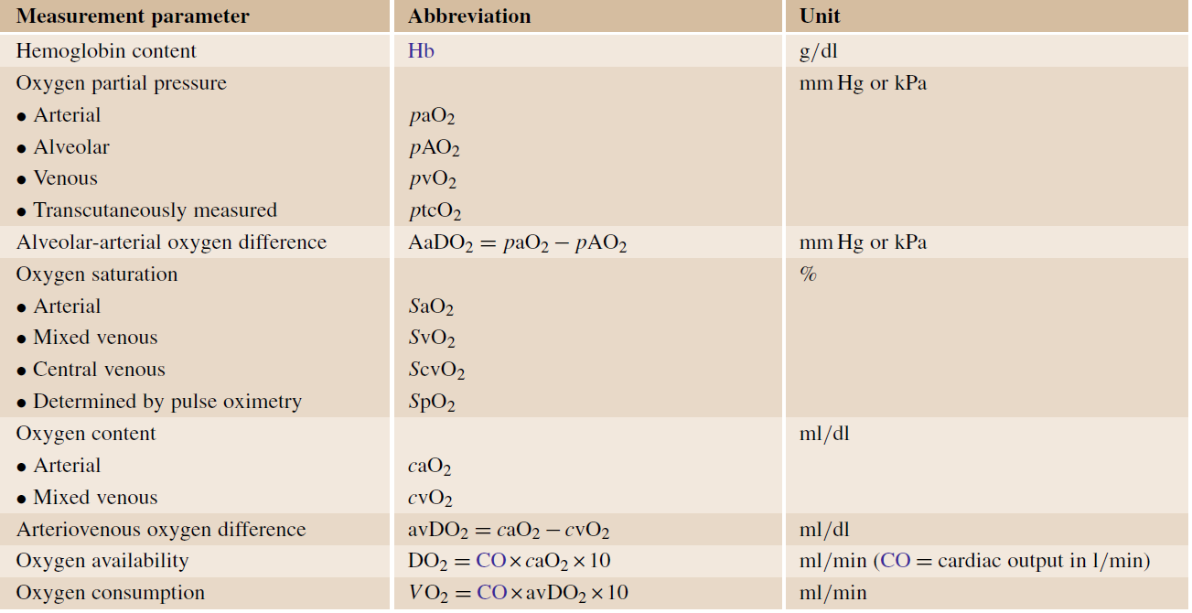
Gas Exchange Monitoring

Slide 17
Gas Exchange Monitoring
In addition to functional hemoglobin Hb (deoxyhemoglobin), available for O₂ uptake, and O₂Hb (oxyhemoglobin), which is already saturated with O₂, there exist other dysfunctional Hb derivatives
  COHb (carboxy-Hb, Hb poisoned with carbon monoxide)
  MetHb (methemoglobin) (heme group is in Fe³⁺ or ferric state)
  Mostly present in the blood in fractions of less than 5 and 1%, respectively
Whereas amount of O₂ physically dissolved in blood is simply proportional to O₂ partial pressure, significantly more complex relationship between pO₂ and degree of hemoglobin oxygenation (or oxygen saturation) is represented by oxygen–hemoglobin dissociation curve

Slide 18
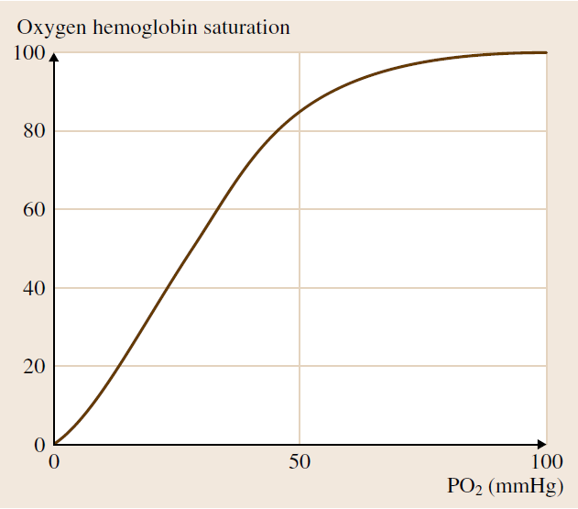
Gas Exchange Monitoring
Position and shape of oxygen–hemoglobin dissociation curve are dependent on various factors in blood
  pH and pCO₂
  Proportion of dysfunctional Hb derivatives (COHb, MetHb)
  Temperature
  Hemoglobin type (fetal or adult)
  Enzyme content (2,3-DPG)
Example 1: With fever or increased pCO₂, dissociation curve is displaced to right, such that oxygen is released to cells more easily
Example 2: Mountain dwellers have increased 2,3-DPG content, which also results in dissociation curve being displaced to right
Example 3: Carbon monoxide poisoning with formation of high concentrations of COHb is, in contrast, accompanied by displacement of dissociation curve to left, such that remaining functional hemoglobin (already depleted) also releases oxygen with greater difficulty

Slide 19
Gas Exchange Monitoring
Dangers resulting from decreased supply of oxygen can be detected in good time in arterial blood by monitoring both arterial oxygen partial pressure paO₂ and the oxygen saturation SaO₂
Whereas arterial blood samples could previously only be examined for this purpose in laboratory analyzer at relatively long time intervals, noninvasive continuous monitoring procedures are now available for both parameters
  Pulse oximetry for determining SpO₂ as measure of arterial O₂ saturation
  Transcutaneous blood gas measurement of ptcO₂ (and ptcCO₂) as correlates of arterial gas partial pressures paO₂ (and paCO₂)

Slide 20
Gas Exchange Monitoring
Hypoxia: low oxygen partial pressure (paO₂)
Hyperoxia: high oxygen partial pressure (paO₂)
Hypoxygenation: low oxygen saturation of hemoglobin (SaO₂)
Hypoxemia: low oxygen content in the blood (caO₂)
Hyperoxemia: high oxygen content in the blood (caO₂)
Anemia: low hemoglobin content in the blood (Hb)
Similar definitions for CO₂: Hypocapnia, Hypercapnia
  Hypercapnia normally triggers reflex which increases breathing and access to oxygen, such as arousal and turning head during sleep

Slide 21

Gas Exchange Monitoring
It can be seen from oxygen-hemoglobin dissociation curve that, in case of oxygen deficiency, even small changes in paO₂ signify large changes in SaO₂
  O₂ saturation is, therefore, a variable that reacts very sensitively in the case of oxygen deficiency
  Pulse oximetry is hence particularly suitable for monitoring oxygen deficiency
On the other hand, even with normal paO₂ of approximately 90–95 mmHg virtually all hemoglobin is oxygenated
  Monitoring of upper limit by means of pulse oximetry is no longer conclusive, particularly if patient is being given oxygen, and transcutaneous blood gas measurement is considered preferable
  Transcutaneous blood gas monitoring is, therefore, most commonly used to avoid hyperoxia in premature infants
    Relatively long-term hyperoxia in their case leads to irreversible blindness

Slide 22
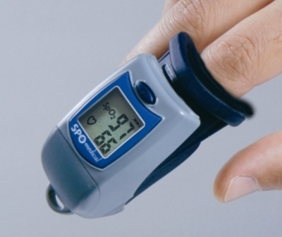
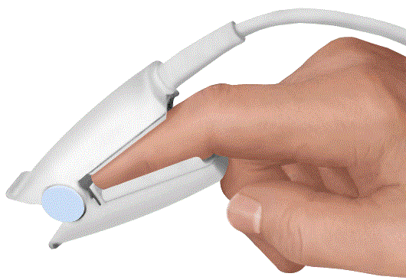
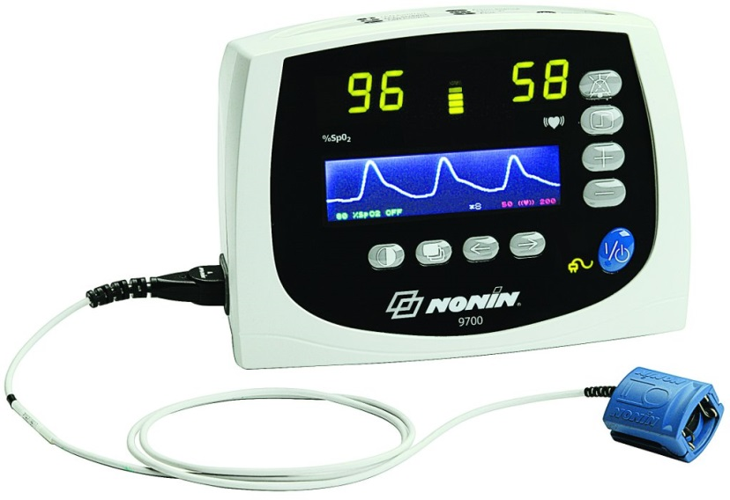
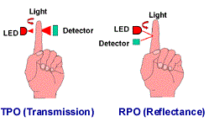

Pulse Oximetry
Pulse oximetry is noninvasive method for continuously measuring oxygen saturation in arterial blood
Parameter measured in pulse oximetry is not called SaO2 but SpO2
  Signify that oxygen saturation is determined by means of pulse oximetry and to point towards their principal difference

Slide 23


Functional and Fractional Saturation
The value SpO2 from pulse oximetry is always what is known as functional saturation
  Oxyhemoglobin as percentage of total functional hemoglobin which can transport oxygen
Fractional saturation is determined in laboratory and defined as hemoglobin as percentage of total measured hemoglobin including dysfunctional hemoglobin derivatives (carboxyhemoglobin or methemoglobin)

Slide 24

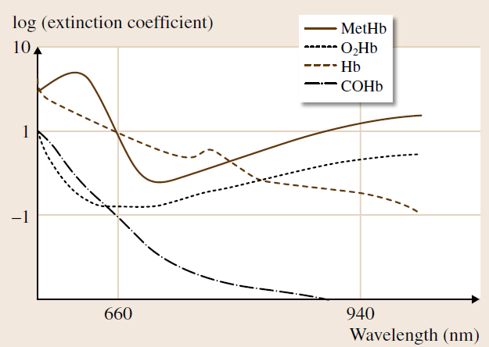
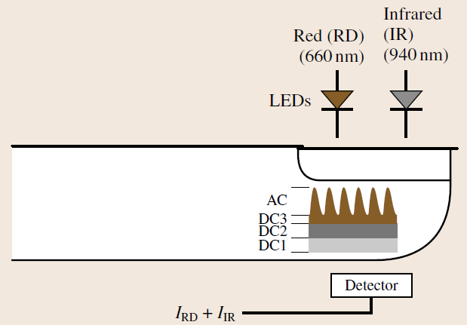
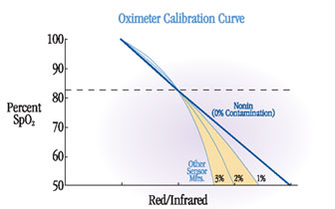
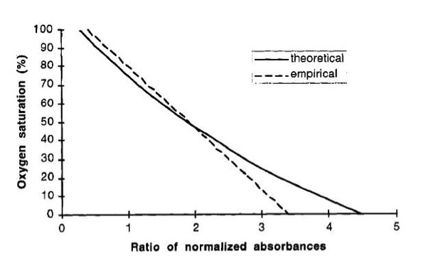
Conventional Pulse Oximetry
Based on assumption that only arterial blood has pulsatile AC component of light absorption, whereas tissue, venous blood and nonpulsatile arterial blood always constitute constant DC
Intensities I_{RD} and I_{IR} registered by detector thus include AC and DC components in each that can be compared as ratio of normalized absorbances
  Can be used to estimate SpO₂ from empirical curves

Slide 25
Motion Artifact in Pulse Oximetry
If patient moves, venous blood at measurement point also moves causing considerable interference in signal
  Pulsatile elements no longer originate from arterial blood alone
  AC components are distorted and imprecise saturation value emerges
  With normal patient movements, interference can be far higher than true
  Quotients are determined by interference components and r is close to 1
  Many systems then show saturation value of approximately 85%
As countermeasure, time for determining average is increased or display is frozen if movement is detected
  This does not provide clinicians with continuous information, however, and can in worst case scenario lead to misinterpretations

Slide 26
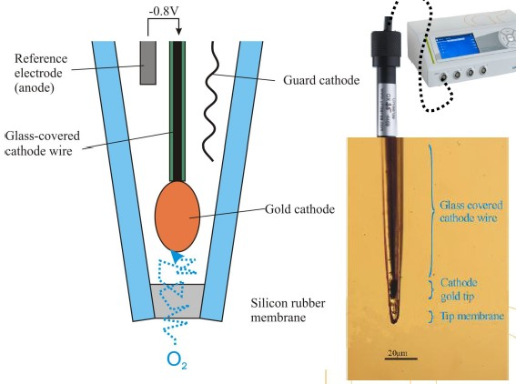
Transcutaneous Blood Gas Measurement
Miniaturized sensor of Clark type placed directly on skin
  Measuring membrane encloses very small volume of electrolyte, into which O₂ or CO₂ can diffuse from cutaneous capillary bed
Since only arterial values are of interest, capillary bed is heated to 42–45 ◦C by means of heating element in sensor and thus arterialized
  High temperature reduces vascular tone, arterioles become slack, and arterial blood penetrates into capillary bed
  Oxygen monitoring requires minimum heating temperature of 43 ◦C
  For CO₂ monitoring, temperature of 42 ◦C is sufficient
  Temperature must not exceed 45 ◦C

Slide 27
Polarographic Method for ptcO₂
Transcutaneous oxygen partial pressure ptcO₂ is measured with polarographic method
  Microelectrodes made from platinum or gold situated in electrolyte and biased towards silver anode with fixed plateau potential (typically 0.8V)
  Small ptcO₂-proportional measurement current flows generated from reduction of O₂ molecules at microelectrodes
  Response time is ~ 8s

Slide 28
Potentiometric Method for ptcCO₂
Transcutaneous CO₂ partial pressure (ptcCO₂) is measured with potentiometric method using pH electrode
  Considerably more stable mechanically, significantly lower and more noise-free output impedance than previous technology
CO₂ diffuses into measuring cell (transcapnode), shifts pH value by forming carbonic acid
  At equilibrium, logarithmic relationship between CO₂ partial pressure and pH, and hence potential at pH electrode
  Response time ~40s

Slide 29
Measuring Respiratory Gases
Paramagnetic O₂ Measuring Cell
Infrared Absorption Spectroscopy

Slide 30
Capnography
Capnography is noninvasive, continuous measurement and graphic representation of the CO₂ in respiratory gas
  High importance for patient under general anesthesia and in ICU
  Capnogram plots CO₂ partial pressure over time
  petCO₂ is maximum at end of alveolar plateau, correlates with the paCO₂
Spontaneous respiration is primarily aimed at stabilizing arterial CO₂ partial pressure around 40 mmHg and represents fundamental respiratory drive
  Deviations in paCO₂ have considerable physiological consequences, such as hypercapnia (vasodilation) and Hypocapnia (vasoconstriction)

Slide 31
Reading Assignment
Read Chapter 49 of Springer Handbook of Medical Technology

