Slide 1

Mechanical Ventilator
Professor Yasser Mostafa Kadah
EE 471

Slide 2
Mechanical Ventilator
A ventilator is a life-sustaining device that supports or replaces spontaneous breathing of the patient

Slide 3
Spontaneous Breathing Cycle
A breath is one cycle of positive flow (inspiration) and negative flow (expiration) defined in terms of the flow versus time curve

Slide 4
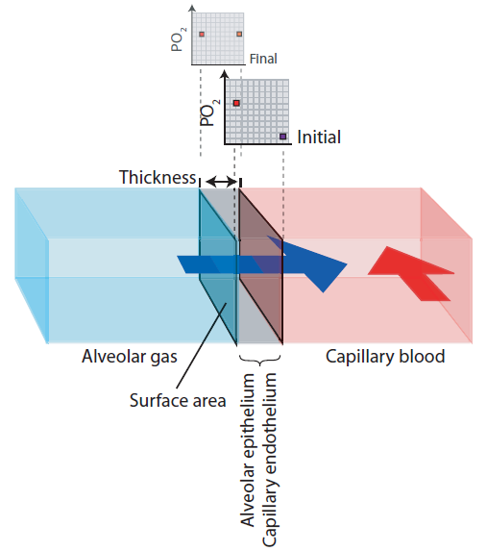
Gas Exchange: Diffusion
Gas is exchanged between alveoli and blood by diffusion
Speed of diffusion is determined by:
  Partial pressure gradient (+)
  Thickness of barrier (-)
In cases when fluid accumulates inside alveoli, hyperoxic (more O₂) is needed to compensate for increased barrier thickness

Slide 5
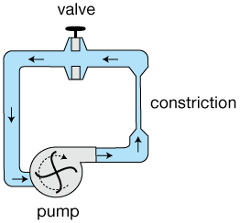
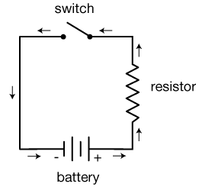
Equations of Motion: Electrical Analogy
Mechanics Electricity
Pressure ➔ Voltage
Flow ➔ Current
Volume ➔ Charge
Resistance ➔ Resistance Compliance ➔ Capacitance
Valve ➔ Switch

Slide 6
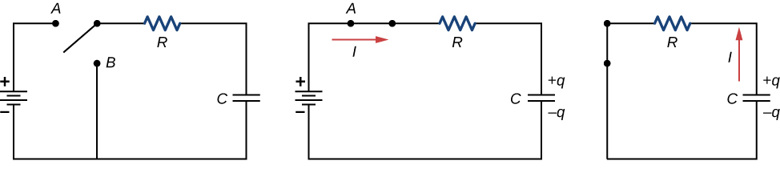
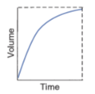
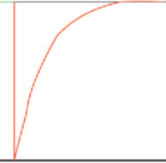
Practical Effects of Compliance and Resistance
A: Filling of normal lung unit
B: Low-compliance unit: fills quickly but with less air
C: Increased resistance: fills slowly
Inspiration
Expiration

Slide 7
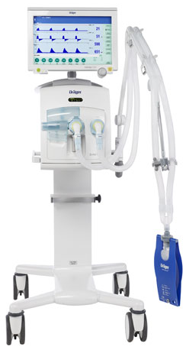
Functional Block Diagram

Slide 8
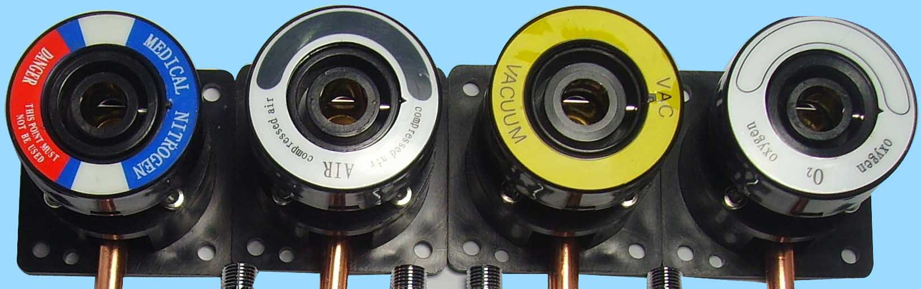
Oxygen Sources
Medical gases supply
Oxygen cylinder
Oxygen concentrator

Slide 9
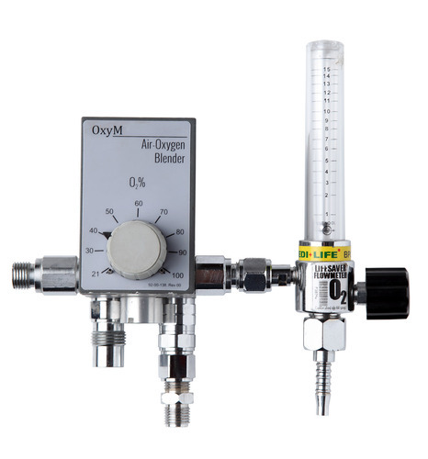
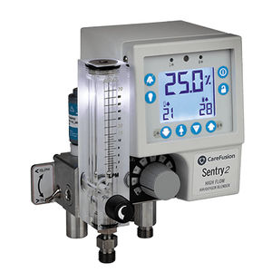
Air/Oxygen Blender
Gas mixer allow the user to vary oxygen concentration of inspiratory gas or fractional inspiratory oxygen (FIO2) between 21% and 100% by volume
  Mechanical gas mixers
  Electronically-controlled gas mixer integrated in ventilator
Gas mixers are usually responsible for ensuring that breathing gas to be supplied is prepared and delivered in required quantity and rate

Slide 10
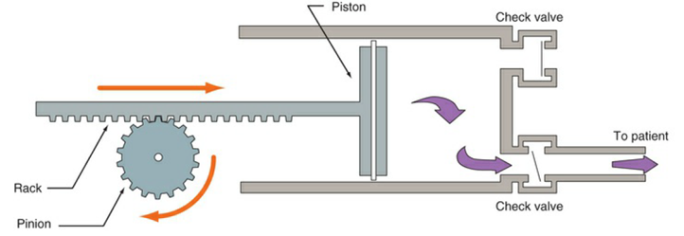
Pressure/Flow Generator
Pressure/flow generator is responsible for delivering mixed gas prepared by gas mixer according to selected ventilation parameters
Flow generator is a controlled valve whose output provides defined gas flow with output pressure is not specified
Pressure generator behaves similar to compressor, whose output provides defined pressure with unspecified gas flow

Slide 11
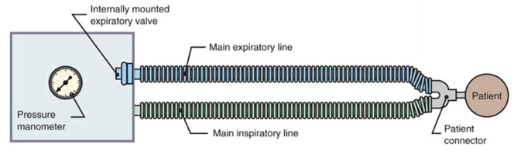
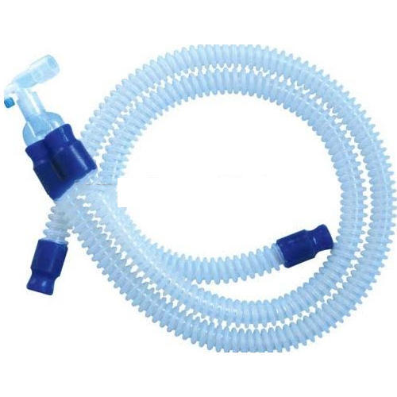
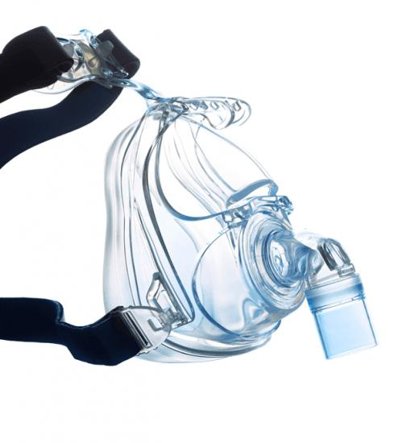
Breathing System
Breathing system forms interface between patient and ventilator
Clinical ventilators are usually connected to patient via inspiratory and expiratory hoses (dual-hose circuit)
Gas flow delivered through inspiratory port passes through breathing gas humidifier before entering patient’s lungs
  To make it adapted to climatic conditions in patient’s lungs
After inspiratory phase, patient exhales through expiratory valve
  Breathing systems of ventilators are referred to as non-rebreathing circuits

Slide 12
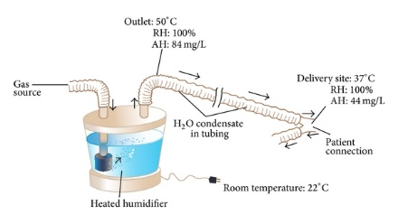
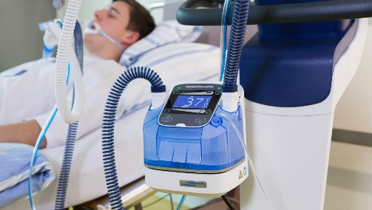
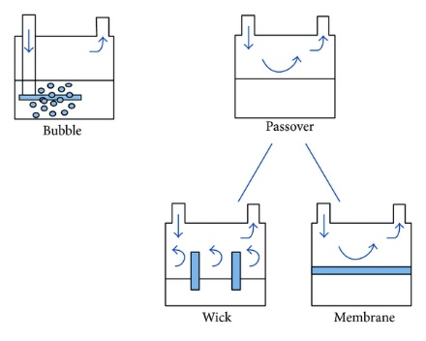
Gas Humidifier
Humidifiers are used to warm and humidify inspiratory gas.
  Dry and cool supply gas dry out the patient’s airways with risk of causing irreversible damage to ciliated epithelium
Active gas humidifiers
  Located in the inspiratory limb and use electrical energy to heat a water bath
  When cold, dry gas passes over the water surface it absorbs water molecules and is thus warmed and humidified
  Examples: pass-over humidifiers and bubble-through humidifiers

Slide 13
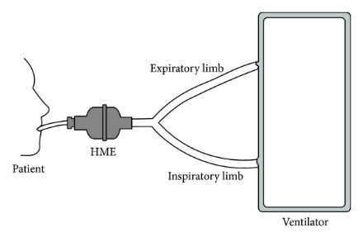
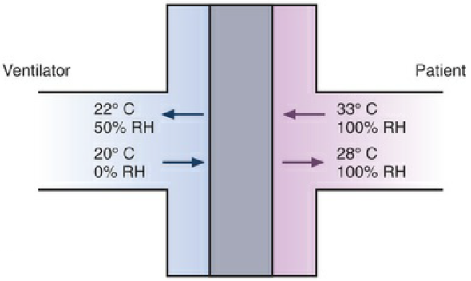
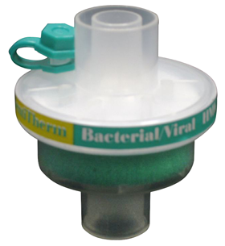
Gas Humidifier
Passive breathing gas humidifiers or heat and moisture exchangers (HMEs)
  Designed to buffer significant fraction of moisture and heat expired by patient
  Retained moisture is then used to condition inspired gas passing through HME during next inspiration

Slide 14
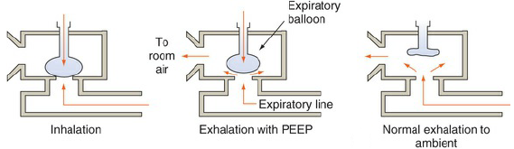
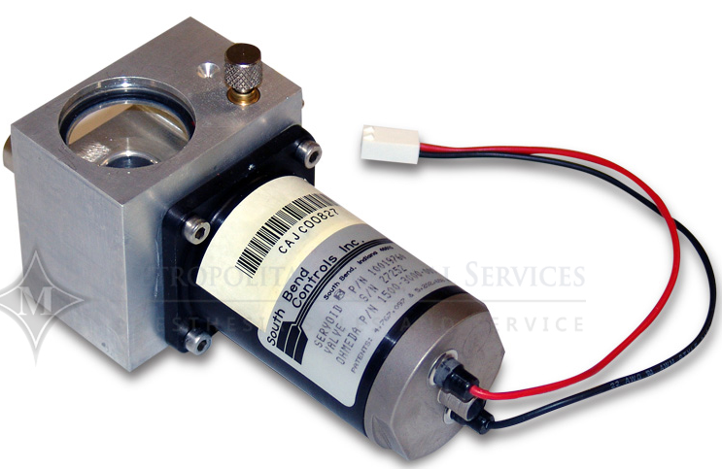
Expiratory (Exhalation) Valve
Allows expired air to move out of breathing circuit
If valve is not opened completely during expiration, positive end-expiratory pressure (PEEP) is created in lungs
  PEEP is therapeutically important as it increases gas exchange surface of lungs
  Adequate PEEP can also prevent collapse of individual alveolar areas
If expiratory valve is controlled during inspiratory phase, it can compensate for undesired pressure rises in breathing system
  Caused, for example, by patient coughing

Slide 15
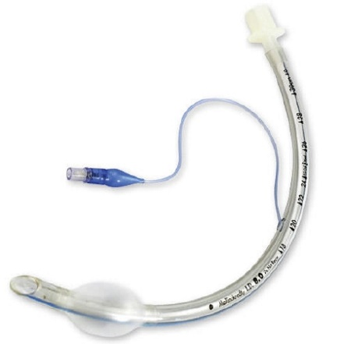
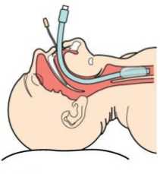
Patient Interface
Noninvasive Ventilation (NIV) vs. Intubation

Slide 16
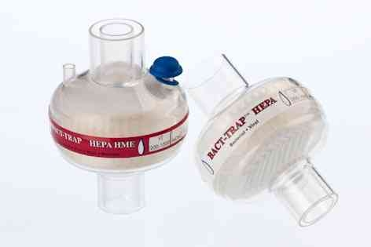
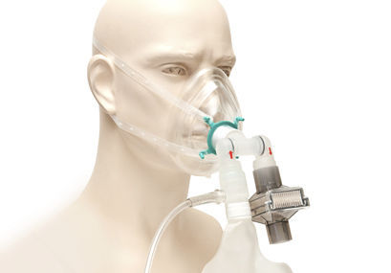
Infection Control: HEPA Filtration
Filtration is the passage of a liquid or gas through a filter with pores small enough to retain microbes
  Membrane filters composed of cellulose esters are commonly used to filter out bacteria, viruses
Microbes can be removed from air by high-efficiency particulate air (HEPA) filters
  Remove almost all microorganisms larger than about 0.3 μm in diameter

Slide 17
Trigger, Limit, Cycle, and Baseline Variables
Trigger variable is one that is measured and used to start inspiration
Limit variable is one that can reach and maintain a preset value before inspiration ends (i.e., does not end respiration)
Cycle variable is one that is measured and used to end inspiration
Baseline variable is the parameter controlled during expiration
  Pressure control is most practical and used in all modern ventilators

Slide 18
Modes of Mechanical Ventilator
“Mode” is defined as a predetermined pattern of interaction between a ventilator and a patient
  There are over 100 names for modes of ventilation on commercially available mechanical ventilators
  Neither the manufacturing community nor the medical community adhere to a standard taxonomy for modes
Breath Control Variable
Breath Sequence
Targeting Scheme
Volume (VC)
Pressure (PC)
CMV
IMV
CSV
Set-point
Adaptive
Servo
Intelligent
Ventilator Mode
+
+
=

Slide 19
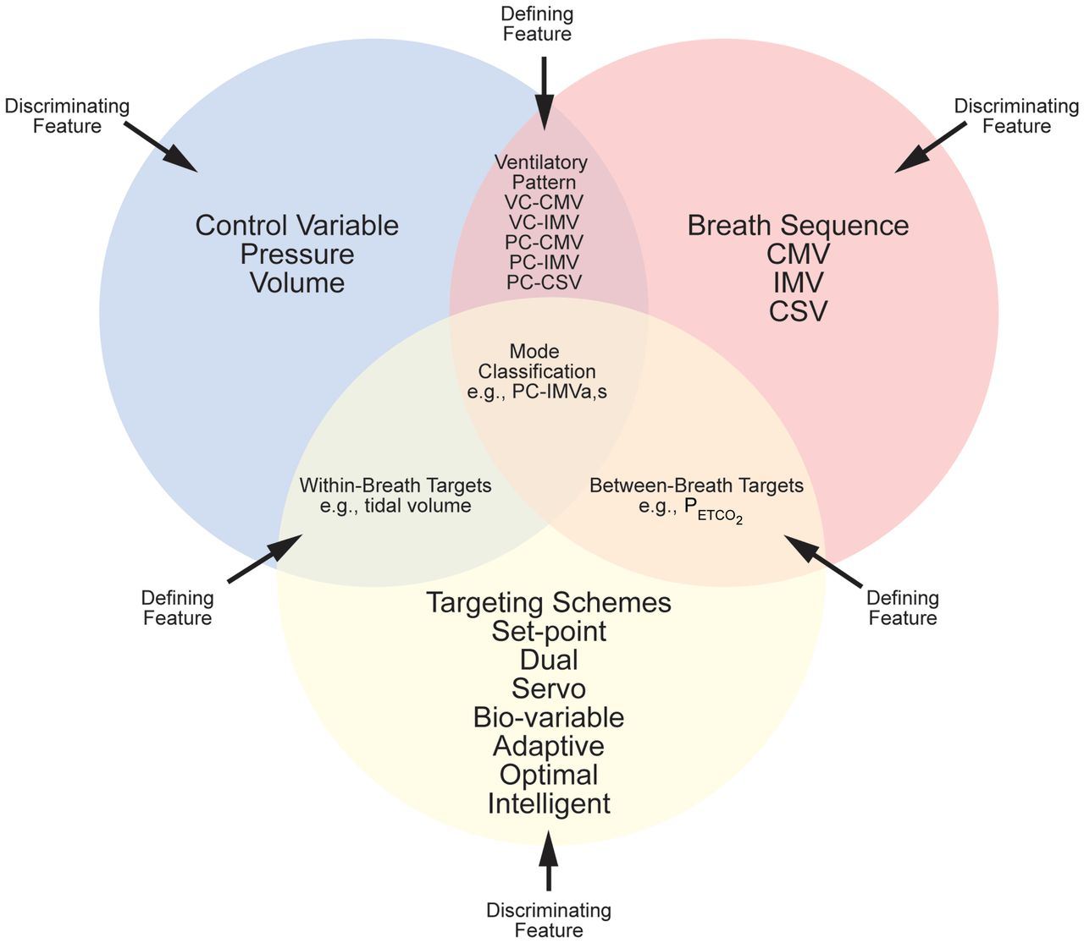
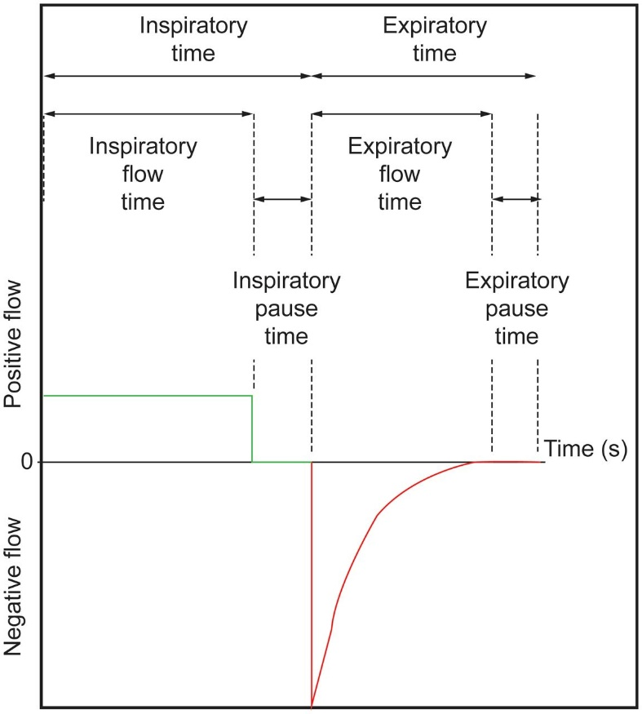
Modes of Mechanical Ventilator

Slide 20
Beginning of Inspiration: Trigger Variable
Time triggering
Patient triggering
  Pressure
  Flow
  Volume

Slide 21
During Inspiration: Control and Limit Variables
Ventilator can control one variable
  Pressure, volume, flow, or time
Limit variable is maximum value variable can attain during inspiration
  Does not end inspiratory phase
  Ventilator can have multiple limit variables
Control
Control

Slide 22
Termination of Inspiration: Cycle Variable
Volume-Cycled Ventilation
Time-Cycled Ventilation
Flow-Cycled Ventilation
Pressure-Cycled Ventilation

Slide 23
Targeting Scheme

Slide 24
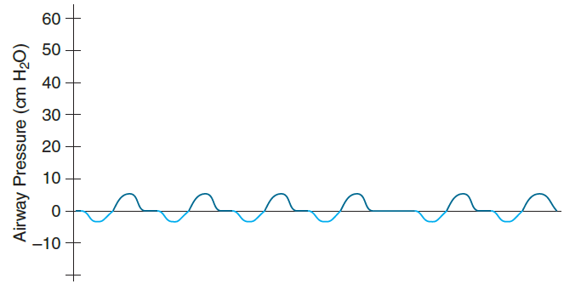

Example Ventilator Modes
Continuous Mandatory Ventilation (CMV)
CPAP
Spontaneous
Pressure-Support (PS)
Synchronized Intermittent Mandatory Ventilation (SIMV)

Slide 25
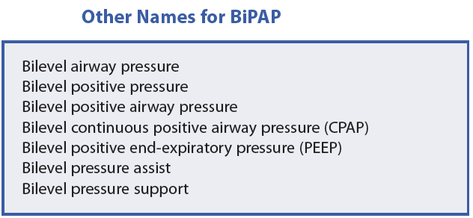
CPAP, PEEP and BiPAP
Continuous Positive Airway Pressure (CPAP)
Positive End-Expiratory Pressure (PEEP or EPAP)
BiLevel Positive Airway Pressure (BiPAP)
CPAP/PEEP + Spontaneous
BiPAP
PEEP + CMV
CPAP/PEEP + IMV

Slide 26
Mechanical Ventilator Functional Diagram
Sensors
  Pressure
  Flow
  Oxygen
  Carbon dioxide
Actuators
  Valves
  Air blower

Slide 27

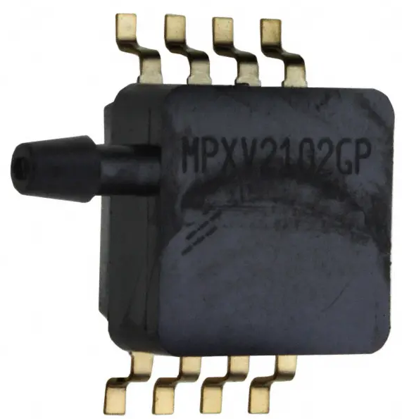
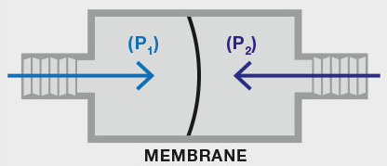
Pressure Sensor
Piezoresistive Sensor
  Solid-state device whose electrical resistance depends on strain of membrane (and hence, pressure)
  Can be designed to be absolute or differential
  Can be selected to have very fast response time
Resistive strain gauge

Slide 28
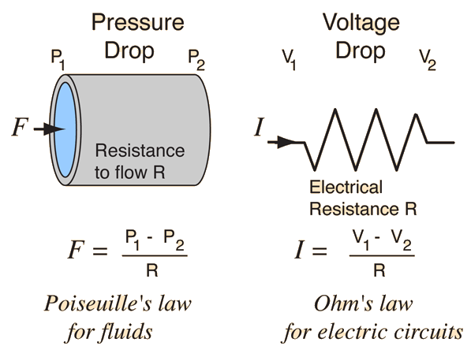
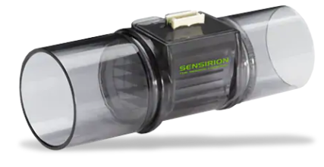
Flow Sensor: Pneumotachograph
Sensing change in pressure across fixed resistance through which gas flow is laminar to calculate flow rate
  Analogous to measuring current through resistance in electric circuits
  Bidirectional operation

Slide 29
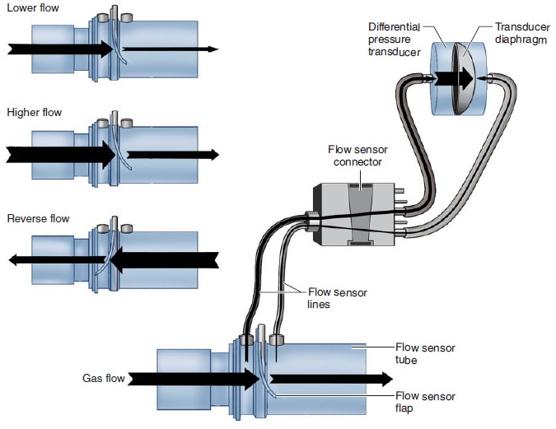
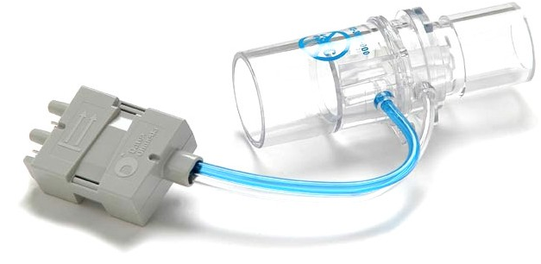
Flow Sensor: Variable Orifice Flowmeter
Pressure measurement across flow-dependent resistance (flap)
  As gas flow increases, flap opens more, reducing resistance to gas flow
  One-to-one correspondence between flow rate and pressure drop
  Bidirectional operation

Slide 30

Flow Sensor: Hot-Wire Anemometer
Resistive wire is placed in flow path and heated using electric current
  Resistance increases linearly with temperature
Flow cools down wire and changes its resistance
  Resistance change can be measured and used to estimate flow rate
Fast and accurate but direction insensitive

Slide 31
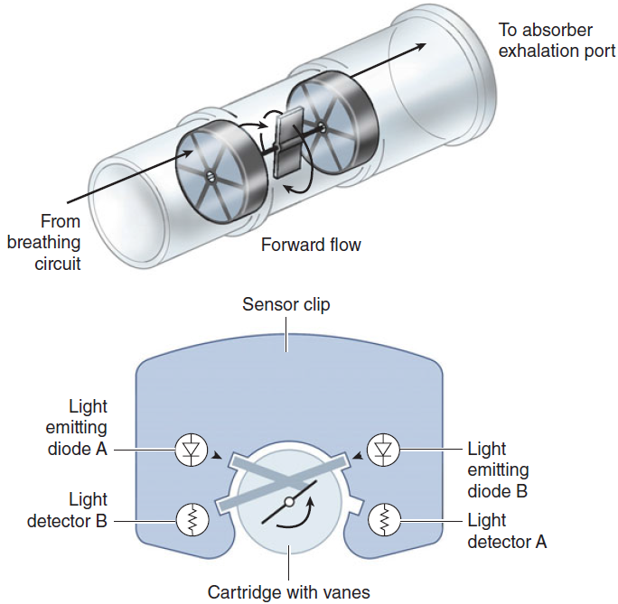
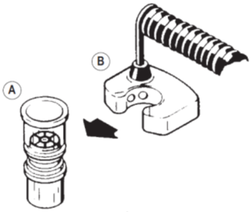
Flow Rate Sensor: Vane Anemometer
Used to measure exhaled tidal volume in breathing circuit near exhalation valve

Slide 32
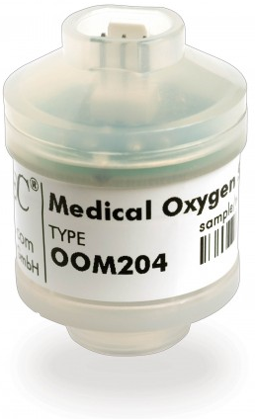
Oxygen Sensor: Fuel Cell or Galvanic Cell
Diffusion of oxygen starts chemical reactions
Flow of current depends on uptake of oxygen at the anode (Faraday’s first law of electrolysis)
  Voltage output is proportional to oxygen partial pressure
Response time (~20-30 s) and depleted by continuous exposure to oxygen because of exhaustion of the cell (less than 1 year lifespan)

Slide 33
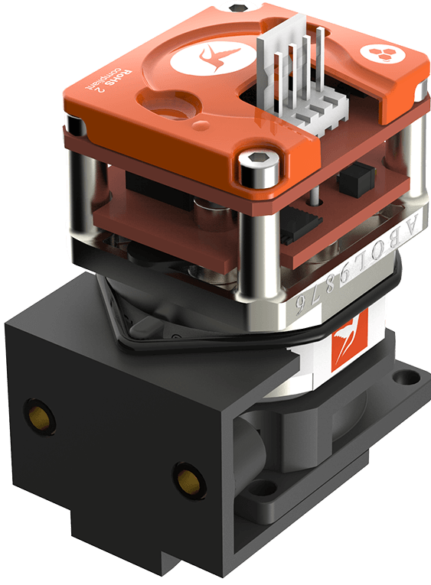
Oxygen Sensor: Paramegnetic
Oxygen is paramagnetic while other gases are diamagnetic
Magnetic field causes oxygen molecules to be attracted and agitated
  Pressure difference proportional to oxygen partial pressure
Very accurate, highly sensitive and fast response
  Allows continuous monitoring
Long lifespan with no service requirements

Slide 34
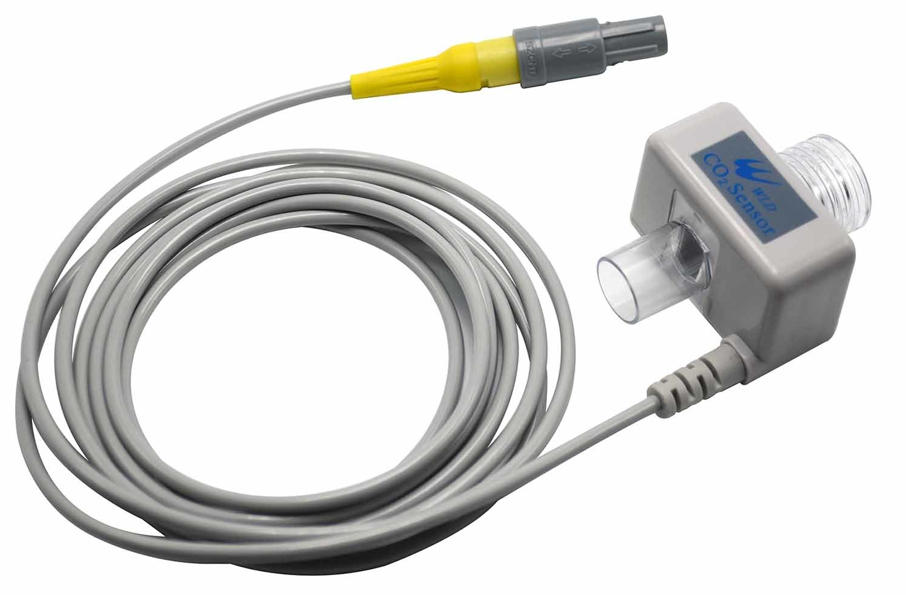
CO₂ Gas Sensor (Capnography)
Infrared absorption spectroscopy
  Based on physical principle that gases absorb infrared radiation at characteristic frequencies
  Level of absorption depends on concentration of molecules according to Beer-Lambert law: Concentration = Absorption constant × ln(I₀/I )
Measures End-Tidal Carbon Dioxide (EtCO₂)
I_{o}
I

Slide 35
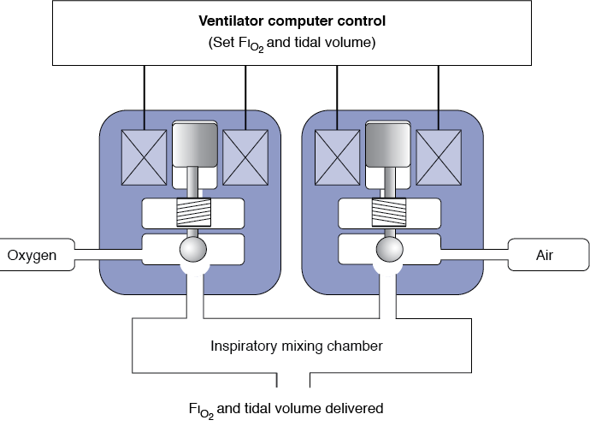
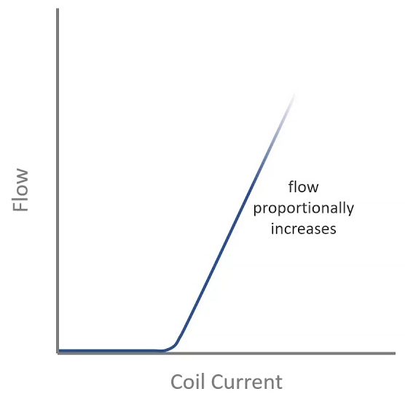
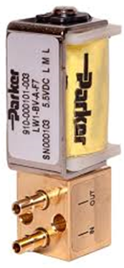
Proportional Solenoid Valves
Idea: constriction causes significant pressure drop
Control of pressure/flow of gases
  Inspiratory valve (control of ventilation mode delivery)
  Expiratory valve (Control of PEEP)

Slide 36
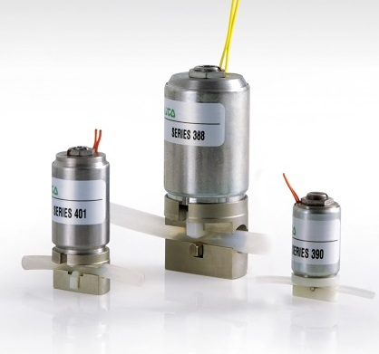
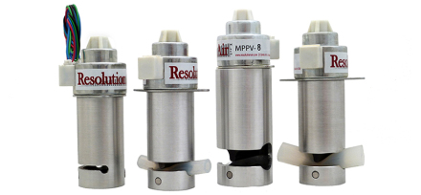
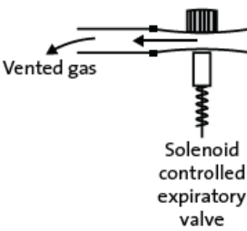
Solenoid Pinch Valves
No contact with air
  No need for sterilization after use
  Particular application: expiratory valve
Proportional control of flow

Slide 37
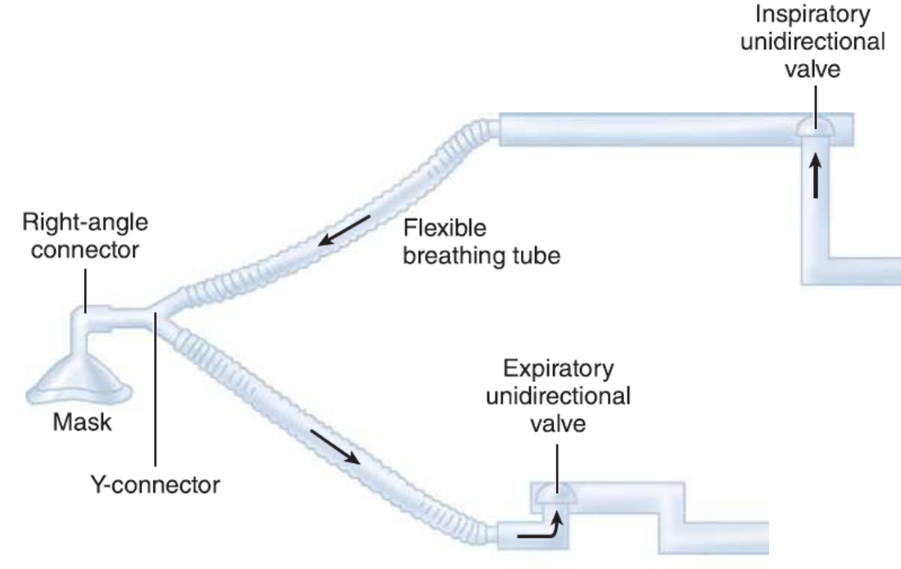
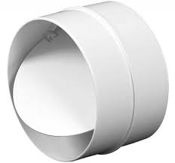
Check Valves
Ensure unidirectional flow in both inspiratory and expiratory limps
Mechanical operation

Slide 38
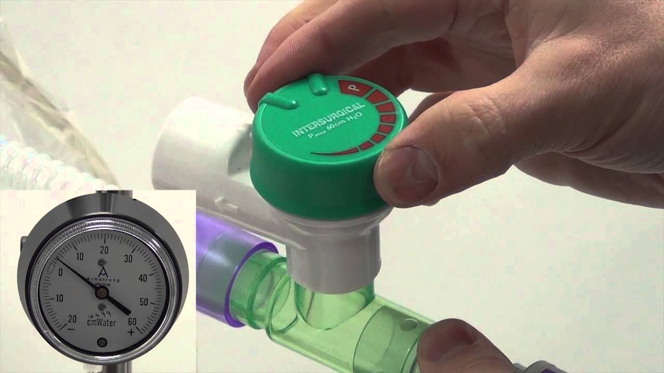
Adjustable Pressure Limiting (APL) Valve
Safety of airway pressure during positive pressure ventilation to avoid barotrauma
Usually a mechanical device but can be implemented as a solenoid valve

Slide 39



Pressure Reduction Valve
Essential for oxygen cylinder interface to ventilators
  Reduction of pressure to 4.1 bar
Mechanical operation

Slide 40




Air Blower
Common technology: Centrifugal Blowers
  Ideal to maintain continual gas transfer and for creating high pressure from small volumes of air
Speed controllable
Silent operation

Slide 41




Electronic Gas Blender
Set values: F_{I}O₂ and tidal volume
Proportional valves for both air and oxygen
  Flowrate in each is proportional to its control signal
Measure pressure and temperature for each to compensate for volume changes
  Gas law: PV= nRT
Solve 2 equations in 2 unknowns to determine flowrates of oxygen and air
Use feedback from oxygen sensor to correct
Target tidal volume = (Flowrate(O₂)+Flowrate(air)) x Inspiratory time
$$\text{Target} \text{FIO}\text{2}\text{ = }\frac{\text{F}\text{lowrate}\text{(}\text{O}\text{2}\text{) }\text{x}\text{ 1 + }\text{F}\text{lowrate}\text{(}\text{air}\text{) }\text{x}\text{ 0.21}}{\text{Fl}\text{owrate}\text{(}\text{O}\text{2}\text{) + }\text{F}\text{lowrate}\text{(}\text{air}\text{)}}$$
Oxygen Sensor
Control Signal 1
Air
Isolated Drivers
Control Signal 2
O₂
Feedback

Slide 42

Typical Ventilator User Interface
Mode
IPAP/EPAP
Rate
F_{I}O₂
Tidal volume
Pressure, flow, volume
Alarm messages

Slide 43
Ventilator Safety Alarm System
Level 1 events include life-threatening situations
  Loss of input power or ventilator malfunction (e.g., excessive or no flow of gas to the patient)
  Alarms in this category should be mandatory (not subject to operator choice), redundant (multiple sensors and circuits), and non-canceling (alarm continues to be activated, even if event is corrected, and must be reset manually)
Level 2 events can lead to life-threatening situations if not corrected in a timely fashion
  Such things as blender failure, high or low airway pressure, auto-triggering, and partial patient circuit occlusion, and may include suspicious ventilator settings such as an inspiratory-to-expiratory timing (I:E) ratio greater than 1:1
  Alarms for level 2 may not be redundant and may be self-canceling (i.e., alarm inactivated if event ceases to occur)
Level 3 events affect patient– ventilator interface and may influence the level of support
  Such events as changes in patient compliance and resistance, changes in patient respiratory drive, and auto-PEEP
Level 4 events reflect the patient condition alone rather than ventilator function
  Usually detected by stand-alone monitors, such as oximeters, cardiac monitors, and blood-gas analyzers
  Some ventilators are able to incorporate such readings (e.g., capnography) in their displays and alarm systems

Slide 44
Example Practical Alarm System

Slide 45

Alarm User Interface
Alarm Setting
Alarm Fatigue
“While device alarms can improve medical care by arming clinicians with valuable information about their patient’s health, most are false or nonactionable, often resulting in a sensory clutter that overwhelms clinicians and caregivers, desensitizing them to the alerts”, AAMI

Slide 46

Advanced Issues: Breathing Circuit Model
Weak link in patient–ventilator system is patient breathing circuit
  Expensive ventilator with state-of-the-art computer control is connected to patient (priceless) with $2 piece of plastic tubing whose design has not changed appreciably in 20 years
  Resistance and compliance of delivery circuit make flow control and volume delivery more difficult
Breathing Circuit
Patient
Mechanics Electricity
Pressure ➔ Voltage
Flow ➔ Current
Volume ➔ Charge
Resistance ➔ Resistance Compliance ➔ Capacitance
Breathing Circuit
Patient

Slide 47

Advanced Issues: Leakage Compensation
Leaks are inherent to patient interfaces and circuits in NIV
  Monitoring and compensating for leaks associated with NIV is critical for maintaining the appropriate trigger and cycle levels for the ventilator
  This is critical to assessing mask seal efficacy and preventing overtightening of the mask that may result in pressure sores
Uncompensated leaks generate auto-triggering, prolonged cycling, ineffective inspiratory efforts, and poor pressurization capacity of ventilator

Slide 48


Recommended Readings
J.M. Cairo, Pilbeam's Mechanical Ventilation: Physiological and Clinical Applications, 5th Ed., Elsevier, 2012.
Martin J. Tobin, Principles And Practice of Mechanical Ventilation, 3rd Ed., McGraw Hill Medical, 2012.

