Slide 1

Computed Tomography
Prof. Yasser Mostafa Kadah
EE 472

Slide 2
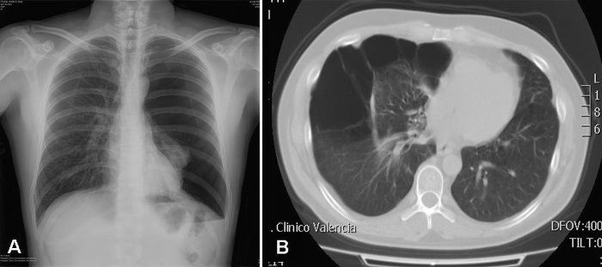
Computed Tomography (CT)
Tomography aims to image slice of the body using x-rays
  Eliminate overlap problem in projection imaging
  Each point in image represents single point in reality not accumulation of many points

Slide 3
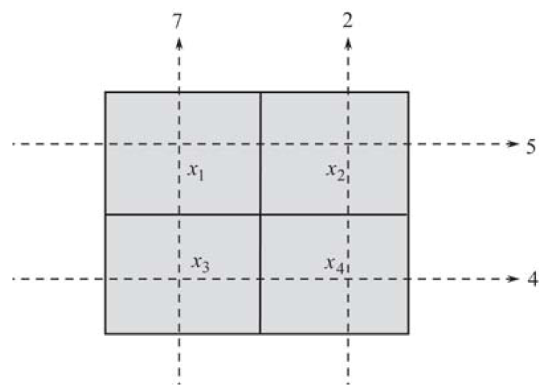
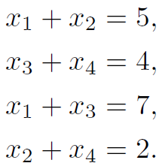
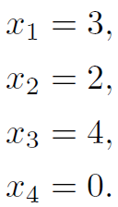
Basic Idea: Image Reconstruction from Projections
For an N×N image, we have N² unknowns to estimate
Collect projections of the object from different angles
Estimate unknowns by Solving linear system of equations
Practical Problem: huge size of linear system (N²xN² matrix)

Slide 4
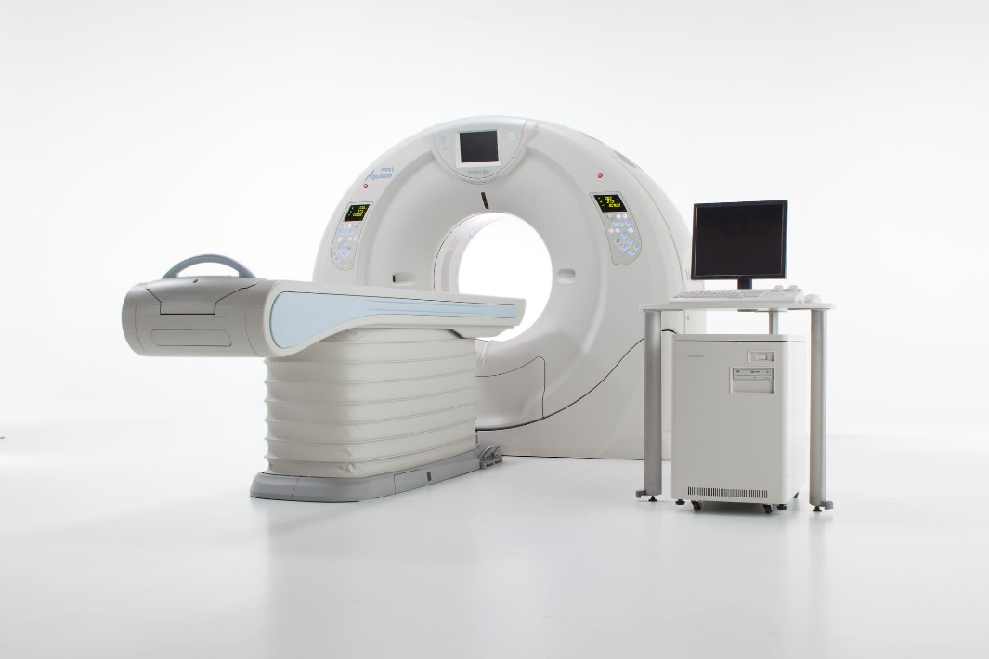
CT System Components

Slide 5
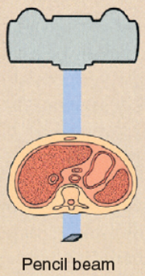
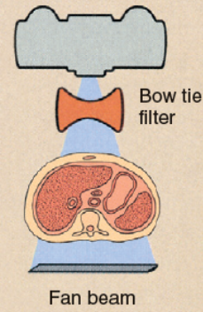
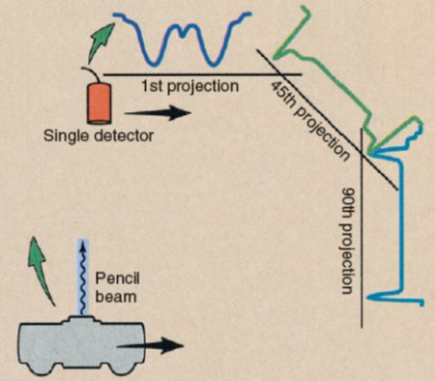
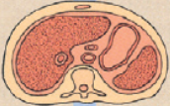
CT Scanner Design Generations
Pencil beam to fan beam: parallel to fan beam projection systems
First Generation
Second Generation
Third Generation
Fourth Generation

Slide 6
Helical (Spiral) CT

Slide 7
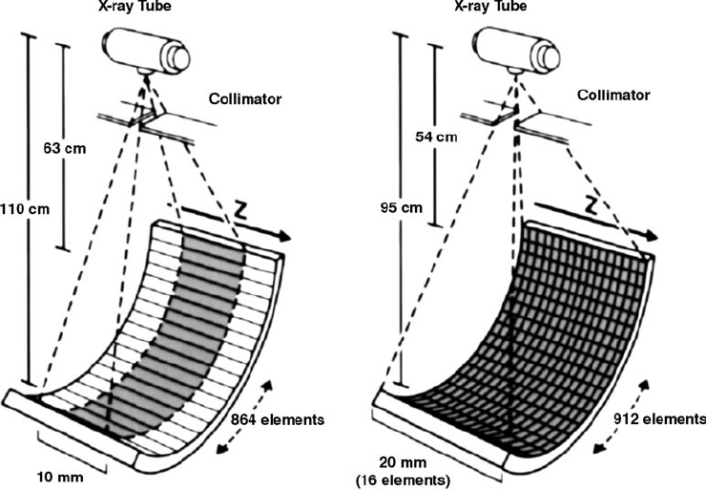
Multi-Slice Helical CT

Slide 8
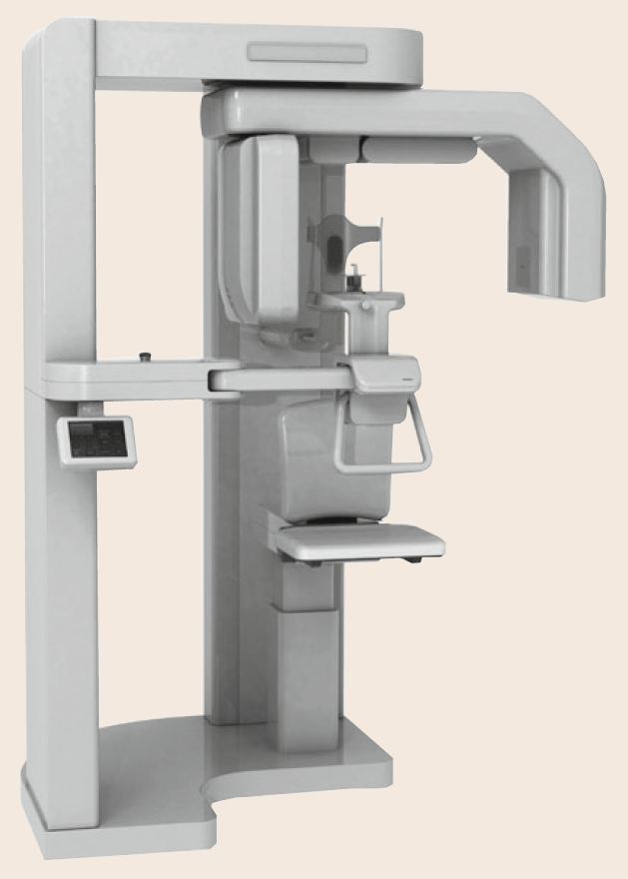
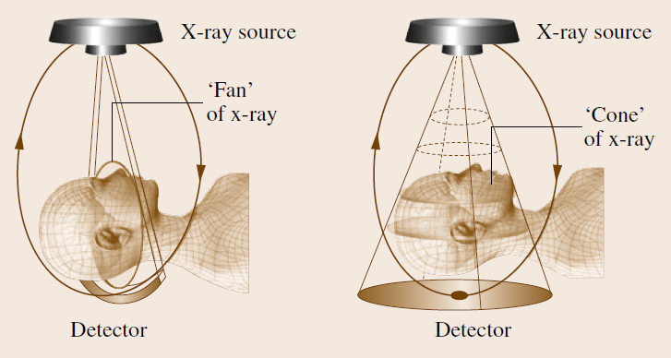
Cone Beam CT
Cone shaped x-ray beam + 2D array of detectors
  Mainly used for dental imaging applications now

Slide 9
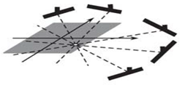
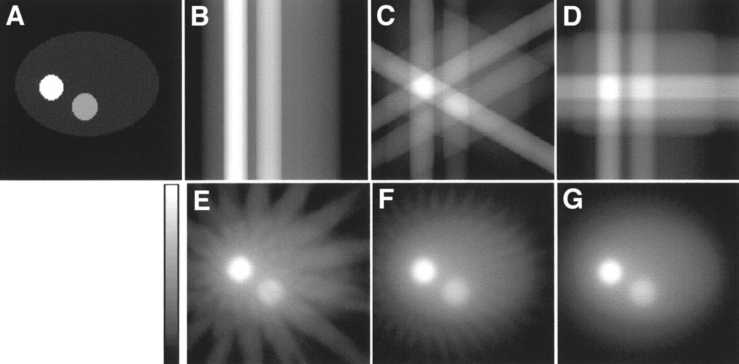
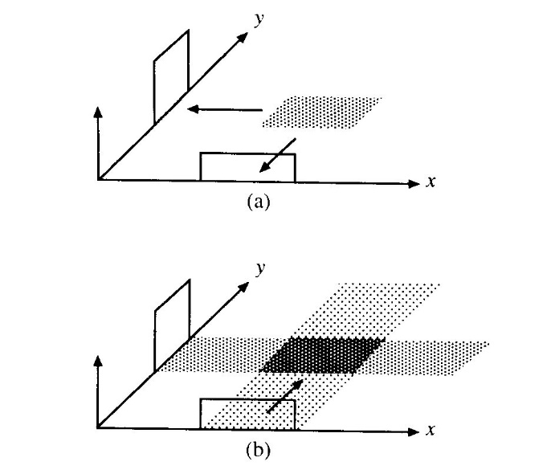
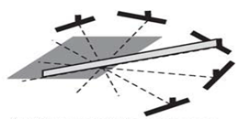
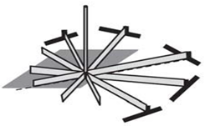
Back-Projection Reconstruction
Efficient method to solve large linear system equations
Idea: Distribute back projection data equally along their paths

Slide 10
Back-Projection Example
3
0
0
True
Image
0
0
0
Projection Data
0
0
3
0
3
0
0
0
0
0 3 0
0
0
0
0
1
0
0
1
0
1
1
0
0
0
0
0
1
0
1
2
1
1
3
1
0
0
0
0
1
0
0
1
0
0
1
1
Initial
Solution
Iterate until sufficient accuracy is achieved

Slide 11
Algebraic Reconstruction Technique (ART)
A low-complexity iterative solver to the algebraic reconstruction problem
Starts with an initial estimate and tries to push the estimate closer to the true solution
  Instead of back-projecting the average ray value, the error between the projection computed from current estimate and the true is used
Update = (True Projection – Estimated Projection) divided over all points in projection path

Slide 12
ART Example
15
8
6
True
Image
1
2
3
Projection Data
12
4
5
6
15
7
8
9
24
12 15 18
0
0
0
4
5
6
1
2
3
1
2
3
0
0
0
4
5
6
4
5
6
4
5
6
0
0
0
4
5
6
7
8
9
7
8
9
Initial
Solution
Iterate until sufficient accuracy is achieved

Slide 13
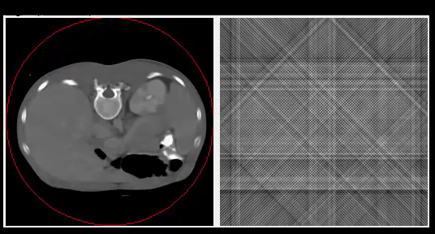
Demo of Image Reconstruction

Slide 14

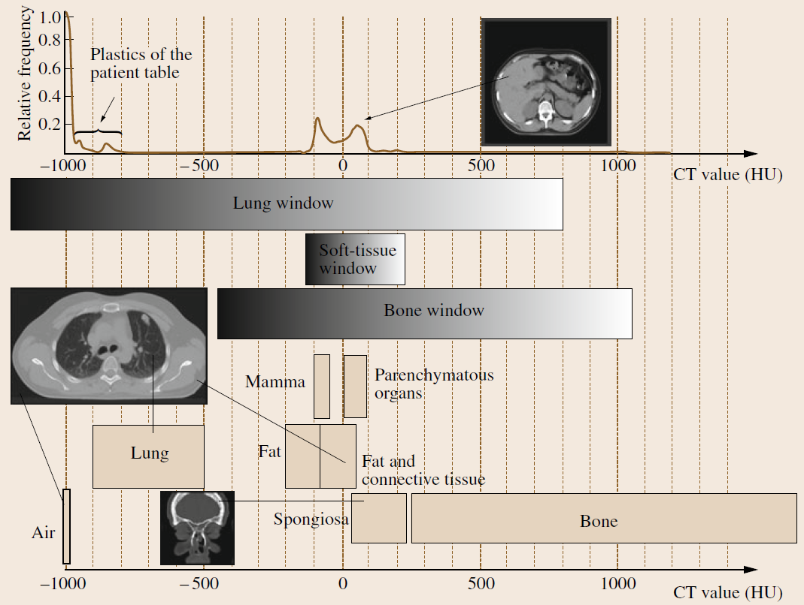
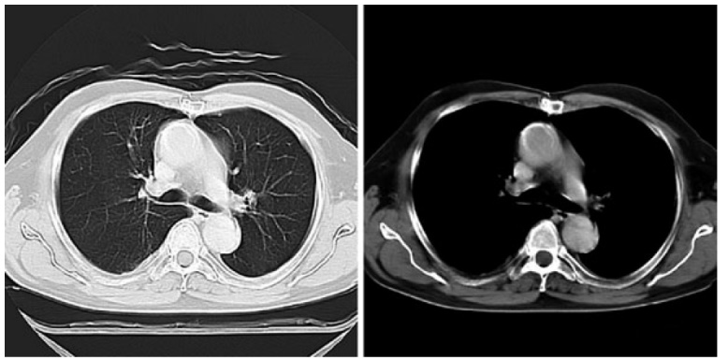
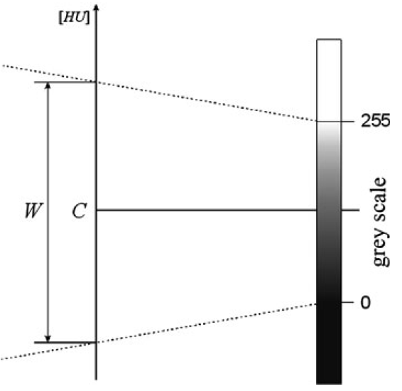
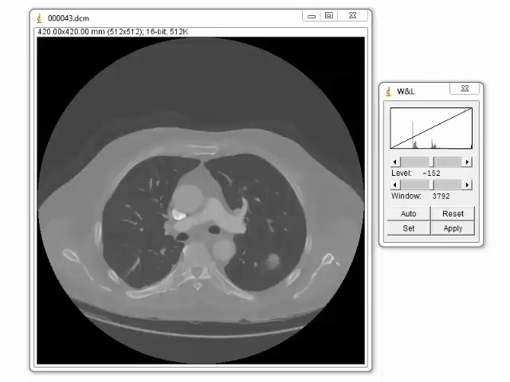

CT Numbers and Hounsfield Units
CT number is the value of CT image pixels expressed in Hounsfield units (HU)
  Value usually varies in the range -1,000 (air) to 3,000 (bone)
  To properly view CT image, it is necessary to apply a so-called window (center C and width W)

Slide 15
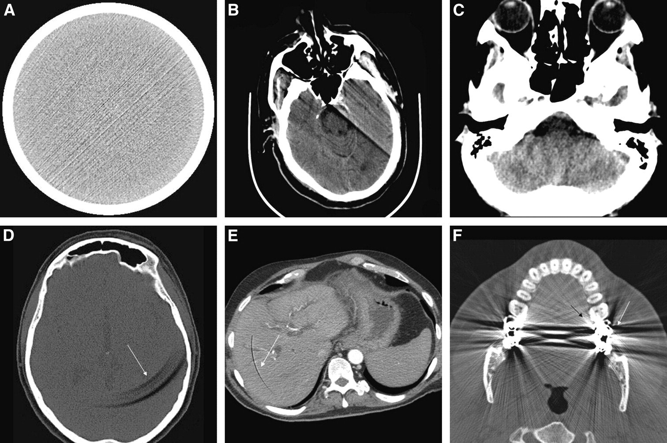
CT Image Artifacts
Numerical errors in image reconstruction on computers
Common CT artifacts:
  (A) Streak artifact
  (B) Motion artifact
  (C) Beam-hardening artifact
  (D-E) Ring artifacts
  (F) Bloom (metal) artifact

Slide 16
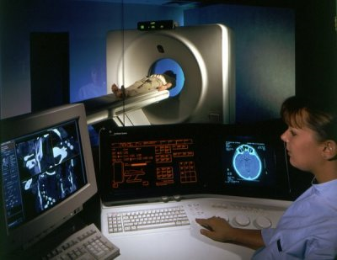
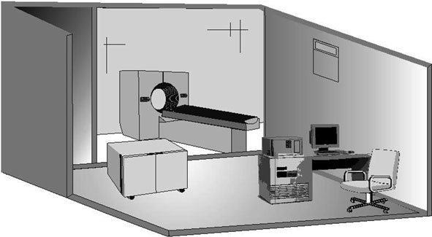
CT Installation
CT room must meet several requirements
  it must have floors with adequate load-carrying capacity
  its walls must be constructed of X-ray absorbing material (this is usually a barium (Ba) plaster)
  the floor should be lined with material that is both anti-slip and antistatic
Separate rooms for CT scanner and radiographers;
  Separated by special protective window-glass (containing lead, Pb)

Slide 17
Evaluation of CT Devices
The final CT image is produced as a result of a whole chain of processes and is affected by a range of factors
  Technical parameters of the scanner
  Type of projection system
  Type of reconstruction algorithm applied
Assessment of the physical and technical capabilities of CT scanners is made possible by the establishment of standardized, quantitative, comparative criteria.

Slide 18
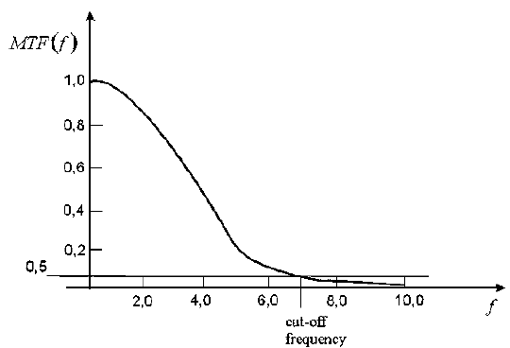
Technical Parameters of CT Devices
Cycle Time: The total time taken to scan and reconstruct the image
  The smaller the cycle time, the greater the chance of avoiding creation of artifacts caused by patient movement, including physiological movements such as beating heart or chest movements while breathing
Spatial Resolution: The minimum area in the image in which changes can be detected
  This quantity is defined using the transfer function of the scanner G(fx, fy) (called often modulation transfer function or MTF)
    MTF defines frequency domain relationship between original and reconstructed image in presence of noise, and determines ability of scanner to capture rapidly changing attenuation coefficients in object
  Spatial resolution is most often defined in terms of cut-off frequency of MTF
    Value at which function MTF(f) drops to 50%, 10% or 2% level

Slide 19

Technical Parameters of CT Devices
Low-Contrast Resolution (Contrast Detail): Ability to detect small differences of attenuation in tissues
  It is defined as ratio between the smallest detectable difference of attenuation coefficient (on the Hounsfield scale) and the average value within an object of a given size, for a specific radiation dose
    This last factor is introduced because low-contrast resolution is proportional to the radiation dose
  Current scanners have a resolution of between 0.3 and 0.4%. This can be increased by increasing the radiation dose or extending the scanning time
Uniformity: Measure of homogeneity of image (or rather heterogeneity)
  This can be calculated from average attenuation coefficients measured at selected areas of uniform standard water phantom as:
    where μ^{max}(x,y) is the highest average attenuation coefficient from among all the selected areas of phantom; μ^{min}(x,y) is the smallest average attenuation coefficient from among all the selected areas of phantom

Slide 20
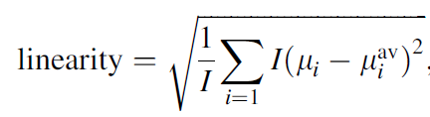
Technical Parameters of CT Devices
Linearity (Sensitometry): defines the relationship between the attenuation coefficients measured at the average energy of the scanner and the values assigned to them on the Hounsfield scale for all types of tissue, using the formula
    μ_{i} is attenuation coefficient assigned to given tissue, on Hounsfield scale
    μ_{i}^{av} is attenuation coefficient measured at average energy of scanner
    I is number of tissues under consideration

Slide 21
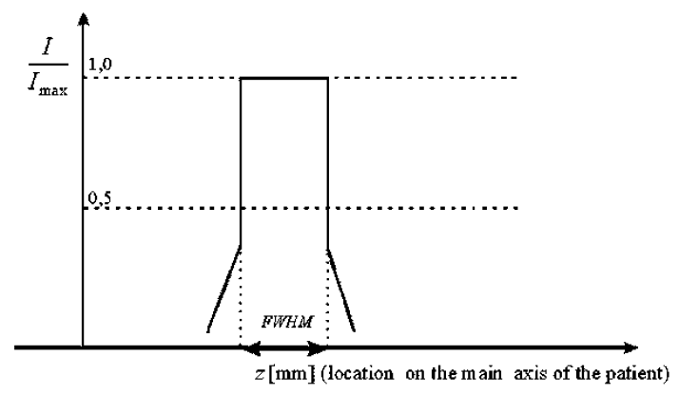
Technical Parameters of CT Devices
Slice Thickness: nominal thickness of image cross-section
  This is often determined using value of full width at half maximum (FWHM) of scanner
    Defined by sensitivity function of the scanner (Example of simplified sensitivity function is shown)
  Slice thickness is distance between two points on graph of sensitivity function which have values equal to half maximum value
    Typical value for this parameter would be in range 0.4–10 mm

Slide 22
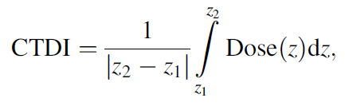
Technical Parameters of CT Devices
Computed Tomography Dose Index (CTDI): Index measured in milligrays (mGy) and defines what dose patient absorbs when scanned by particular CT apparatus
  CTDI is determined by:
    Dose(z) is distribution along z-axis of dose absorbed by phantom during test
    z₁, z₂ are start and endpoints on z-axis of measurements made by dosimeter
  Total dose absorbed by patient should not exceed permissible levels
    Much of efforts of CT manufacturers are currently directed towards minimizing this dose

Slide 23

Technical Parameters of CT Devices
Pitch: Ratio between displacement of table with patient on it and thickness of scanned layer for one revolution of the scanner
  This factor is only relevant to spiral scan systems
    λ is relative travel of spiral described by tube as it moves around test object in mm/rad
    SW is nominal thickness of layer in mm

Slide 24
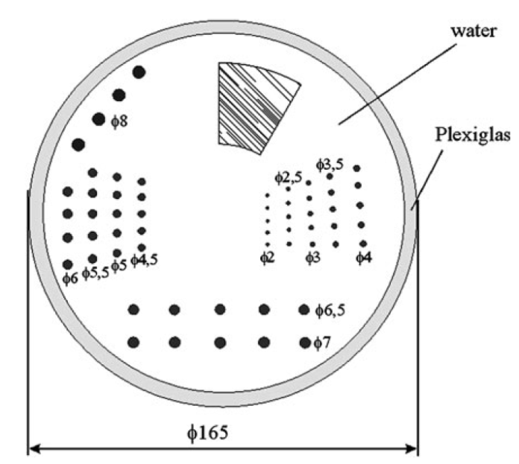
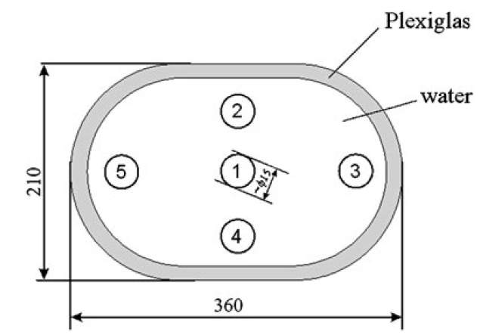
Quality Control Phantoms
ATS Phantom proposed by American Association of Physicists in Medicine (AAPM)
  Designed to test low-contrast resolution
  Situated inside Plexiglas housing of this phantom are rows of circular inserts with diameters that change from row to row
  These inserts have adjustable attenuation coefficient values, expressed on Hounsfield scale with whole of inside of phantom filled with water
Moström’s Phantom
  Used to measure Linearity (sensitometry) or homogeneity of image
    In example phantom illustrated, parameter I = 5

Slide 25
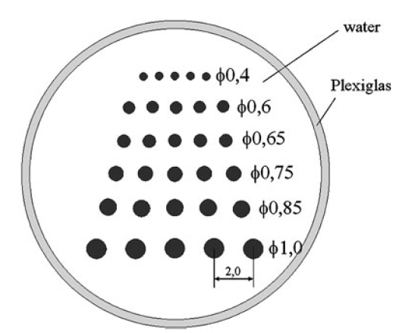
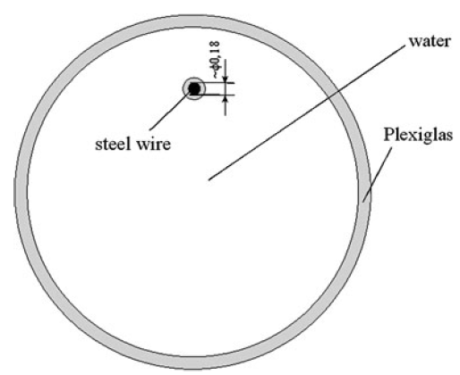
Quality Control Phantoms
Low-contrast Resolution Phantom
  Earliest design of phantom used to measure low-contrast resolution
  Metal rods, shown immersed in water in diagram, are arranged in rows, where both diameter d_{i} and distance between rods 2d_{i} decrease as index i of row increases
  Low-contrast resolution of scanner is determined by smallest diameter of rod, which is visible as distinct element in reconstructed image
Spatial Resolution Phantom
  Spatial resolution (units: lp/cm) is determined by use of phantom to measure point spread function
  In this phantom, length of stainless steel wire is placed perpendicular to test cross-section
  MTF, which directly determines resolution of scanner, can be calculated using Fourier transform of reconstructed image
    Because diameter of wire is small in relation to size of pixels, it can be neglected in calculation

Slide 26
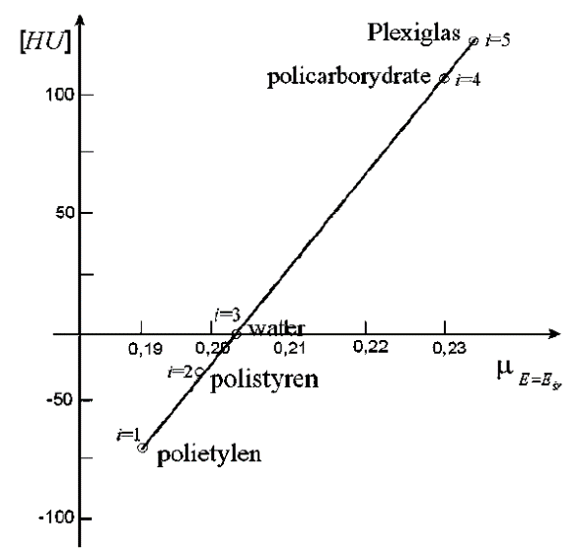
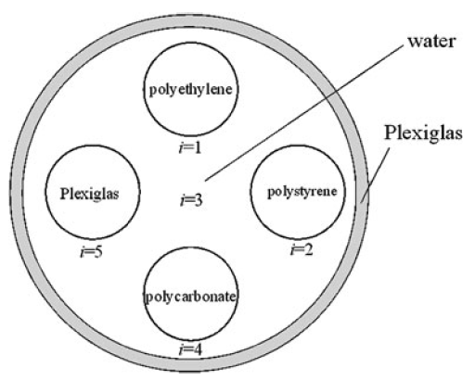
Quality Control Phantoms
CT Linearity Phantom
  Assess the linearity of the tomographic image (parameter I = 5)
  The five materials used here are selected according to the Hounsfield number assigned to them chosen to cover the widest possible range of the scale
  By drawing a graph of the relationship between the Hounsfield numbers assigned to these materials and their attenuation coefficients measured by the scanner (at the average radiation energy), we can establish the nonlinearity parameter based on its equation

Slide 27
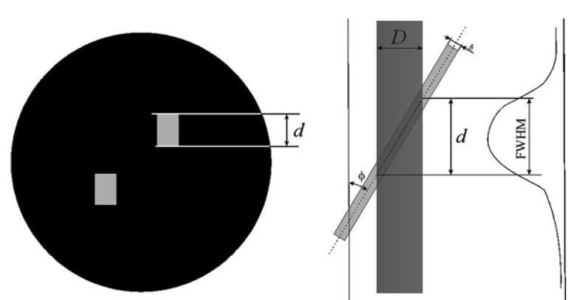
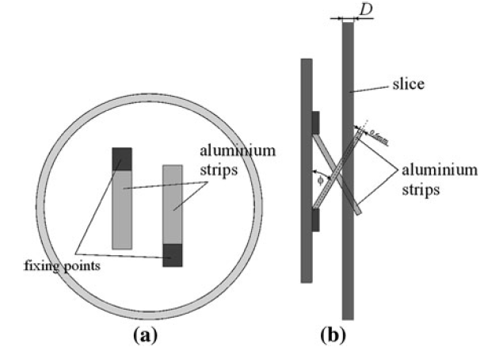


Quality Control Phantoms
Slice Thickness Phantom
  This phantom has two aluminum strips of thickness b = 0.6 mm inclined to reconstruction plane at fixed angle φ (30 or 45 degrees)

Slide 28
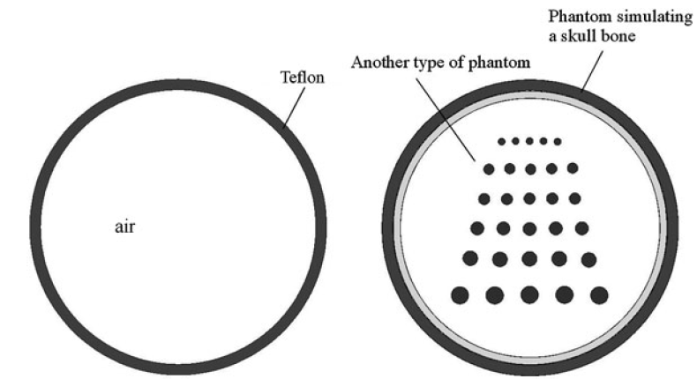
Quality Control Phantoms
Phantom Simulating Skull Bone
  Filters are often used in reconstruction algorithms to compensate for the distortions to the image at boundary between skull and brain.
  Use of phantoms described before would cause these filters to have an adverse effect on reconstructed image in absence of skull bone
  For that reason, a Teflon rim, as shown is usually fitted to one of the phantoms described above to simulate the skull bone

Slide 29
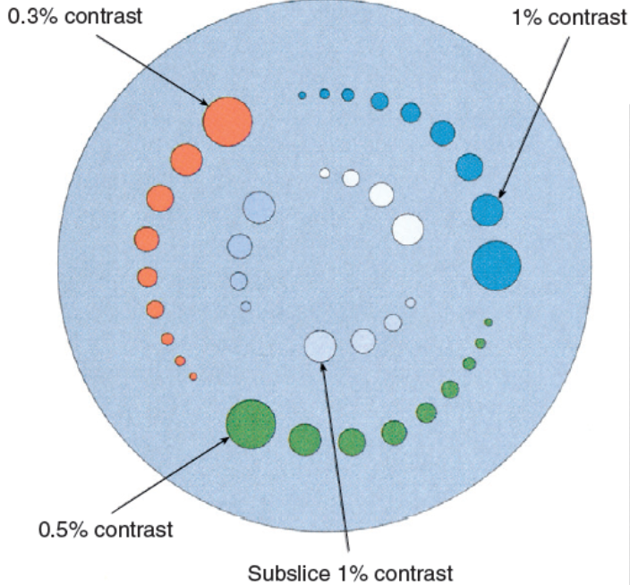
Quality Control Phantoms
Measure CT image quality parameters
  Examples: uniformity, linearity, spatial resolution, contrast resolution, slice thickness

Slide 30
Start-Up and Test Procedures
To ensure reliable operation of CT scanner throughout the whole of its working life, it is important that all manufacturer’s recommended procedures for startup and testing are followed
After sliding the table out of the scanner’s gantry (Feed Out), image quality is tested (Test Image), but without the emission of radiation to confirm the correct operation of the imaging system
Next step is to prepare x-ray tube for operation by heating it up (Warm Up).
Next step (Calibration) takes place in the absence of any radiation-absorbing material in the gantry of scanner.
  Measurements made at this time form the basis of the corrections that must be made to the projections obtained during the routine operation of the scanner

Slide 31
Start-Up and Test Procedures
After calibration, procedures testing operation of CT scanner are carried out
  Qualitative tests, performed each day or weekly
  Stability tests, performed each month
  Annual tests
Set of daily/weekly tests performed by technicians to check quality of reconstructed image
  Test to measure homogeneity of image
  Test of point spread function
  Check of X-ray tube voltage
Battery of tests performed by service personnel or technicians on monthly basis
  Spatial resolution
  Positioning accuracy
  Linearity
  Slice thickness

Slide 32
Start-Up and Test Procedures
Annual tests might be combination of several examinations and performed by physicists
  Daily/weekly tests
  Index accuracy and table positioning test
  Contrast scale test
  Distance accuracy test
  Patient dose
In emergency, if time needed to perform entire start-up procedure could affect life or health of patient, fast start-up procedure may be carried out
Appropriate tests should also be carried out on scanner after installation/upgrading of equipment and after any routine maintenance or servicing
  Application software installed on the scanner’s computer enables results of tests to be saved, so creating historical record of device for purposes of comparison

Slide 33
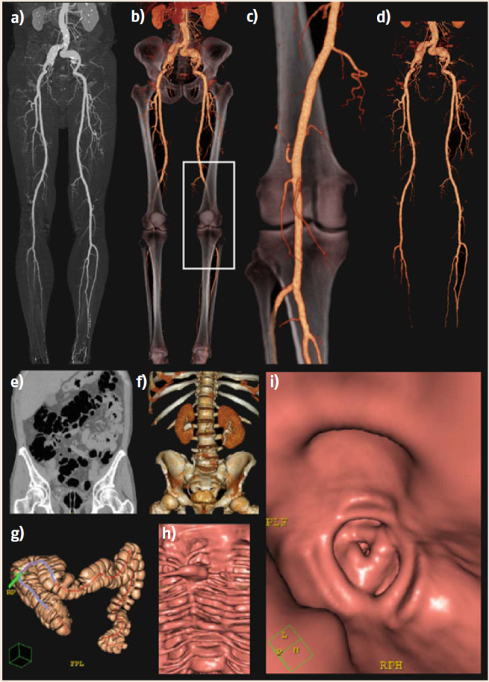
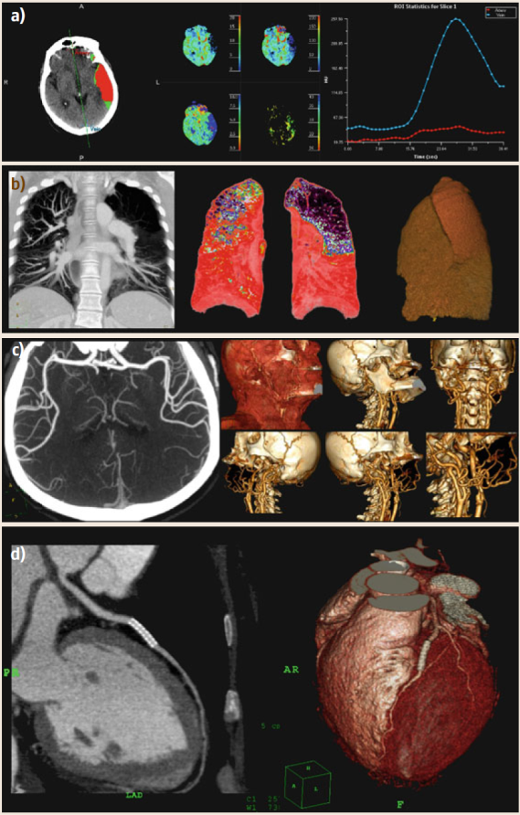
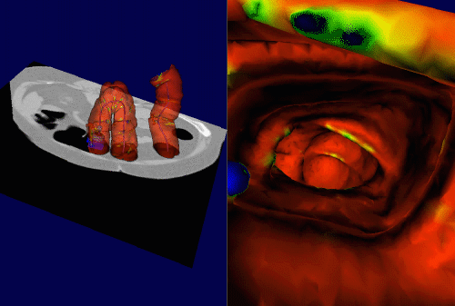
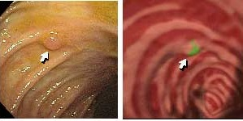
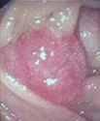
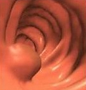
CT Imaging Applications

Slide 34
CT Exposure Dose (Micro Sievert)
5
100
Chest
400
Breast
3000
Average Normal Yearly Exposure
10000
Virtual Colonoscopy
15000
CT on Abdomen and Pelvis
Dental

Slide 35
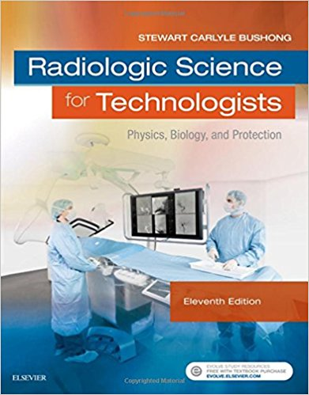

Recommended Readings
Stewart C. Bushong, Radiologic Science for Technologists: Physics, Biology, and Protection, 11th ed., Mosby, 2017.
  Chapter 28
Robert Cierniak, X-Ray Computed Tomography in Biomedical Engineering, Springer, 2011.
  Chapters 3, 4, 9

