Slide 1

Magnetic Resonance Imaging
Prof. Yasser Mostafa Kadah
EE 472

Slide 2
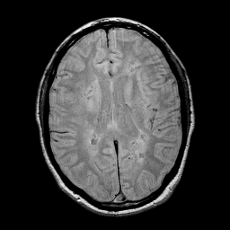
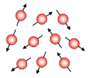
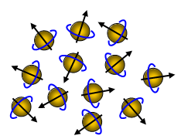
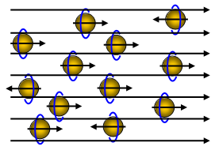
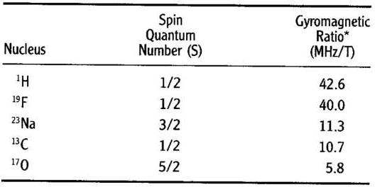


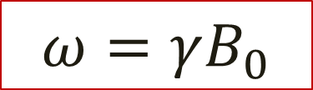
Basic Idea
Mapping distribution of Hydrogen in human tissues
Nuclear magnetic resonance phenomenon (Bloch and Purcell, 1946)
  Nuclei of some atoms with odd number of protons or neutrons act as tiny bar magnets aligned randomly with net magnetization of zero
  With applied external magnetic field B0, tiny magnets tend to align with magnet
    Nonzero net magnetization results
  Communication with such nuclei is possible at resonance or Larmor Frequency
Net = 0
Net ≠ 0
$$ω=γB_{0}$$
No Magnetic Field
Applied Magnetic Field B0

Slide 3
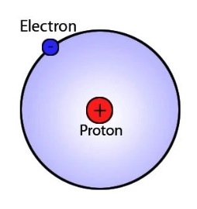
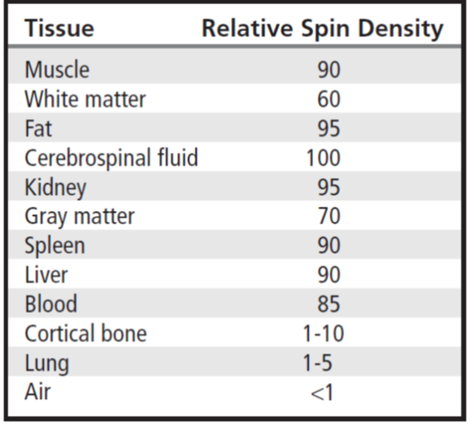
Why Protons?
Natural abundance and tissue abundance
Essential part of all organic compounds
  Variations unique to different tissue types
Element | Biological Abundance
Hydrogen (H) | 0.63
Sodium (Na) | 0.00041
Phosphorus (P) | 0.0024
Carbon (C) | 0.094
Oxygen (O) | 0.26
Calcium (Ca) | 0.0022
Nitrogen (N) | 0.015
Element | Symbol | Natural Abundance
Hydrogen | ¹H | 99.985
 | ²H | 0.015
Carbon | ¹³C | 1.11
Nitrogen | ¹⁴N | 99.63
 | ¹⁵N | 0.37
Sodium | ²³Na | 100
Phosphorus | ³¹P | 100

Slide 4

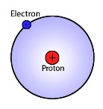

Communication with Nuclei: Proton
Step 1: Apply strong static magnetic field
  Protons act as radio tuned to Larmor frequency
Step 2: Send radiofrequency pulse at Larmor frequency of proton
  Protons only can listen to this frequency – other nuclei are not tuned to it
  Energy in RF pulse is absorbed by protons raising their energy level
Step 3: Protons with high energy level return to their ground state
  Protons act as radio station sending radiofrequency at Larmor frequency
  All received RF energy at this Larmor frequency come only from protons
  By measuring received energy, count of protons can be estimated
1
MRI
2
Proton
MRI
3
Proton

Slide 5
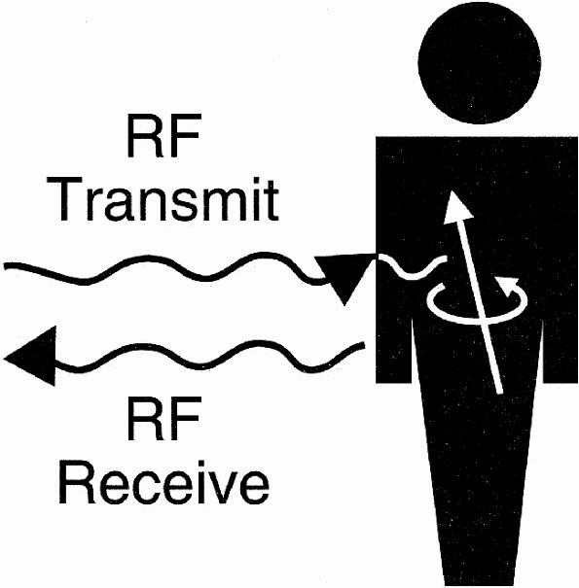
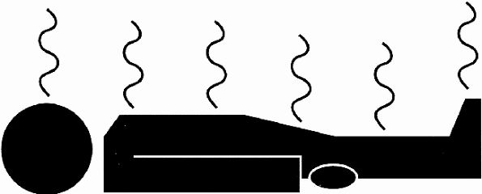
Steps to Perform MR Imaging
M: Magnetic Field
  Patient is placed inside magnet
R: Radio-Frequency (RF) Pulse
  RF pulse is applied
R: Relaxation
  After RF application, signal is collected from relaxation

Slide 6
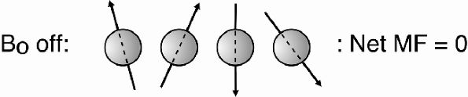
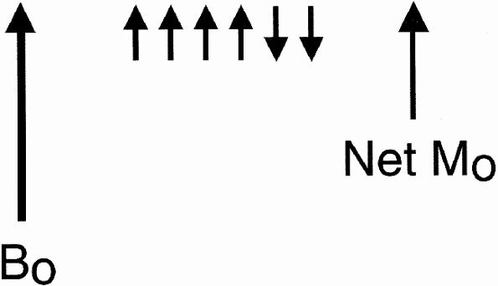
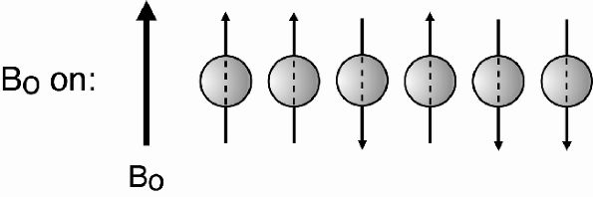
B0 Field
External magnetic field is denoted B0 (read as “B-zero”)
In MRI, B0 is in Tesla (T) range
  1 Tesla is equal to 10,000 Gauss

Slide 7
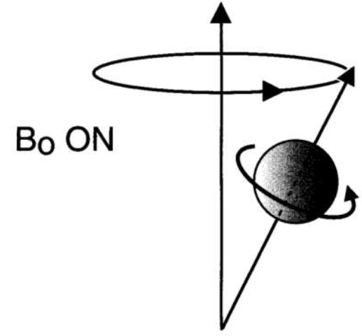
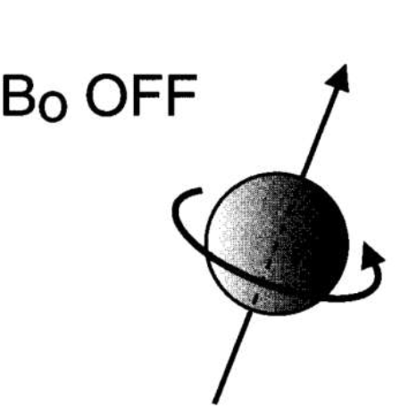
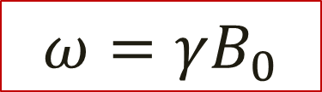
Precession
When proton is placed in strong magnetic field, it begins to wobble or precess
Rate of precession around external magnetic field is given by Larmor Equation
$$ω=γB_{0}$$

Slide 8
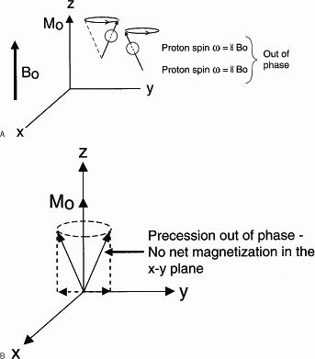

Practical Problem in MRI Signal Acquisition
B0 field is much larger than tissue net magnetization
  Impossible to measure net magnetization in the z-direction
  Need to look at component on x-y plane
  Problem: x-y components cancel out
Measured using pick-up coils

Slide 9
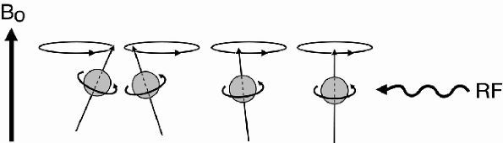
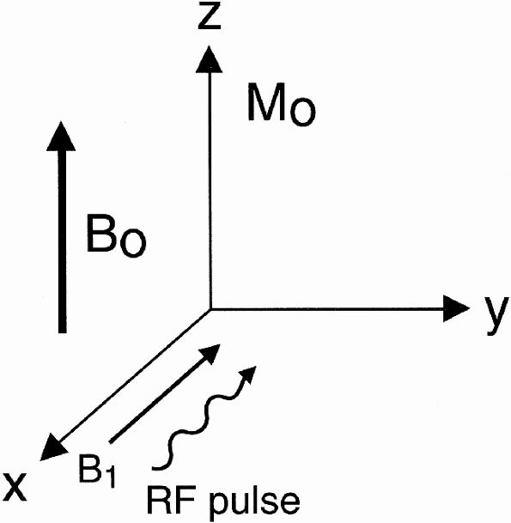
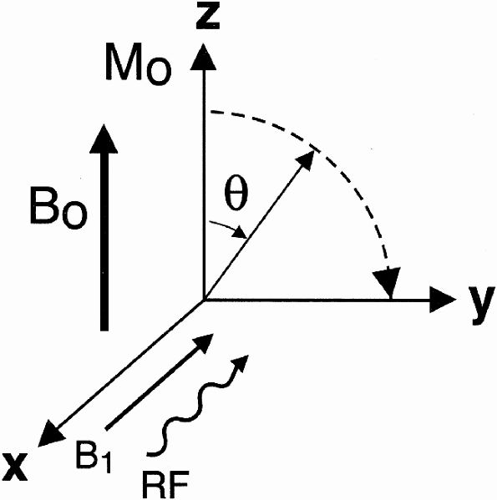
RF Pulse
Idea: Send RF radiation at Larmor frequency to flip net magnetization to x-y plane

Slide 10
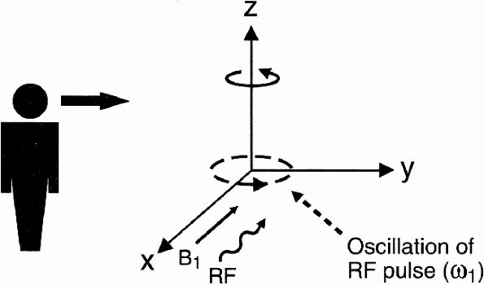
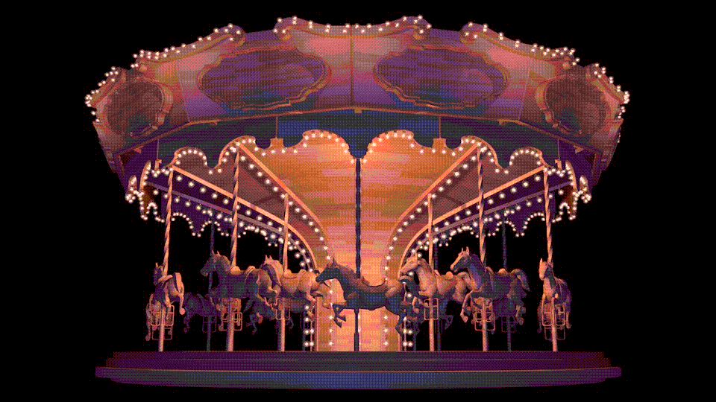
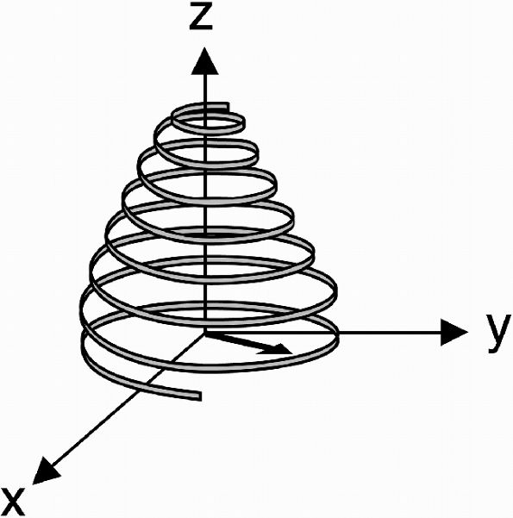
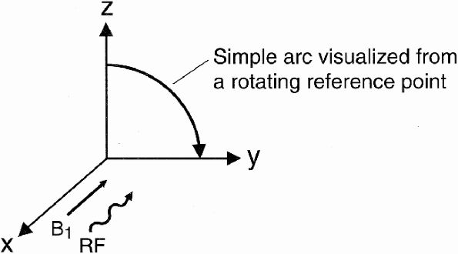
Rotating Frame of Reference

Slide 11
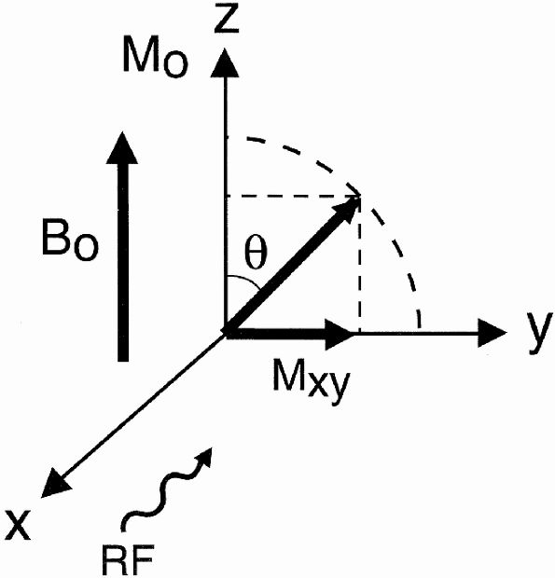
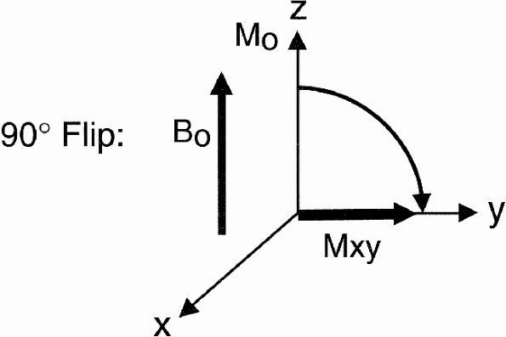
Selection of RF Pulse Flip Angle
90° or 180° or partial flip

Slide 12
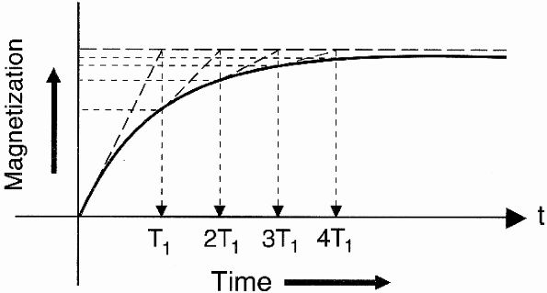
Relaxation
Relaxation means that the spins are relaxing back into their lowest energy state or back to the equilibrium state
  Equilibrium by definition is the lowest energy state possible
  Once the RF pulse is turned off, the protons will have to realign with the axis of the B0 magnetic field and give up all their excess energy

Slide 13
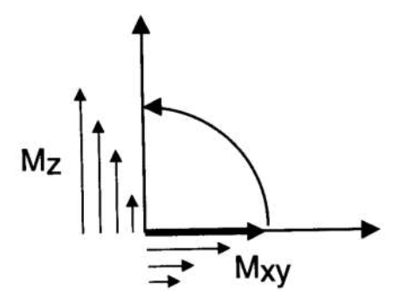
T1 Relaxation
T1 is called longitudinal relaxation time because it refers to time it takes for spins to realign along longitudinal (z) axis
T1 is also called spin-lattice relaxation time because it refers to time it takes for spins to give energy they obtained from RF pulse back to surrounding lattice in order to go back to their equilibrium state

Slide 14
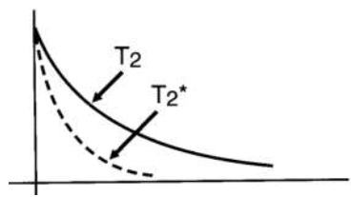
T2 Relaxation
Dephasing: after the 90° RF pulse is turned off, all spins are in phase; they are all lined up in the same direction and spinning at the same frequency ω₀
There are two phenomena that will make the spins get out of phase
  Interactions between spins
  External magnetic field inhomogeneities
T2 Relaxation
  Only spin-spin interactions
T2* Relaxation
  Both effects
1/T2*= 1/T2 + γΔB

Slide 15
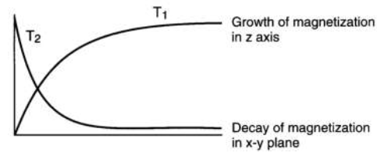
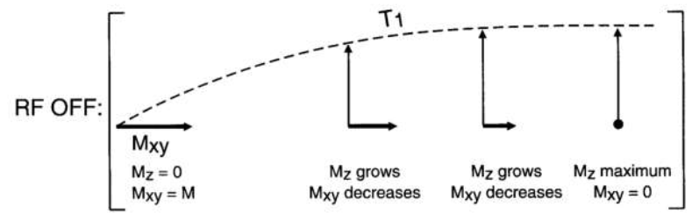
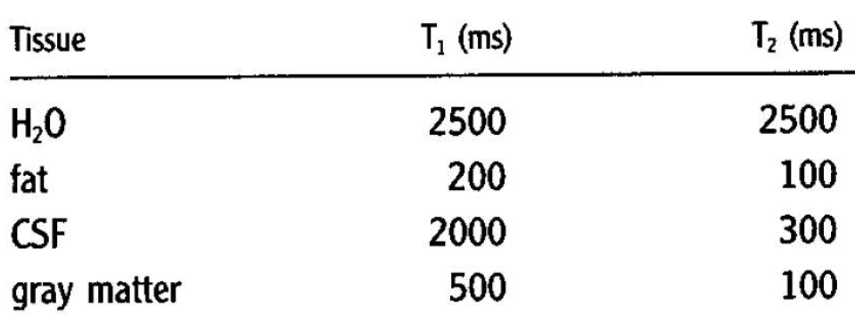
Effect of Both T1 and T2 Relaxations

Slide 16
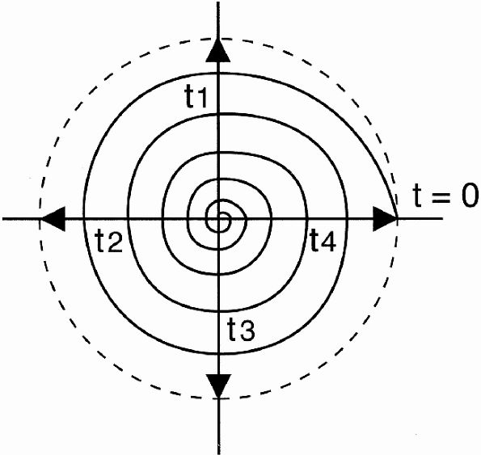
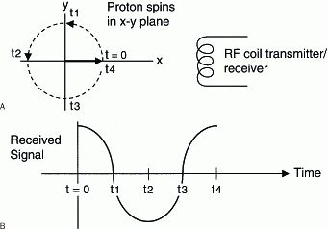
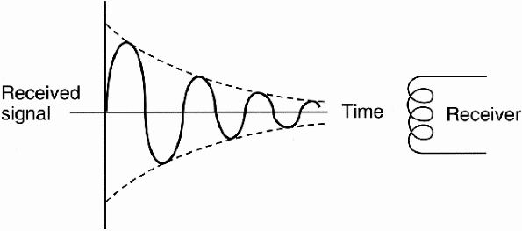
Received Signal: Free Induction Decay (FID)

Slide 17
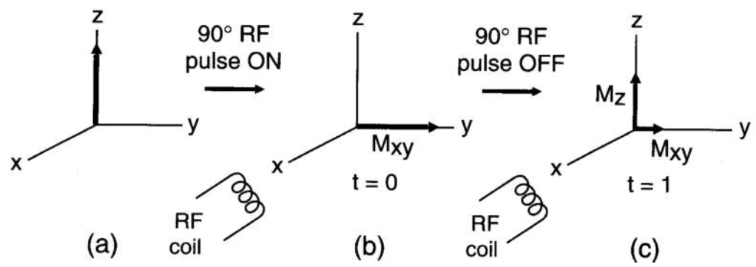
Sequence of Events in MRI

Slide 18
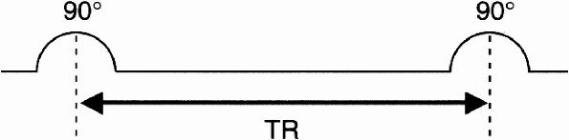
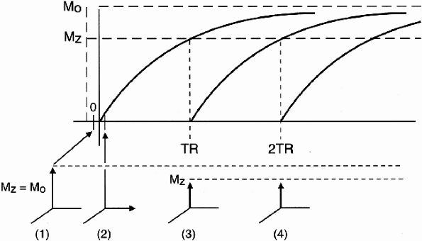

Pulse Repetition Time (TR)
Distance between successive RF pulses
M_{z} (t) = M₀ (1 - e^{-t/T1})
M_{z} (TR) = M₀ (1 - e^{-TR/T1})
S ∝ N(H) (1 - e^{-TR/T1})

Slide 19
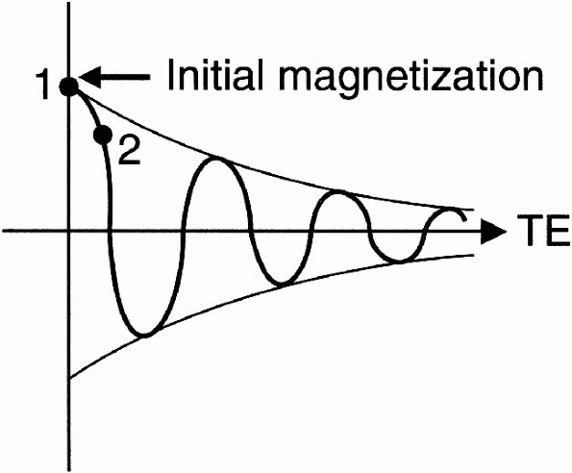
Echo Time or Time to Echo (TE)
Instead of making the measurement immediately after the RF pulse, we wait a short period of time TE and then make the measurement
  Time sampling of FID starts
M₀ (e^{-TE/T2*})

Slide 20
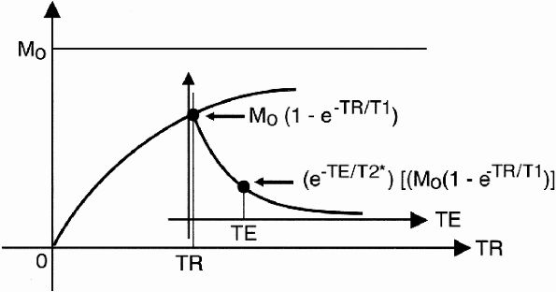
General Formula: Both T1 Recovery and T2 Decay
Now we have to put the two curves together because both T1 recovery and T2 decay processes are occurring simultaneously
Signal Intensity = SI ∝ N(H)(e^{-TE/T2*}) (1 - e^{-TR/T1})

Slide 21
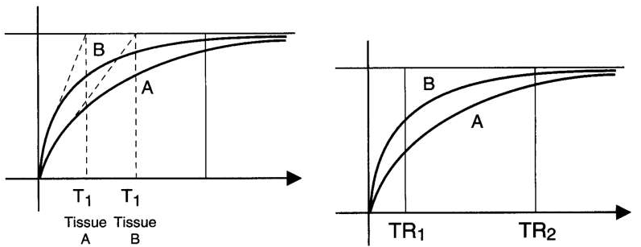
Tissue Contrast: T1-Weighting
Long TR reduces the T1 effect
Short TR enhances the T1 contrast

Slide 22
Tissue Contrast: T2-Weighting
Short TE reduces the T2* (T2) effect
Long TE enhances the T2* (T2) effect

Slide 23
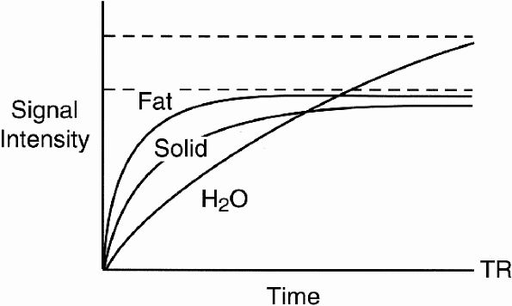
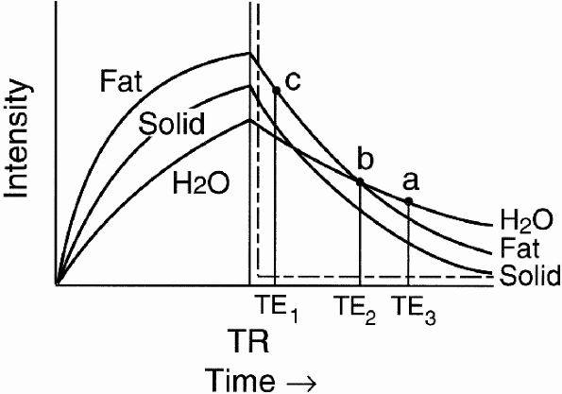
Tissue Contrast: Clinical Applications
T1 Recovery Curve
  Fat has shortest T1
  Proteinaceous fluid also has short T1
  H₂O has longest T1
  Solid tissue has intermediate T1
T2 decay Curve
  H₂O has very long T2
  Solid tissue has short T2
  Fat has intermediate T2
  Proteinaceous fluid may have short or intermediate T2 depending on protein content

Slide 24
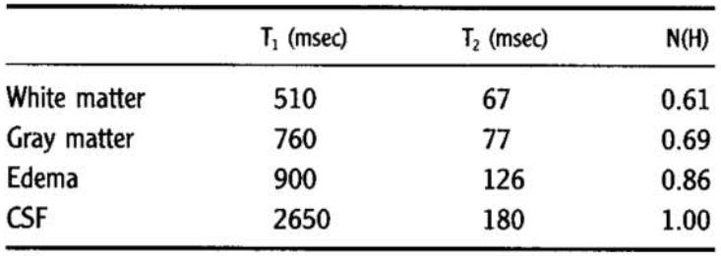
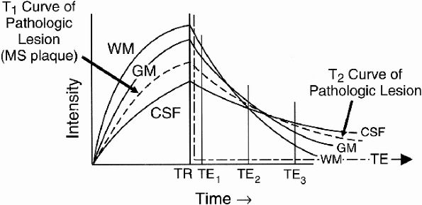
Example: Brain Imaging
White Matter (WM): Fat
Grey Matter (GM): Solid Tissue
Cerebrospinal Fluid (CSF): H₂O
Detecting pathological lesion
  Compare contrasts at different TE values
  TE₁ appears to provide best contrast

Slide 25

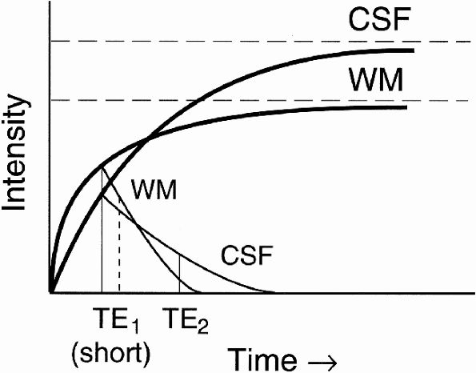
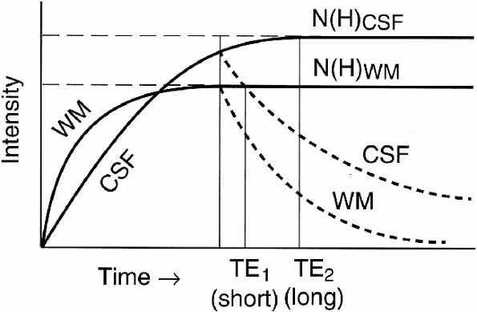
Tissue Contrast: T1W, T2W and PDW
Consider different values of TR and TE
  Short/Long TR
  Short/Long TE
Short TR
Long TR

Slide 26
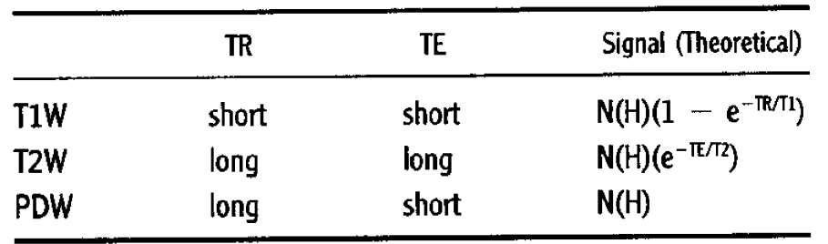
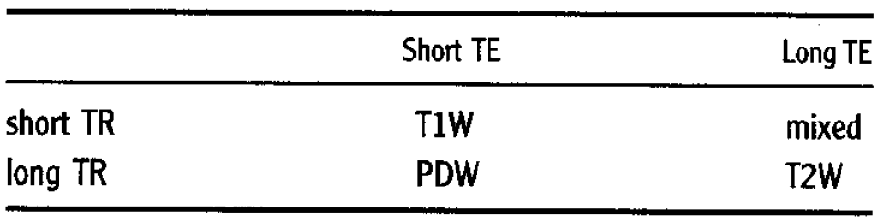
Tissue Contrast Summary

Slide 27



Tissue Contrast Examples
Different contrast using different weighting selection
T1
T2
T1
PD
T2

Slide 28

Pulse Sequences: Saturation, Saturation Recovery and Inversion Recovery
Pulse sequence is sequence of radio frequency (RF) pulses applied repeatedly during an MR study
  Embedded in it are TR and TE time parameters
  It is described as timing diagram or pulse sequence diagram
90° pulse: Saturation
180° pulse: Inversion
<90° pulse: Partial Saturation

Slide 29
Saturation
Immediately after longitudinal magnetization has been flipped into x-y plane by 90° pulse, system is said to be saturated
  Application of second 90° pulse at this moment will elicit no signal (like beating a dead horse)
A few moments later, after some T1 recovery, system is partially saturated
With complete T1 recovery to plateau value, system is unsaturated or fully magnetized
If longitudinal magnetization only partially flipped into x-y plane (flip angles < 90°) then there is still component of magnetization along z axis
  Spins in this state are also partially saturated

Slide 30


Partial Saturation Pulse Sequence
Start with 90° pulse, wait for short TR, then apply next 90° pulse
Longitudinal Magnetization
only partially recovered

Slide 31



Saturation Recovery Pulse Sequence
Start with 90° pulse, wait for long TR, then apply next 90° pulse
  Try to recover all the longitudinal magnetization before we applying another 90° RF pulse
Longitudinal Magnetization
almost completely recovered

Slide 32


Inversion Recovery Pulse Sequence
First apply 180° RF pulse, wait for period of time called inversion time (TI) then apply 90° RF pulse

Slide 33




Inversion Recovery: Null Point
Point at which signal crosses zero line (M_{z}=0) is called null point
  Clinical application: Suppress a tissue
Example: Fat Suppression using STIR
  STIR: Short TI Inversion Recovery

Slide 34



Pulse Sequences: Spin Echo
Dephasing of spins has two mechanisms
  Spin-spin interactions (inherent)
  External magnetic field inhomogeneity
Spin echo sequence: contrast based only on T2
1/T2*= 1/T2 + γΔB

Slide 35


Fourier Transform
Fourier Transform (FT) provides frequency spectrum of signal
High frequencies represent details of signal
  The more you acquire, the higher the resolution (details) will be
  Bandwidth (BW) is range of frequencies present in signal

Slide 36
Image Reconstruction
Signals received from patient contain information about entire part being imaged
  They do not have any particular spatial information
    That is, we cannot determine specific origin point of each component of signal
This is the function of gradients where one gradient is required in each of x, y, and z directions to obtain spatial information in that direction
  Slice-select gradient
  Readout or frequency-encoding gradient
  Phase-encoding gradient
Depending on their orientation axis they are called Gx, Gy, and Gz
Depending on the slice orientation (axial, sagittal, or coronal), Gx, Gy, and Gz can be used for slice select, readout, or phase encode

Slide 37


Slice Selection
Signal is obtained only from particular slice from the body
  Can be in any direction
Larmor equation with gradient G_{z}
  Larmor frequency depends on location
  Send RF pulse with desired frequency range to excite selected slice

Slide 38



Slice Selection
Slice definition
  Slice location (RF pulse modulation)
  Slice thickness (RF pulse bandwidth)
  Slice profile (RF pulse shape)
  Flip angle (RF pulse amplitude)
Ideal
Practical

Slide 39



Slice Selection: Multi-Slice Scan
Cross-talk should be avoided
  Increase slice separation
Ideal Contiguous Slices
Practical Slices
More spacing between slices

Slide 40

In-Plane Spatial Encoding: Fourier Imaging
Basic idea: encode location by frequency
  Magnetic field gradient is used during reception
    Larmor frequency changes with location
    Returned frequency from an area depends on its location
    Easily decoded by Fourier transformation
Applied by 2 different methods
  Frequency encoding
    One direction only
    No image acquisition time cost
  Phase encoding
    Any number of directions
    Increases image acquisition time

Slide 41



Frequency Encoding
Read-out gradient
  G_{x} gradient is applied during time when echo is received (during readout)

Slide 42




Frequency Encoding Example
True Image
Frequency Encoding Applied
Image
sum
Column
sum
No Frequency Encoding

Slide 43


Phase Encoding
Can we apply frequency encoding in 2 directions simultaneously?
  Answer is NO
Encoding second dimension using 2D Fourier transform: Phase Encoding
$$F\left(k_{x},k_{y}\right)=\int{e^{−j2πk_{y}y}\left\{\int{f(x,y)∙}e^{−j2πk_{x}x}dx\right\}dy}$$
Phase Encoding
Frequency Encoding

Slide 44




Phase Encoding
G_{y} is usually applied after the RF pulse (or pulses in Spin Echo or Inversion Recovery)
Each phase encoding setting requires one RF pulse
  Acquisition time = number of phase encoding steps x TR

Slide 45

K-Space and Image Space
K-space= Fourier domain
Sample Spin-Echo Pulse Sequence

Slide 46



K-Space and Image Space
Spatial frequencies k_{x} and k_{y}
  k_{x} = $γ\int_{0}^{t}{G_{x}\left(τ\right)dτ}$
  k_{y} = $γ\int_{0}^{t}{G_{y}\left(τ\right)dτ}$
  (units in cycles/cm)

Slide 47

MRI Scan Parameters
Primary
Secondary
  SNR
  Scan time
  Coverage
  Resolution
  Image contrast

Slide 48

Parameter Optimization
SNR defines as ratio of signal magnitude to noise standard deviation
  Voxel volume = Δx · Δy · Δz
  Number of excitations (NEX)
  Number of phase-encoding steps (Ny and Nz)
  Bandwidth (BW)
SNR can be increased by
  Increasing TR
  Decreasing TE
  Using a lower BW
  Using volume (3D) imaging
  Increasing NEX
  Increasing Ny
  Increasing voxel size
$$3D SNR ∝ ∆x∙∆y∙∆z \sqrt{{(N}_{y}){(N}_{z})(NEX)/BW}$$

Slide 49

Parameter Optimization
Spatial Resolution is determined by pixel size = FOV/number of pixels
  For example, pixel size in y = Δy = FOV_{y}/N_{y}
  Nx, Ny, Nz are called Matrix Size
  Trade-off between and SNR
Acquisition Time or Scan Time, is given by
  Ny, Nz are numbers of phase-encoding steps in y and z directions
For multi-slice sequence (no phase encoding in z direction), then we may be able to squeeze in each TR multiple slice acquisitions
  Maximum of TR/TE slices
  For example, if TR= 500 ms and TE= 30 ms, we can collect floor(500/30)= 16 slices within one TR
Scan time = TR · Ny · Nz · NEX

Slide 50
Parameter Optimization: Examples
Keep FOV_{y} constant and increase Ny
  ↑ Ny, FOV_{y} constant → ↑ Resolution, ↓ SNR, ↑ Scan time
Increase Ny and increase FOV_{y} (keeping pixel size constant)
  ↑ FOV, pixel size fixed → ↑ SNR, ↑ Scan time
Decrease FOV_{y} and keep number of pixels constant
  ↓ FOV_{y} , Ny constant → ↑ Resolution, ↓ SNR, Scan time same
In x direction, there are two ways of increasing resolution (for given FOV)
  Increase N_{x} by reducing sampling time ΔTs (increasing BW) and keeping total sampling time fixed
    Same TE but with reduction in SNR (due to increased BW)
  Increase N_{x} by lengthening Ts and keeping ΔTs (and thus BW) fixed
    SNR does not change but with possibly increased TE (due to longer Ts)
Scan time = TR · Ny · Nz · NEX

Slide 51
Components of MRI System

Slide 52
Primary Magnetic Field (B0)
Permanent magnet
Resistive magnet
Superconductive magnet

Slide 53


Permanent Magnet

Slide 54

Resistive Magnet

Slide 55
Superconductive Magnet

Slide 56

Superconductive Magnet
Magnetic field ramp-up
Ramp-down must be very slow, otherwise catastrophic quenching will occur
  Heating up increases resistance, which in turn increases heating, causing positive feedback loop that can result in rapid vaporization of helium

Slide 57

Magnet Shielding
None
Passive
Active
Distance to Safe 5G (0.5 mT) Line for different fields

Slide 58


Secondary Magnets: Shim Coils
Make small adjustments to make B0 uniform throughout whole volume
  Inhomogeneity measured in ppm units
  Example: for 1T magnet, homogeneity of ±1ppm means that field has variation of up to ±1 μT

Slide 59

Secondary Magnets: Gradient Coils
Apply gradients in x, y, and z directions (Units of mT/m)
  Slice selection
  Frequency encoding
  Phase encoding

Slide 60

Secondary Magnets: RF Coils
Send RF pulses and receive signal from patient

Slide 61



Choosing Magnet Type

Slide 62

Site Selection for MRI

Slide 63

Effects of MRI on Environment

Slide 64


Effects of Environment on MRI

Slide 65



Acoustic Noise During MRI Scanning
Gradient switching causes vibration of the coils and/or their packaging that result in very loud noise that could be harmful to human ears (noise levels up to 95 dB)
  Not far below threshold of pain of 120 dB
Patients should wear protective ear plugs or earphones during scan

Slide 66








MRI Safety Incidents
Must always keep in mind how strong MRI magnetic field is and never bring any ferromagnetic tools/accessories near magnet

Slide 67
MRI Exposure Safety
MRI energy field threshold intensity (IT), below which no response is elicited (safe)
  Above IT, responses to MRI are deterministic
Occupational exposure to energy fields of MRI is safe
Ionizing
Radiation
Nonionizing
Radiation

Slide 68
MRI Bioeffects
Static magnetic field B0 causes tissues to be rendered weakly magnetic, or polarized
  Induced tissue magnetism cannot be sensed
  No scientific evidence to show that intense static magnetic fields produce harmful effects in humans
Transient magnetic fields can induce electric currents
  Can stimulate or impair electric impulses along neuronal pathways (neurologic response)
  Main influence is time rate of change of magnetic field (dB/dt) measured in T/s
    For example, transient magnetic field of 3 T/s results in an induced electric current density of approximately 3 μA/cm² in tissue, capable of producing involuntary muscle contraction
Radiofrequency field (RF) induces eddy currents in conductive tissues resulting in heat
  RF frequency, exposure time, and mass of exposed object determine amount of absorbed energy
  Physiologic measure of intensity of RF energy is Specific Absorption Rate (SAR) with units of W/kg

Slide 69






Magnetic Resonance Imaging Applications
Anatomy
Physiology (function)
Angiography
Diffusion
Perfusion
Spectroscopy

Slide 70

Recommended Readings
MRI: The Basics, 3rd Edition, by Ray H. Hashemi, William G. Bradley, and Christopher J. Lisanti, Lippincott Williams & Wilkins, 2010.
  Chapters 2:17
Magnetic Resonance Imaging: Physical and Biological Principles, 4th Edition, by Stewart C. Bushong, 2015.
  Chapters 9:11, 29

