Slide 1

Nuclear Medicine
Prof. Yasser Mostafa Kadah
EE 472

Slide 2
Nuclear Medicine Basics
Nuclear medicine scans a very small amount (e.g., nanograms) of radioactive material called a radiotracer is injected intravenously into the patient
  Agent then accumulates in specific organs in the body
  How much, how rapidly and where this uptake occurs are factors which can determine whether tissue is healthy or diseased
Three different modalities under the general umbrella of nuclear medicine
  Plain scintigraphy
  Single photon emission computed tomography (SPECT)
  Positron emission tomography (PET)

Slide 3
Nuclear Medicine Basics
Relative to most other imaging modalities, nuclear medicine scans (in particular planar scintigraphy and SPECT) are characterized as having:
  Poor SNR
  Low spatial resolution (~5–10 mm)
  Slow image acquisition
  Extremely high sensitivity
  Very high specificity (no natural radioactivity from the body)
  Intrinsic functional characteristics of the information content of the images

Slide 4
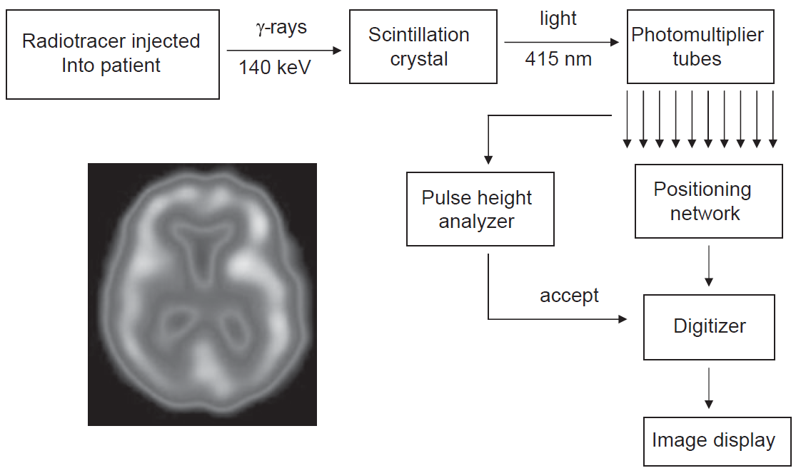
Operation of a Nuclear Medicine Gamma Camera

Slide 5


Radioactivity
Radioactive isotope is one which undergoes a spontaneous change in composition of the nucleus, termed disintegration
Radioactivity is measured in units of curies (Ci), where one curie equals 3.73x10¹⁰ disintegrations per second

Slide 6
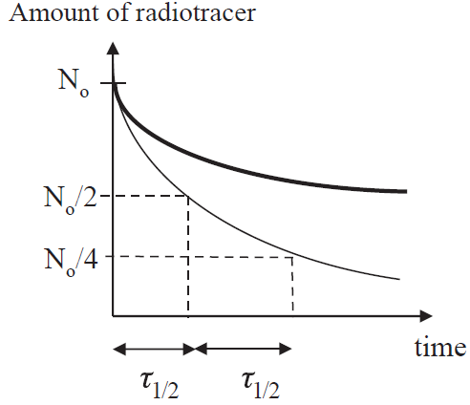


Half-Life Time
Half-life (τ_{½}): time required for the radioactivity to drop to one-half of its value
Biological half-life of the radiotracer (τ_{½,bio}) (how long the radiotracer remains in the body) must also be considered
Effective half-life (τ_{½,eff}) is a combination of the two half-lives

Slide 7

Radioactivity Example:
Two patients undergo nuclear medicine scans. One receives a dose of radiotracer A and the other radioatracer B. The half-life of A is 6 hours and of B is 24 hours. If the administered dose of radiotracer A is three times that of radiotracer B, and the biological half-lives of A and B are 6 and 12 hours respectively, at what time is the radioactivity in the body the same for the two patients?
Solution:
Obtain values for decay constants λ_{A}, λ_{B}
Obtain values for required time t

Slide 8
Properties of Ideal Radiotracers
Radioactive half-life that is short enough to produce significant radioactivity without requiring a very large initial dose, but not so short that there is significant decay before the required post-injection delay to allow the radiotracer to clear the blood and distribute in the relevant organs
Decay should be via emission of a mono-energetic γ-ray without emission of alpha- or beta-particles.
  Mono-energetic γ-ray allows discrimination between Compton scattered and unscattered γ-rays, thereby improving image contrast. Alpha- or beta-particles are completely absorbed within tissue, therefore increasing the radioactive dose without giving any useful image information

Slide 9
Properties of Ideal Radiotracers
Energy of γ-ray should be greater than ~100 keV so that reasonable proportion of γ-rays which are emitted deep within tissue have sufficient energy to travel through body and reach detector
Energy of the γ-ray should be less than ~200 keV so that the rays do not penetrate the thin lead septa in the collimator (which is analogous to the anti-scatter grid in X-ray imaging)
Radiotracer should have high uptake in organ of interest and relatively low non-specific uptake in rest of the body
  These two factors lower required dose for the patient and increase image contrast, respectively

Slide 10

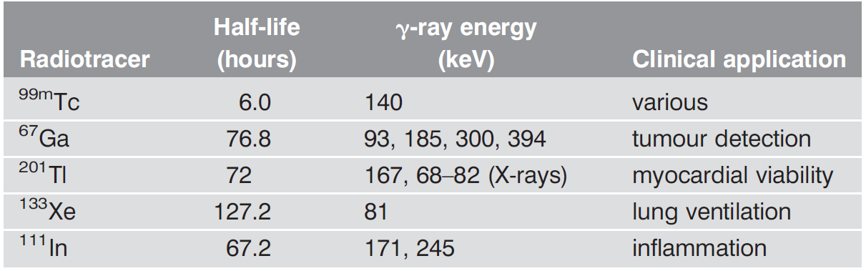
Example Radiotracers
Most widely used radiotracer is ^{99m}Tc which is involved in over 90% of planar scintigraphy and SPECT studies
  It exists in metastable state (one with reasonably long half-life)
  Formed from ⁹⁹Mo
  Energy of emitted γ-ray is 140 keV

Slide 11
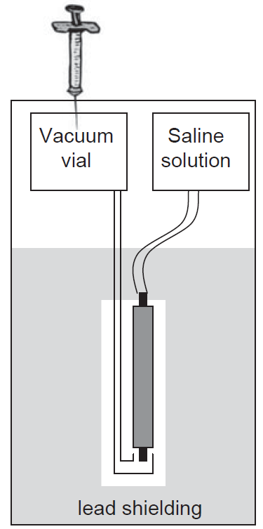
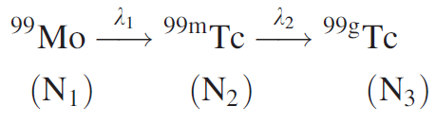

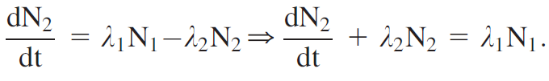
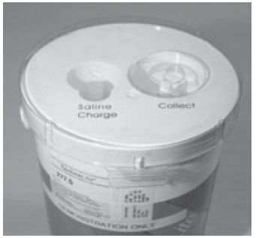



Technetium Generator
Tc generator is delivered to nuclear medicine department at the beginning of the week, returned at the end of the week
  Very convenient method for producing ^{99m}Tc

Slide 12
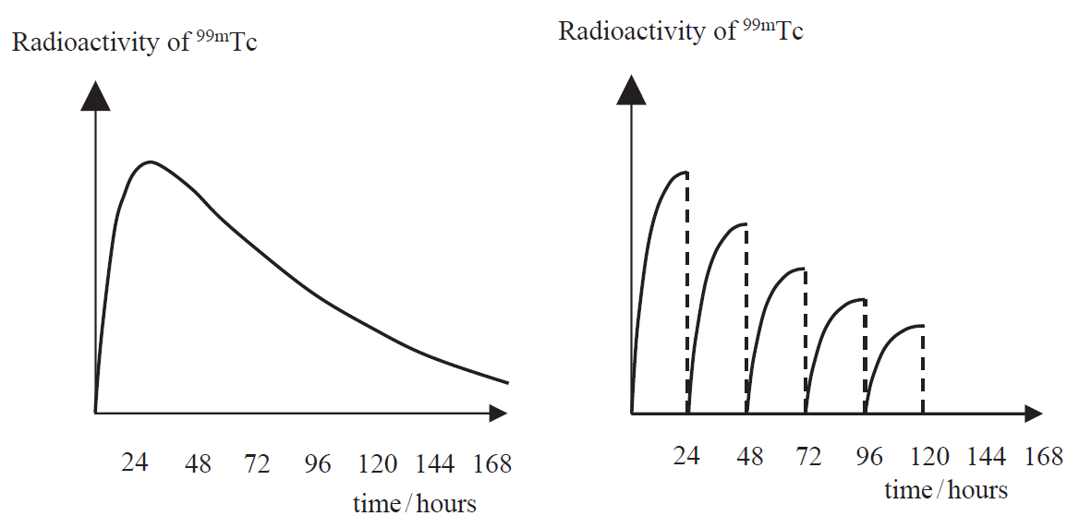
Radioactivity of ^{99m}Tc vs Time
Generator that is not milked
Generator that is milked every 24 hours

Slide 13
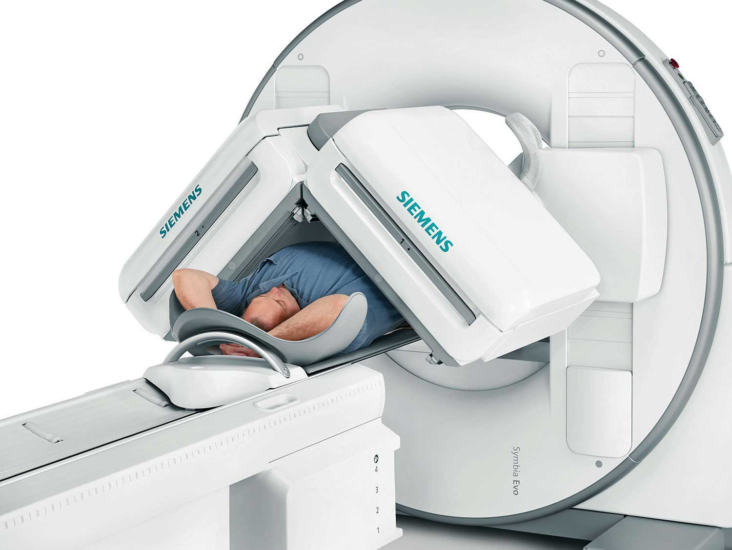
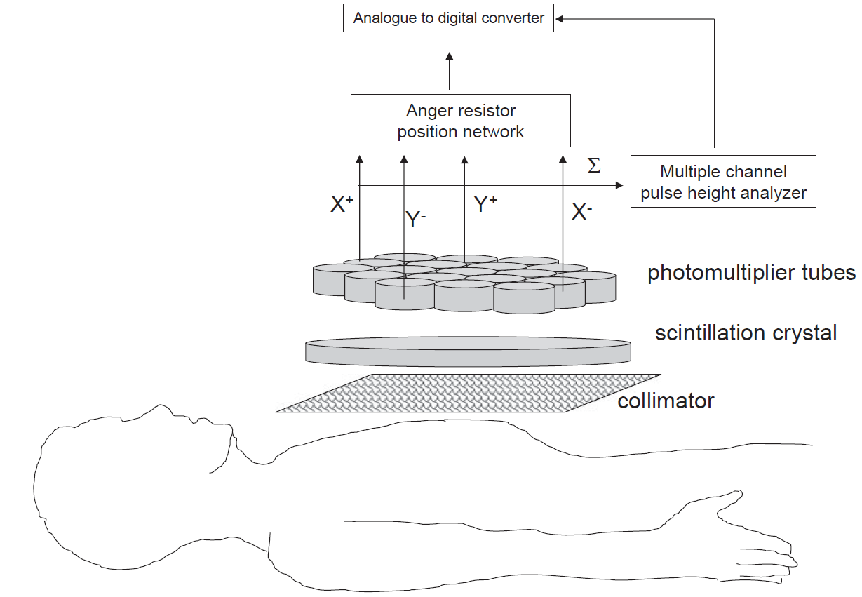
Gamma Camera

Slide 14
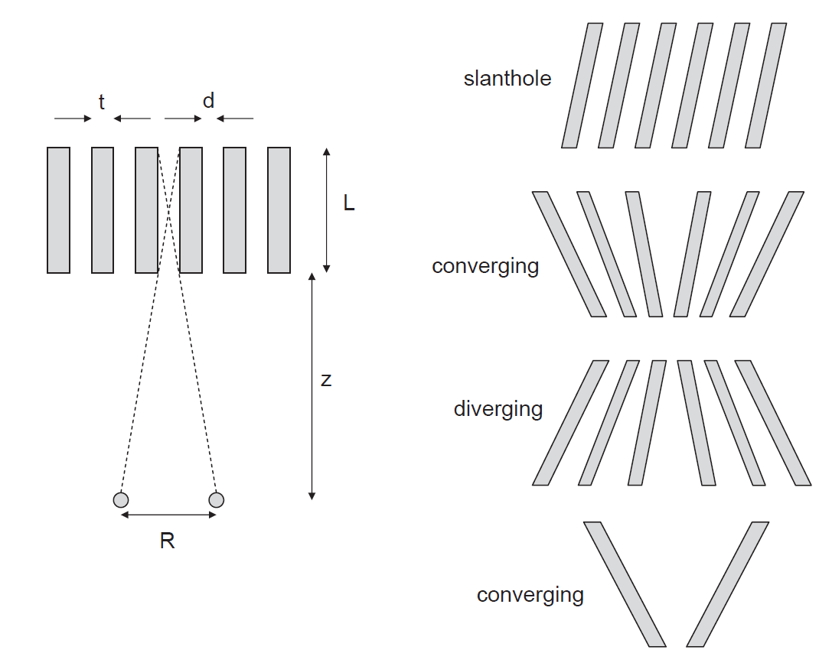


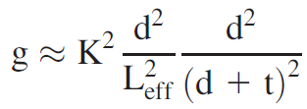
Collimator
Parallel Collimator
Spatial Resolution (R)
Efficiency (g)

Slide 15
Detector Scintillation Crystal
In the gamma camera, the detector is a large single crystal of thallium-activated sodium iodide, NaI(Tl), 40–50 cm diameter
When γ-ray strikes the crystal, it loses energy through photoelectric and Compton interactions which result in a population of excited electronic states within the crystal
De-excitation of these states occurs ~230 nanoseconds later via emission of photons with wavelength of 415 nm (visible blue light), corresponding to photon energy of ~4 eV
Important characteristic of scintillators such as NaI(Tl) is that amount of light (number of photons) produced is directly proportional to energy of incident γ-ray

Slide 16
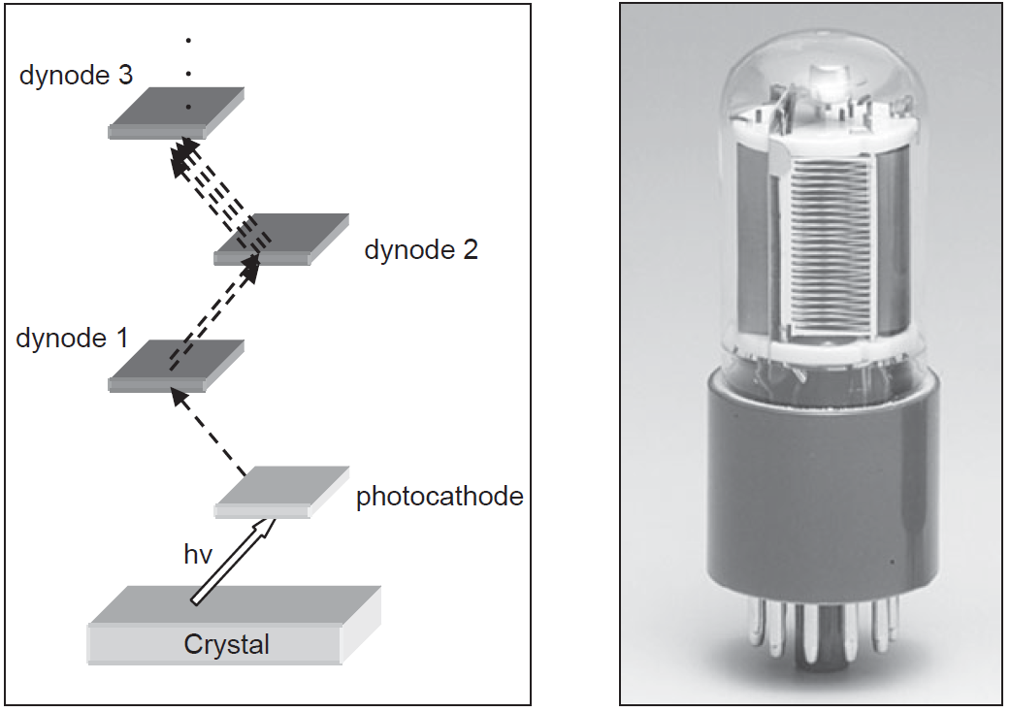
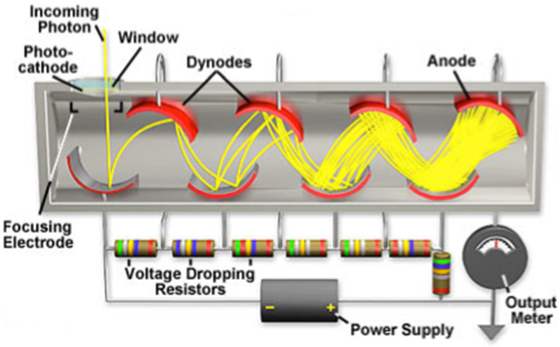
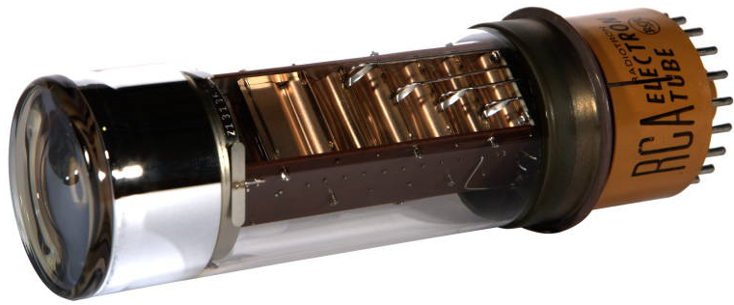
Photomultiplier Tube (PMT)

Slide 17
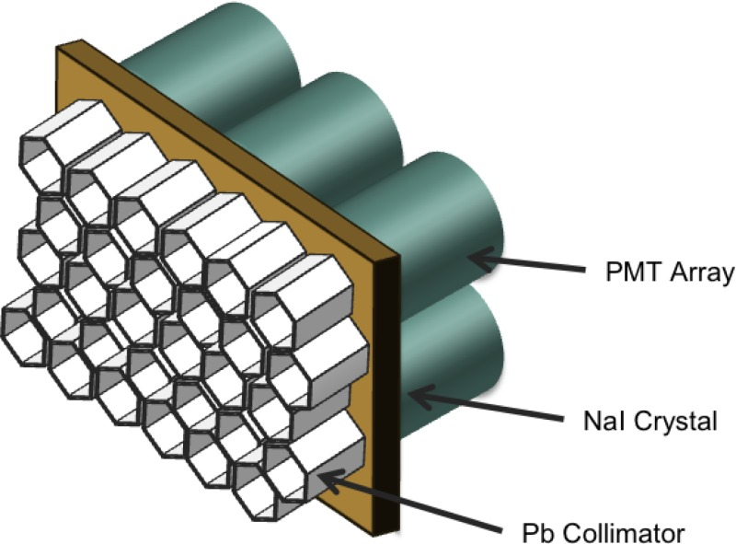
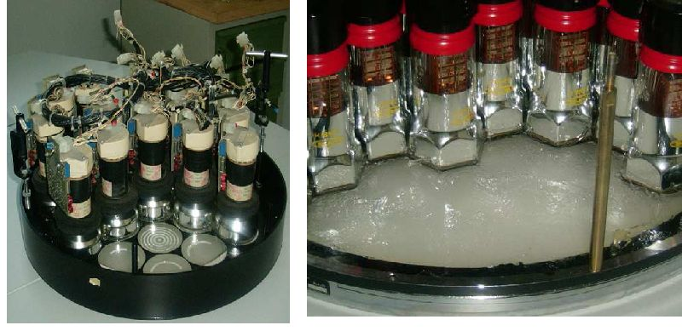
Photomultiplier Tube (PMT)
Produces between 10⁵ and 10⁶ electrons for each initial photoelectron, creating an amplified current at PMT output
Since each PMT has a diameter of 2–3 cm, and NaI(Tl) crystal is much larger in size, number of PMTs are used and are closely coupled to scintillation crystal
  Most efficient packing geometry is hexagonally-close-packed
  Arrays of 61, 75 or 91 PMTs are typically used, with a thin optical coupling layer used to interface the surface of each PMT with the scintillation crystal

Slide 18
Anger Position Network
Whenever a scintillation event occurs in NaI(Tl) crystal PMT closest to scintillation event produces largest output current
  If this were only method of signal localization, then spatial resolution would be no finer than dimensions of the PMT, i.e., several cm
Adjacent PMTs produce smaller output currents, with amount of light detected being approximately inversely proportional to distance between scintillation events and particular PMT
  By comparing magnitudes of currents from all PMTs, location of scintillation within crystal can be much better estimated

Slide 19
Anger Position Network
In modern Anger position networks, interpolation between outputs from adjacent PMTs is used to improve resolution of scintillation detection
Linear Interpolation Example

Slide 20
Pulse Height Analyzer (PHA)
Pulse Height Analyzer discriminates recorded events into two scenarios
  𝛾-ray not scattered in patient (primary) = good event → retained
  𝛾-ray Compton scattered in patient (scattered)→ lost spatial information = bad event → rejected
Amplitude of PMT output signal proportional to energy of gamma ray 𝐸_{𝛾}
  Amplitude of PMT output signal proportional to number of optical photons arriving from scintillator
  Number of optical photons produced in scintillator proportional to 𝐸_{𝛾}
  Discriminating on the basis of amplitude of PMT output signal = discriminating on basis of 𝐸_{𝛾}
Pulse height analyzer takes summed electrical signals from the PMT array and applies thresholds in two steps
  PMT output signals are sent to multiple-channel analyzer → pulse-height histogram
  Two thresholds, upper and lower, are applied to pulse-height histogram to select acceptable 𝛾-rays

Slide 21
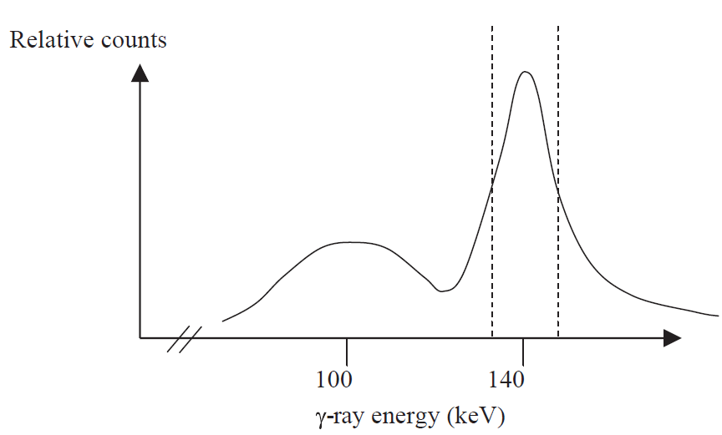
Pulse Height Analyzer (PHA)
Multiple channel analyzer (MCA), in which term ‘channel’ refers to specific energy range, digitizes signal within each range then produces pulse-height spectrum
  Pulse height analyzer allows spectroscopic imaging = selects for display only events falling within particular energy range
  Number of channels in MCA can be more than 1000, allowing essentially complete energy spectrum to be produced
  After digitization, upper and lower threshold values for accepting γ-rays are applied
Energy Resolution of system is defined as full-width-half-maximum (FWHM) of photopeak
Typically, about 14 keV (or 10%) for most gamma cameras without patient present
In clinical scan with patient in place, threshold level for accepting ‘photopeak’ is set to slightly larger value, typically 20%

Slide 22
Instrument Dead Time
If an injected dose of radiotracer is very large, the total number of γ-rays striking the scintillation crystal can exceed the recording capabilities of the system
  Particularly true at the beginning of a clinical scan when radioactivity is at its highest level
  Limitation is due to the finite recovery and reset times required for various electronic circuits in the gamma camera
Two types of behaviour exhibited by the system components, termed paralyzable and nonparalyzable

Slide 23
Instrument Dead Time
Paralyzable (extendable) behavior is a phenomenon in which a component of the system cannot respond to a new event until a fixed time after the previous one, irrespective of whether that component is already in a non-responsive state
  Each time a γ-ray strikes the scintillation crystal it produces an excited electronic state, which decays in 230 ns to release a number of photons
  If another γ-ray strikes same spot in the crystal before the excited state decays, then it will take a further 230 ns to decay, and only one set of photons will be produced even though two γ-rays have struck the crystal
  Very high rate of γ-rays striking detector can result in a considerably elongated dead-time and so the number of recorded events can actually decrease

Slide 24

Instrument Dead Time
Non-paralyzable (non-extendable) component cannot respond for a set time, irrespective of the level of radioactivity
  For example, Anger logic circuit and PHA take a certain time to process a given electrical input signal, and during this time any further events are simply not recorded
  This time is fixed for a given system, and is not elongated if further scintillation events occur
Overall dead-time τ is determined by non-paralyzable part
N: true count rate (number of scintillations per second), n: measured count rate,
maximum measurable count rate is given by 1/τ

Slide 25
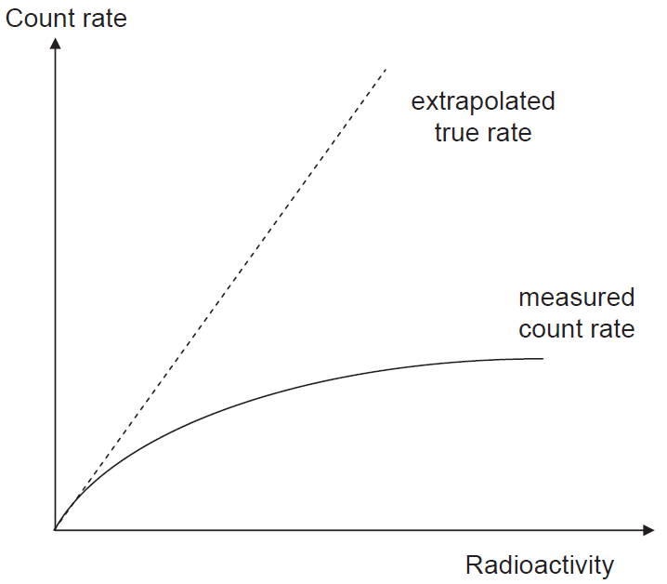
Instrument Dead Time Correction
Corrections for the dead-time are based upon calibrations using phantoms of known radioactivity, and also independent electronic measurements of the dead time of individual components of the system
Example: Suppose that the true count rate in a gamma camera is N=10,000 per second, but the measured rate is only n=8,000 per second. What is the dead time of the system?
Solution:

Slide 26
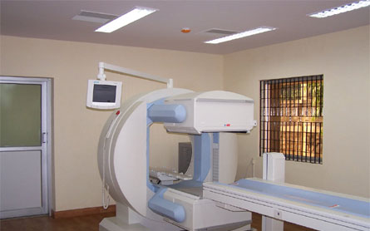
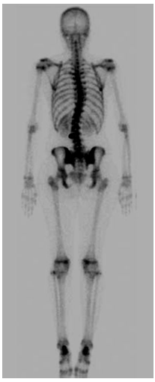
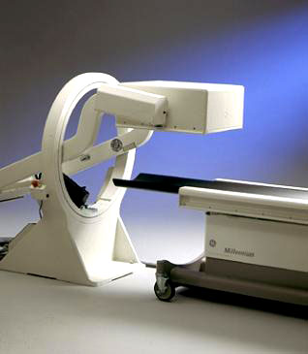
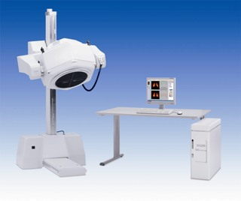
Practical Planar Scintigraphy

Slide 27
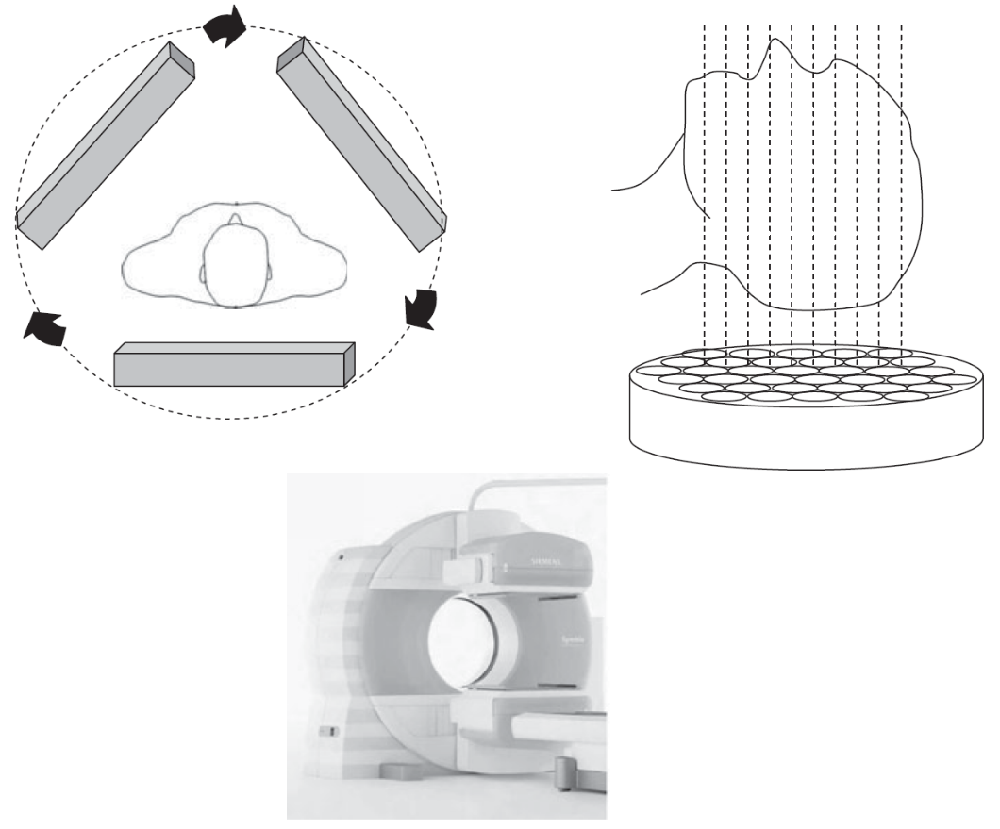
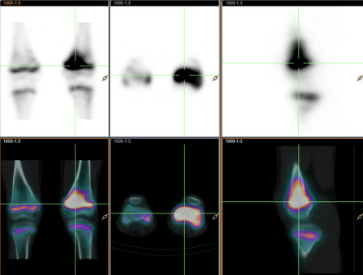
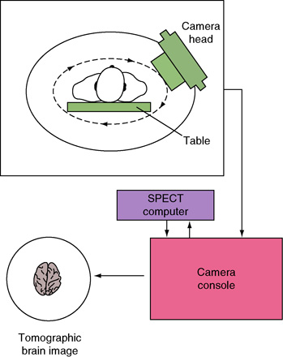
Single Photon Emission Computed Tomography (SPECT)
Injected radioactive tracer
Moving Gamma Camera
Tomographic scans can be used to reconstruct image

Slide 28
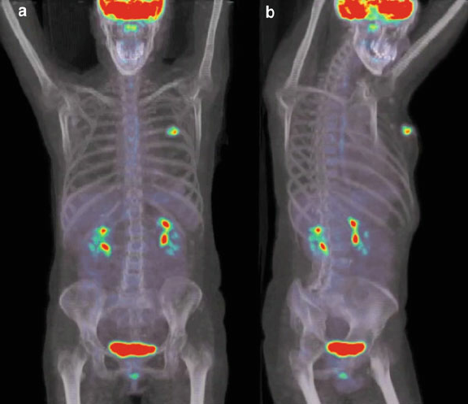
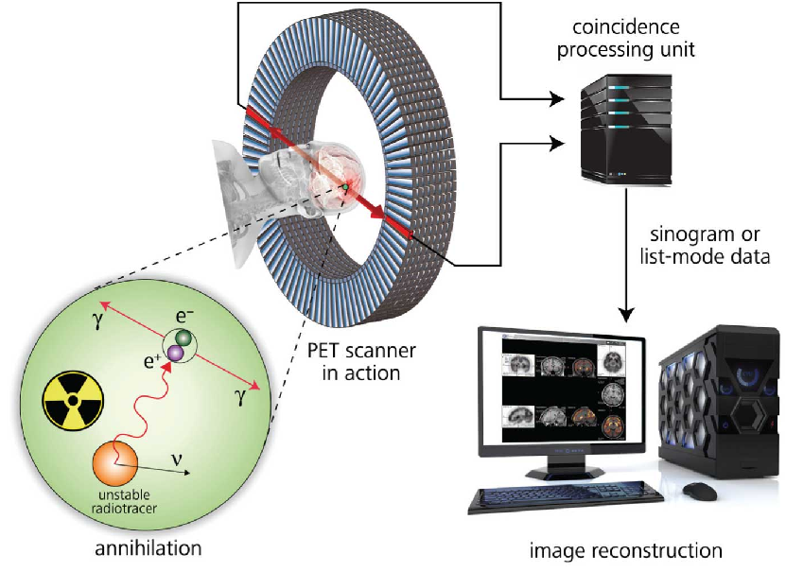
Positron Emission Tomography (PET)
PET is a tomographic technique which also uses radiotracers
  Radiotracers used in PET emit positrons which, after annihilation with an electron in tissue, result in the formation of two γ-rays with energies of 511 keV each and with trajectories 180° apart
  PET has between 100-1000 times higher SNR and significantly better spatial resolution than SPECT

Slide 29

Recommended Textbook
Introduction to Medical Imaging: Physics, Engineering and Clinical Applications, by Nadine Barrie Smith and Andrew Webb, Cambridge University Press, 2010.
  Relevant parts of Chapter 3

