Slide 1
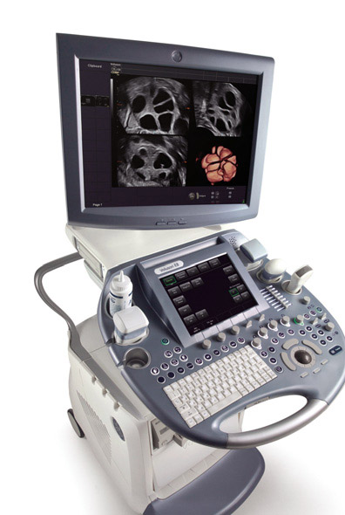

Ultrasound Imaging
EE 472
Prof. Yasser Mostafa Kadah – www.k-space.org

Slide 2
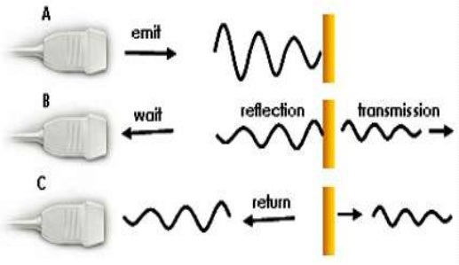
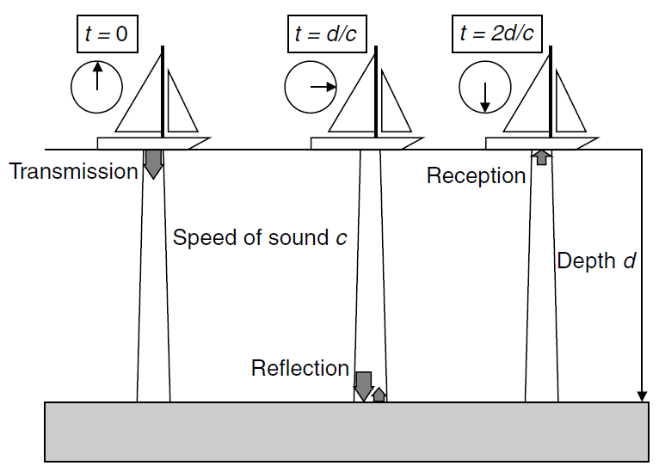
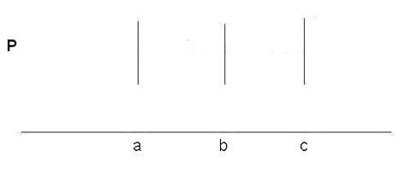
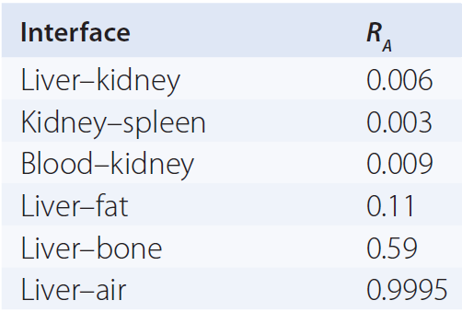
Pulse Echo Ultrasound Imaging
Echo Ranging
  Sending pulse and measuring time until reflected echo is received to determine location of reflecting surface
Medium 1
Medium 2
I_{o}
(1-R_{A}) I_{o}
R_{A} I_{o}
Interface 1
Time

Slide 3
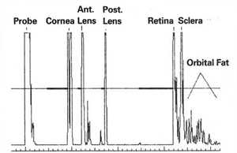
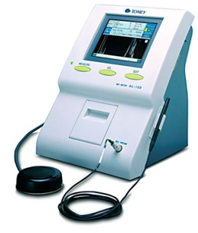
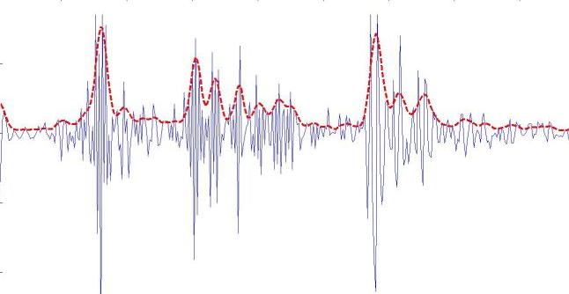
A-Mode (Amplitude)
Sends ultrasound pulse and presents received echo as 1D plot
  Applications: opthalmology
Envelope Detection

Slide 4
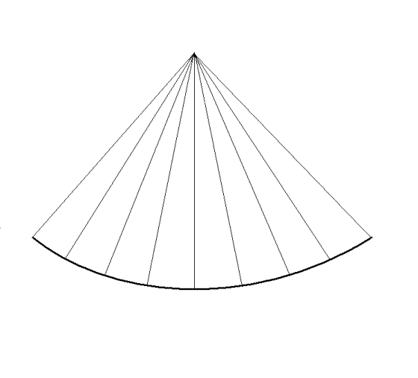
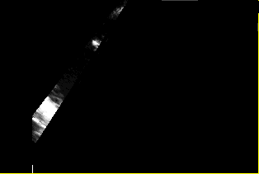
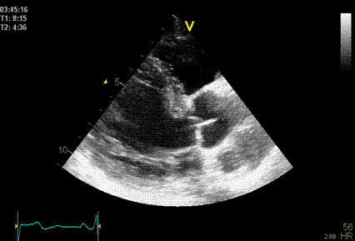

B-Mode (Brightness)
Transmits ultrasound pulse to a particular direction and reflected echoes are received and displayed as intensity values of one line
  Repeat in different directions to acquire multiple lines to form an image

Slide 5
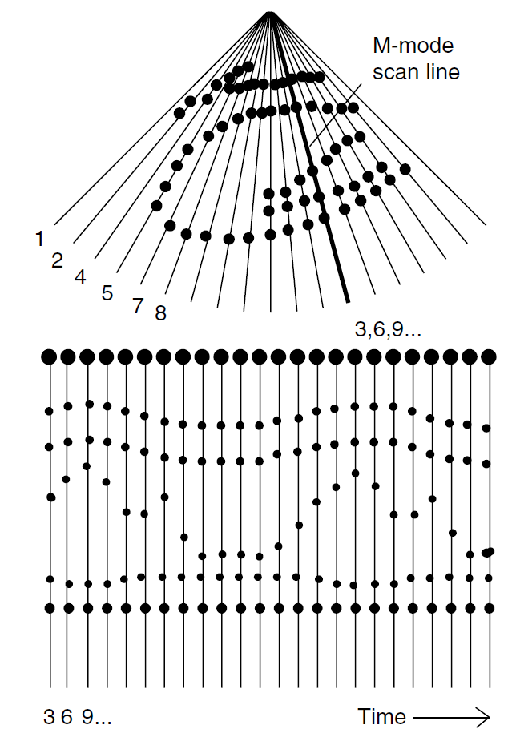
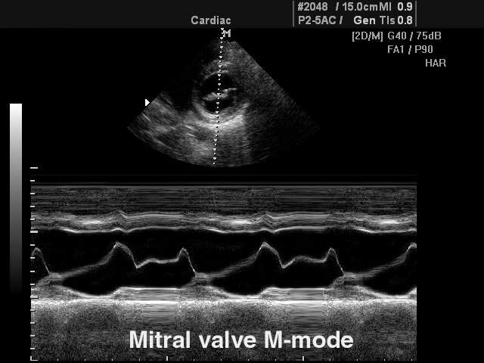
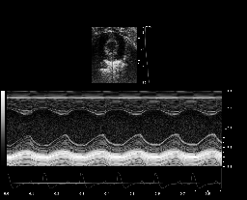
M-Mode (Motion)
One line in B-mode image is selected by doctor and scanned repeatedly with time – output is displayed as moving line trace
  Application: study of heart valves

Slide 6
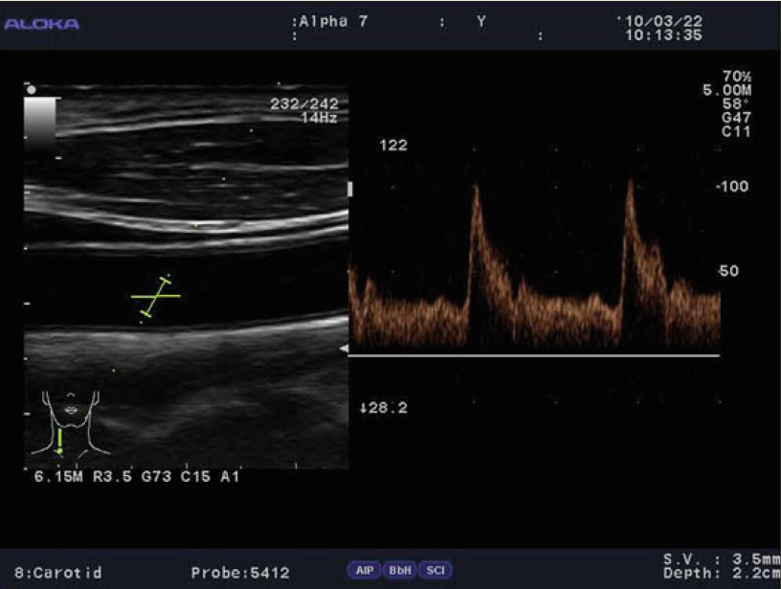
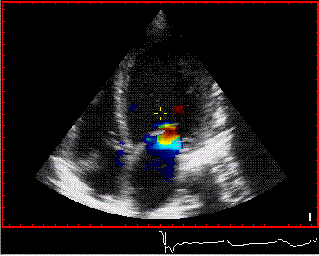
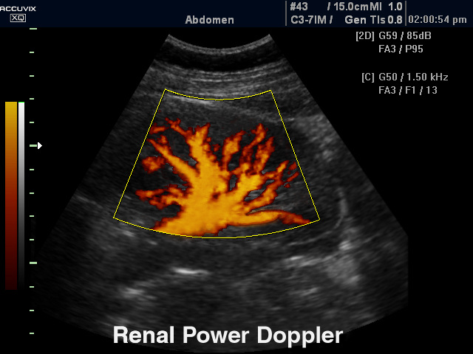
Doppler Mode
Spectral Doppler Mode (B&W Doppler)
Color Doppler Mode (Color Flow Mapping or CFM)
Power Doppler (Perfusion)
B&W Doppler
Color Doppler
Power Doppler

Slide 7
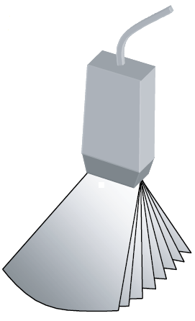
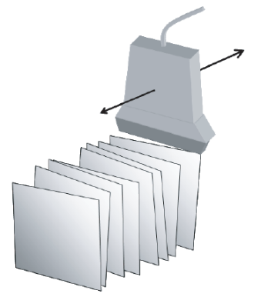
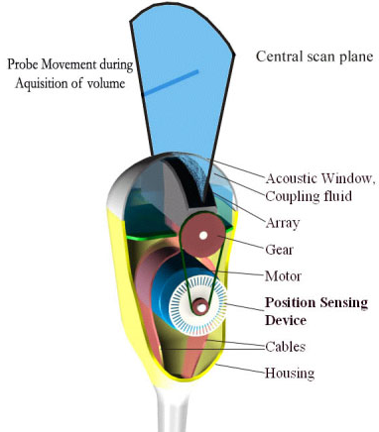
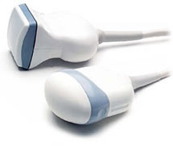
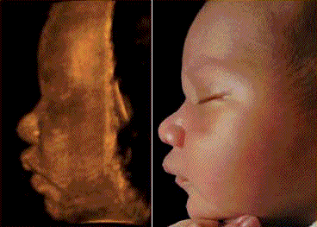
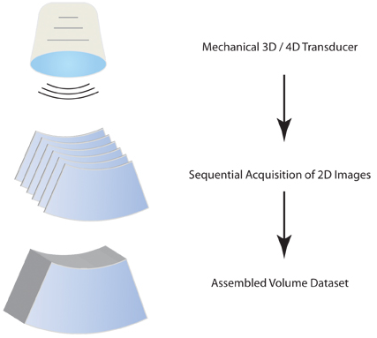
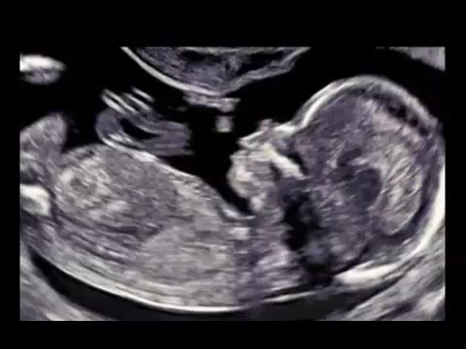
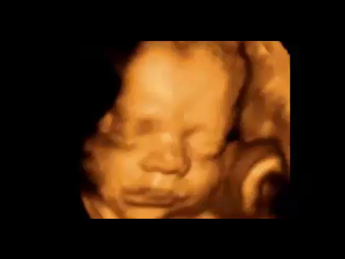
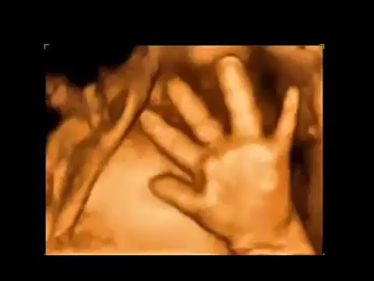
3D and 4D Imaging Modes
Volume Scanning
  Freehand or mechanical scanning
2D Imaging
3D Imaging
4D Imaging
Real-Time Slice
Static Volume
Real-Time Volume

Slide 8


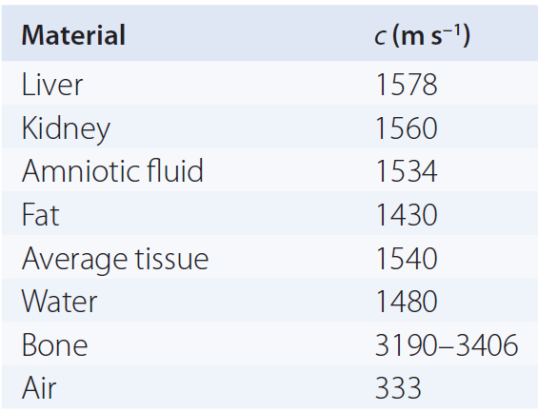
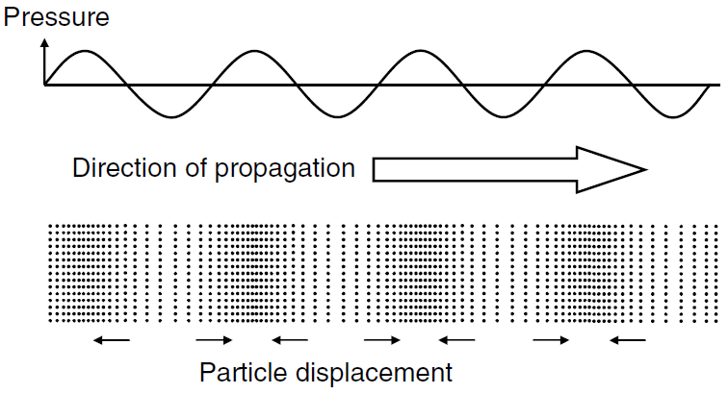
Ultrasound Physics
Sound waves used to form medical images are longitudinal waves, which propagate (travel) only through a physical medium (usually tissue or liquid)
  Characterized by frequency, wavelength, speed and phase

Slide 9
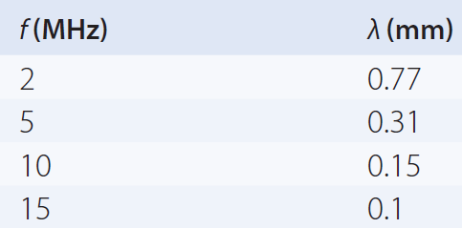

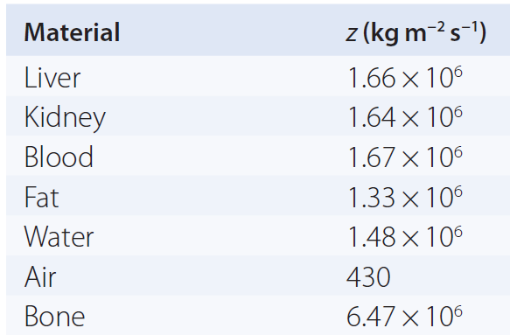


Ultrasound Physics
Medical ultrasound frequencies used in the range 2–15 MHz
  Higher frequencies are now utilized for special applications
  Resolution proportional to wavelength
Acoustic impedance
  p is the local pressure and v is the local particle velocity.
  Analogous to electrical impedance (or resistance R )

Slide 10
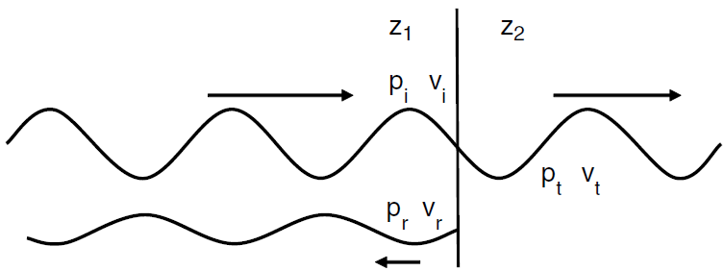
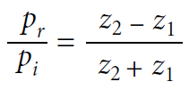

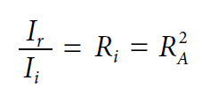
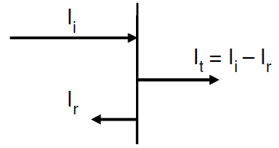
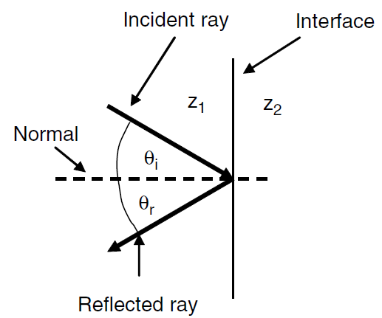

Ultrasound Physics
Reflection: Large Interfaces

Slide 11
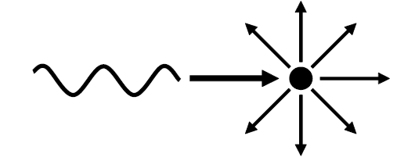
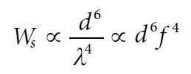
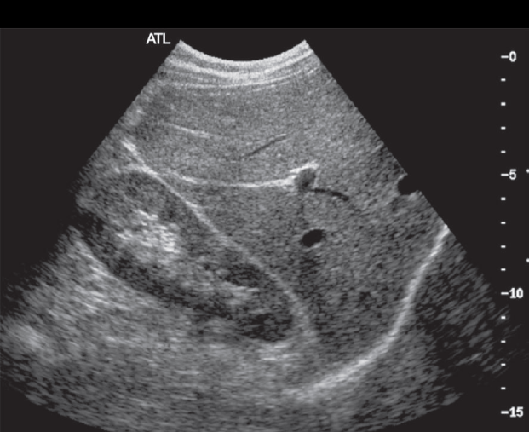
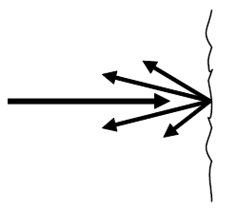
Ultrasound Physics
Scattering: Small Interfaces (size less than wavelength)
Two important aspects of scattering:
  Ultrasonic power scattered back is small compared to reflections
  Beam angle-independent appearance in the image unlike reflections
Diffuse Reflection: Rough Surfaces

Slide 12
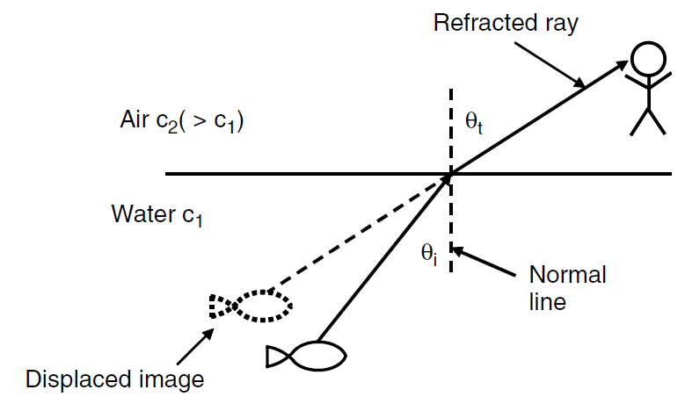
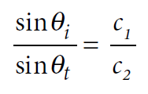
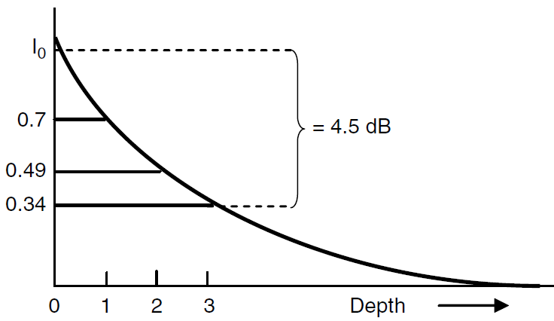
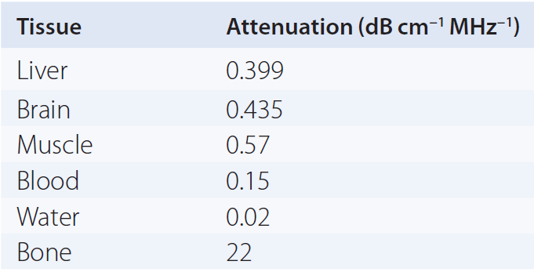
Ultrasound Physics
Refraction: Snell’s law
Attenuation: gradual loss of beam energy
  Depends on both distance and frequency

Slide 13
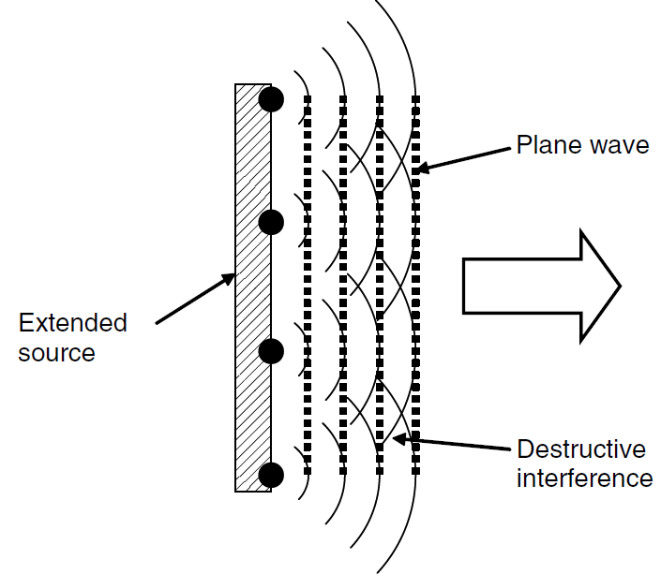
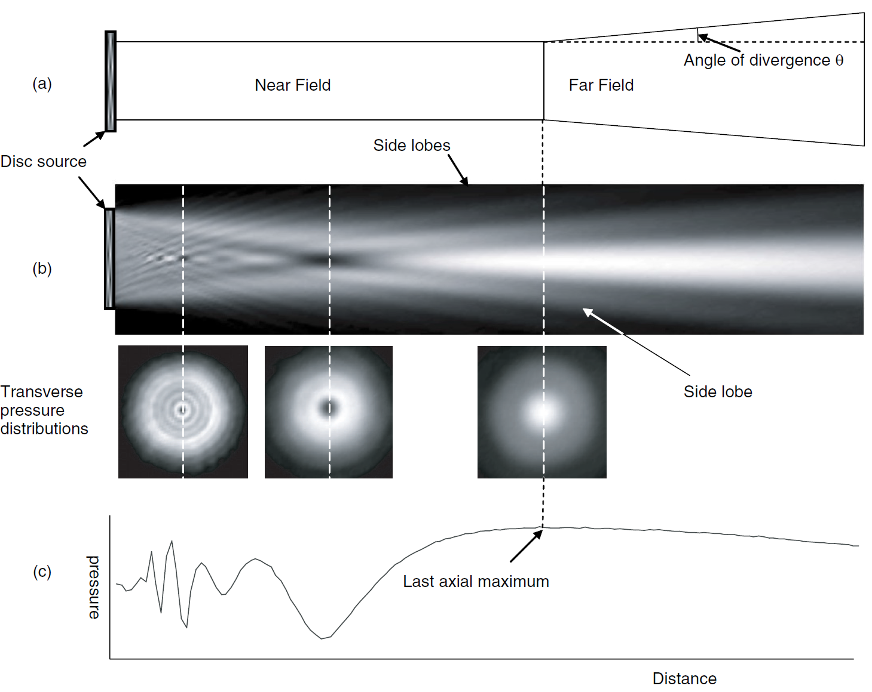



Ultrasound Physics
Interference and diffraction
  Constructive/Destructive interference

Slide 14
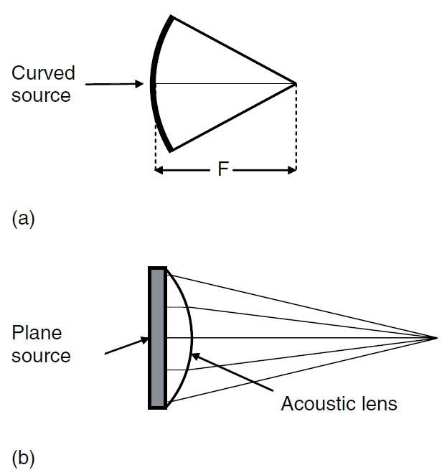
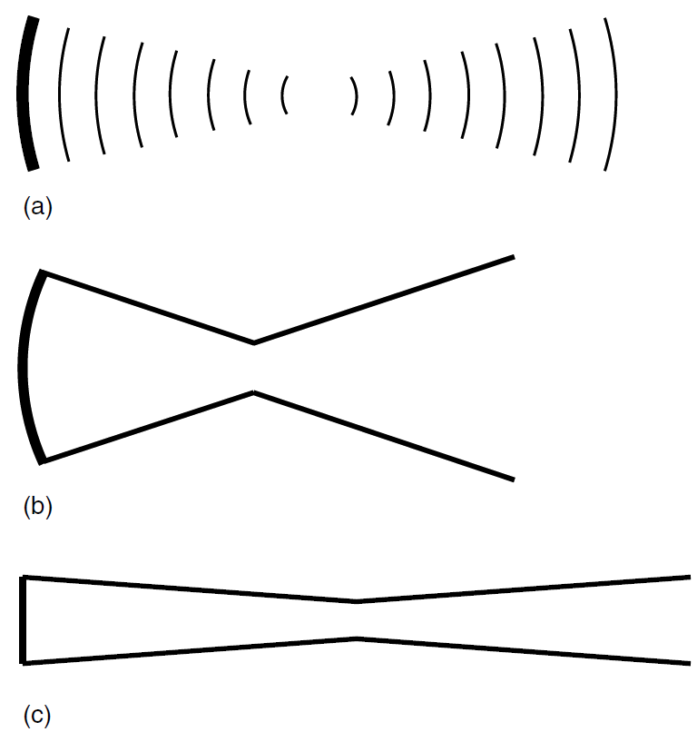
Ultrasound Physics
Focusing: narrower ultrasound beam

Slide 15
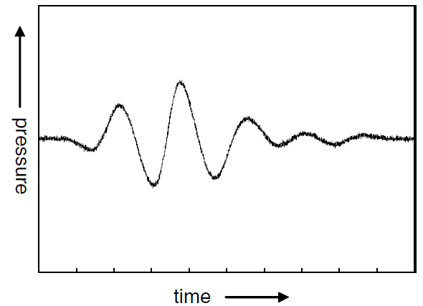
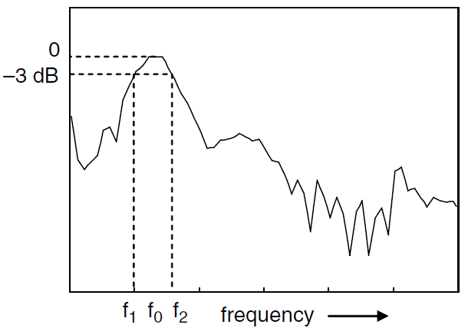
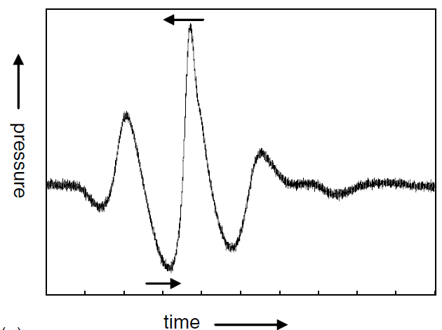

Ultrasound Physics
Ultrasound pulse
Harmonic Imaging

Slide 16




Ultrasound Physics
Acoustic pressure and intensities within ultrasound beam

Slide 17


Ultrasound Physics
Acoustic pressure and intensities within ultrasound beam
  I_{SPTP}
  I_{SPTA}
  I_{SATA}

Slide 18




Ultrasound Transducer
Device that converts electrical transmission pulses into ultrasonic pulses and, conversely, ultrasonic echo pulses into electrical echo signals
  Piezoelectric material

Slide 19


Ultrasound Transducer
Quarter-wavelength matching layer
Bandwidth for multi-frequency transducers

Slide 20










Mechanical vs. Electronic Scanning

Slide 21

Ultrasound Electronic Array Transducer
Linear- and convex-array transducers

Slide 22





Electronic Scanning in Array Transducers
Linear Array
Phased Array
1 | 2 | 3 | 4 | 5 | 6 | 7 | 8 | 9 | 10 | 11 | 12 | 13 | 14 | 15 | 16 | 17 | 18 | 19 | 20 | 21 | 22 | 23 | 24 | 25 | 26 | 27 | 28 | 29 | 30 | 31 | 32
Line 1
 | Line 2
 |  | Line 3
 |  |  | Line 4
 |  |  |  | Line 5
 |  |  |  |  | Line 6
 |  |  |  |  |  | Line 7
 |  |  |  |  |  |  | Line 8
 |  |  |  |  |  |  |  | Line 9
 |  |  |  |  |  |  |  |  | Line 10
 |  |  |  |  |  |  |  |  |  | Line 11
 |  |  |  |  |  |  |  |  |  |  | Line 12
 |  |  |  |  |  |  |  |  |  |  |  | Line 13
 |  |  |  |  |  |  |  |  |  |  |  |  | Line 14
 |  |  |  |  |  |  |  |  |  |  |  |  |  | Line 15
 |  |  |  |  |  |  |  |  |  |  |  |  |  |  | Line 16
 |  |  |  |  |  |  |  |  |  |  |  |  |  |  |  | Line 17
 |  |  |  |  |  |  |  |  |  |  |  |  |  |  |  |  | Line 18
 |  |  |  |  |  |  |  |  |  |  |  |  |  |  |  |  |  | Line 19
 |  |  |  |  |  |  |  |  |  |  |  |  |  |  |  |  |  |  | Line 20
 |  |  |  |  |  |  |  |  |  |  |  |  |  |  |  |  |  |  |  | Line 21
 |  |  |  |  |  |  |  |  |  |  |  |  |  |  |  |  |  |  |  |  | Line 22
 |  |  |  |  |  |  |  |  |  |  |  |  |  |  |  |  |  |  |  |  |  | Line 23
 |  |  |  |  |  |  |  |  |  |  |  |  |  |  |  |  |  |  |  |  |  |  | Line 24
 |  |  |  |  |  |  |  |  |  |  |  |  |  |  |  |  |  |  |  |  |  |  |  | Line 25
1 | 2 | 3 | 4 | 5 | 6 | 7 | 8 | 9 | 10 | 11 | 12 | 13 | 14 | 15 | 16 | 17 | 18 | 19 | 20 | 21 | 22 | 23 | 24 | 25 | 26 | 27 | 28 | 29 | 30 | 31 | 32
Line 1
Line 2
Line 3
Line 4
Line 5
Line 6
Line 7
Line 8
Line 9
Line 10
Line 11
Line 12
Line 13
Line 14
Line 15
Line 16
Line 17
Line 18
Line 19
Line 20
Line 21
Line 22
Line 23
Line 24
Line 25

Slide 23


Electronic Array Focusing: Beamforming
Transmission Focusing
Reception focusing
  Delay-Sum beamforming

Slide 24



Dynamic Active Elements and Apodization
Use smaller number of elements for small depth
Use smaller element weights for outside elements to improve beam shape

Slide 25


Grating lobes
Make sure to eliminate grating lobes by designing element spacing in array transducers to be half the ultrasound wavelength or less

Slide 26

Dynamic Reception Focusing
Change focal point dynamically to follow received depth

Slide 27


Multiple Transmission zones
Combine images with different focal points to improve overall beam shape
  Cost: lower frame rate

Slide 28




Elevation Direction: Image Slide Thickness
Focusing is needed in the elevation direction as well
  Mechanical: Lens
  Electronic: 1.5D or 2D arrays

Slide 29


Electronic Beamformer Design
Function: Compensation of different path lengths for echoes coming from a focal point to different array elements to emulate function of acoustic lens
  Delay and Sum beamforming: echoes from focal point arrive at same time
  Number of channels determines quality (e.g., 32 vs. 64)
Software Processing (Computer)
Analog Beamformer (Old Technology)
Digital Beamformer (New Technology)

Slide 30


Frequency
Ultrasound attenuation (loss) in tissues is around 0.5 dB/cm/MHz
Image resolution is proportional to wavelength of ultrasound
Multi-frequency transducers offer flexibility to trade-off depth and resolution
  Transducers with 100% bandwidth are now common

Slide 31



Gain (Brightness)
Increases intensity of received echoes at all depths
  Too little gain: too dark image
  Too much gain: too bright image
Proper Gain
Too Little Gain
Too Much Gain

Slide 32







Time-Gain Compensation (TGC)
Amplifier with gain that varies with depth (time)
  Compensates for ultrasound attenuation inside tissues

Slide 33







Dynamic Range (Contrast)

Slide 34


B-Mode Instrumentation
Image reconstruction: scan conversion and interpolation
Real-time display: frame every 1/25 s
Freeze: updating frame stops
Cine Loop: recording of real-time scan as a movie
Frame Averaging: moving average filter to improve SNR

Slide 35



B-Mode Image Properties
Lateral Resolution
Thickness resolution
  Elevation

Slide 36


B-Mode Image Properties
Axial resolution
  Half pulse length
Speckle
  Random yet stationary pattern

Slide 37




B-Mode Image Properties
Higher Frame Rate
Frame time / Frame rate
  Time to scan a complete image
  Example: time to scan 1 cm= 2x1cm/c= 2 cm/(1540 m/s) = 13 μs
  Then, frame time to scan a 20 cm depth with 128 lines=13 μs x20 x128
  Frame rate = 1/ frame time = 30 frames/s
Smaller D
Smaller N

Slide 38



Doppler Ultrasound
Doppler effect: Change in the observed frequency of the sound wave compared to the emitted frequency which occurs due to relative motion between observer and source
Up-Shift
No Shift
Down-Shift

Slide 39



Doppler Ultrasound
Doppler Effect: Change in received frequency of ultrasound wave compared to transmitted frequency due to relative motion between receiver and transmitter
Up-Shift
No Shift
Down-Shift

Slide 40


Continuous Wave (CW) Doppler
Only a small region for Doppler sensitivity
No range information
No limitation on maximum velocity and high velocity accuracy

Slide 41


Pulsed-Wave (PW) Doppler
Range information is available and region is selectable by user
Limitations on maximum velocity and accuracy

Slide 42


Color Doppler
Display mean blood velocity at each point encoded in color
  Red: flow toward transducer
  Blue: flow away from transducer

Slide 43


Power Doppler
Display estimate of power of all shifted components encoded in shades of orange
  Assessment of tissue perfusion

Slide 44



Doppler Ultrasound
Doppler Shift Equation

Slide 45


CW Doppler Signal Processing
Transmitted
Received
Transmitted x Received
Low-pass Filtered Transmitted x Received

Slide 46


Clutter Problem in Doppler Ultrasound
Clutter: signal from stationary tissues
  Low Doppler shift and much stronger signal
  Signal from stationary tissue and wall motion
  Critical step in Doppler processing

Slide 47


PW Doppler Signal Processing
Sampled version of CW Doppler
  Aliasing may occur

Slide 48

PW Doppler Example
Consider Doppler imaging of a vessel at depth d1= 10 cm. derive the maximum detectible velocity if the transmitted signal frequency was 5 MHz and Doppler angle was 45°.
Time to collect one sample = PRI = 13μs/cm x (10 cm)= 130μs
Sampling frequency = PRF = 1/PRI= 7692 Sa/s = 2 f_{d}^{max}
v_{max}=(1540 x 7692/2)/(2x5x10⁶xcos(45°))

Slide 49
Doppler Ultrasound Terminologies
Aliasing
  Highest Doppler frequency shift that can be measured is equal to PRF/2
Angle dependence
  Estimated Doppler shift is dependent on cosine of the angle between the beam and the direction of motion
Clutter breakthrough
  Tissue motion giving rise to Doppler frequencies above wall thump or clutter filter may be displayed on spectral Doppler or color flow systems
Loss of low Doppler
  Blood velocities which give rise to low Doppler frequencies (as a result of low velocity or angle near to 90°) will not be displayed if value of Doppler frequency is below the level of wall thump or clutter filter

Slide 50



Ultrasound Safety and Limitations
Ultrasound waves may have mechanical or thermal effects on human tissues
  To date, no clear evidence that diagnostic ultrasound imaging causes harm
  Only imaging modality allowed to scan fetus
Fundamental approach to safety is to use lowest output power and shortest scan time consistent with acquiring required diagnostic information
  “ALARA” principle (i.e. as low as reasonably achievable)
Limitations of ultrasound imaging include:
  Inability to image tissues masked by air or bone/stones
  Geometric inaccuracy due to beam shape variation with depth
  Problems in imaging obese patients
A: 250 lb Patient
B: 150 lb Patient

Slide 51


Quality Assurance
Performance testing using ultrasound phantom
  Uniformity
  Depth of Penetration
  Beam Profile/ Focal Zone/ Lateral Response Width
  Vertical Distance Measurement
  Horizontal Distance Measurement
  Axial and Lateral Resolution
  Elevational Resolution
  Contrast Resolution
  Grayscale Contrast Sensitivity
  Dead Zone Assessment

Slide 52
Ultrasound Imaging System Components
Ultrasound Transducer
Transmit/Receive Switch
Pulser
Transmit Beamformer
Amplifier (Gain)
User Interface
Receive Beamformer
Display
Control
Preprocessing

Slide 53



External Look
Hand-Held
Mobile
Portable

Slide 54

Transducer

Slide 55



Zero Insertion Force (ZIF) Connector
Easier to use for high pin count connectors to avoid damaging connector pins
  Common to have 156 connector pins or more

Slide 56




User Interface: Keyboard and Display
Select, control, and show status
  Transducer
  Mode
  Frequency
  Depth
  Power
  Gain
  TGC
  Trackball
  Alphanumeric keyboard
  Freeze

Slide 57
Covered Material
Diagnostic Ultrasound Physics and Equipment, Chapters 2, 3, 4, 5 and 7

