Slide 1

X-Ray Imaging
Prof. Yasser Mostafa Kadah
EE 472

Slide 2
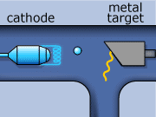
X-Ray Production

Slide 3
X-Ray Production
Bremsstrahlung x-rays are produced when a projectile electron is slowed by the nuclear field of a target atom nucleus
  In the diagnostic range, most x-rays are bremsstrahlung x-rays
Characteristic x-rays are emitted when an outer-shell electron fills an inner-shell void
  This type of x-radiation is called characteristic because it is characteristic of the target element
  Only the K-characteristic x-rays of tungsten are useful for imaging
Approximately 99% of the kinetic energy of projectile electrons is converted to heat (Anode heat)

Slide 4
Quantity and Quality of X-ray Beam
General shape of an emission spectrum is always the same, but its relative position along the energy axis can change
  The farther to the right a spectrum is, the higher the effective energy or quality of the x-ray beam
  The larger the area under the curve, the higher is the x-ray intensity or quantity

Slide 5
Effect of mA and mAs
A change in mA or mAs results in a proportional change in the amplitude of the x-ray emission spectrum at all energies

Slide 6
Effect of kVp
As kVp is raised, area under curve increases by approximating the square of the factor by which kVp was increased
  Accordingly, x-ray quantity increases with the square of this factor
Change in kVp affects both amplitude and position of x-ray emission spectrum
  In diagnostic range, 15% increase in kVp is equivalent to doubling mAs

Slide 7
Effect of Added Filtration
Adding filtration to the useful x-ray beam reduces x-ray beam intensity while increasing the average energy
  The result of added filtration is an increase in the average energy of the x-ray beam with an accompanying reduction in x-ray quantity

Slide 8
Effect of Target Material
The atomic number of the target affects both the number (quantity) and the effective energy (quality) of x-rays
  As the atomic number of the target material increases, the efficiency of the production of bremsstrahlung radiation increases, and high-energy x-rays increase in number to a greater extent than low-energy x-rays.

Slide 9
Effect of Voltage Waveform
There are five voltage waveforms: half-wave–rectified, full-wave–rectified, three-phase/six-pulse, three-phase/12-pulse, and high-frequency waveforms
Both quantity and quality decrease by ripple
  Because of reduced ripple, operation with three-phase power or high frequency is equivalent to an approximate 12% Increase in kVp, or almost a doubling of mAs over single phase power.

Slide 10
Factors Affecting X-Ray Quantity

Slide 11
Factors Affecting X-Ray Quality

Slide 12
Half-Value Layer (HVL)
In radiography, quality of x-rays is measured by the HVL
  Diagnostic x-ray usually has HVL 3 to 5 mm Al or 3 to 6 cm of soft tissue
Although x-rays are attenuated exponentially, high-energy x-rays are more penetrating than low-energy x-rays
  100-keV x-rays are attenuated at rate of 3%/cm of soft tissue
  10-keV x-rays are attenuated at 15%/cm of soft tissue

Slide 13
X-Ray Interaction with Matter
Coherent scattering (energy < 10 keV)
Compton scattering
Photoelectric effect
Pair production (energy > 1.02 MeV)
Relevant to x-ray imaging

Slide 14
Compton (Incoherent) Scattering
+

Slide 15
Photoelectric Effect

Slide 16

Photoelectric Effect

Slide 17
Differential Absorption

Slide 18
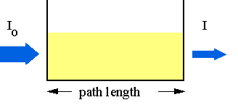
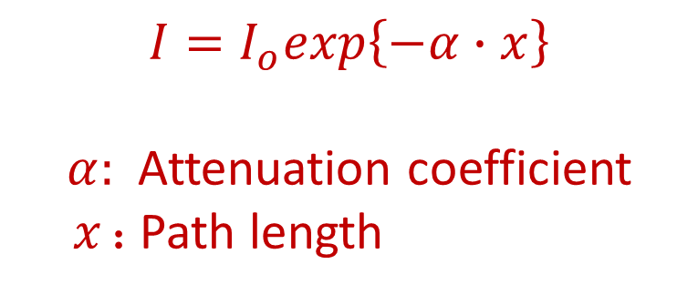
X-Ray Exponential Attenuation
Total reduction in number of x-rays remaining in x-ray beam after penetration through a given thickness of tissue is called attenuation
When broad beam of x-rays is incident on any tissue, some x-rays are absorbed, and some are scattered
Attenuation is the combined effect of both absorption and scattering
$$I=I_{o}exp\left\{−α∙x\right\}$$
$α$: Attenuation coefficient
$x$: Path length
Tissue

Slide 19
Radiologic Units
Air Kerma (Kinetic Energy Released in Matter) (Gya)
  Kinetic energy transferred from photons to electrons during ionization and excitation measured in J/kg where 1 J/kg = 1 gray (Gya)
Absorbed Dose (Gyt )
  Radiation energy absorbed in tissue per unit mass with units of J/kg or Gyt (gray) which depends on tissue type
Sievert (Sv): quantity of radiation received by radiation workers and populations
Becquerel (Bq): quantity of radioactive material, not the radiation emitted by that material
  Radioactivity and the becquerel have nothing to do with x-rays

Slide 20
Radiologic Units

Slide 21
X-Ray Tube
External structures
  Support structure
  Protective housing
  Glass or metal enclosure
Internal structures
  Anode and cathode

Slide 22
X-Ray Tube Support Structure
X-ray tube and housing assembly are quite heavy
  Require support mechanism so radiologic technologist can position them
  Mainly ceiling, floor or C-arm support systems

Slide 23
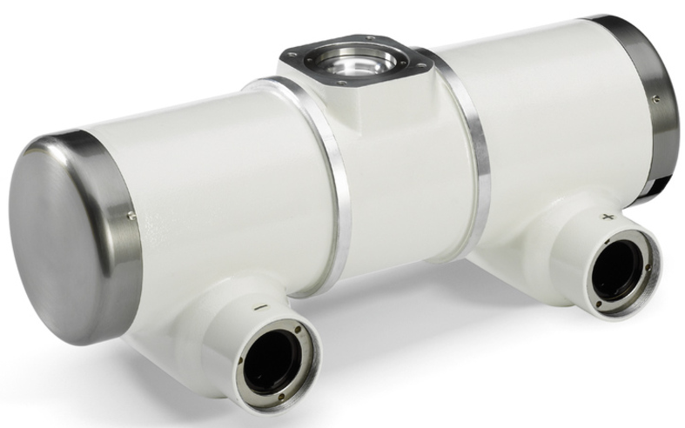
Protective Housing
When x-rays are produced, they are emitted isotropically
  That is, with equal intensity in all directions
Only x-rays emitted through window are called useful beam
  X-rays that escape through protective housing: leakage radiation
  Leakage radiation contributes nothing to diagnostic information and result in unnecessary exposure of patient and radiologic technologist
Protective housing guards against excessive radiation exposure and electric shock
  Also mechanically protects x-ray tube

Slide 24
Metal or Glass Enclosure
X-ray tube is an electronic vacuum tube with components contained within a glass or metal enclosure
  vacuum allows for more efficient x-ray production and longer tube life
As glass enclosure tube ages, some tungsten vaporizes and coats the inside of glass enclosure
  Alter electrical properties of the tube, allowing tube current to stray and interact with the glass enclosure resulting in arcing and tube failure
  Most common cause of tube failure
Metal enclosures maintain constant electric potential between electrons of tube current and enclosure
  Longer life and less likely to fail
  Virtually all high-capacity x-ray tubes now use metal enclosures

Slide 25
Cathode
Cathode is the negative side of the x-ray tube
It has two primary parts, a filament and a focusing cup
  Dual-filament cathode allows two focal spots (e.g., 0.5 and 1.5 mm)
  Focusing cup is a metal shroud that surrounds filament
  Tube current is adjusted by controlling filament current

Slide 26
Anode
Anode is the positive side of the x-ray tube
Two types: stationary (dental) and rotating (general purpose)
  Higher tube currents and shorter exposure times are possible with rotating anode because of their better heat dissipation
Three functions in an x-ray tube:
  Electrical conductor that receives electrons emitted by cathode and conducts them through the tube to the connecting cables and back to the high-voltage generator
  Mechanical support for the target
  Thermal dissipation

Slide 27
Target
The target is area of anode struck by electrons from cathode

Slide 28
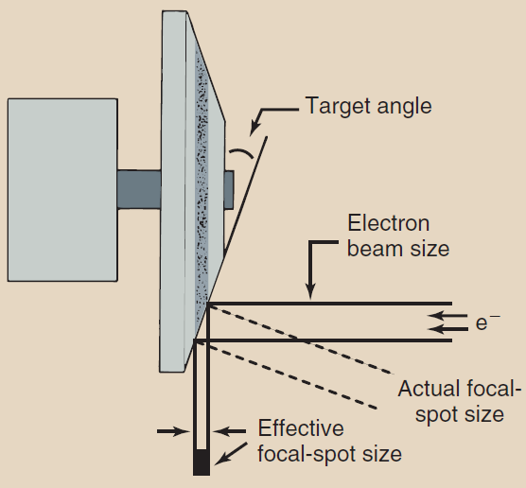
Focal Spot
Focal spot is the area of target from which x-rays are emitted
  The smaller the focal spot, the better the spatial resolution of the image
  Unfortunately, as the size of focal spot decreases, heating of target is concentrated onto a smaller area (limiting factor to focal spot size(
Line-focus principle: angling target makes effective area of the target much smaller than actual area of electron interaction

Slide 29
Radiographic Image Quality
Definition: fidelity with which anatomical structure being examined is rendered on radiograph
  Spatial resolution: ability to image small objects
  Contrast resolution: ability to distinguish anatomical structures
  Radiographic noise: random fluctuation in intensity of image
    Film graininess, structure mottle, quantum mottle, and scatter radiation

Slide 30
Geometric Factors: Magnification

Slide 31
Geometric Factors: Distortion
Unequal magnification of different portions of the same object is called shape distortion
  Distortion depends on object thickness, position, and shape
  Thick objects are more distorted than thin objects
  If object plane and image plane are not parallel, distortion occurs

Slide 32
Geometric Factors: Focal-Spot Blur
Focal-spot blur is caused by effective size of focal spot
  The most important factor for determining spatial resolution
  Smaller on anode side than cathode side of the image (Heel effect)

Slide 33
Subject Factors
kVp is the most important influence on subject contrast

Slide 34
Control of Scatter Radiation
Reduced image contrast results from scattered x-rays
  Restricting x-ray beam (collimation) reduces scattering

Slide 35
Beam Restricting Devices
Collimation reduces patient radiation dose and improves contrast resolution

Slide 36
Radiographic Grids
Effective device for reducing level of scatter radiation that reaches image receptor
  The principal function of a grid is to improve image contrast

Slide 37
Radiographic Grids
High-ratio and high-frequency grids increase patient radiation dose
When grid is used, radiographic technique must be increased to produce same image receptor signal by a factor called Bucky (Grid) factor (B)
  As Bucky factor increases, radiographic technique and patient dose increases
  The higher the grid ratio, the higher is the Bucky factor
  The Bucky factor increases with increasing kVp

Slide 38
Radiographic Grids
Grid Cutoff: undesirable absorption of primary x-rays by grid
  Greater Attenuation of primary x-rays near edges of image receptor

Slide 39
Radiographic Grids Types
Parallel, Crossed and Focused
Moving Grid (Bucky): reciprocating and oscillating
  (-) Require a bulky mechanism that is subject to failure
  (-) Distance between patient and the image receptor is increased
  (-) Moving grids can introduce motion into cassette-holding device
  Advantages of moving grids far outweigh disadvantages

Slide 40
Computed Radiography (CR)
Filmless radiology using special imaging plates
  Photostimulable luminescence (PSL)

Slide 41
Computed Radiography (CR)
Screen-Film Radiography
Proper radiographic technique and exposure are essential
Computed
Radiography
Radiographic technique is not so critical

Slide 42
Digital Fluoroscopy (DF)
Fluoroscopy: real-time dynamic viewing of anatomic structures
  Advantages of DF: speed of image acquisition and postprocessing to enhance image contrast

Slide 43
Interventional Radiology
Performing surgical procedures under guidance from radiographic equipment

Slide 44
Digital Mammography
Radiographic examination of the breast
Digital Mammography spatial resolution limited by pixel size
  Superior contrast resolution principally because of postprocessing

Slide 45
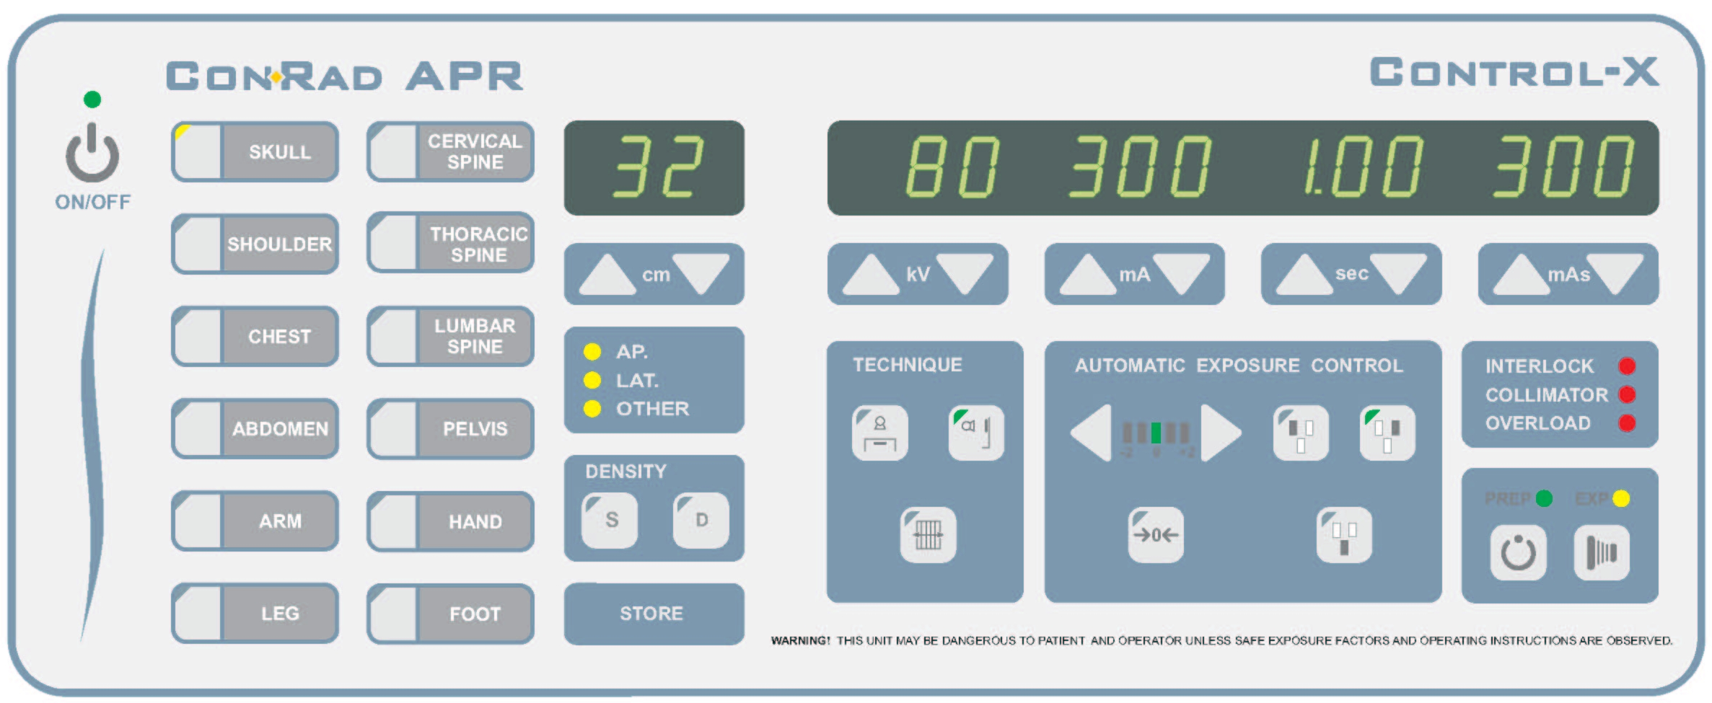
Operating Console
Allows radiologist to control x-ray tube current and voltage so that useful x-ray beam is of proper quantity and quality
  Radiation quantity refers to number of x-rays or intensity of x-ray beam
  Radiation quality refers to penetrability of x-ray beam and is expressed in kilovolt peak (kVp) or, more precisely, half-value layer (HVL)

Slide 46
Autotransformer
Power supplied to x-ray imaging system is delivered first to autotransformer where it provides controlled but variable voltage to high-voltage transformer
  It is much safer and easier to control a low voltage and then increase it than to increase a low voltage to the kilovolt level and then control its magnitude

Slide 47
Adjustment of Kilovolt Peak (kVp)
kVp determines the quality of the x-ray beam
Appropriate autotransformer connections can be selected with an adjustment knob, a push button, or a touch screen
  This low voltage from autotransformer becomes the input to high-voltage step-up transformer that increases voltage to chosen kilovolt peak
Note: kVp meter placed across output terminals
of autotransformer actually reads voltage, not kVp.
It registers kilovolts because of the known multiplication factor of high voltage transformer

Slide 48
Control of Milliamperage (mA)
The x-ray tube current, crossing from cathode to anode, measured in milliamperes (mA)
  Number of electrons emitted by filament is determined by filament temperature (controlled in turn by filament current)
  Thermionic emission is the release of electrons from a heated filament
Space Charge Effect: As the kVp is raised, anode becomes more attractive to electrons that
would not have enough energy to leave the filament. Hence, this effectively increases mA with kVp and hence should be corrected for by special circuit

Slide 49
Exposure Timer
Most exposure timers are electronic, controlled by microprocessor
  Allow wide range of time intervals to be selected and are accurate to intervals as small as 1 ms
Special kind of electronic timer, called an mAs timer, monitors product of mA and exposure time and terminates exposure when desired mAs value is reached
  Because the mAs timer must monitor actual tube current, it is located on the secondary side of the high-voltage transformer

Slide 50
Automatic Exposure Control (AEC)
AEC is a device that measures quantity of radiation that reaches image receptor and automatically terminates exposure when image receptor has received required radiation intensity

Slide 51
High-Voltage Generator
Function: increases output voltage from autotransformer to kVp necessary for x-ray production
High-voltage generator contains three primary parts: high-voltage transformer, filament transformer, and rectifiers
Note: Although some heat is generated in the high-voltage section and is conducted to oil,
the oil is used primarily for electrical insulation

Slide 52
High-Voltage Transformer
High voltage transformer is a step-up transformer
  Turns ratio of is usually between 500:1 and 1000:1

Slide 53
High-Voltage Rectification
Rectification is the process of converting AC to DC
  Rectification is accomplished with diodes
Transformers operate AC while x-ray tubes need DC
  X-rays are produced by acceleration of electrons from cathode to anode and cannot be produced by electrons flowing in reverse

Slide 54
Single-Phase vs. Three-Phase
Three-phase power is a more efficient way to produce x-rays than is single-phase power
  With three-phase power, voltage applied across the x-ray tube is nearly constant, never dropping to zero during exposure.

Slide 55
High-Frequency Generator
High-frequency generators produce nearly constant potential voltage waveform, improving image quality
Rectified power at 60 Hz is inverted to a higher frequency, from 500 to 25,000 Hz, then transformed to high voltage
  Advantage: much smaller size than 60-Hz high-voltage generators

Slide 56
Voltage Ripple Comparison
Less voltage ripple results in greater radiation quantity and quality

Slide 57
Power Rating
Transformers and high-voltage generators usually are identified by their power rating in kilowatts (kW)
  Power (W) = Current (A) × Potential (V)
For specifying high-voltage generators, the industry standard is to use the maximum tube current (mA) possible at 100 kVp for an exposure of 100 ms
  This generally results in the maximum available power
Use RMS voltage factor to account for voltage ripples
  0.7 of peak in single phase generators
  Close enough to 1 in three-phase and high-frequency generators

Slide 58
X-Ray Circuit

Slide 59
Cardinal Principles for Radiation Protection
Simplified rules designed to ensure safety in radiation areas for occupational workers

Slide 60
Cardinal Principles for Radiation Protection
Minimize Time
  Dose is directly related to duration of radiation exposure
  Exposure = Exposure rate × Exposure time
Maximize Distance
  As distance between source of radiation and person increases, radiation exposure decreases rapidly by inverse square law
  If distance from source exceeds 5 times source diameter, it can be treated as point source (assume true and apply inverse square law)
Use Shielding
  Positioning shielding between radiation source and exposed persons greatly reduces level of radiation exposure
  Shielding used in diagnostic radiology usually consists of lead, although conventional building materials also are used

Slide 61
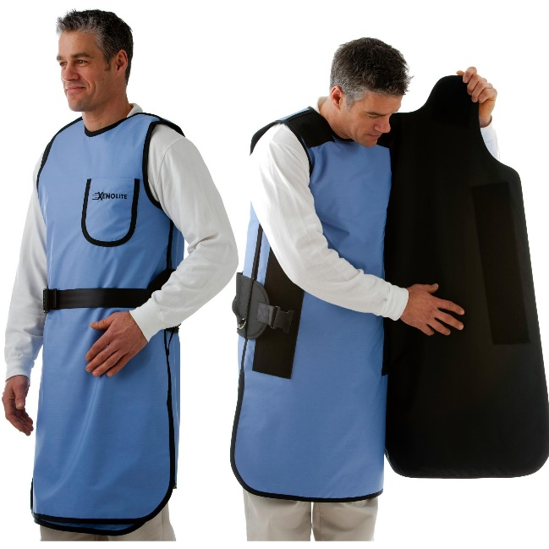
Shielding
Estimate dose reduction using half-value layer (HVL) or tenth-value layer (TVL) of barrier material (1 TVL = 3.3 HVL)
Protective apparel
  Protective aprons usually contain 0.5 mm Pb (2 HVL – reduction to 25%).
  Actual measurements show reduction to approximately 10%

Slide 62
Effective Dose
Effective dose is the equivalent whole-body dose
  When only part of body is exposed, as in medical x-ray imaging, risk is proportional to effective dose (E)
  Equivalent whole-body dose is the weighted average of the radiation dose to various organs and tissues

Slide 63
Patient and Occupational Effective Dose

Slide 64
Covered Material and Suggest Problems
Stewart C. Bushong, Radiologic Science for Technologists: Physics, Biology, and Protection, 11th ed., Mosby, 2017. (ISBN 978-0-323-35377-9)
  Chapters 1, 5, 6, 7, 8, 9, 10, 11, 35

