Slide 1
Human Factors Engineering: Design of Medical Devices Signs, Symbols, and Markings
Prof. Yasser Mostafa Kadah – www.k-space.org

Slide 2
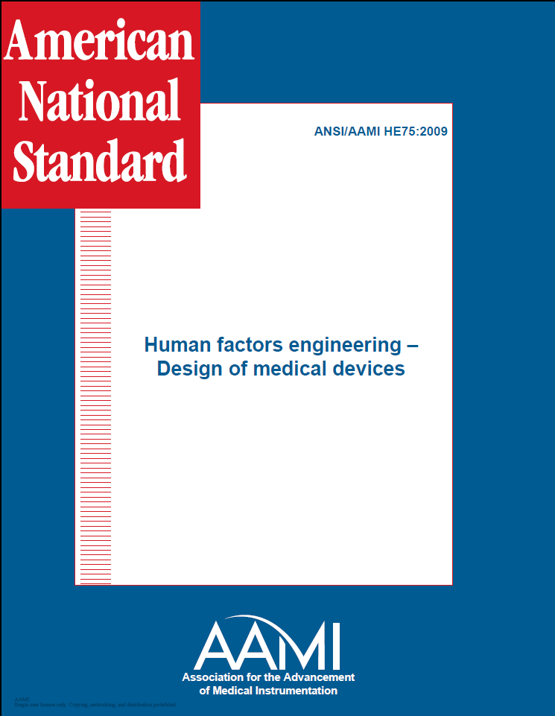
Recommended Reference
ANSI/AAMI HE75: 2009

Slide 3
Introduction
Proper labeling can have an enormous impact on how a user interacts with a device by increasing intuitiveness, minimizing required training, and ensuring accurate performance
Properly designed labeling presents users with instructions, identifications, markings, symbols, colors, and commands that they already know or can easily intuit
Labeling of medical devices and associated accessories, shipping containers, and wrappings
Labeling should be the absolute last resort for protecting users from potential risks

Slide 4
General Considerations
All equipment elements that are not intuitively obvious, that have some usable functions, or that require identification for other reasons should be labeled or marked
Markings should be positioned so that they are clearly associated with the correct equipment feature and not obscured by hand positions or equipment components
Appropriate markings can enhance the identification of both individual elements and their functional relationships
Labels should be visible at typical viewing distances and angles

Slide 5
General Considerations
Labels should be resistant to wear and tear
Ambiguous symbols, codes, or terminology should be avoided
Designing for legibility requires careful analysis of ambient illumination in typical use environments
Consistency of placement, terminology, and coding is critical
All markings should be tested with typical users. Users can be clinicians, caregivers, patients, or maintenance personnel and can vary by age, disability, and other characteristics

Slide 6
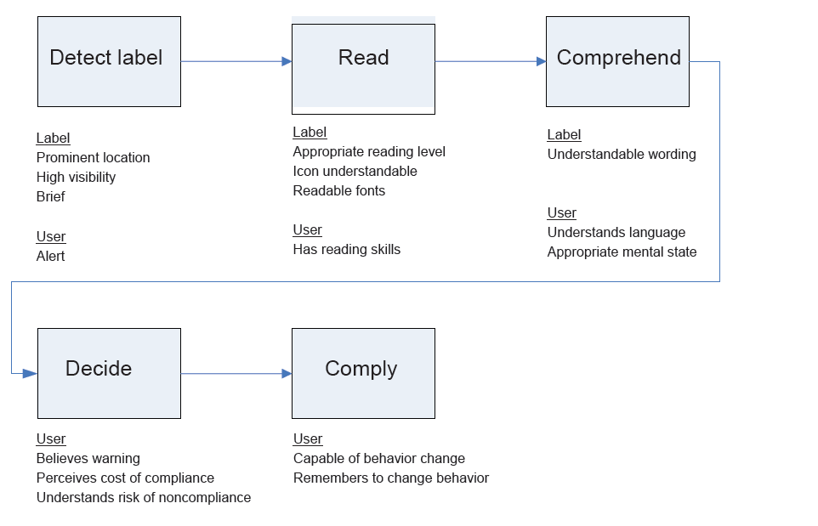
Label Design Model

Slide 7
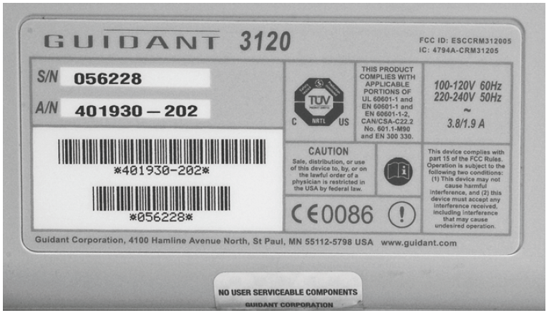
Design Guidelines
Labels for equipment identification
At a minimum, provide the name or trade name of the manufacturer, a distinctive catalog or model number, and the electrical rating
Positioning of nonfunctional markings (e.g., logo) should not distract from or compromise the clear presentation of other information

Slide 8
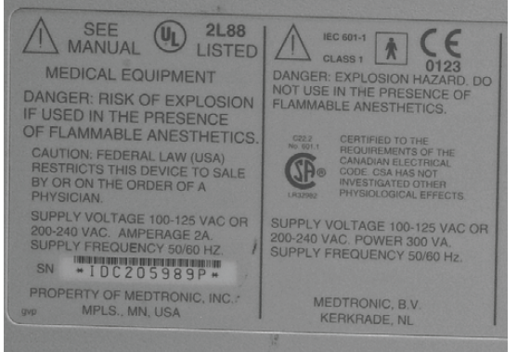
Design Guidelines
Hazard labels
Hazards categorized as (a) death or irreversible injury, (b) reversible injury, and (c) minor injury or discomfort
Used to alert personnel to possible hazards that could be encountered during the use, handling, storage, or repair of a device

Slide 9
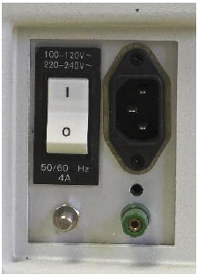
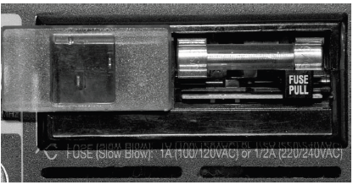
Design Guidelines
Electrical receptacle and connector labels
Receptacles and connectors should be marked with their power rating and the intended function or connecting cable
Convenience receptacles should be labeled with the maximum allowable load in amperes or watts
Fuse and circuit-breaker labels
Permanently marked adjacent to the fuse holder
Legible in the ambient illumination anticipated

Slide 10
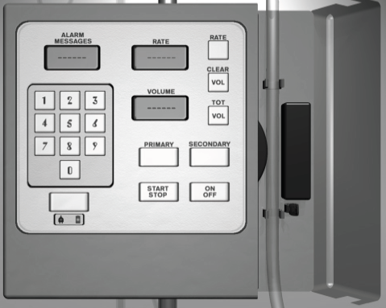
Design Guidelines
Labels on controls, keyboards, and keypads
Intended to facilitate identifying, locating, and functionally grouping user display and control components.
Markings of control positions are also important to users when they adjust mechanical controls and read mechanical displays
Positioning and mounting of labels
Placed near above panel elements, panel displays, or flow lines that users grasp, press, follow, or otherwise handle
Positioned for visibility and readability
from typical viewing angles
Separated by sufficient space

Slide 11
Design Guidelines
Label orientation
Labels should be oriented horizontally so that they can be read quickly
Indications of functional relationships
“Location aids” such as demarcation, color coding, background shading, mimics, and flashing lights can be used to indicate the positions of, and relationships between, functionally related controls, displays, and other features
Redundant if necessary to ensure reliability

Slide 12
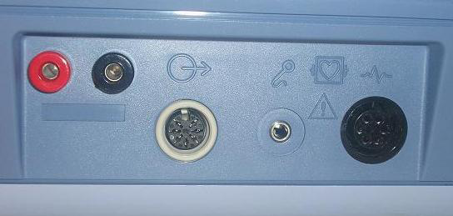
Design Guidelines
Permanence and durability of labels
Markings should be permanent and should remain legible throughout the intended life of the equipment under anticipated use and maintenance conditions
Durability is of special concern for controls like keypads and pushbuttons because constant use can lead to wear
Etched molding

Slide 13
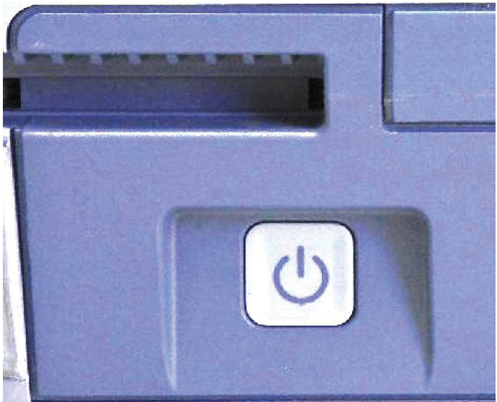
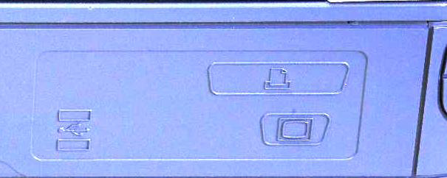
Specific Design Guidance
Consistency
Wording, symbology, coding, and all other aspects of labeling should be consistent within devices and systems.
Label content
Clarity, consistency, and brevity of label information are critical

Slide 14
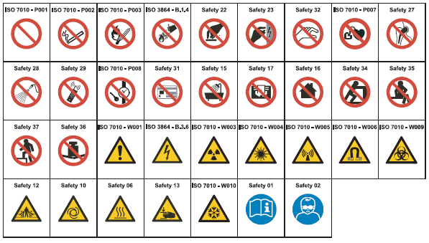
Specific Design Guidance
Use of standard symbols
ANSI/AAMI/IEC TIR 60878

Slide 15
Specific Design Guidance
Legibility
Contrast, lettering, character height (refer to Ch. 6)
Assessed under worst-case viewing conditions (i.e., max intended viewing distance and angle, worst-case lighting, and min exposure time)
Coding
Use of shapes, colors, symbols, or other attributes that have established meanings or associations for a given user population.
Facilitates quick, accurate identification of controls, displays, connector ports, and other features.
Application of color to mimics and flow lines
Different colors with sufficient contrast
Lines depicting the flow of the same contents (e.g., blood, oxygen) should have the same color throughout the system

Slide 16
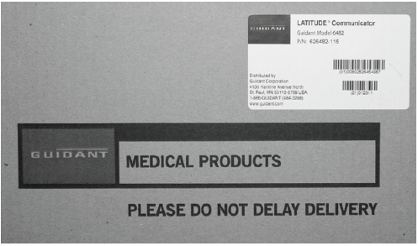
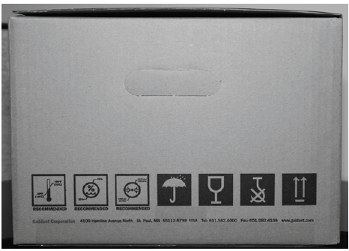
Specific Design Guidance
Package labels
Should provide the product and model names and the name and business address of the manufacturer, packer, or distributor.
Should also describe shipping and storage requirements.

Slide 17
Further Reading and Assignments
Chapter 10 of Recommended Reference
Solved MCQ exams on web site (Part of Medical Equipment courses)

