Slide 1
Human Factors Engineering: Design of Medical Devices Anthropometry and Biomechanics
Prof. Yasser Mostafa Kadah – www.k-space.org

Slide 2
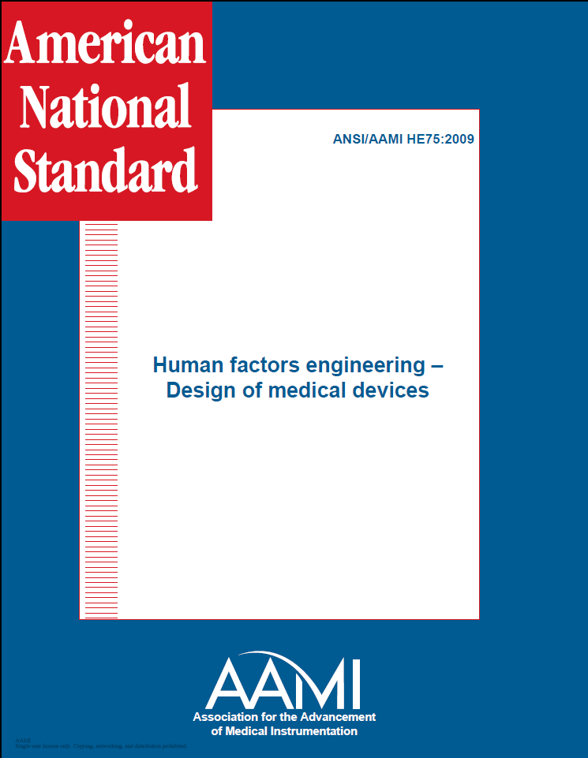
Recommended Reference
ANSI/AAMI HE75: 2009

Slide 3
Anthropometry and Biomechanics
Understanding of human physical capabilities and limitations is fundamental to the design of effective medical devices
Properly designed medical devices will help to reduce errors, decrease injury risk, increase productivity, and improve user satisfaction
Anthropometry: science of measuring and quantifying various human physical traits (size, weight, proportion, mobility, strength, etc.)
Biomechanics: use of laws of physics and engineering principles to study various body segments as they move and are acted upon by internal and external forces
Good anthropometric and biomechanical design principles help designers produce tools, equipment, and workstations that accommodate most of the individuals for whom they are intended
Improve safety and appropriate use but no guarantee to fit all users

Slide 4
General Considerations
Most anthropometric and biomechanical information available today is not specific to health care professionals or patients
Just as useful for medical device designers as designers from other areas
Medical device design should account for physical sizes of people
Data on body-size distributions of males and females are available
Medical domain has unique anthropometric challenges
Implanted component: no data available
In some cases, anthropometric information in the public domain is not detailed enough to be of value
Example: Ear dimensions for headset design (proprietary data)

Slide 5
Anthropometric Design Guidance
Good anthropometric design of medical devices should accommodate as wide a range of human physical dimensions as is possible
In most cases, design of medical tools, equipment, and workstations ought to accommodate adults ranging in size from a 5th percentile female to a 95th percentile male
Accommodate larger percentages of the population if:
a) the device involves critical functions
b) there are safety issues associated with not accommodating extremes
c) the user population has large physical diversity
d) device usability and functionality is not compromised
e) the costs of doing so are not excessive

Slide 6
Available Anthropometric Databases
Most anthropometric data have come from military populations
Existing military data can be considered if it can be assumed that the dimensions of interest are not different for military and civilian populations
Kroemer et al. (1997) reported that “with proper caution and insight, we can use military anthropometric data to approximate size data for the general population. Dimensions of the head, hand, and foot are virtually the same in military and civilian populations.”
Database selection should be specific to the population of users of the medical device of interest, if such a database exists
Medical device designers often need even more specific anthropometric data from measurements in specialized populations (e.g., children)

Slide 7
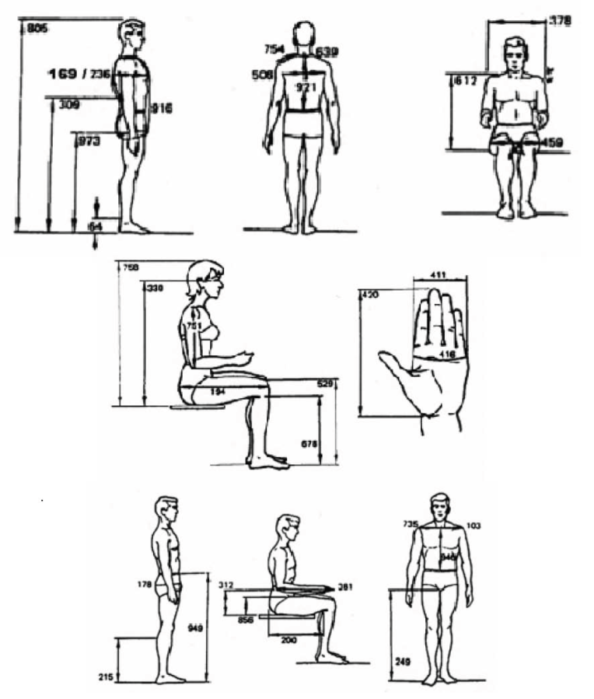
Body Measurement Examples

Slide 8
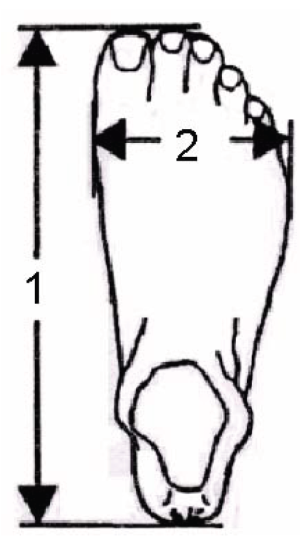
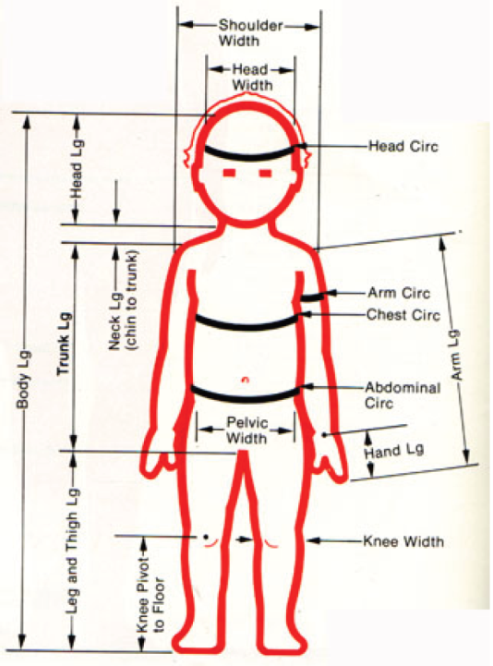
Body Measurement Examples

Slide 9
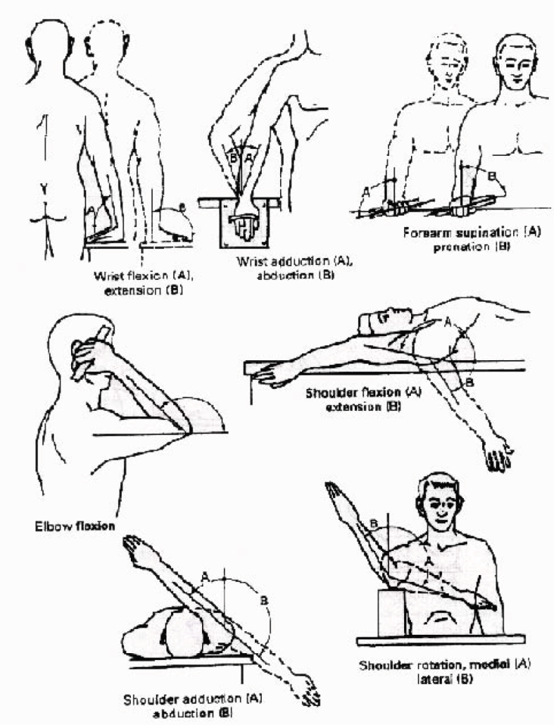
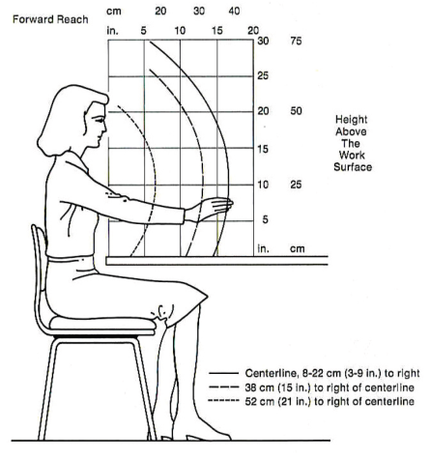
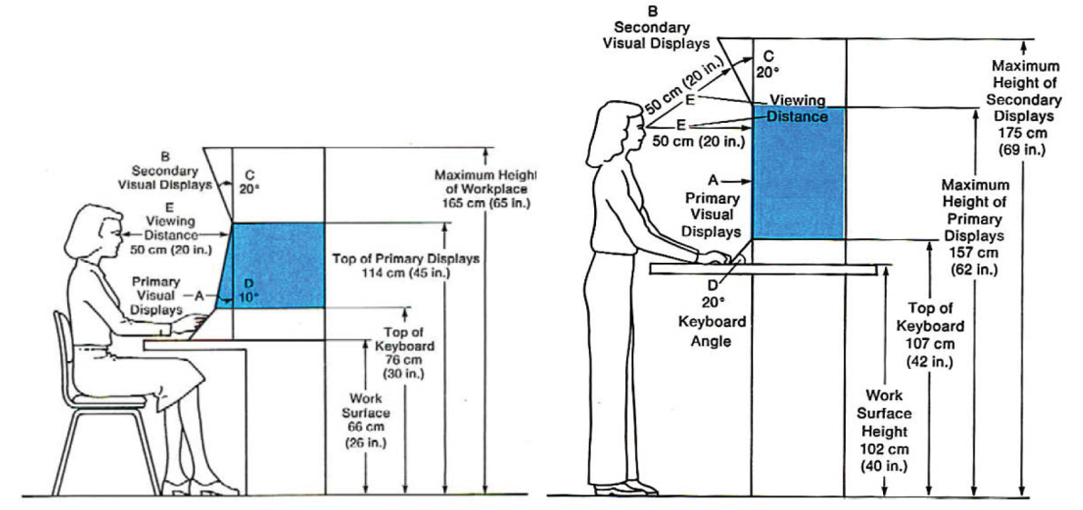
Mobility and Functional Measurements
Flexibility and mobility
Range of motion
Functional work
Visual Work

Slide 10
Strength
Several factors could affect the user’s strength potential
Factors include (but are not limited to) age, gender, health status, body part, body-part position, direction of exertion, whether the exertion is applied statically or dynamically, posture, and environmental issues
It is seldom appropriate to expect people to exert their maximum strength, which is what the data reported describe
A common rule of thumb to avoid complaint is to keep the required force below one-third of maximum strength

Slide 11
Special Considerations
Gender differences
Disabilities
Designing for population extremes
Designing for the average user
Designing for adjustability
Use average anthropometric data only for very general design considerations and never for critical activities or functions
Consider the extremes of the user population (e.g., allow those on the larger end of the spectrum to “fit” into the space and those on the smaller end of the spectrum to “reach” what is needed)
Whenever possible, allow devices to be adjusted to the user’s size and personal preferences

Slide 12
Derivation of Missing Data
Ratio-Scaling technique
Assumes that many individual body sizes (such as various segment lengths) are roughly proportional to each another
Regression Equation technique
Assumes a linear relationship between two values. For example, if arm length data exist for 5th, 50th, and 95th percentiles but not for the 1st and 99th percentiles, use of regression techniques on the known data could allow the unknown values to be extrapolated
Probability Statistics approach
Estimates a measurement for an entire population from data gathered from a small sample.

Slide 13
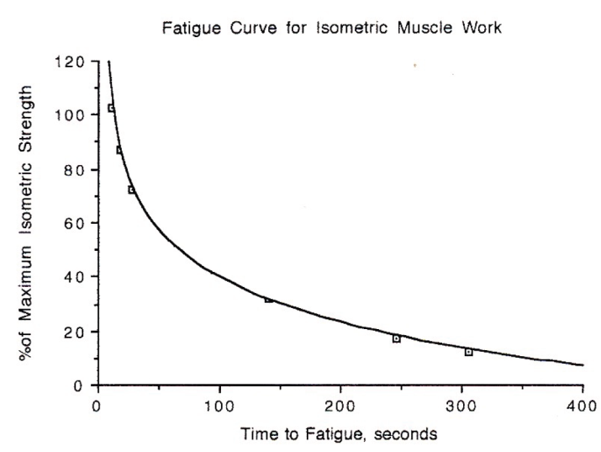
Biomechanical Design Guidance
Body posture
Determine which body part is most relevant to the task, most often used, or most prone to loading or potential injury
Focus device design on proper positioning of that joint or body segment
Endurance
Muscular endurance is a function of the amount of strength exerted by a muscle or group of muscles
Repetitive motions
Repeated use of the same body part to
perform a task is known to increase the risk
of musculoskeletal injury

Slide 14
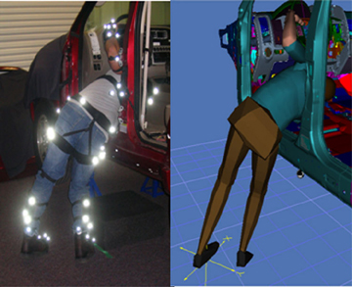
Biomechanical Design Guidance
Methods and tools to quantitatively analyze biomechanics
Expert observation and video
Motion analysis
EMG
Measurement of joint angles and acceleration during movement

Slide 15
Further Reading and Assignments
Chapter 7 of Recommended Reference
Solved MCQ exams on web site (Part of Medical Equipment courses)

