Slide 1
Human Factors Engineering: Design of Medical Devices Environmental Considerations
Prof. Yasser Mostafa Kadah – www.k-space.org

Slide 2
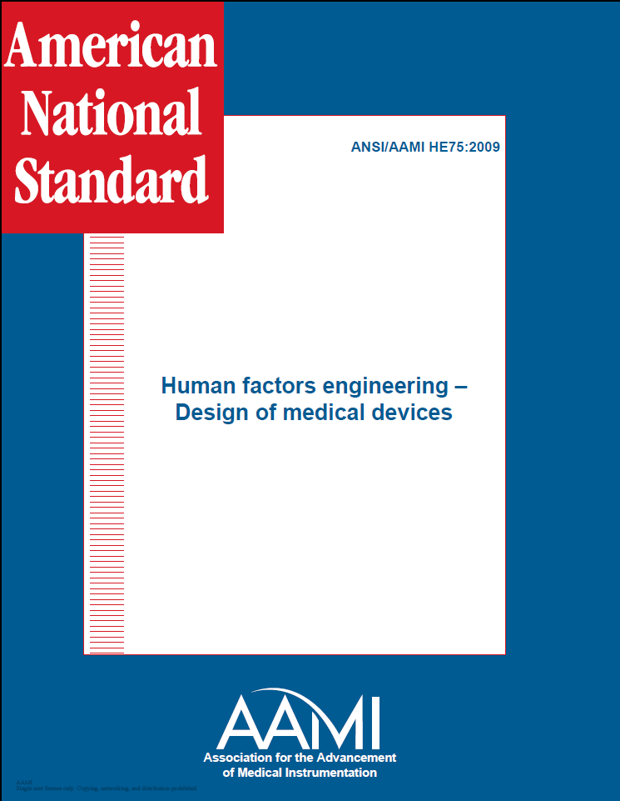
Recommended Reference
ANSI/AAMI HE75: 2009

Slide 3
Environmental Considerations
Identify factors within the use environment that affect medical device usability and safety
Recommend appropriate design approaches that can help overcome poor use conditions
Design recommendations to address means of overcoming existing sources of noise, illumination, temperature, humidity, vibration, and other environmental parameters that could impede the user’s ability to accurately and safely use a medical device
Does not recommend ways to design the physical environment for medical device use

Slide 4
Environmental Considerations
Medical devices are used in very diverse environments
Hospitals, clinics, homes, public spaces
It is important to consider how the environmental characteristics of these places differ and how they can affect the use of medical devices
Although many medical devices are used in only one location, others do not always remain stationary in one location
Example: Infusion pumps frequently used in hospitals but also used in ambulances and increasingly in patients’ homes

Slide 5
Environmental Considerations
Examples of environments where medical devices are used:
Patient’s home (bedroom, den, bathroom, kitchen)
Emergency room (ER)
Operating room (OR)
Catheterization laboratory
Patient’s hospital room
Hospital or clinic test laboratory
Mobile emergency hospital
Transport routes in a hospital or clinic (used while a patient is being moved on a bed)
Emergency medical transport helicopter or ambulance
Shopping centers or airline terminals (e.g., emergency mobile medical devices with public access)
Places of employment or passenger airplanes (e.g., emergency mobile medical devices with semipublic access).

Slide 6
General Considerations
Clinical environment
Complex system of medical and support personnel, patients, and a large number of different medical devices
Characterized by interprofessional and interpersonal relationships and communication
Background, knowledge, culture, and experience of personnel and patients are important characteristics of this environment
Physical environment
Comprises the building and the utilities, physically hosts the clinical environment
Many clinical environments have very specific, medically related physical subsystems (e.g., medical gases, special air conditioning and air filtering, sterilization equipment)

Slide 7
General Considerations
Designers should consider physical environmental factors
Levels of noise, vibration, humidity, and heat that the device generates, and to which the device, patients, device users, and maintenance personnel are exposed in the anticipated use environment
Need to protect the device from contamination, electrical and electromagnetic interference, and temperature and humidity extremes
Need to protect maintenance personnel, users, and patients from electrical shock, thermal burns, and toxicologic, infection, radiologic, visual-injury, and explosion risks, as well as from potential hazards such as sharp edges and corners on devices, tripping, and devices falling on the patient or user
Adequacy of the physical, visual, auditory, and other communication links among users and between users and equipment within the use environment

Slide 8
General Considerations
Designers should consider physical environmental factors
Importance of minimizing psychophysiological stress and fatigue in the use environment;
Potential effects that natural or artificial illumination could have on the operation, control, and maintenance of the device
Need for rapid, safe, simple, and economical maintenance and repair
Possible positions of the device in relation to its users (those who operate, monitor, or maintain the device) and how the device is used as a function of the user’s location and mobility;
Electrical and electromagnetic characteristics of the physical environments
Unique aspects of home use

Slide 9
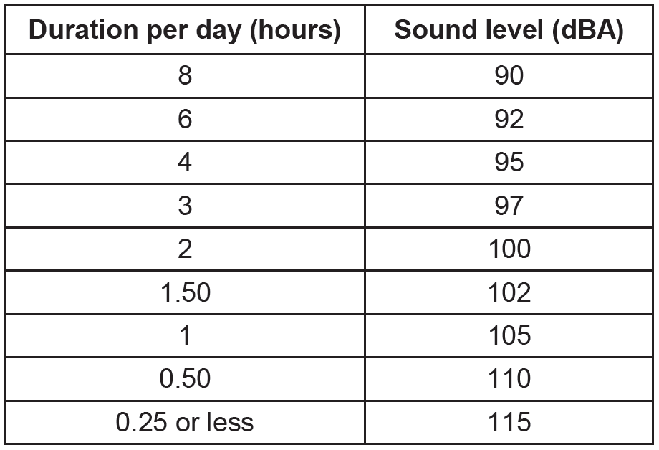
Design Guidelines
Interruptions and distractions
Designers should account for type and frequency of these interruptions in their designs so that interruptions do not adversely affect device use
Acoustic noise
Medical equipment as a source of noise in hospital or home
Acoustic noise exposure limits related to safety

Slide 10
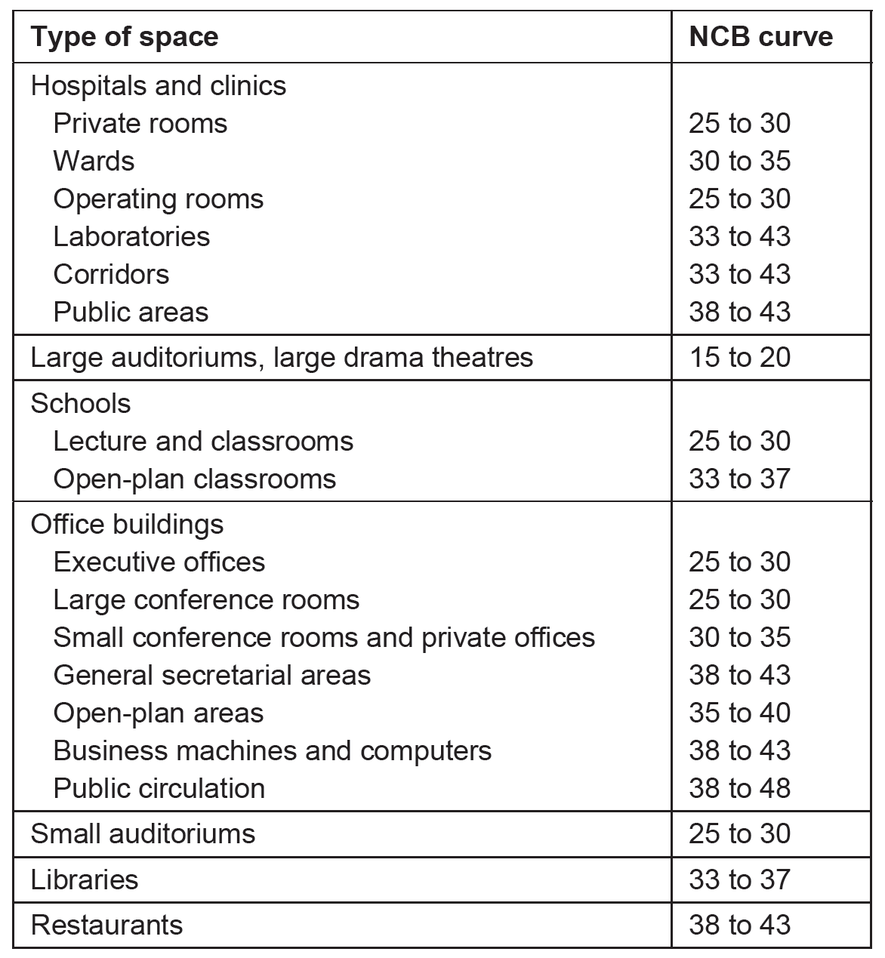
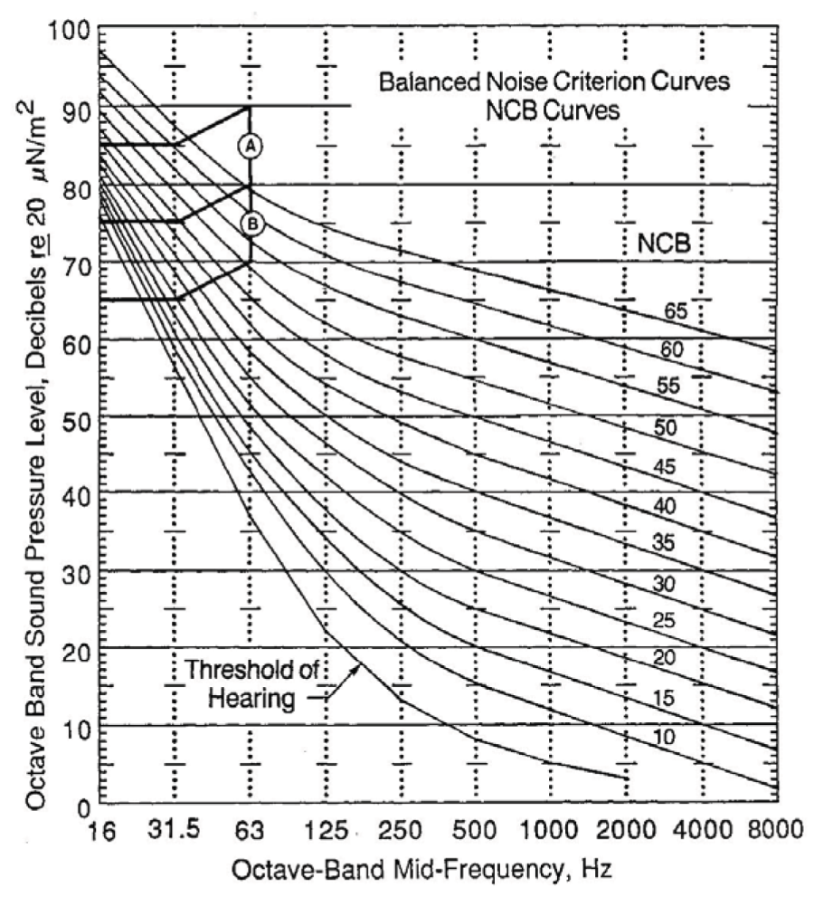
Design Guidelines
Acoustic noise limits for auditory communication

Slide 11
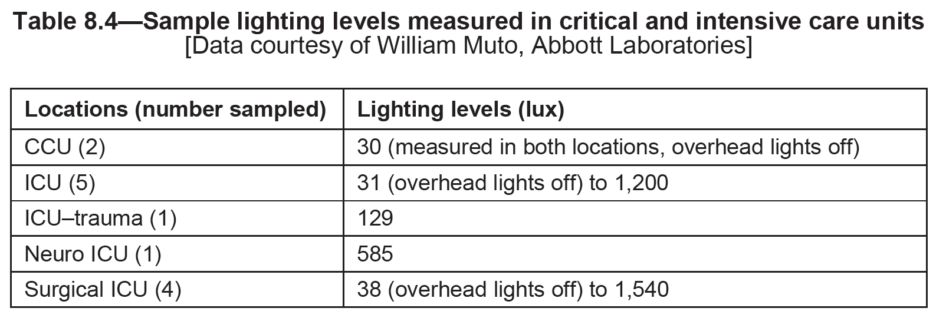
Design Guidelines
Lighting
Ambient illumination
Device displays and lighting conditions

Slide 12
Design Guidelines
Temperature and humidity
Optimum: 21ºC to 27ºC (warm climate) and 18ºC to 24ºC (cold climate)
Temperature and humidity extremes can degrade performance
Surface temperature

Slide 13
Design Guidelines
Humidity
Medical devices should not increase relative humidity in the environment by >15% and should not cause relative humidity to be >45% at 21ºC
Vibration
Vibration of visual displays should not compromise user performance
Larger characters on display, larger keys to counteract tracking and reach errors that can occur at accelerations higher than 2.0 m/sec²

Slide 14
Design Guidelines
Slipperiness and friction
Medical devices used in wet environments should be designed to reduce slipperiness (e.g., IV tubing)
Atmospheric pressure
Effect of hyperbaric chamber on performance
Ease of maintenance
Devices used in the home by lay users should require minimal or no maintenance, or the maintenance requirements should be obvious
Cleaning and sterilization
Adequate access for component replacement and testing
Battery-operated devices: battery status indication

Slide 15
Design Guidelines
Storage requirements
stored in a way that makes them easy to recognize and retrieve
Need for power during storage and fire hazards
Effect of dust and dirt on performance
Radiant energy
Design so that incorrect information cannot be displayed and controls cannot change automatically
Warning or caution labels should be provided on the device or in its accompanying documents if device cannot tolerate adverse radiant energy
Emergency environment
Devices intended for such environments should be designed for extreme use (e.g., ER works 24 hours a day, seven days a week, year-round)

Slide 16
Further Reading and Assignments
Chapter 8 of Recommended Reference
Solved MCQ exams on web site (Part of Medical Equipment courses)

