Slide 1
Medical Image Reconstruction Topic 5: Synthetic Aperture Ultrasound Imaging
Professor Yasser Mostafa Kadah – www.k-space.org

Slide 2
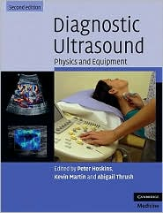
Recommended References
Diagnostic Ultrasound: Physics and Equipment, 2nd ed., by Peter R. Hoskins (Editor), Kevin Martin (Editor), Abigail Thrush (Editor) Cambridge University Press, 2010.
Papers cited in this lecture

Slide 3
Block Diagram of Ultrasound Imaging

Slide 4
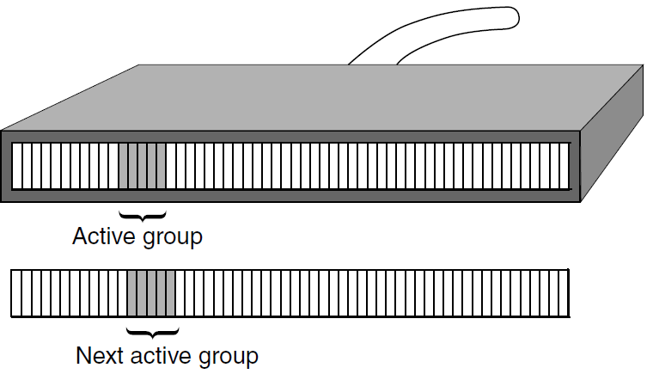
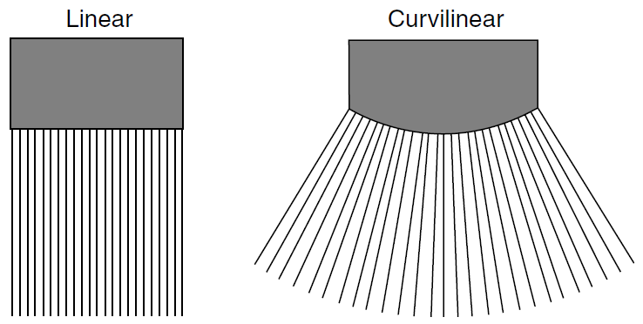
Scanning in Linear Arrays
Element selection of active group to use in transmission and reception to acquire a line
Move active group by one element to acquire another line and so on
Same for linear and curvilinear array transducers

Slide 5
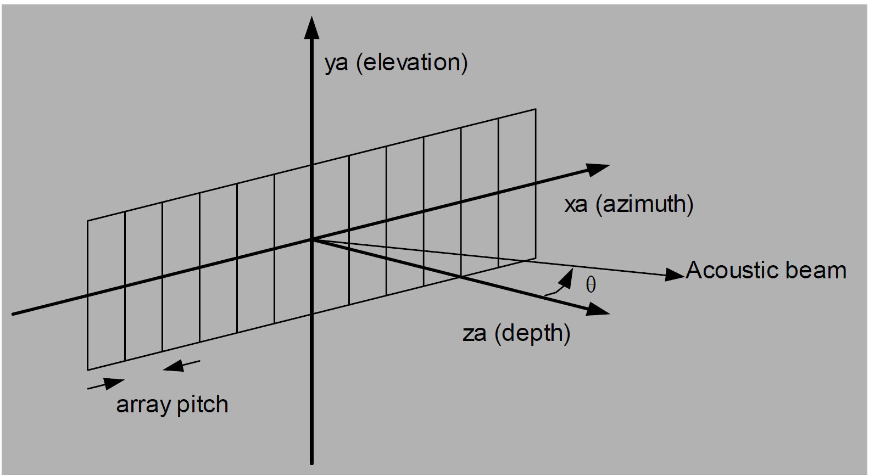
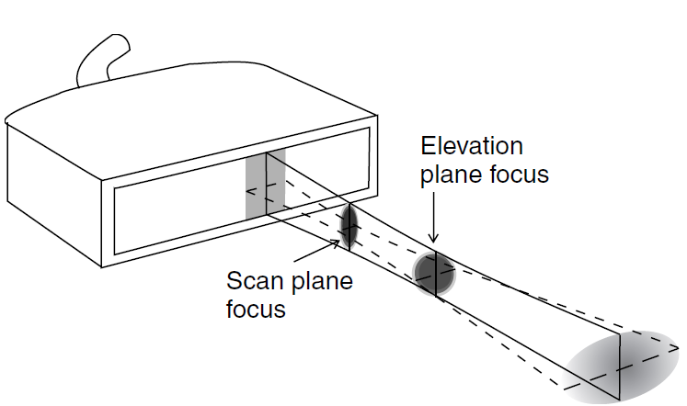
Beamforming
The part of scanner that determines the shape, size and position of the ultrasound beams by controlling electrical signals to and from the transducer array elements

Slide 6
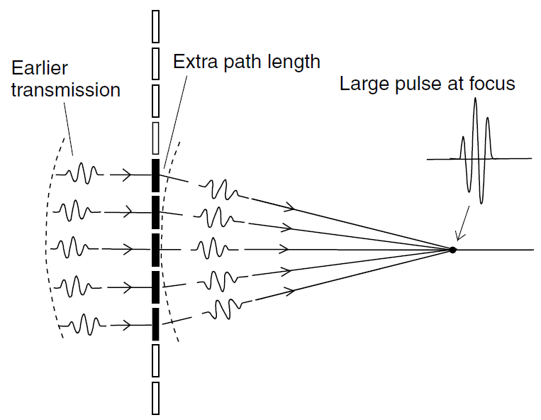
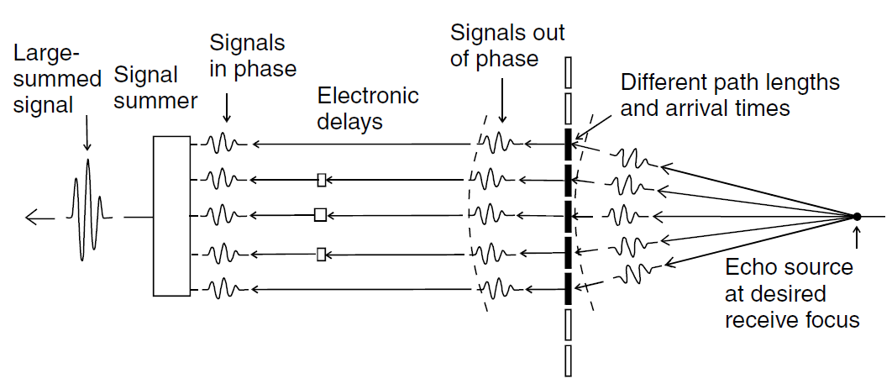
Beamforming
Transmission focusing
Reception focusing
Delay-Sum beamforming

Slide 7
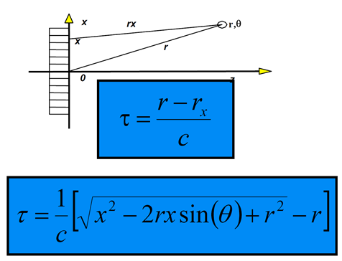
Delay Calculation from Geometry
Simple path length difference given array geometry and focus point coordinates
Relative to longest path
Assume c=1540m/s
Focusing: θ=0
Same for transmission
and reception focusing
calculations

Slide 8
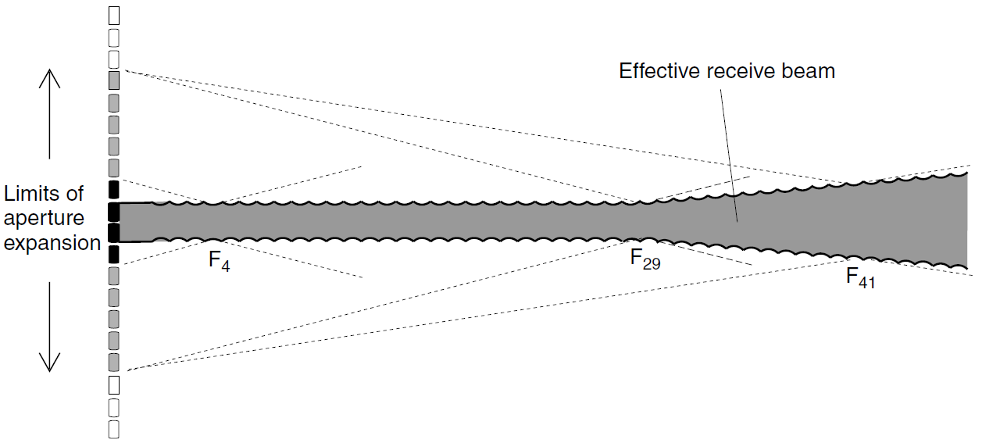
Dynamic Reception Focusing
Change electronic focusing delays with time to follow received signal depth
Dynamic delays
At time T focus is at depth (cT/2)

Slide 9
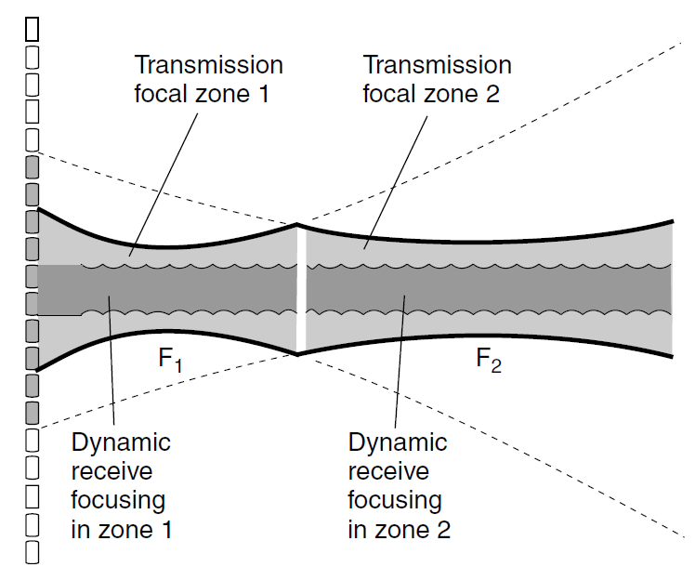
Multiple Transmission Zones
It is not possible to focus at two locations in transmission
Acquire same field twice with two different transmission foci and combine images to get the best beam shape

Slide 10
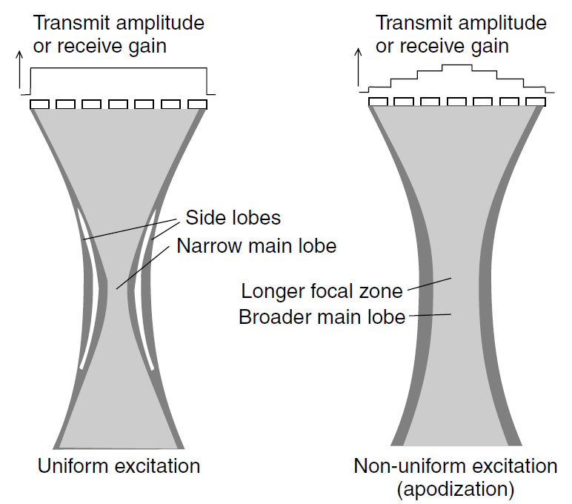
Apodization
Windowing of aperture
Recall that the field is the Fourier transform of the aperture
Lower side lobes (+)
Wider main lobe (-)

Slide 11
Scan Conversion

Slide 12
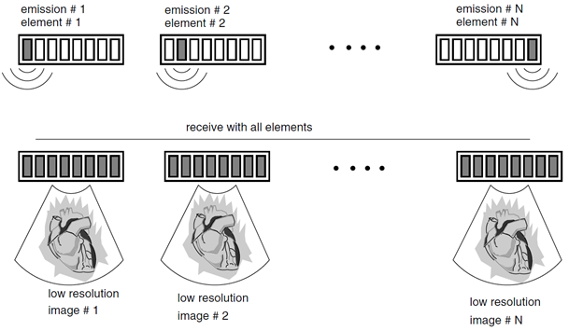
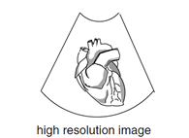
Synthetic Aperture Imaging
Uses a very small aperture (1 element) in transmission and collect data from all elements
Allows off-line processing of collected data to generate images with different transmission and reception apertures and beamforming (by superposition)
Combine

Slide 13
Synthetic Aperture Data
Given as a 3-D array of size NxNxM
N: number of elements in array probe
M: number of points in the received signal
The array data(n, m,:) represents ultrasound data samples received from element m as a result of a transmission by element n
Can use linearity to form an arbitrary imaging system by selecting number of elements in transmission and reception as well as their phasing for focusing/steering

Slide 14
Synthetic Aperture Imaging: Example
Problem definition: Given synthetic aperture data array Data(128,128,512), reconstruct an image with the following specifications:
8 element aperture in transmission and reception
No transmission focusing
Single reception focus at 5 cm
No apodization
Sampling rate of ultrasound line is 10 MSa/s
Element size= 1 mm, assume nearly zero element spacing

Slide 15
Synthetic Aperture Imaging: Example
Step #1: Element selection for line 1
8-element aperture: elements 1:8 are selected
Matlab: Data1= Data(1:8,1:8, : )
Resultant data array size: 8x8x512 (3D array)
Step #2: Obtain transmission using 8 elements – no focus
Superposition: Sum all data from transmission elements 1:8
Matlab: DataTr1= sum(Data1(1:8, : , : ), 1) (sums over 1st dim)
Resultant data array size: 8x512 (2D array)

Slide 16
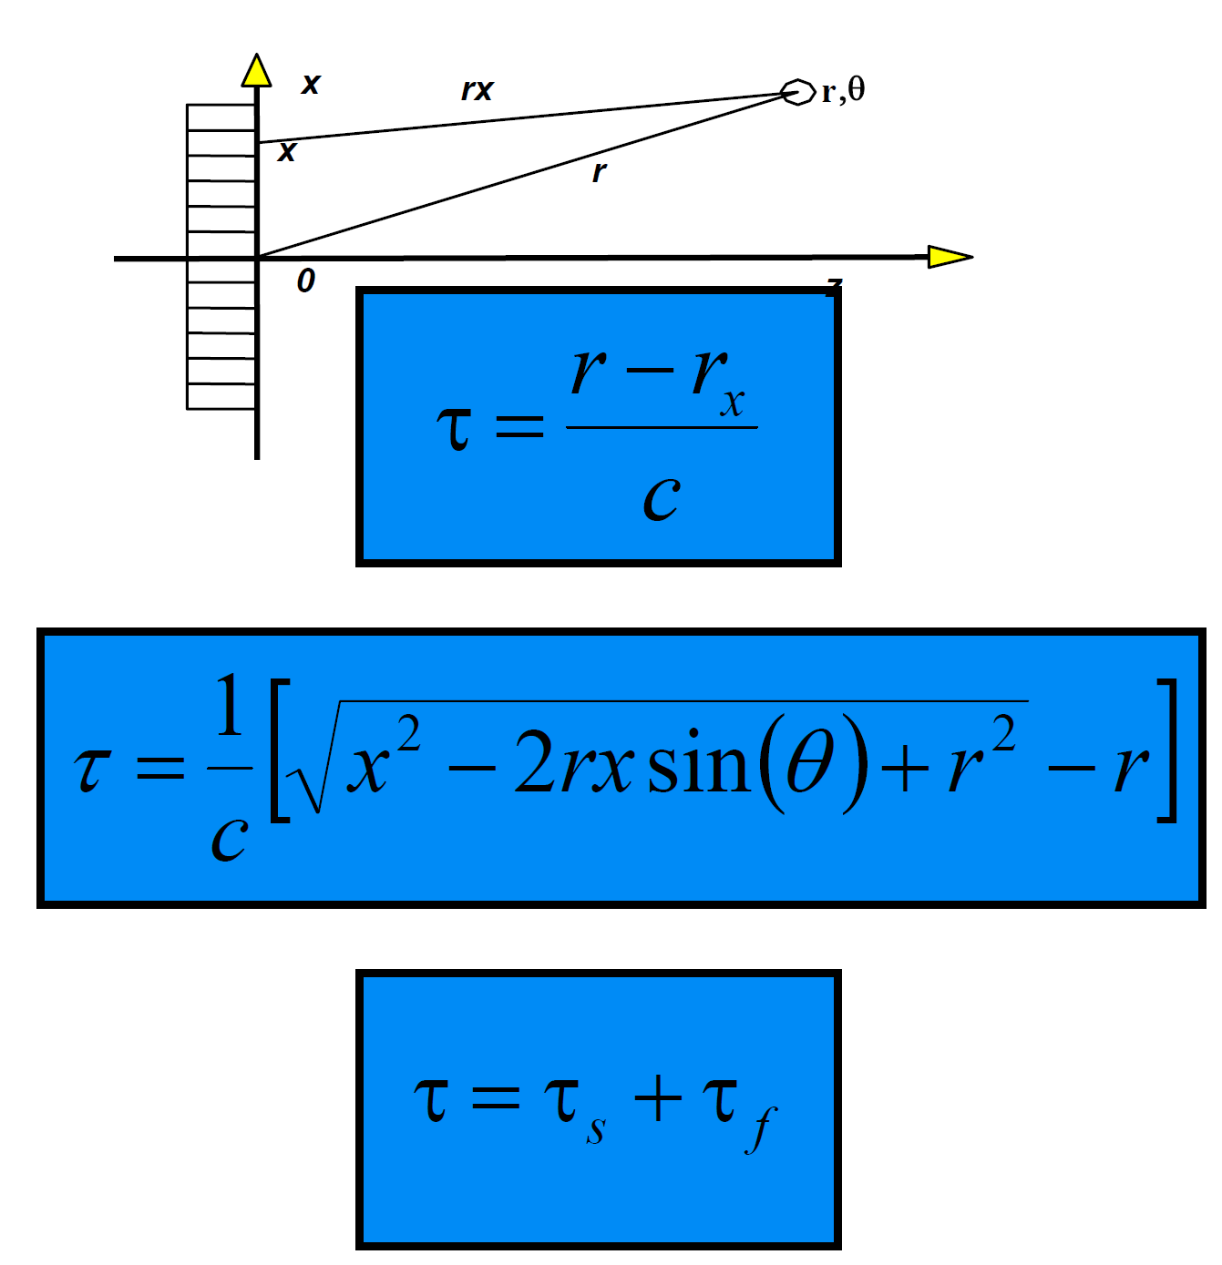
Synthetic Aperture Imaging: Example
Step #3: Compute focusing delays for reception
Calculate focusing delays corresponding to 5 cm focal depth given the array geometry and store in array delay1(8x1 array)
Convert delays to samples given that data point corresponds to 1/10e6= 0.1 μs: delaysamples1= delay1 / (0.1e-6)
For each point, sum signals from all 8 reception elements with their respective delays to obtain image line
ImageLine(n)= DataTr1(1, n+delaysamples1(1)+
DataTr1(2, n+delaysamples1(2))+ …
DataTr1(8, n+delaysamples1(8))
Step #4: Repeat for all image lines
Line 2 uses element 2:9, line 3 uses 3:10, etc.

Slide 17
Exercise
Use one of data sets available on the class web site to reconstruct an ultrasound image. Assume any missing imaging parameters outside those given in the data set description.
Do a literature/patent search on the topic of ultrasound beamforming and scan conversion and come up with a list of all relevant references that should be the starting point for doing research on the subject.

