Slide 1
Medical Equipment: Computed Tomography
Prof. Yasser Mostafa Kadah – www.k-space.org

Slide 2
Recommended Textbook
X-Ray Computed Tomography in Biomedical Engineering, by Robert Cierniak, Springer, 2011

Slide 3
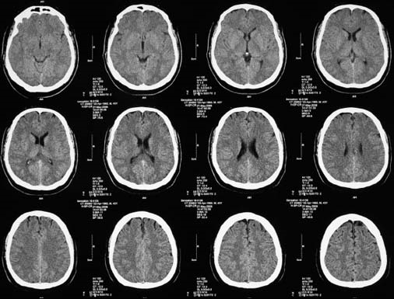
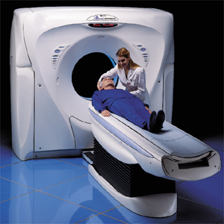
Computed Tomography
X-ray based imaging method
Main feature: sectional imaging rather than projection imaging

Slide 4
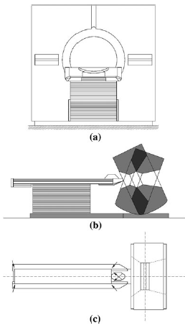
Computed Tomography Components
Gantry with a central opening, into which the patient is moved during the examination.
X-ray tube, the source of the X-rays that pass through the body situated in the gantry in the form of a series of projections;
Detector array converts the projection values, in the form of radiation intensities, into electrical quantities. Usually, the whole detector array rotates synchronously with the X-ray tube around the test object
Table allows the patient to be maneuvered easily into position

Slide 5
CT Scanner Design
One of three basic tube-detector projection systems
A projection system using a parallel beam of radiation
Parallel-beam system
A system using a beam of radiation in the shape of a fan
Fan-beam system
A system using a beam of radiation in the shape of a cone
Cone-beam system

Slide 6
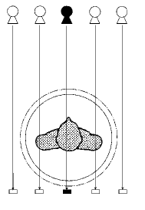
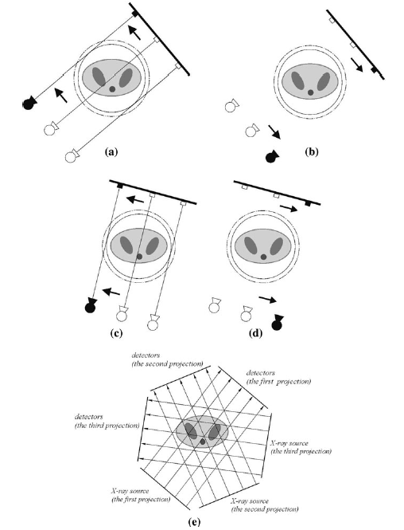
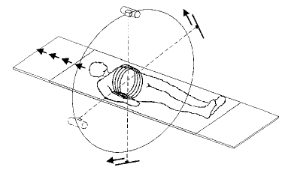
First-Generation CT Scanners
Pencil beam or translation/rotation single detector CT scanners
belong to the parallel-beam projection system
Two components to the movement of the rigidly coupled tube-detector system
lateral movement to make a single projection
circular movement about the central opening in the gantry to gather all projections necessary to form the image
Very slow (5 min/slice)

Slide 7
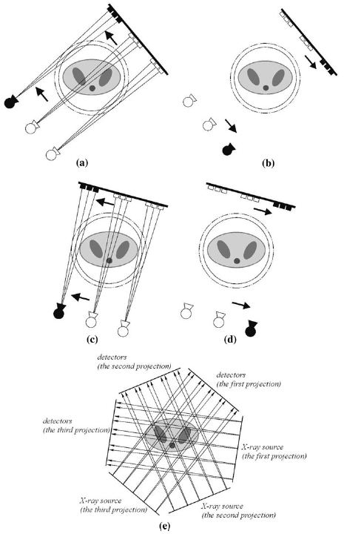
Second-Generation CT Scanners
Partial fan beam or translation/rotation multiple detector scanners
3-52 detectors in the array
enable the projections to cover a larger area of the patient’s body at any one time
results in reduction of number of projections needed to reconstruct an image
Faster!

Slide 8
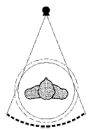
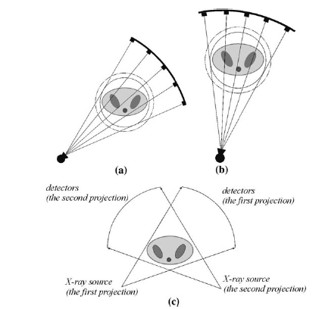
Third-Generation CT Scanners
Elimination of lateral movement of tube-detector system
Fan-beam or continuous rotation scanner
Fan beam of radiation (40-55 degrees) to encompass whole object
Increase number of detectors in the array moving synchronously with rotating X-ray tube (up to 1,000 detectors)
Much faster: 5 s/slice

Slide 9
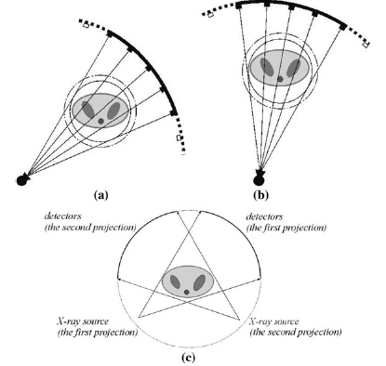
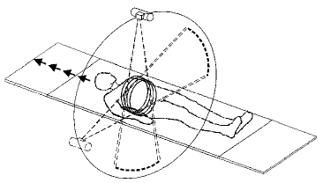
Fourth-Generation CT Scanners
Differ only slightly from the third generation
Rotation of the detector array is eliminated by arranging it on a stationary ring
“Rotate-fixed” scanner

Slide 10
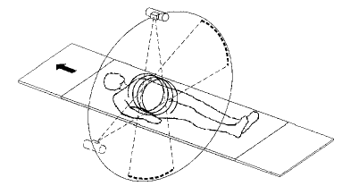
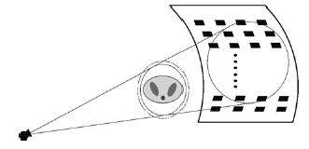
Spiral Scanners
Fan beam scanning + table motion
Single-slice spiral CT scanner (SSCT)
Multi-slice spiral CT (MSCT)
8-34 rows of detectors
Cone beam spiral CT (CBCT)
possible to increase width of detector array to 16 or even 320 elements
Allowing simultaneous acquisition of up to 256 adjacent image slices
No collimation losses: less x-ray power
Faster, higher resolution scanning

Slide 11
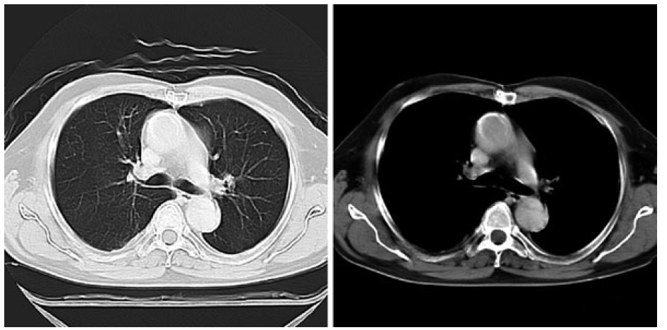
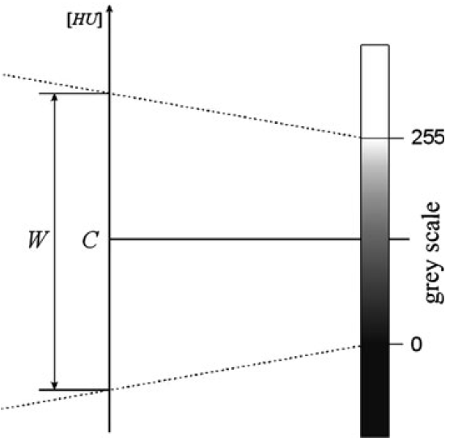
Hounsfield Units
It is common practice in medical applications to use units on the Hounsfield scale: Hounsfield units (HU) .
Value usually varies in the range -1,000 (air) to 3,000 (bone), making it necessary to apply a so-called window (center C and width W).

Slide 12
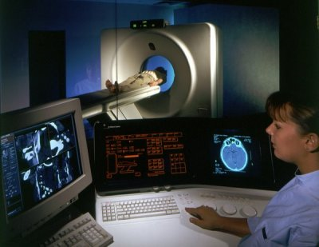
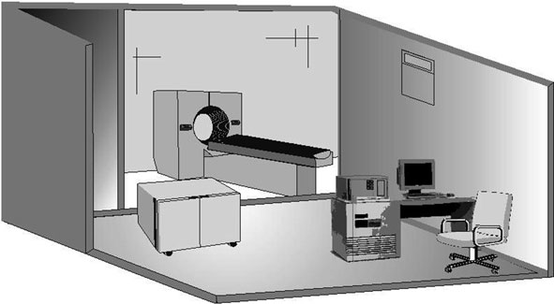
CT Installation
CT room must meet several requirements
it must have floors with adequate load-carrying capacity
its walls must be constructed of X-ray absorbing material (this is usually a barium (Ba) plaster)
the floor should be lined with material that is both anti-slip and antistatic
Separate rooms for CT scanner and radiographers;
Separated by special protective window-glass (containing lead, Pb)

Slide 13
CT Scanner Physical Elements
A CT scanner consists of the following main elements
a data acquisition system that carries out the X-ray projections
a computer to reconstruct the images from the projections and to assist in the analysis of the reconstructed images
a variable power supply
a monitor to display the routine operation of the computer system and to act as an interactive interface in the diagnosis of reconstructed images
a documentation camera to produce an image on film similar to traditional X-ray images
other data archiving systems, such as tape or disk, collectively referred to as storage devices

Slide 14
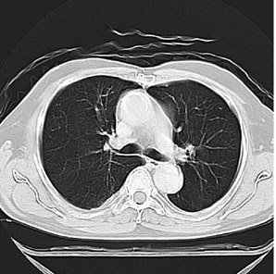
Image Reconstruction Problem
For an N×N image, we have N² unknowns to estimate
Sufficient equations must be available
In most cases the problem can be formulated as a linear system
Simplest case when the acquired data correspond directly to the image points (i.e., diagonal linear system matrix), e.g., ultrasound imaging.

Slide 15
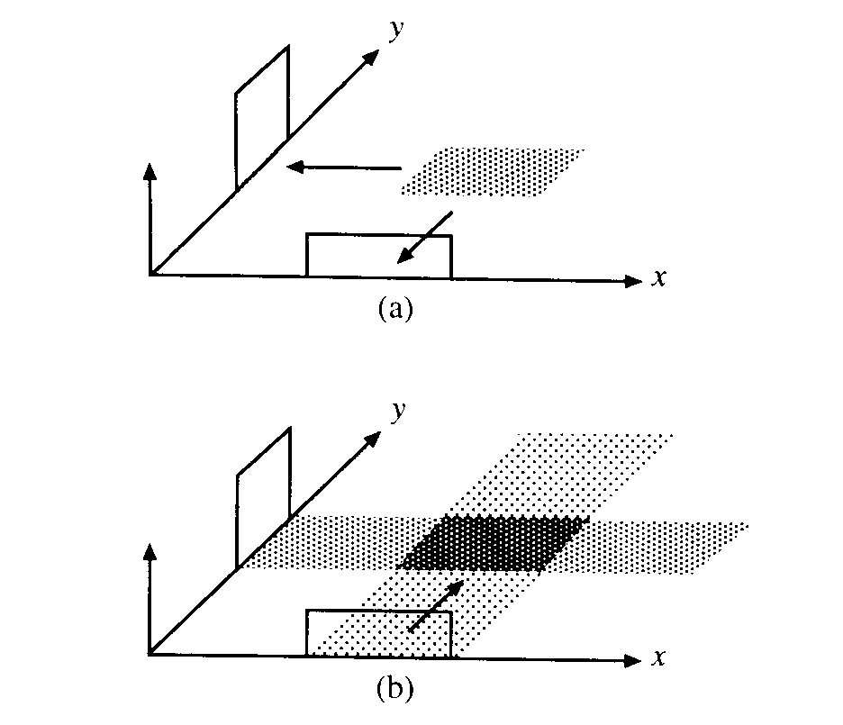
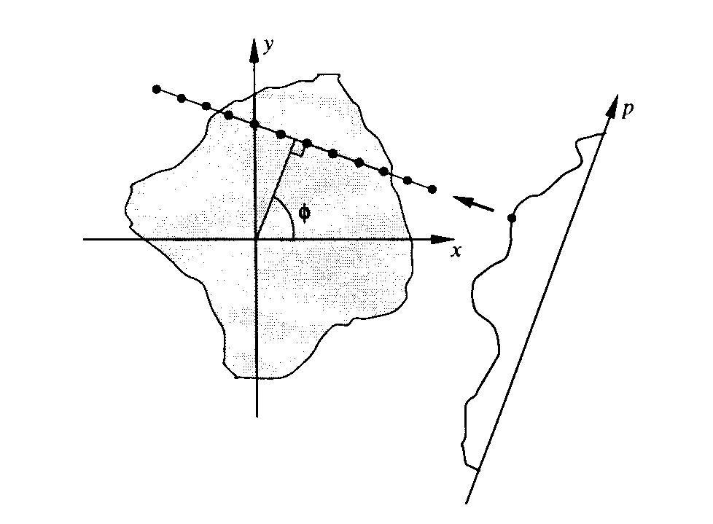
Back-Projection Method
Start from a projection value and back-project a ray of equal pixel values that would sum to the same value
Back-projected ray is added to the estimated image and the process is repeated for all projection points at all angles
With sufficient projection angles, structures can be somewhat restored

Slide 16
Back-Projection Example
3
0
0
True
Image
0
0
0
Projection Data
0
0
3
0
3
0
0
0
0
0 3 0
0
0
0
0
1
0
0
1
0
1
1
0
0
0
0
0
1
0
1
2
1
1
3
1
0
0
0
0
1
0
0
1
0
0
1
1
Initial
Solution
Iterate until sufficient accuracy is achieved

Slide 17
Algebraic Reconstruction Technique (ART)
A low-complexity iterative solver to the algebraic reconstruction problem
Starts with an initial estimate and tries to push the estimate closer to the true solution
Instead of back-projecting the average ray value, the error between the projection computed from current estimate and the true is used
Update: (True Projection – Estimated Projection) divided over all points in the projection path

Slide 18
ART Example
15
8
6
True
Image
1
2
3
Projection Data
12
4
5
6
15
7
8
9
24
12 15 18
0
0
0
4
5
6
1
2
3
1
2
3
0
0
0
4
5
6
4
5
6
4
5
6
0
0
0
4
5
6
7
8
9
7
8
9
Initial
Solution
Iterate until sufficient accuracy is achieved

Slide 19
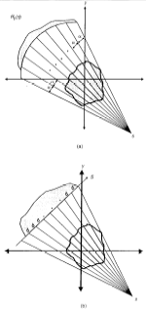
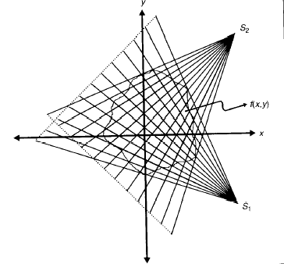
Problem Extensions: Fan Beam Problem
In newer CT generations, fan beams are used to gain more efficiency in hardware implementation
Detectors may be aligned on a line or a circular arc
A modification of the algebraic reconstruction method is used to compute the image

Slide 20
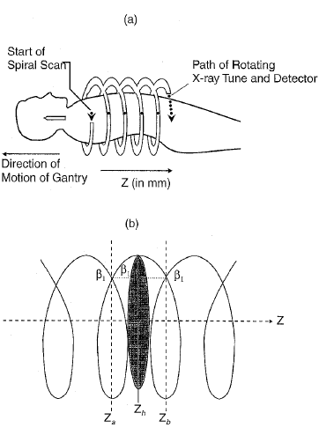
Problem Extensions: Spiral CT
A much more efficient way of acquiring a volume in CT
Instead of acquiring a slice then shifting the table, the table moves continuously during the acquisition
To compute a slice, interpolated projections are obtained from the 3D spiral then reconstructed as a regular 2D slice

Slide 21
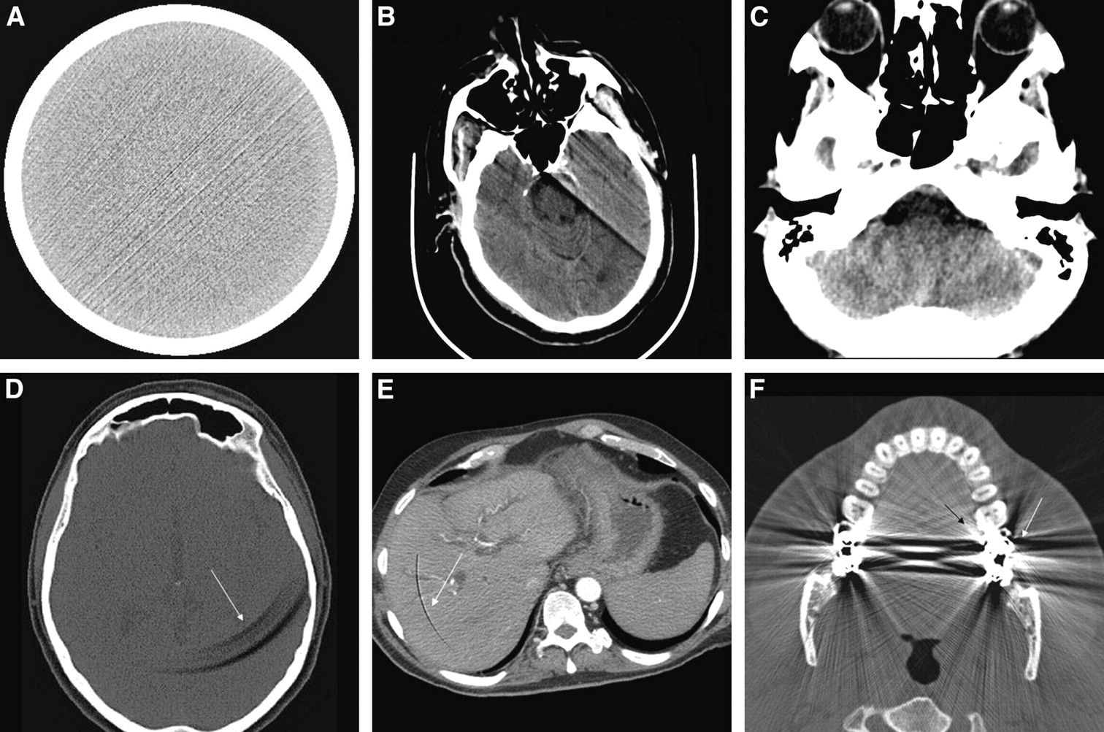
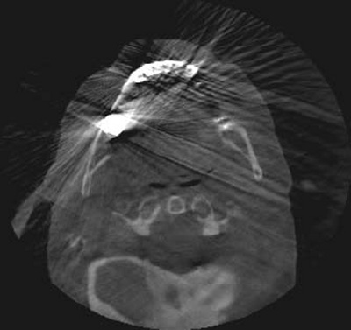
CT Image Artifacts
Examples of CT artifacts: streak artifact (A), motion artifact (B), beam-hardening artifact (C), ring artifacts (D and E), and bloom artifact (F)

Slide 22
Evaluation of CT Devices
The final CT image is produced as a result of a whole chain of processes and is affected by a range of factors
Technical parameters of the scanner
Type of projection system
Type of reconstruction algorithm applied
Assessment of the physical and technical capabilities of CT scanners is made possible by the establishment of standardized, quantitative, comparative criteria.

Slide 23
Technical Parameters of CT Devices
Cycle Time: The total time taken to scan and reconstruct the image
The smaller the cycle time, the greater the chance of avoiding the creation of artifacts caused by patient movement, including physiological movements such as the beating heart or chest movements while breathing

Slide 24
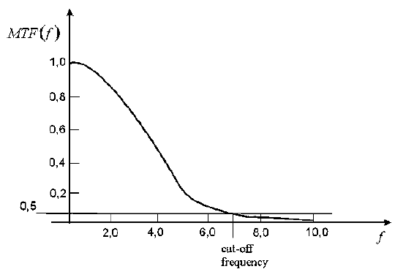
Technical Parameters of CT Devices
Spatial Resolution: The minimum area in the image in which changes can be detected
This quantity is defined using the transfer function of the scanner G(fx, fy) (called often the MTF, modulation transfer function)
MTF defines the frequency domain relationship between the original and the reconstructed image in the presence of noise, and determines the ability of the scanner to capture rapidly changing attenuation coefficients in the object
Spatial resolution is most often defined in terms of the cut-off frequency of the one dimensional transfer function, i.e. the value at which the function MTF(f) drops to the 50, 10 or 2% level.

Slide 25
Technical Parameters of CT Devices
Low-Contrast Resolution (Contrast Detail): The ability to detect small differences of attenuation coefficient in tissues.
It is defined as the ratio between the smallest detectable difference of attenuation coefficient (on the Hounsfield scale) and the average value within an object of a given size, for a specific radiation dose
This last factor is introduced because low-contrast resolution is proportional to the radiation dose
Current scanners have a resolution of between 0.3 and 0.4%. This can be increased by increasing the radiation dose or extending the scanning time

Slide 26
Technical Parameters of CT Devices
Uniformity: A measure of the homogeneity of the image (or rather the heterogeneity)
This can be calculated from the average attenuation coefficients measured at selected areas of a uniform standard water phantom as:
where μ^{max}(x,y) is the highest average attenuation coefficient from among all the selected areas of the phantom; μ^{min}(x,y) is the smallest average attenuation coefficient from among all the selected areas of the phantom

Slide 27
Technical Parameters of CT Devices
Linearity (Sensitometry): defines the relationship between the attenuation coefficients measured at the average energy of the scanner and the values assigned to them on the Hounsfield scale for all types of tissue, using the formula
where μ_{i} is the attenuation coefficient assigned to a given tissue, on the Hounsfield scale; μ_{i}^{av} is the attenuation coefficient measured at the average energy of the scanner; I is the number of the tissue under consideration

Slide 28
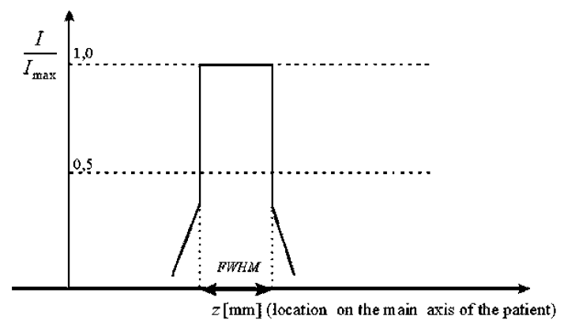
Technical Parameters of CT Devices
Slice Thickness: The nominal thickness of the image cross-section
This is often determined using the value of the full width at half maximum (FWHM) of the scanner, which is defined on the basis of the sensitivity function of the scanner (Example of simplified sensitivity function is shown)
The slice thickness is the distance between the two points on the graph of the sensitivity function, which have values equal to half the maximum value.
A typical value for this parameter would be in the range 0.4–10 mm

Slide 29
Technical Parameters of CT Devices
Computed Tomography Dose Index (CTDI): This index is measured in milligrays (mGy) and defines what dose a patient absorbs when scanned by a particular CT apparatus
CTDI is determined by:
where Dose(z) is the distribution along the z-axis of the dose absorbed by a phantom during the test; z₁, z₂ are the start and endpoints on the z-axis of the measurements made by the dosimeter
Total dose absorbed by the patient should not exceed permissible levels and consequently, much of the efforts of manufacturers of tomographic equipment are currently directed towards minimizing this dose.

Slide 30
Technical Parameters of CT Devices
Pitch: The ratio between the displacement of the table with the patient on it and the thickness of the scanned layer for one revolution of the scanner
This factor is only relevant to spiral scan systems
where λ is the relative travel of the spiral described by the tube as it moves around the test object in (mm/rad); SW is the nominal thickness of the layer in (mm)

Slide 31
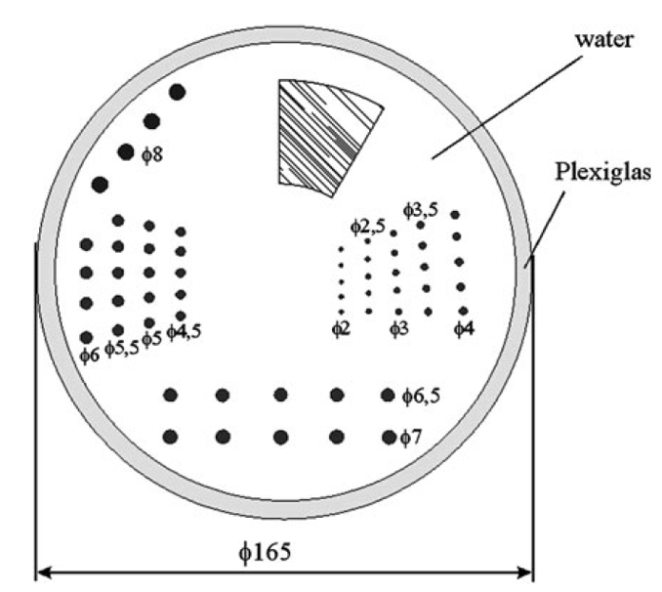
Quality Control Phantoms
ATS Phantom proposed by American Association of Physicists in Medicine (AAPM)
Designed to test low-contrast resolution
Situated inside the Plexiglas housing of this phantom are rows of circular inserts with diameters that change from row to row
These inserts have adjustable attenuation coefficient values, expressed on the Hounsfield scale. The whole of the inside of the phantom is filled with water

Slide 32
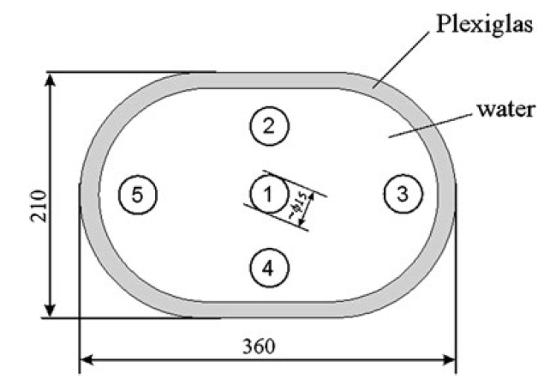
Quality Control Phantoms
Moström’s Phantom
Used to measure the Linearity (sensitometry) or homogeneity of the image
In the example of the phantom illustrated, the parameter I = 5

Slide 33
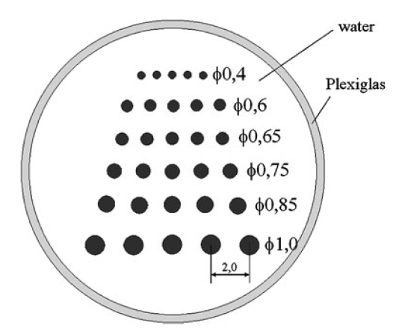
Quality Control Phantoms
Low-contrast Resolution Phantom
The earliest design of phantom used to measure low-contrast resolution
The metal rods, shown immersed in water in the diagram, are arranged in rows, where both the diameter d_{i} and the distance between the rods 2d_{i} decrease as the index i of the row increases
The low-contrast resolution of the scanner is determined by the smallest diameter of rod, which is visible as a distinct element in the reconstructed image

Slide 34
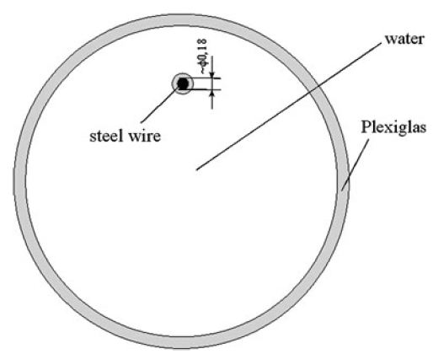
Quality Control Phantoms
Spatial Resolution Phantom
Spatial resolution (units: lp/cm) is determined by the use of a phantom to measure the point spread function
In this phantom, a length of stainless steel wire is placed perpendicular to the test cross-section
The MTF, which directly determines the resolution of the scanner, can be calculated using the Fourier transform of the reconstructed image. Because the diameter of the wire is small in relation to the size of the pixels, it can be neglected in the calculation.

Slide 35
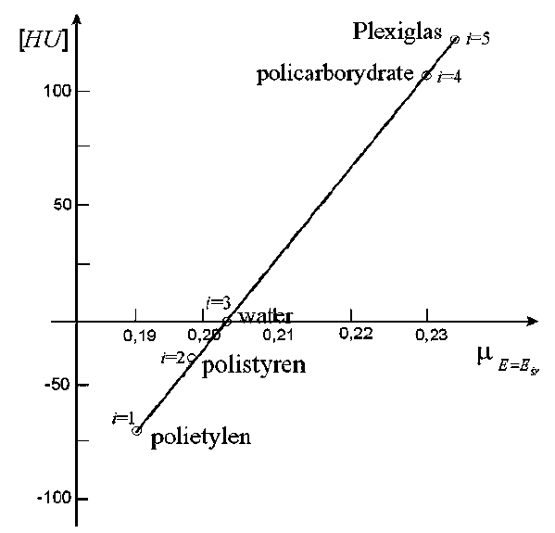
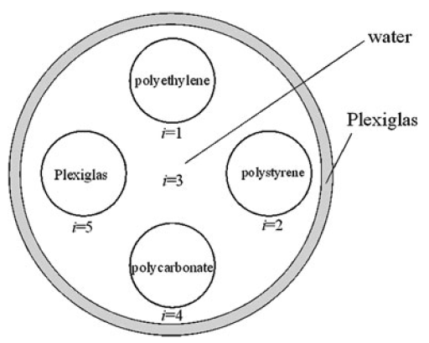
Quality Control Phantoms
CT Linearity Phantom
Assess the linearity of the tomographic image (parameter I = 5)
The five materials used here are selected according to the Hounsfield number assigned to them chosen to cover the widest possible range of the scale
By drawing a graph of the relationship between the Hounsfield numbers assigned to these materials and their attenuation coefficients measured by the scanner (at the average radiation energy), we can establish the nonlinearity parameter based on its equation

Slide 36
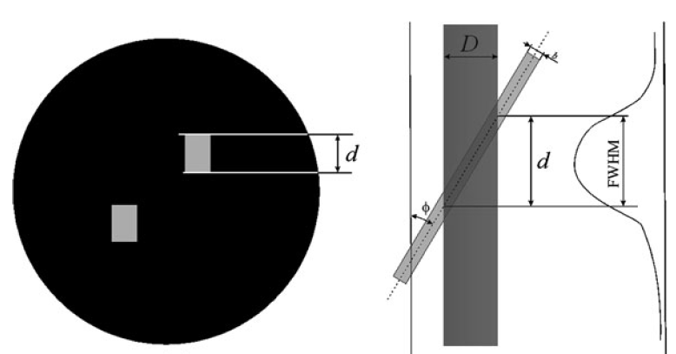
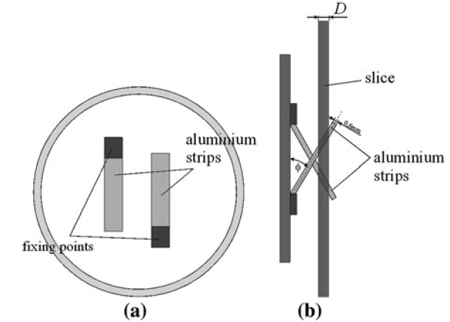
Quality Control Phantoms
Slice Thickness Phantom
This phantom has two aluminum strips of thickness b = 0.6 mm inclined to the reconstruction plane at a fixed angle φ (30 or 45 degrees)

Slide 37
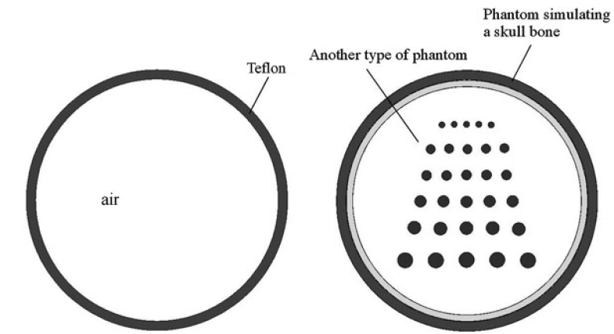
Quality Control Phantoms
Phantom Simulating a Skull Bone
Filters are often used in reconstruction algorithms to compensate for the distortions to the image at boundary between skull and brain.
Use of phantoms described before would cause these filters to have an adverse effect on reconstructed image in absence of skull bone
For that reason, a Teflon rim, as shown is usually fitted to one of the phantoms described above to simulate the skull bone

Slide 38
Start-Up and Test Procedures
To ensure reliable operation of CT scanner throughout the whole of its working life, it is important that all manufacturer’s recommended procedures for startup and testing are followed
After sliding the table out of the scanner’s gantry (Feed Out), image quality is tested (Test Image), but without the emission of radiation to confirm the correct operation of the imaging system
Next step is to prepare x-ray tube for operation by heating it up (Warm Up).
Next step (Calibration) takes place in the absence of any radiation-absorbing material in the gantry of scanner.
Measurements made at this time form the basis of the corrections that must be made to the projections obtained during the routine operation of the scanner

Slide 39
Start-Up and Test Procedures
After calibration, procedures testing operation of CT scanner are carried out (Quality) and can be divided into two types:
Qualitative tests, performed each day or weekly
Stability tests, performed each month
Annual tests.
Set of daily/weekly tests (performed by technicians) to check the quality of the reconstructed image might include:
Test to measure the homogeneity of the image
Test of the point spread function
Check of the X-ray tube voltage

Slide 40
Start-Up and Test Procedures
A battery of tests performed by service personnel or technicians on a monthly basis might consist of measuring the following items:
Spatial resolution
Positioning accuracy
Linearity
Slice thickness
Annual tests might be a combination of the following examinations (performed by physicists):
Daily/weekly tests
Index accuracy and table positioning test
Contrast scale test
Distance accuracy test
Patient dose

Slide 41
Start-Up and Test Procedures
In an emergency, if the time needed to perform the entire start-up procedure could affect the life or health of the patient, a fast start-up procedure (Quickstart) can be carried out, which excludes all the points selected in the start-up window
Appropriate tests should also be carried out on the scanner after the installation of the equipment and after any routine maintenance or servicing
Application software installed on the scanner’s computer enables the results of the tests to be saved, so creating a history of the device for purposes of comparison.

Slide 42
Covered Material
Parts of chapters 3 and 9 of Cierniak textbook
Parts of chapter 15 of Hendee and Ritenour textbook
Recommended further reading: CT image reconstruction

