Slide 1
Intermediate Physics for Medicine and Biology Chapter 1: Mechanics
Professor Yasser M. Kadah
Web: http://www.k-space.org/

Slide 2
Textbook
Russell K. Hobbie and Bradley J. Roth, Intermediate Physics for Medicine and Biology, 4th ed., Springer-Verlag, New York, 2007. (Hardcopy)
Textbook's official web site: http://www.oakland.edu/~roth/hobbie.htm

Slide 3
Distances and Sizes
Valuable skill in physics: ability to make order-of-magnitude estimates
Example: calculate number of cells in body
Simplify problem: assume simple shapes and use average sizes
Cells ~ 10 μm in size → volume ~ (10 μm)³
Adult ~ 2 m tall and 0.3 m wide
→ volume ~ 2 × 0.3 × 0.3 = 0.18 m³
Assume body is made entirely of cells
Estimated number of cells = 0.18/1e-15 ~ 2 × 10¹⁴

Slide 4
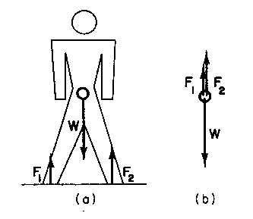
Forces and Translational Equilibrium
Force defined by Newton’s second law
Translational equilibrium:
Apply to all 3 axes in a 3D problem
Equilibrium:
remains at rest
move at constant speed

Slide 5
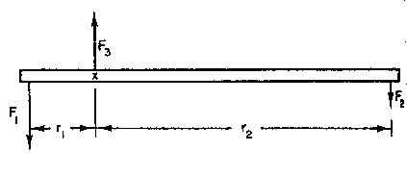
Rotational Equilibrium
Torques τ_{i} is defined as
Require a pivot point to measure r_{i} from
Rotational equilibrium if around any point in the body,

Slide 6
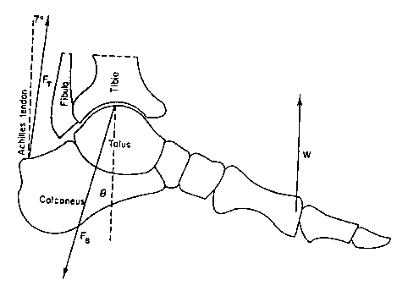
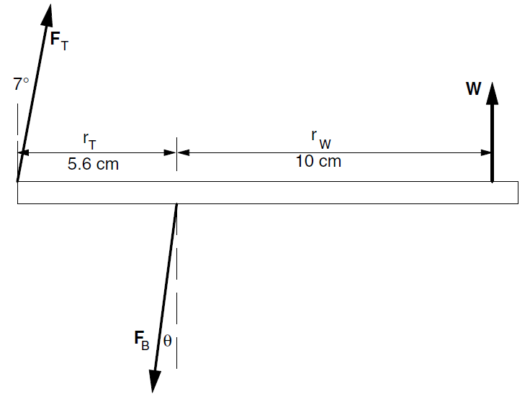
Example: Achilles Tendon
Apply both translational and rotational equilibrium conditions
Unknowns: F_{T}, F_{B}, and θ
Rotational:
(1) Solve for F_{T}
Translational:
(2) Solve for F_{B}, and θ

Slide 7
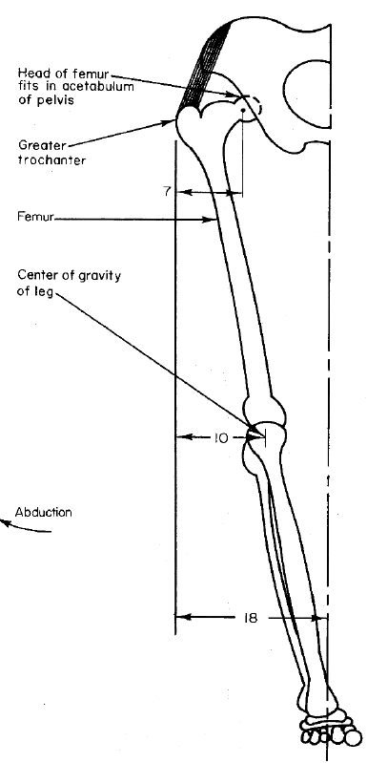
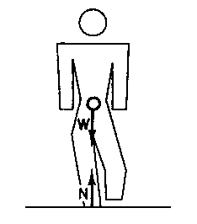
Example: Forces on the Hip

Slide 8
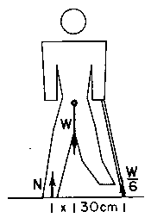
Example: Use of a Cane
Significantly less than 2.4W without a cane

Slide 9
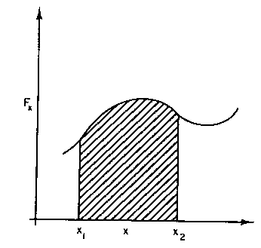
Work
Work done by a force F_{x} as it moves from x₁ to x₂
Area under curve
Equal to increase in K.E.

Slide 10
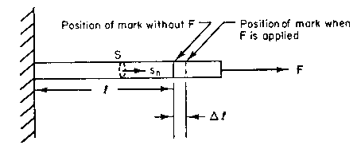
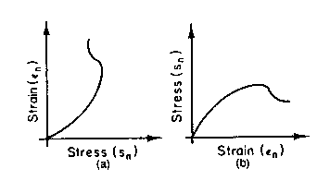
Stress and Strain
Normal stress: tensile/compressive
E: Young’s modulus

Slide 11
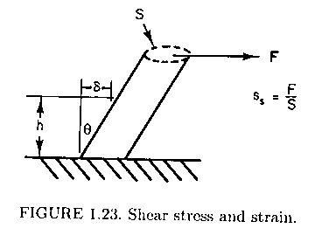
Shear
Force parallel to surface
G: shear modulus

Slide 12
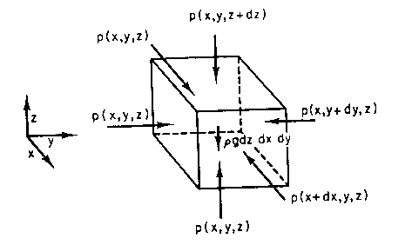
Hydrostatics
Equilibrium of a unit volume:

Slide 13
Buoyancy
Object immersed in fluid
Example: Terrestrial animals
Very small buoyancy because
Example: Aquatic animals
Very small F because
“Weightless” in water

Slide 14
Compressibility
Pressure on a fluid
Compressibility κ negligible in many cases (e.g., κ =5×10⁻¹⁰ Pa⁻¹ for water)
Important for such phenomena as ultrasound transmission

Slide 15
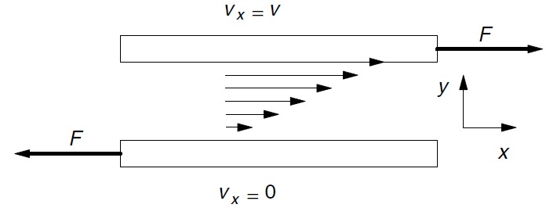
Viscosity
Laminar flow of a Newtonian fluid
Shear forces between layers
No mixing between adjacent layers
Application: clean room isolation

Slide 16
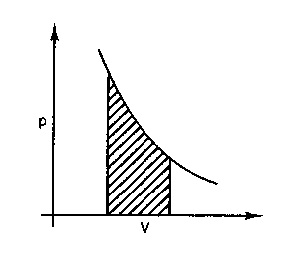
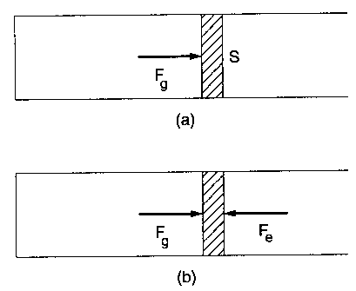
Pressure-Volume Work
Work done by a gas

Slide 17
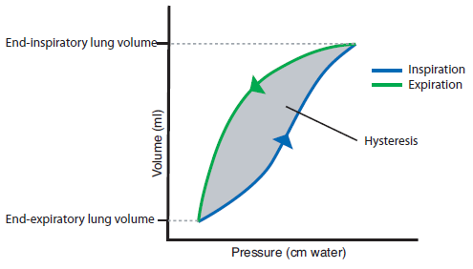
Example: Respiration Work

Slide 18
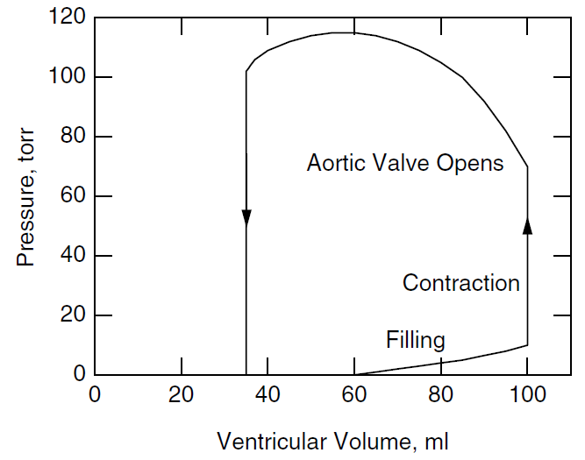
Example: Heart

Slide 19
Problem Assignment
Posted on class web site
Web: http://www.k-space.org

