Slide 1
Intermediate Physics for Medicine and Biology Chapter 2: Exponential Decay and Growth
Professor Yasser M. Kadah
Web: http://www.k-space.org

Slide 2
Textbook
Russell K. Hobbie and Bradley J. Roth, Intermediate Physics for Medicine and Biology, 4th ed., Springer-Verlag, New York, 2007. (Hardcopy)
Textbook's official web site: http://www.oakland.edu/~roth/hobbie.htm

Slide 3
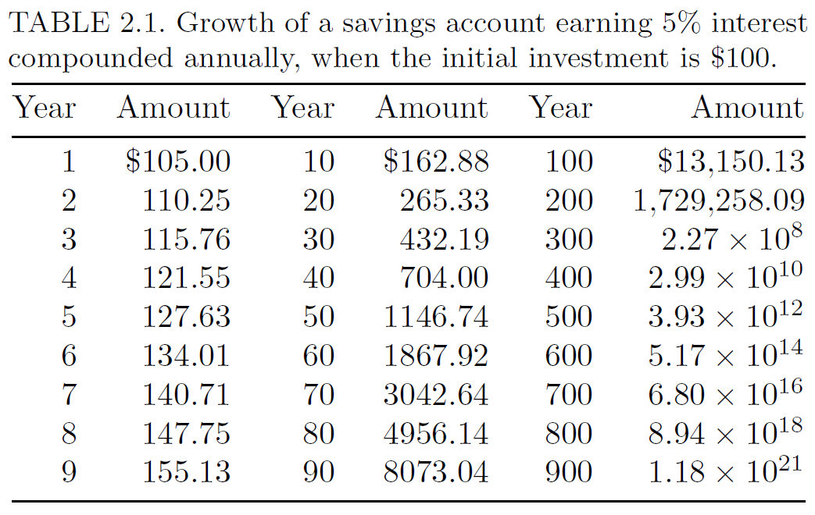
Exponential Growth
An exponential growth process is one in which the rate of increase of a quantity is proportional to that quantity
Example:
Savings account

Slide 4
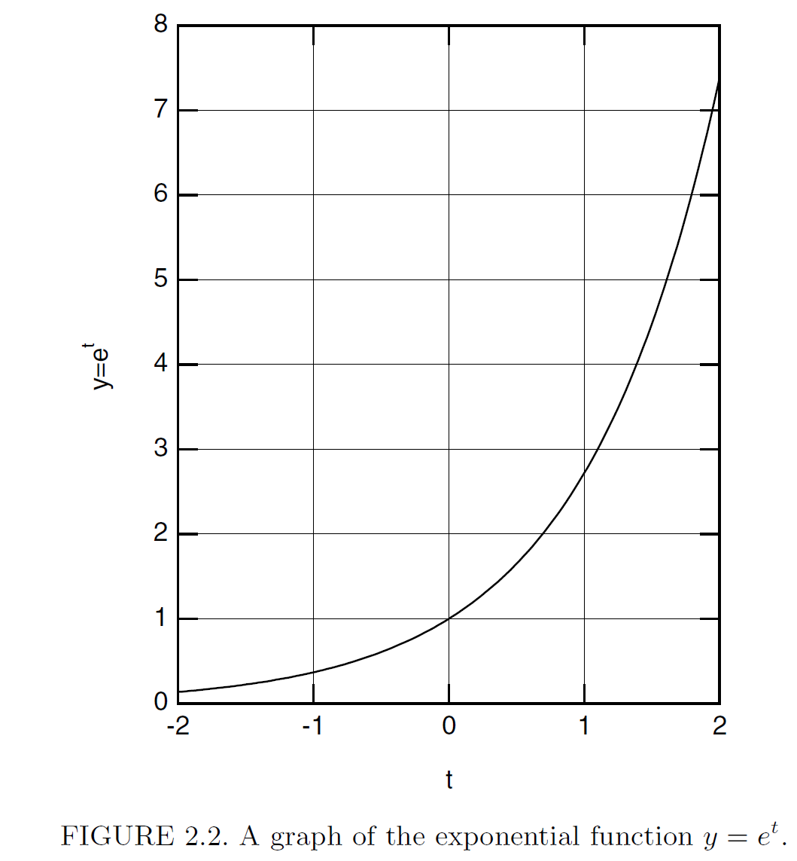
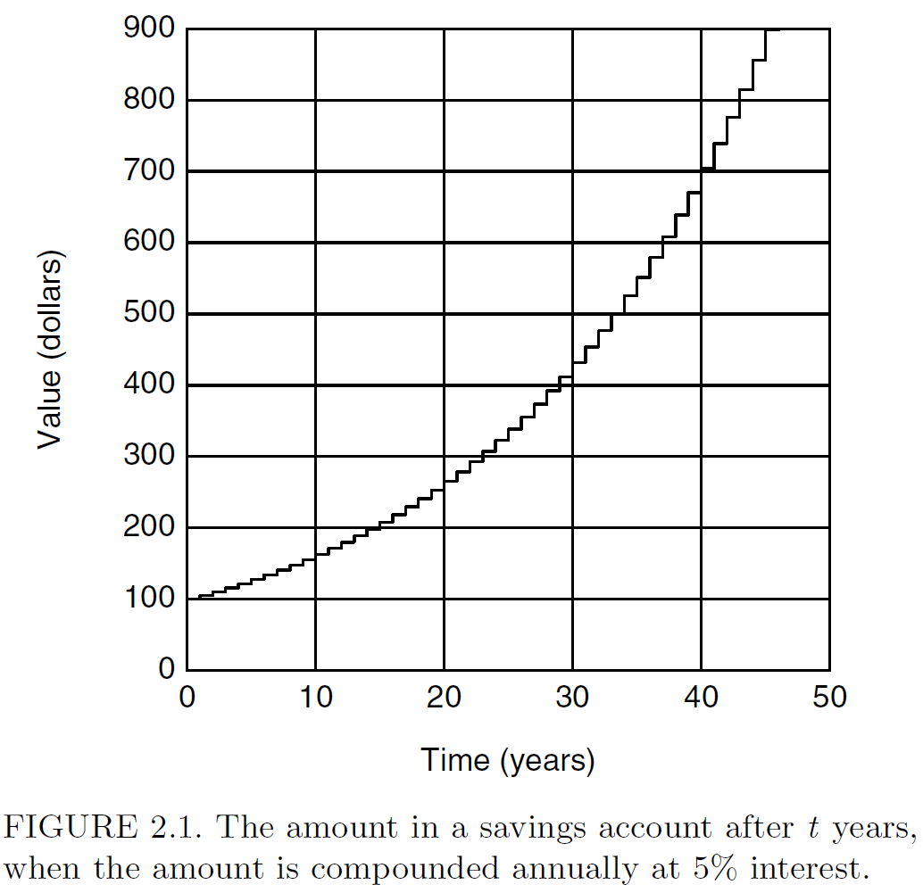
Exponential Growth

Slide 5
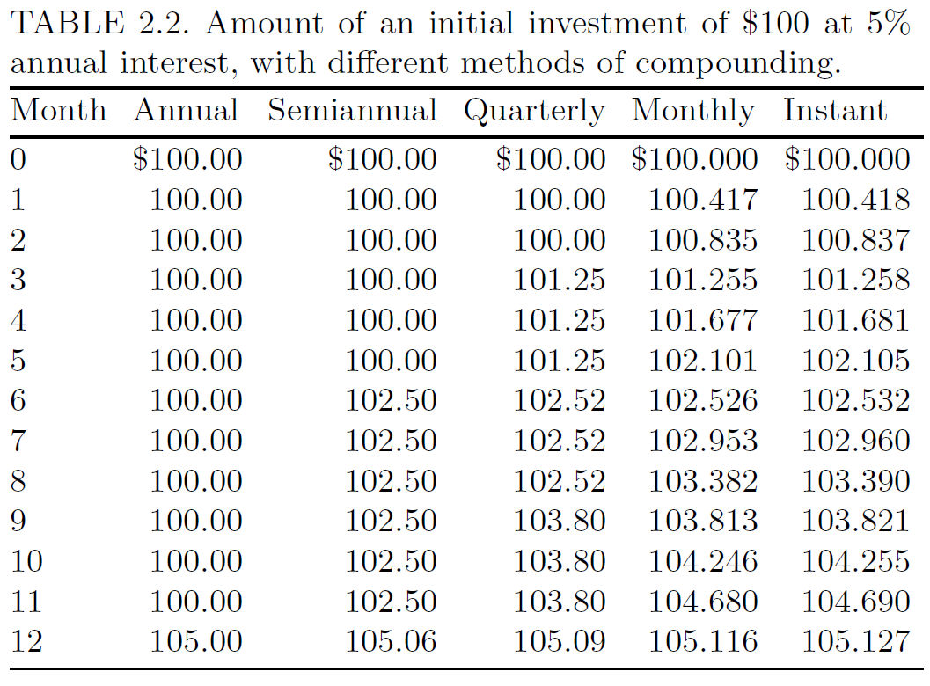
Exponential Growth: Compounding
N times/year

Slide 6
Exponential Growth
As compounding N →∞,

Slide 7
Exponential Growth
Differential Equation

Slide 8
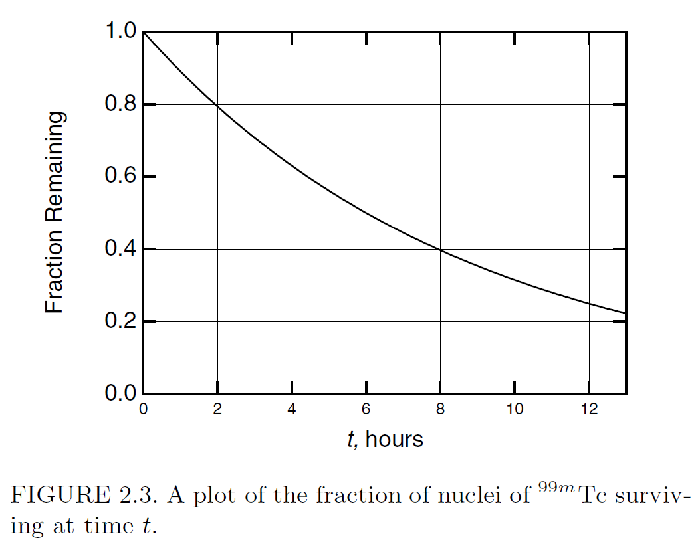
Exponential Decay
Example: assume b>0

Slide 9
Exponential Decay
Half-Life T_{½} : Length of time required for y_{t} to decrease to ½ its original value
Note: Doubling time T₂ is same value

Slide 10
Exponential Decay
Example: Radioactive decay of ^{99m}Tc
Decay rate: b= 0.1155 h⁻¹
T_{½} = 0.693/0.1155 = 6 h

Slide 11
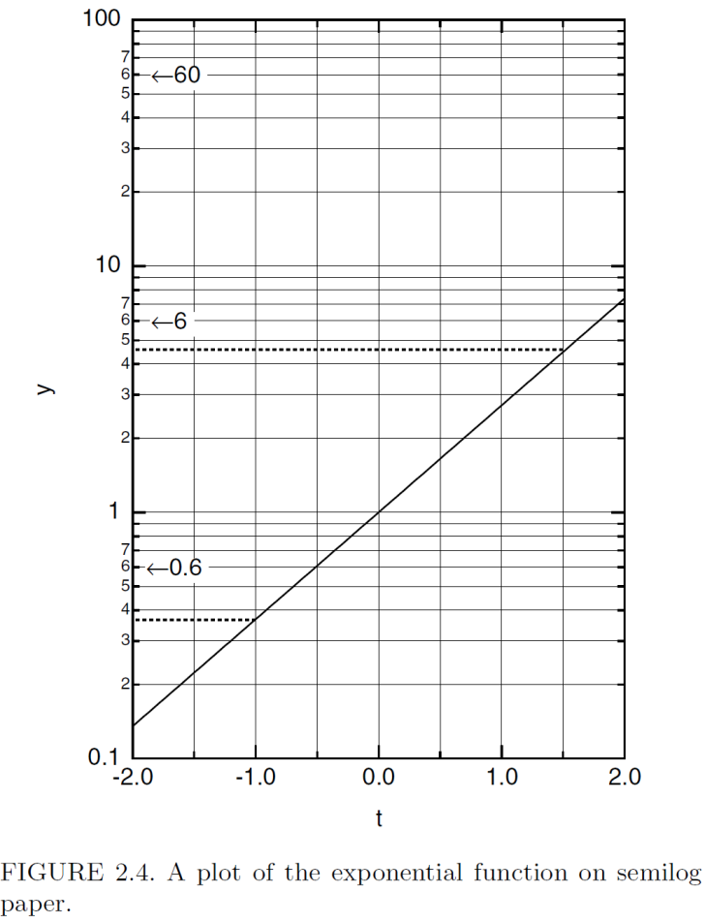
Semilog Paper

Slide 12
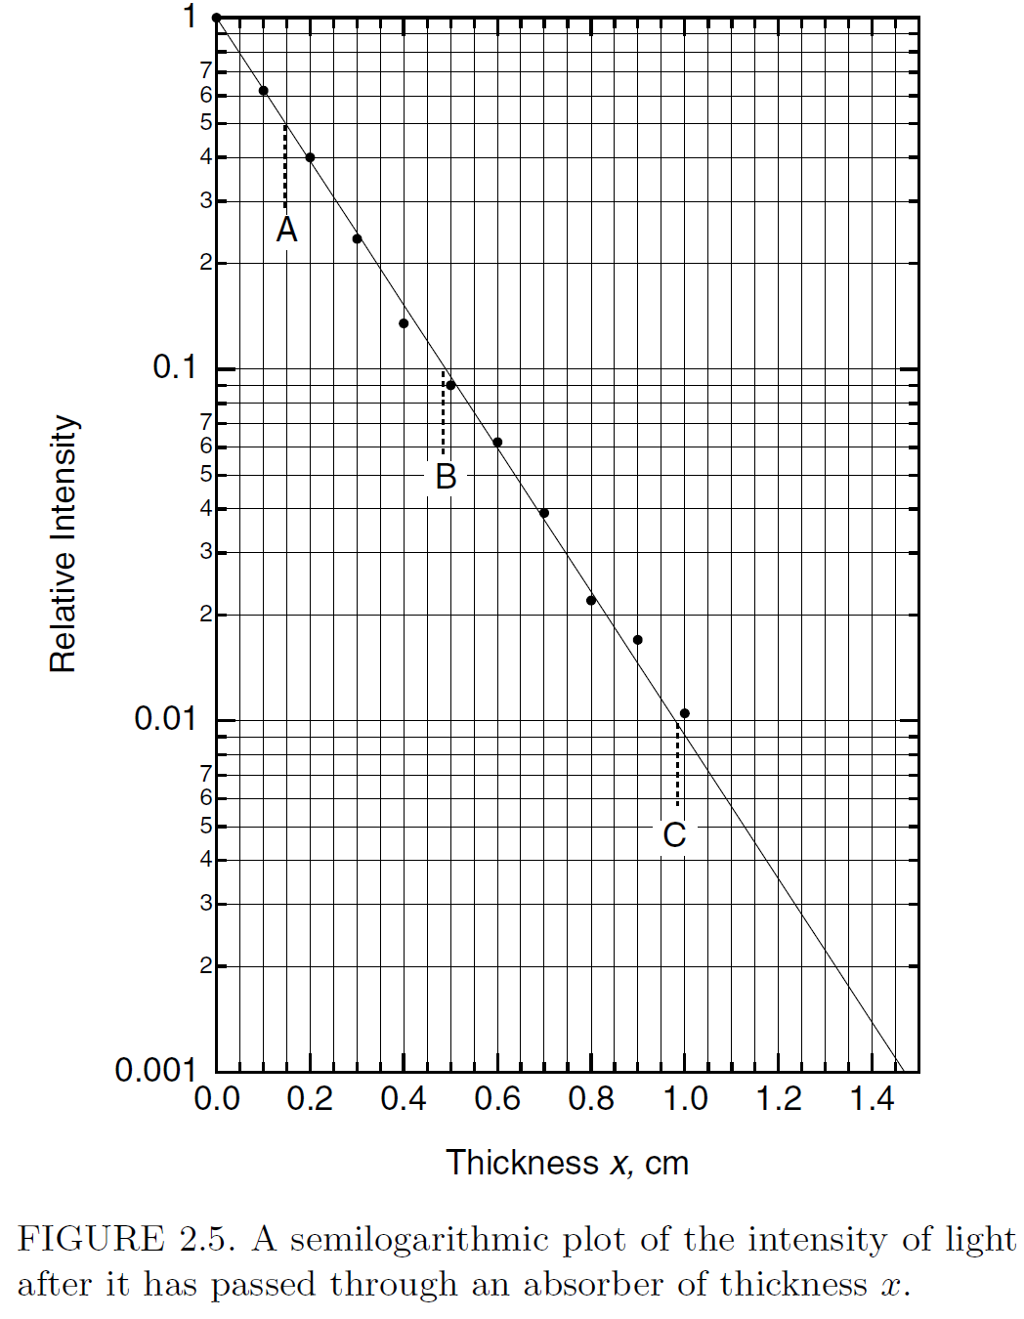
Semilog Paper: Example

Slide 13
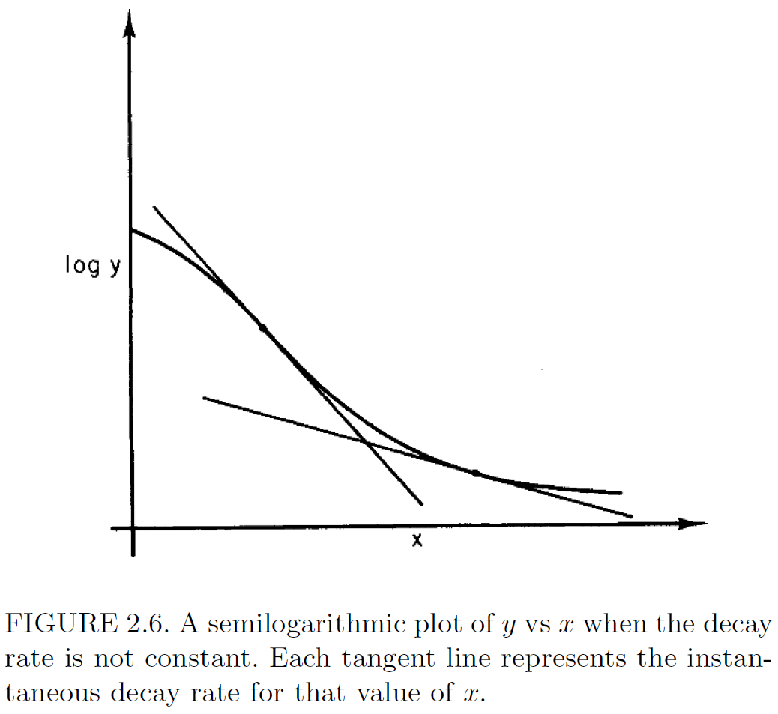
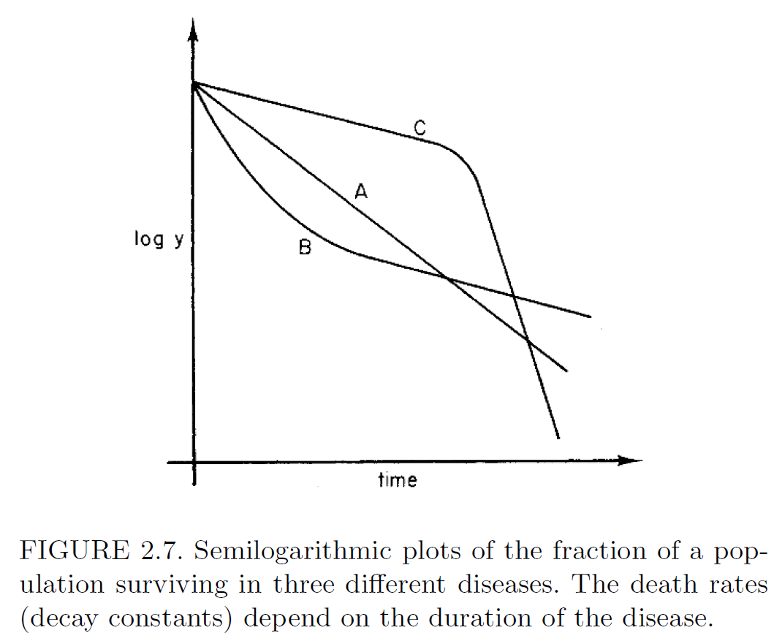
Variable Rates

Slide 14
Variable Rates: Example

Slide 15
Variable Rates: Example

Slide 16
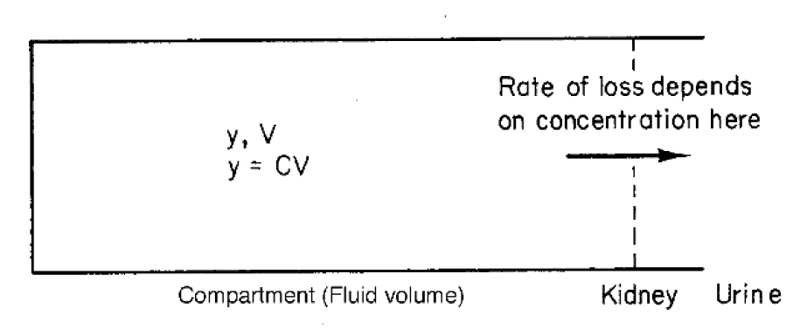
Clearance
Clearance K is defined by,

Slide 17
Multiple Decay Paths
Multiple decay processes
Half-life

Slide 18
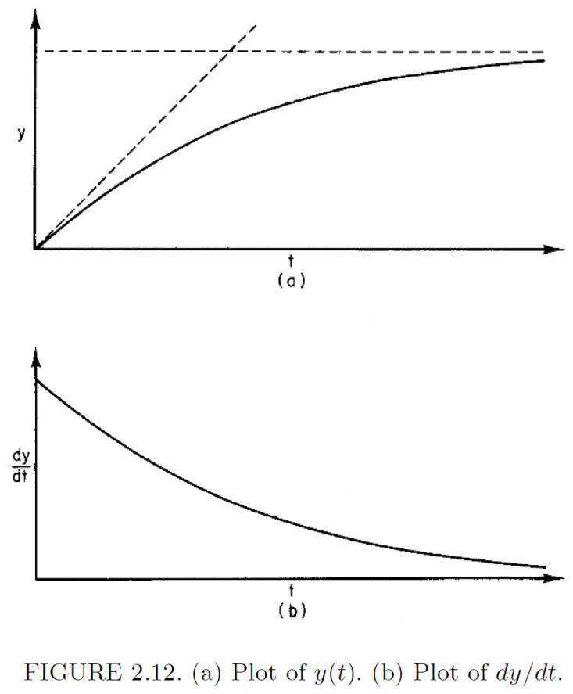
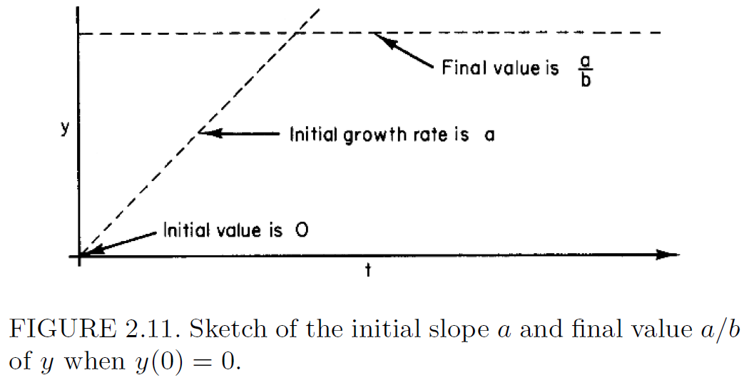
Decay Plus Input at a Constant Rate

Slide 19
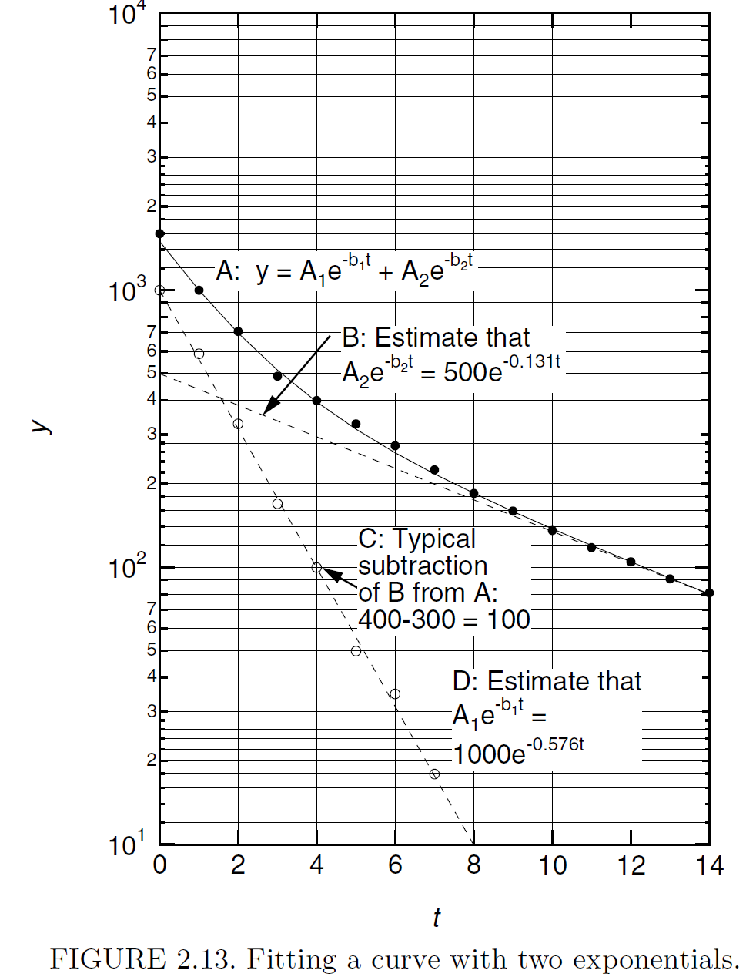
Decay with Multiple Half-Lives: Fitting Exponentials

Slide 20
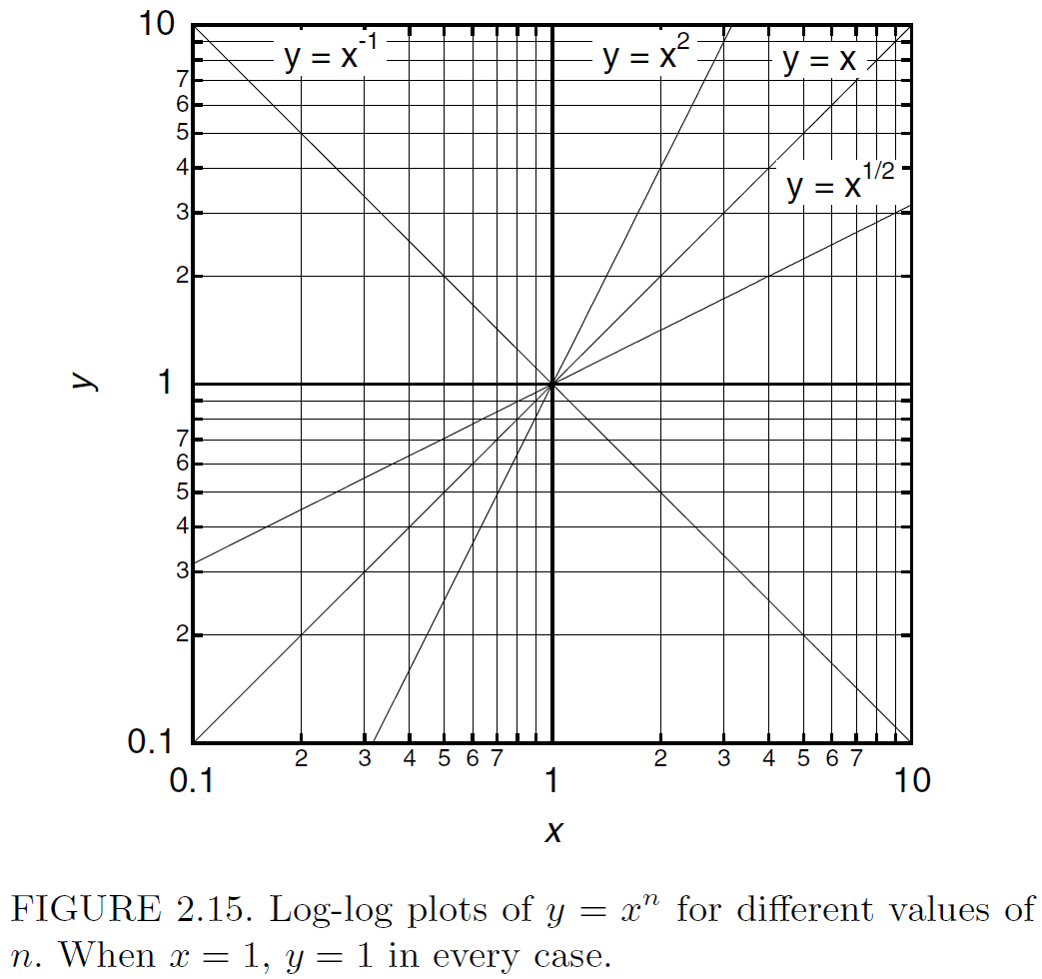
Log-Log Plots

Slide 21
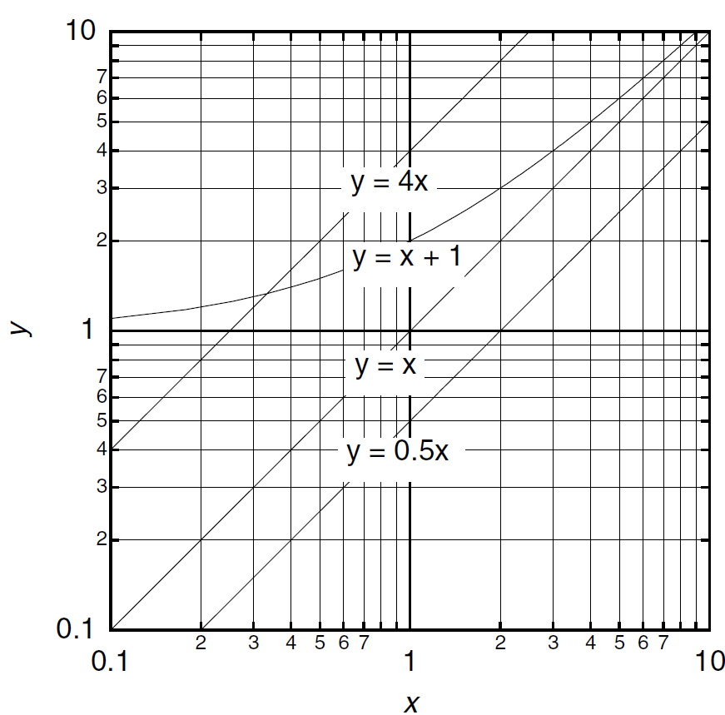
Log-Log Plots
Scaling
Nonzero intercept

Slide 22
Example: Food Consumption

Slide 23
Example: Basal Metabolic Rate

Slide 24
Problem Assignment
Posted on class web site
Web: http://www.k-space.org

