Slide 1
Intermediate Physics for Medicine and Biology Chapter 4: Transport in an Infinite Medium
Professor Yasser M. Kadah
Web: http://www.k-space.org

Slide 2
Textbook
Russell K. Hobbie and Bradley J. Roth, Intermediate Physics for Medicine and Biology, 4th ed., Springer-Verlag, New York, 2007. (Hardcopy)
Textbook's official web site: http://www.oakland.edu/~roth/hobbie.htm

Slide 3
Definitions
Flow rate, volume flux or volume current (i)
Total volume of material transported per unit time
Units: m³s⁻¹
Mass flux
Particle flux

Slide 4
Definitions
Particle fluence
Number of particles transported per unit area across an imaginary surface
Units: m⁻²
Volume fluence
Volume transported per unit area across an imaginary surface
Units: m³m⁻² = m

Slide 5
Definitions
Fluence rate or flux density
Amount of “something” transported across an imaginary surface per unit area per unit time
Vector pointing in the direction the “something” moves and is denoted by j
Units: “something” m⁻²s⁻¹
Subscript to denote what “something” is

Slide 6
Continuity Equation: 1D
We deal with substances that do not “appear” or “disappear”
Conserved
Conservation of mass leads to the derivation of the continuity equation

Slide 7
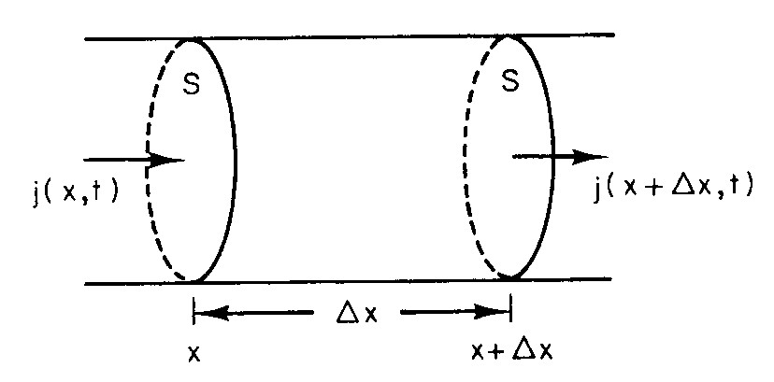
Continuity Equation: 1D
Consider the case of a number of particles
Fluence rate: j particles/unit area/unit time
Value of j may depend on position in tube and time
j = j(x,t)
Let volume of paricles in the volume shown to be N(x,t)
Change after Δt = ΔN

Slide 8
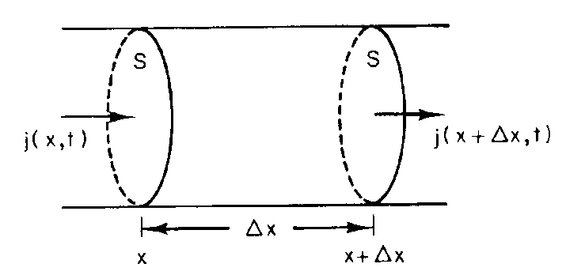
Continuity Equation: 1D
As Δx→0,
Similarly, increase in N(x,t) is,

Slide 9
Continuity Equation: 1D
Hence,
Then, the continuity equation in 1D is,

Slide 10
Solvent Drag (Drift)
One simple way that solute particles can move is to drift with constant velocity.
Carried along by the solvent,
Process called drift or solvent drag.

Slide 11
Brownian Motion
Application of thermal equilibrium at temperature T
Kinetic energy in 1D =
Kinetic energy in 3D =
Random motion → mean velocity
can only deal with mean-square velocity

Slide 12
Brownian Motion

Slide 13
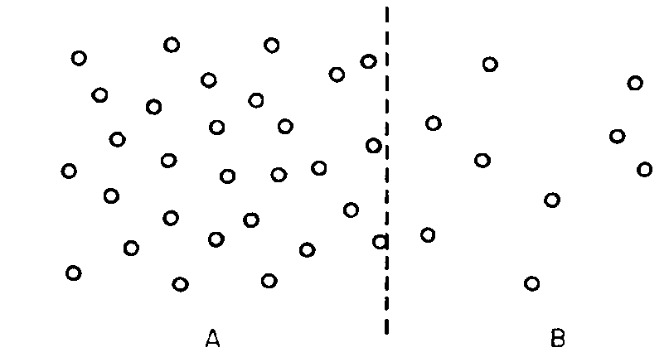
Diffusion: Fick’s First Law
Diffusion: random movement of particles from a region of higher concentration to a region of lower concentration
Diffusing particles move independently
Solvent at rest
Solute transport

Slide 14
Diffusion: Fick’s First Law
If solute concentration is uniform, no net flow
If solute concentration is different, net flow occurs
D: Diffusion constant (m²s⁻¹)

Slide 15
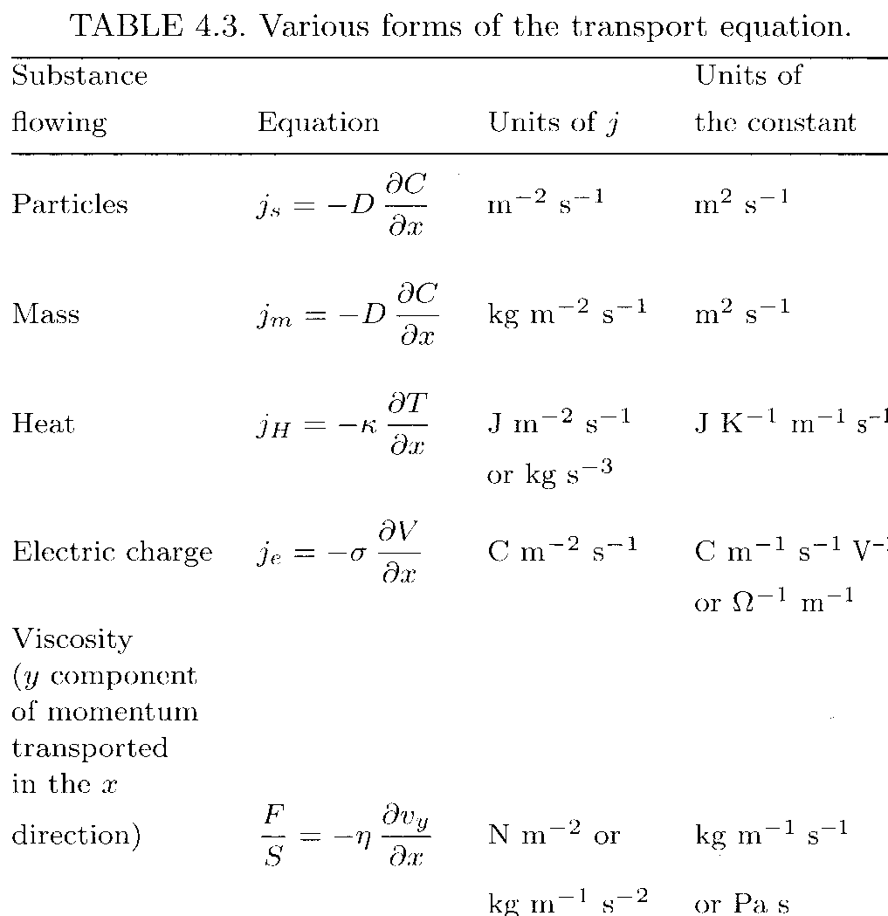
Diffusion: Fick’s First Law

Slide 16
Diffusion: Fick’s Second Law
Consider 1D case
Fick’s first law
Continuity equation

Slide 17
Diffusion: Fick’s Second Law
Combining Fick’s first law and continuity equation,
→Fick’s second law
3D Case,

Slide 18
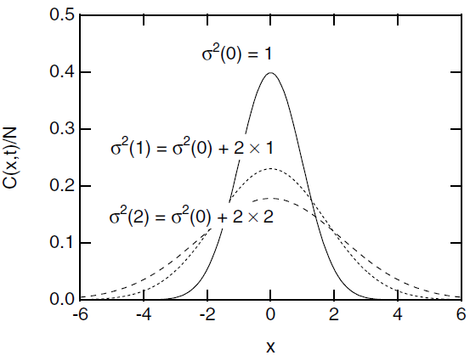
Diffusion: Fick’s Second Law
Solving Fick’s second law for C(x,t)
Substitution
where,

Slide 19
Applications
Kidney dialysis
Tissue perfusion
Blood oxygenation in the lung

Slide 20
Problem Assignments
Information posted on web site
Web: http://www.k-space.org

