Slide 1
Intermediate Physics for Medicine and Biology Chapter 5: Transport Through Neutral Membranes
Professor Yasser M. Kadah
Web: http://www.k-space.org

Slide 2
Textbook
Russell K. Hobbie and Bradley J. Roth, Intermediate Physics for Medicine and Biology, 4th ed., Springer-Verlag, New York, 2007. (Hardcopy)
Textbook's official web site: http://www.oakland.edu/~roth/hobbie.htm

Slide 3
Membranes
Cells are surrounded by a membrane 7-10 nm thick
Permeable to a substance
Substance can pass freely through it
Semipermeable
Only certain substances can get through it
Permeant
Substance that can pass through

Slide 4
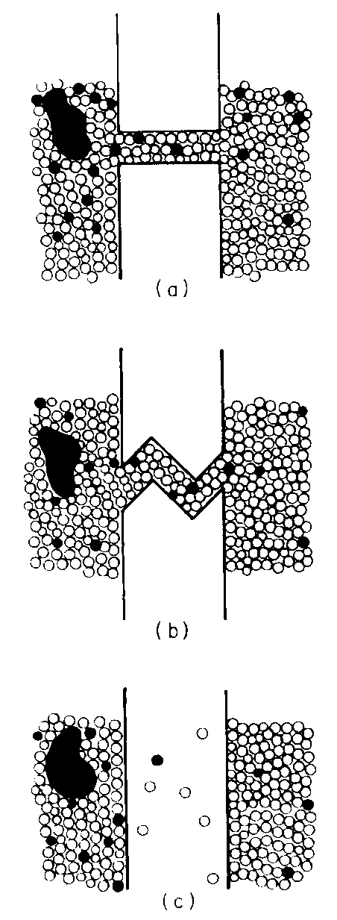
Membranes
Examples
Straight pores
Tortuous pores
No pores; molecules dissolve
Water motion: bulk flow
Solute motion: random walk
Effective motion: diffusion superimposed on bulk flow

Slide 5
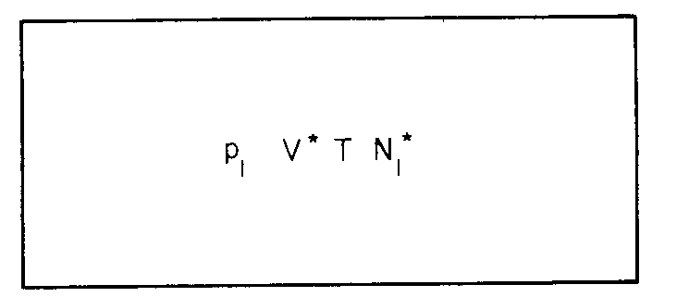
Osmotic Pressure
Gas law
N₁* : # of molecules, n₁* : # of moles
Denote,

Slide 6
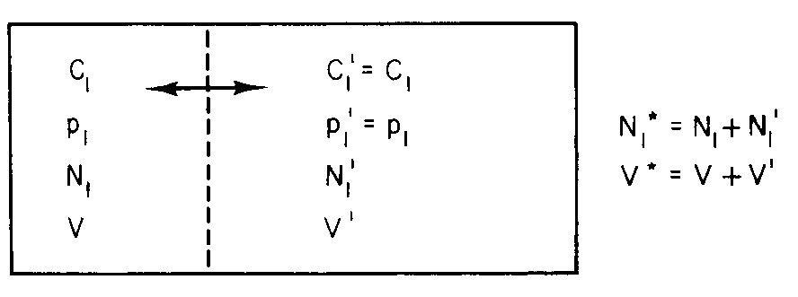
Osmotic Pressure
Imagine volume V* divided into two subvolumes V,V’
Pressure remains p₁ in both partitions
Average number of molecules remain unchanged

Slide 7
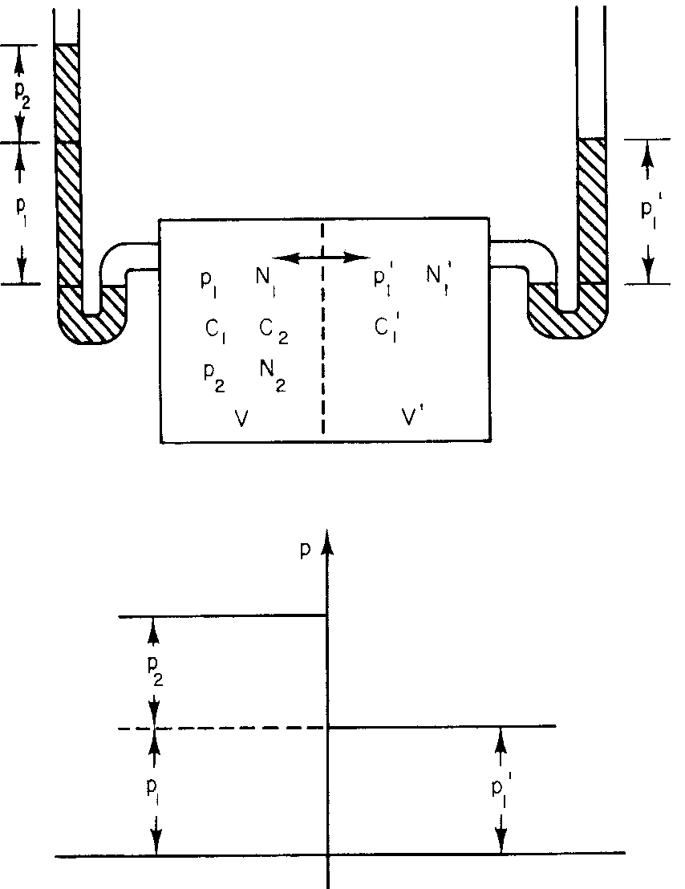
Osmotic Pressure
Second species
Cannot pass through

Slide 8
Osmotic Pressure
Total partial pressure for all species that cannot pass through the membrane is called osmotic pressure and denoted by π

Slide 9
Osmotic Pressure
Total pressure = driving pressure + osmotic pressure
There is no flow if the driving pressure is the same between the two sides of the membrane

Slide 10
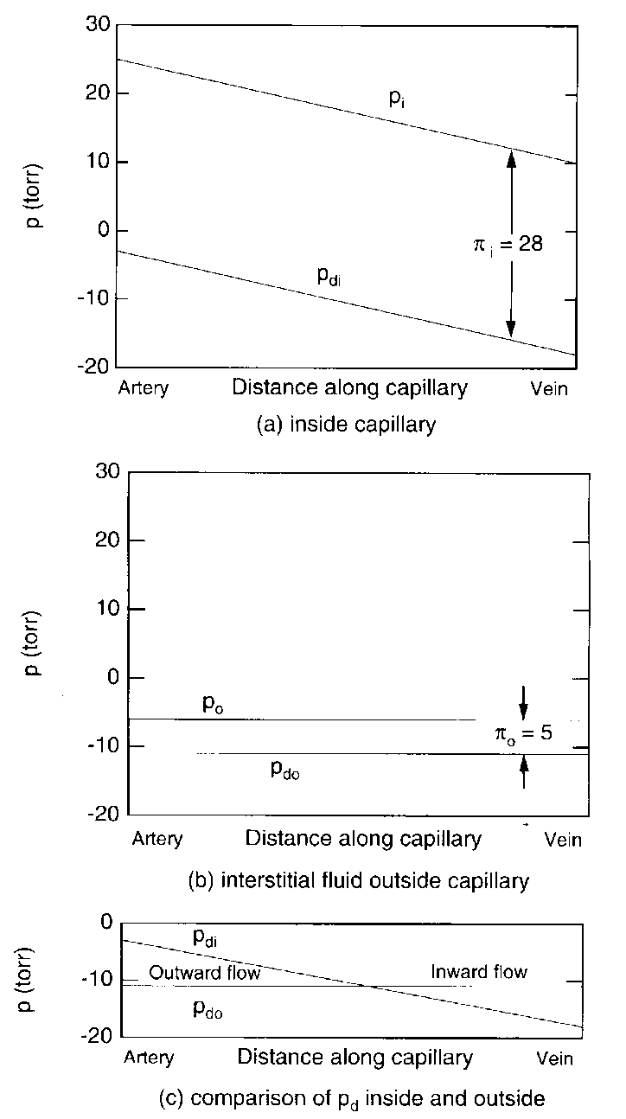
Clinical Examples
Capillary model
Arterial Side
p_{i}
p_{di}
π_{i}
p_{o}
p_{do}
π_{o}
Venous Side

Slide 11
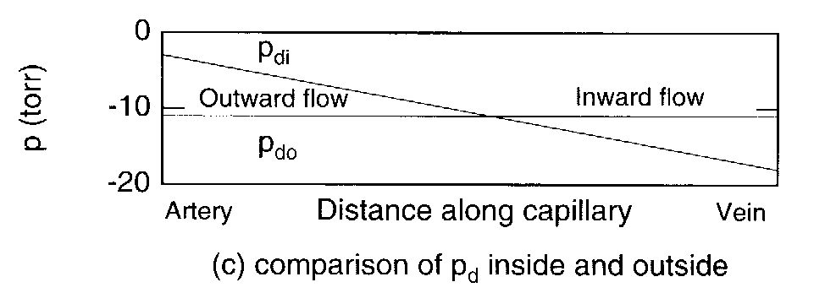
Edema
Abnormal collection of fluid inside tissue

Slide 12
Edema due to Heart Failure
Right heart failure
Swelling of legs
Left heart failure
Pulmonary edema
Root cause:
Rising venous pressure

Slide 13
Nephrotic Syndrome, Liver Disease and Ascitis
Lower protein in blood
Hypoproteinemia
Several causes
Nephrons leaking proteins
Liver malfunction
Ascitis (blocking of
veins in the liver)

Slide 14
Edema of Inflammatory Reactions
3 Steps
Vasodilation
Fluid exodation (plasma)
Cellular migration
Rise in osmotic pressure
in extracellular space

Slide 15
Headaches in Renal Dialysis
Capillary-brain barrier
Low permeability to urea
Plasma urea ↓, temporary urea osmotic pressure inside brain ↑
Water flows into brain causing cerebral edema, which can cause severe headache.
Converse: inject into blood urea/manitol
Water flows from brain to blood
Emergency treatment for cerebral edema

Slide 16
Osmotic Diuresis
Water and many solutes pass into nephron from the blood
Net reabsorption occurs through the rest of the nephron
Most of water and variable for solutes
Medium-weight molecules are not reabsorbed at all (e.g., manitol, glucose)
If they are present, water reabsorption is less
Increase in urine volume

Slide 17
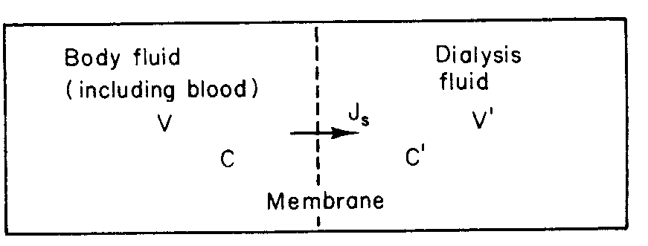
The Artificial Kidney
No solvent drag
where

Slide 18
The Artificial Kidney: Example
Let:
ωRT= 5×10⁻⁶ m/s
S= 2 m²
V= 40 L
Then,
τ= 1.1 h
Dialysis typically takes hours
A number of τ must elapse
Larger molecules are slower
Not to cause cerebral edema and headache

Slide 19
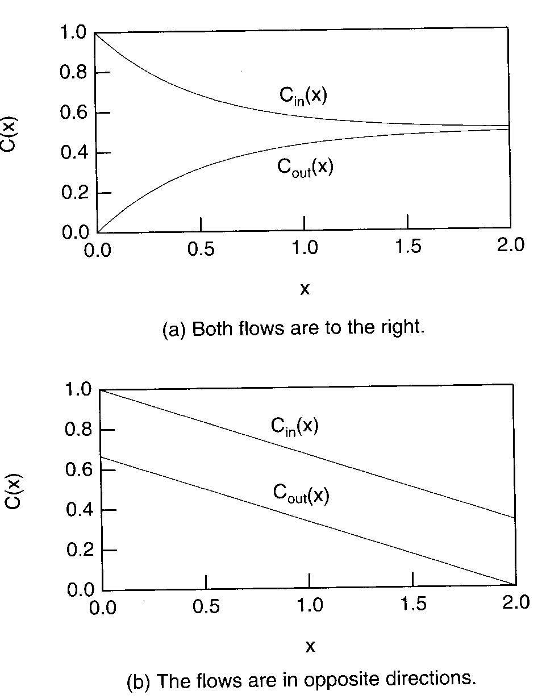
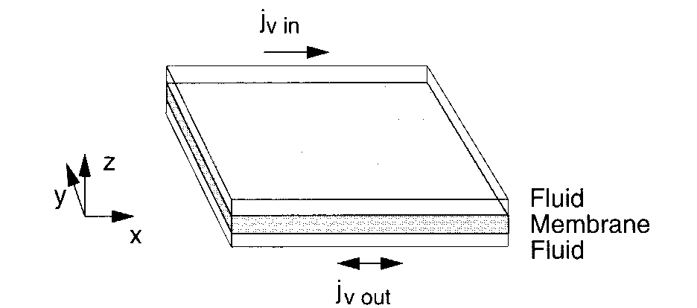
Countercurrent Transport

Slide 20
Problem Assignments
Information posted on web site
Web: http://www.k-space.org

