Slide 1
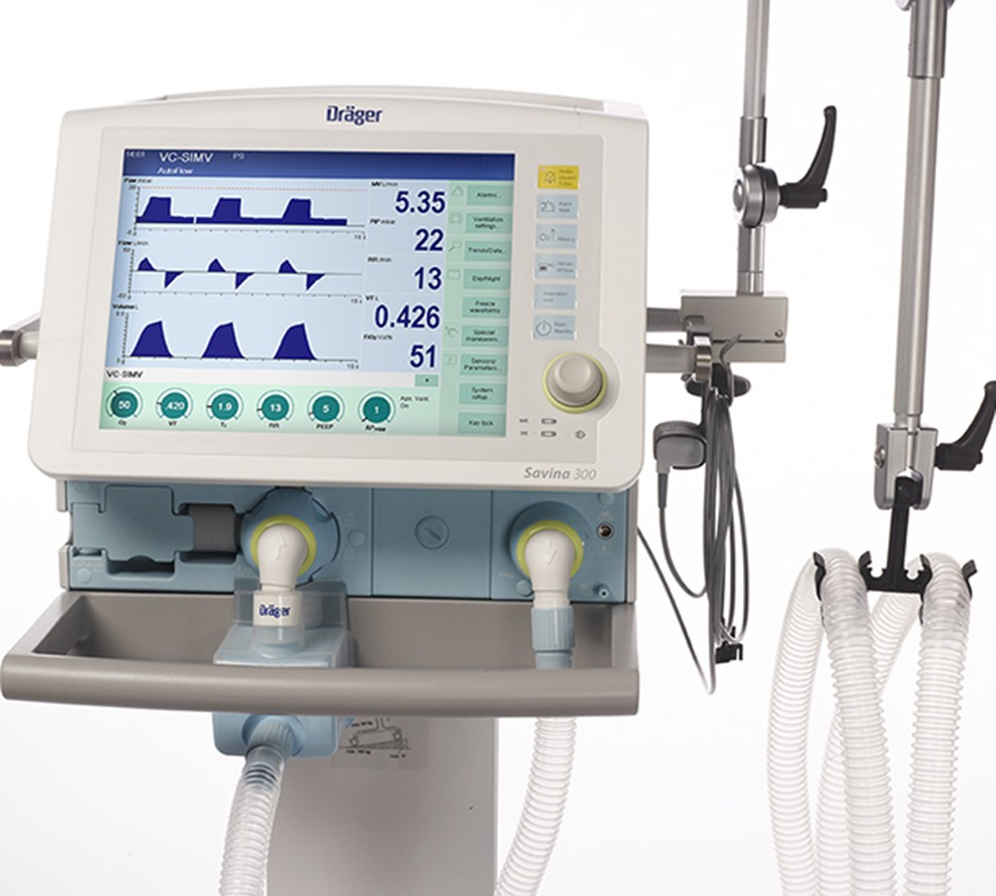
Mechanical Ventilator:
The Basics
Professor Yasser Mostafa Kadah

Slide 2
Mechanical Ventilator
A ventilator is a life-sustaining device that supports or replaces spontaneous breathing of the patient

Slide 3
Spontaneous Breathing Cycle
A breath is one cycle of positive flow (inspiration) and negative flow (expiration) defined in terms of the flow versus time curve

Slide 4
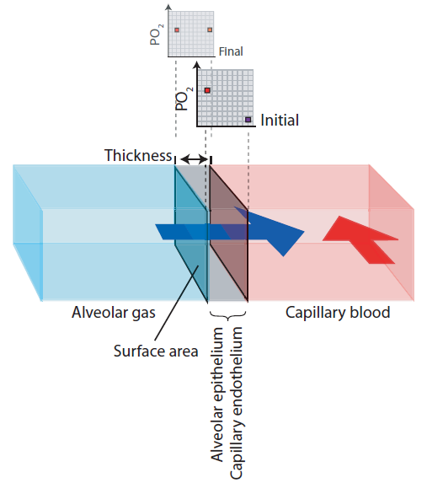
Gas Exchange: Diffusion
Gas is exchanged between alveoli and blood by diffusion
Speed of diffusion is determined by:
  Partial pressure gradient (+)
  Thickness of barrier (-)
In cases when fluid accumulates inside alveoli, hyperoxic (more O₂) is needed to compensate for increased barrier thickness

Slide 5
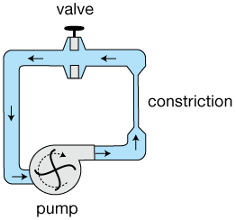
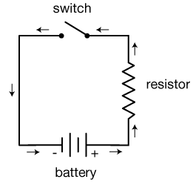
Equations of Motion: Electrical Analogy
Mechanics Electricity
Pressure ➔ Voltage
Flow ➔ Current
Volume ➔ Charge
Resistance ➔ Resistance Compliance ➔ Capacitance
Valve ➔ Switch

Slide 6
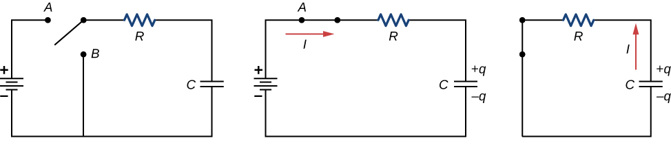
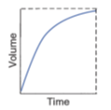
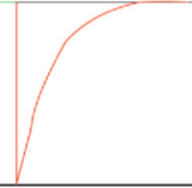
Practical Effects of Compliance and Resistance
A: Filling of normal lung unit
B: Low-compliance unit: fills quickly but with less air
C: Increased resistance: fills slowly
Inspiration
Expiration

Slide 7
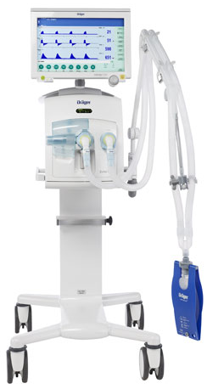
Functional Block Diagram

Slide 8
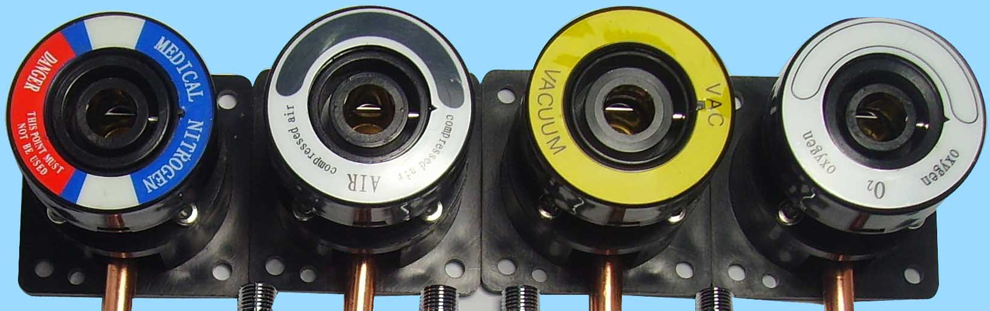
Oxygen Sources
Medical gases supply
Oxygen cylinder
Oxygen concentrator

Slide 9
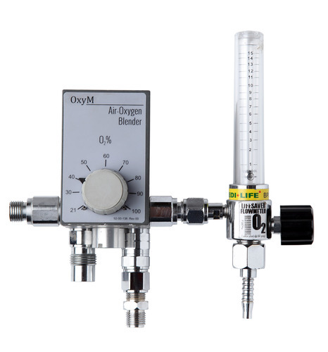
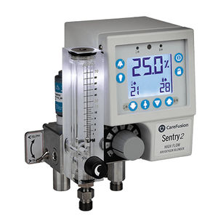
Air/Oxygen Blender
Gas mixer allow the user to vary oxygen concentration of inspiratory gas or fractional inspiratory oxygen (F_{I}O₂) between 21% and 100% by volume
  Mechanical gas mixers
  Electronically-controlled gas mixer integrated in ventilator
Gas mixers are usually responsible for ensuring that breathing gas to be supplied is prepared and delivered in required quantity and rate

Slide 10
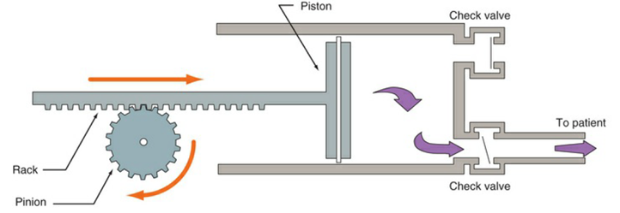
Pressure/Flow Generator
Pressure/flow generator is responsible for delivering mixed gas prepared by gas mixer according to selected ventilation parameters
Flow generator is a controlled valve whose output provides defined gas flow with output pressure is not specified
Pressure generator behaves similar to compressor, whose output provides defined pressure with unspecified gas flow

Slide 11
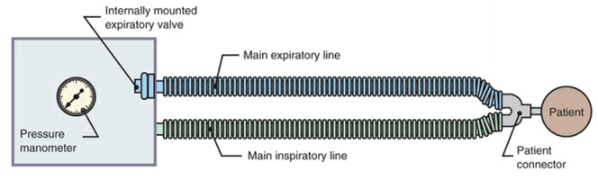
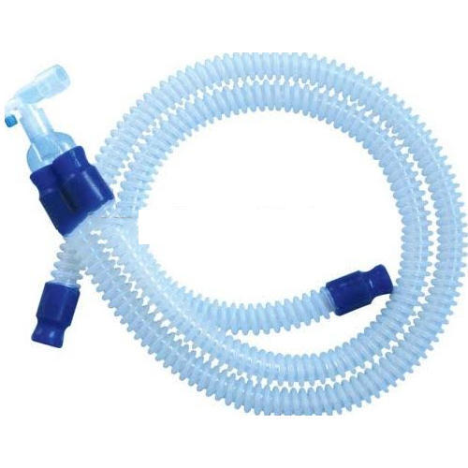
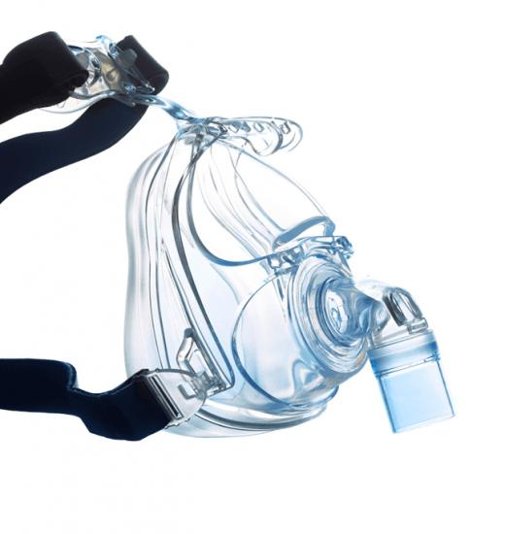
Breathing System
Breathing system forms interface between patient and ventilator
Clinical ventilators are usually connected to patient via inspiratory and expiratory hose (dual-hose circuit)
Gas flow delivered through inspiratory port passes through breathing gas humidifier before entering patient’s lungs
  To make it adapted to climatic conditions in patient’s lungs
After inspiratory phase, patient exhales through expiratory valve
  Breathing systems of ventilators are referred to as non-rebreathing circuits

Slide 12
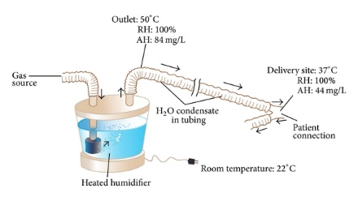
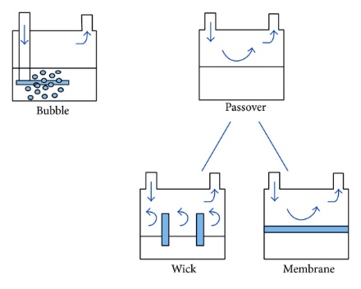
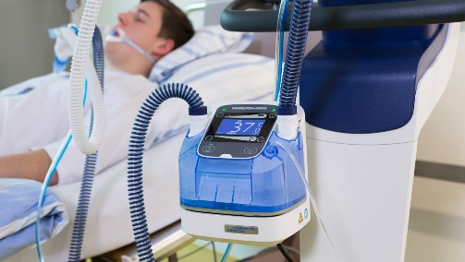
Gas Humidifier
Humidifiers are used to warm and humidify inspiratory gas.
  Dry and cool supply gas dry out the patient’s airways with risk of causing irreversible damage to ciliated epithelium
Active gas humidifiers
  Located in the inspiratory limb and use electrical energy to heat a water bath
  When cold, dry gas passes over the water surface it absorbs water molecules and is thus warmed and humidified
  Examples: pass-over humidifiers and bubble-through humidifiers

Slide 13
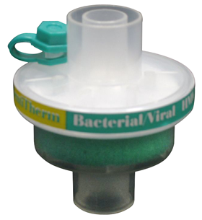
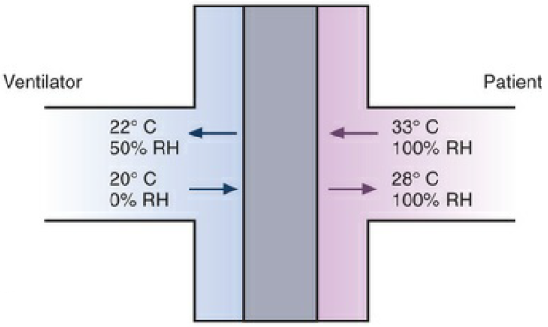
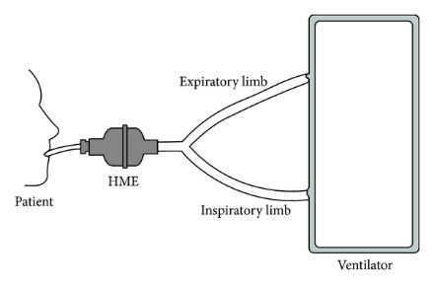
Gas Humidifier
Passive breathing gas humidifiers or heat and moisture exchangers (HMEs)
  Designed to buffer significant fraction of moisture and heat expired by patient
  Retained moisture is then used to condition inspired gas passing through HME during next inspiration

Slide 14
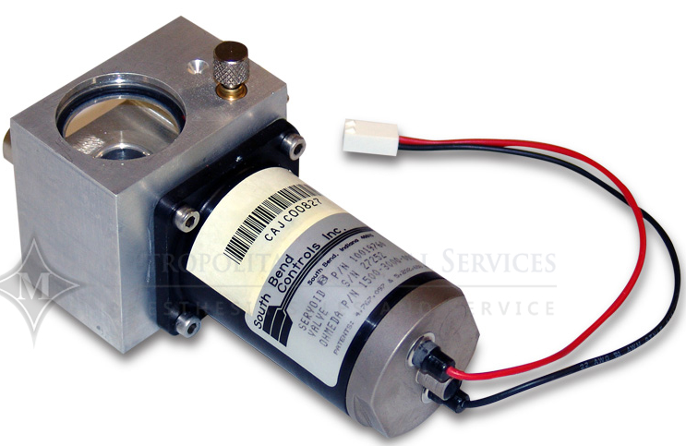
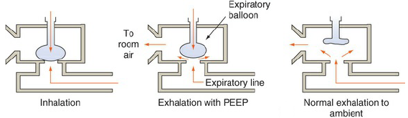
Expiratory (Exhalation) Valve
Allows expired air to move out of breathing circuit
If valve is not opened completely during expiration, positive end-expiratory pressure (PEEP) is created in lungs
  PEEP is therapeutically important as it increases gas exchange surface of lungs
  Adequate PEEP can also prevent collapse of individual alveolar areas
If expiratory valve is controlled during inspiratory phase, it can compensate for undesired pressure rises in breathing system
  Caused, for example, by patient coughing

Slide 15
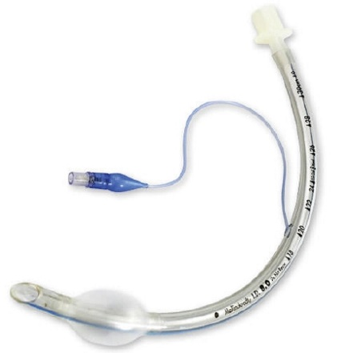
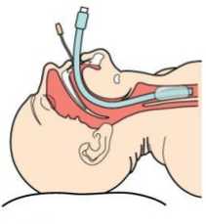
Patient Interface
Noninvasive Ventilation (NIV) vs. Intubation

Slide 16
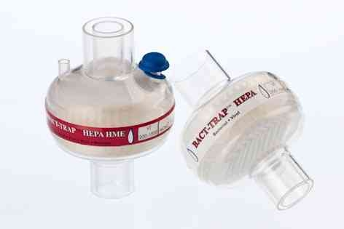
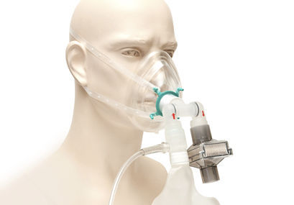
Infection Control: HEPA Filtration
Filtration is the passage of a liquid or gas through a filter with pores small enough to retain microbes
  Membrane filters composed of cellulose esters are commonly used to filter out bacteria, viruses
Microbes can be removed from air by high-efficiency particulate air (HEPA) filters
  Remove almost all microorganisms larger than about 0.3 μm in diameter

Slide 17
Trigger, Limit, Cycle, and Baseline Variables
Trigger variable is one that is measured and used to start inspiration
Limit variable is one that can reach and maintain a preset value before inspiration ends (i.e., does not end respiration)
Cycle variable is one that is measured and used to end inspiration
Baseline variable is the parameter controlled during expiration
  Pressure control is most practical and used in all modern ventilators

Slide 18
Modes of Mechanical Ventilator
“Mode” is defined as a predetermined pattern of interaction between a ventilator and a patient
  There are over 100 names for modes of ventilation on commercially available mechanical ventilators
  Neither the manufacturing community nor the medical community adhere to a standard taxonomy for modes
Breath Control Variable
Breath Sequence
Targeting Scheme
Volume (VC)
Pressure (PC)
CMV
IMV
CSV
Set-point
Adaptive
Servo
Intelligent
Ventilator Mode
+
+
=

Slide 19
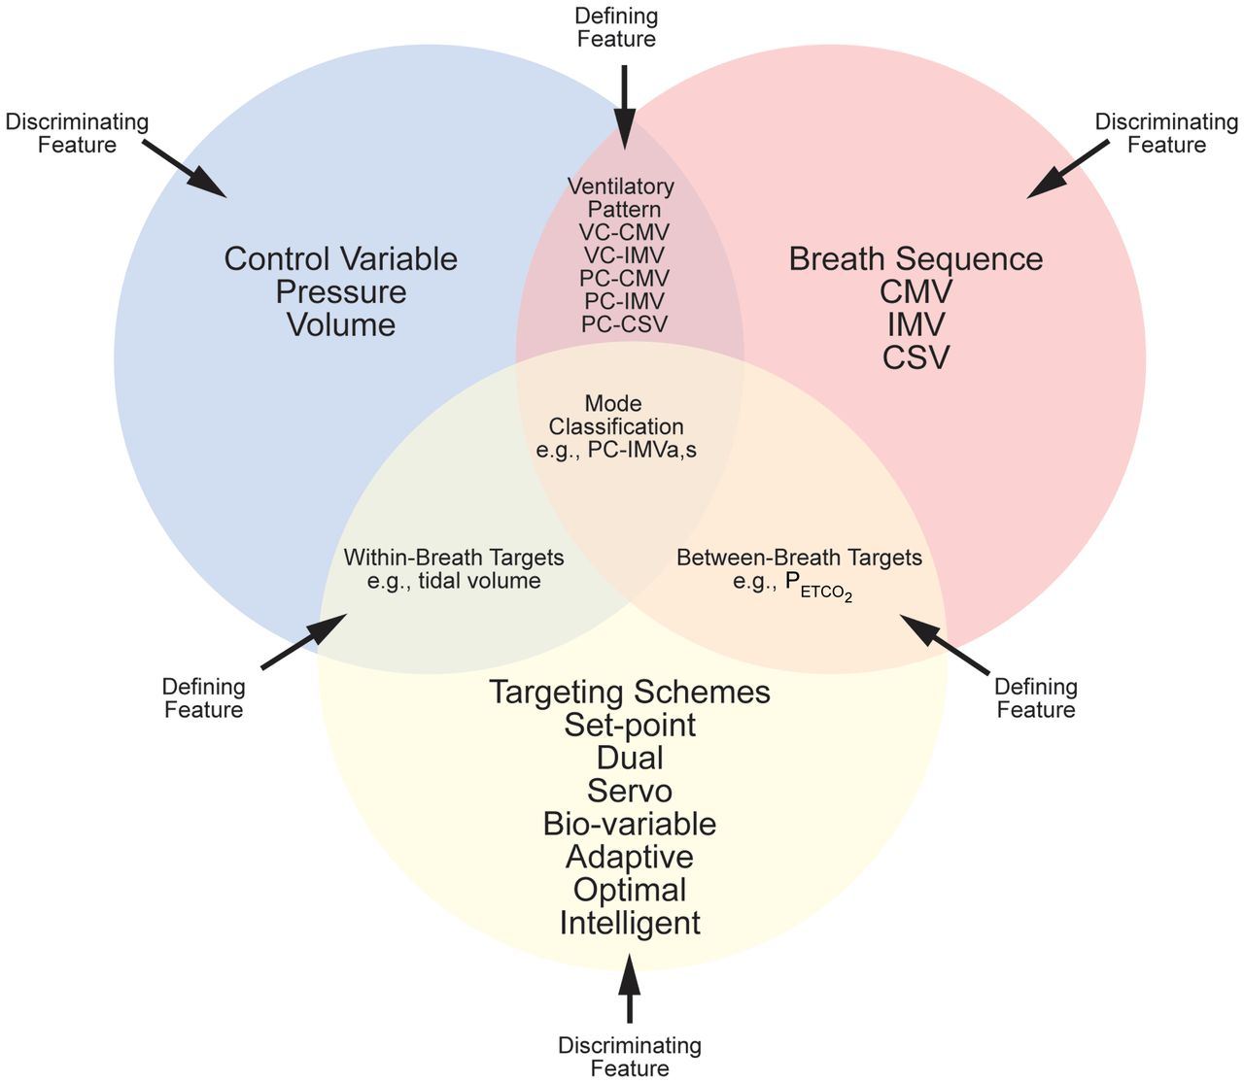
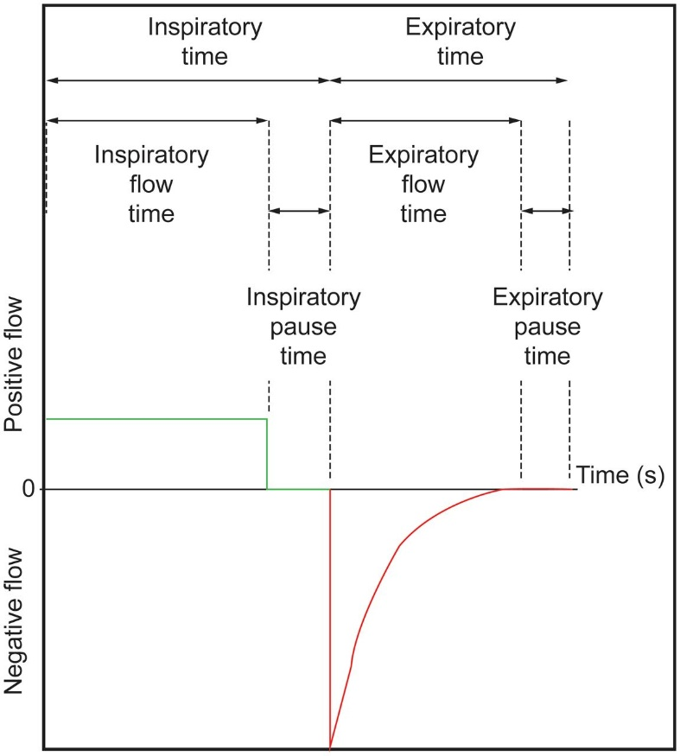
Modes of Mechanical Ventilator

Slide 20
Beginning of Inspiration: Trigger Variable
Time triggering
Patient triggering
  Pressure
  Flow
  Volume

Slide 21
During Inspiration: Control and Limit Variables
Ventilator can control one variable
  Pressure, volume, flow, or time
Limit variable is maximum value variable can attain during inspiration
  Does not end inspiratory phase
  Ventilator can have multiple limit variables
Control
Control

Slide 22
Termination of Inspiration: Cycle Variable
Volume-Cycled Ventilation
Time-Cycled Ventilation
Flow-Cycled Ventilation
Pressure-Cycled Ventilation

Slide 23
Targeting Scheme

Slide 24
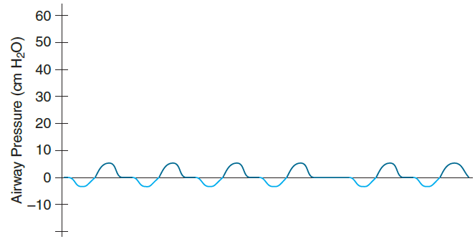

Example Ventilator Modes
Continuous Mandatory Ventilation (CMV)
CPAP
Spontaneous
Pressure-Support (PS)
Synchronized Intermittent Mandatory Ventilation (SIMV)

Slide 25
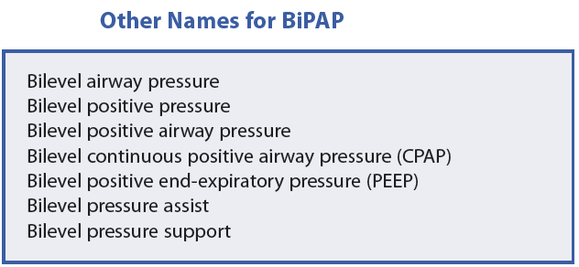
CPAP, PEEP and BiPAP
Continuous Positive Airway Pressure (CPAP)
Positive End-Expiratory Pressure (PEEP or EPAP)
BiLevel Positive Airway Pressure (BiPAP)
CPAP/PEEP + Spontaneous
BiPAP
PEEP + CMV
CPAP/PEEP + IMV

Slide 26
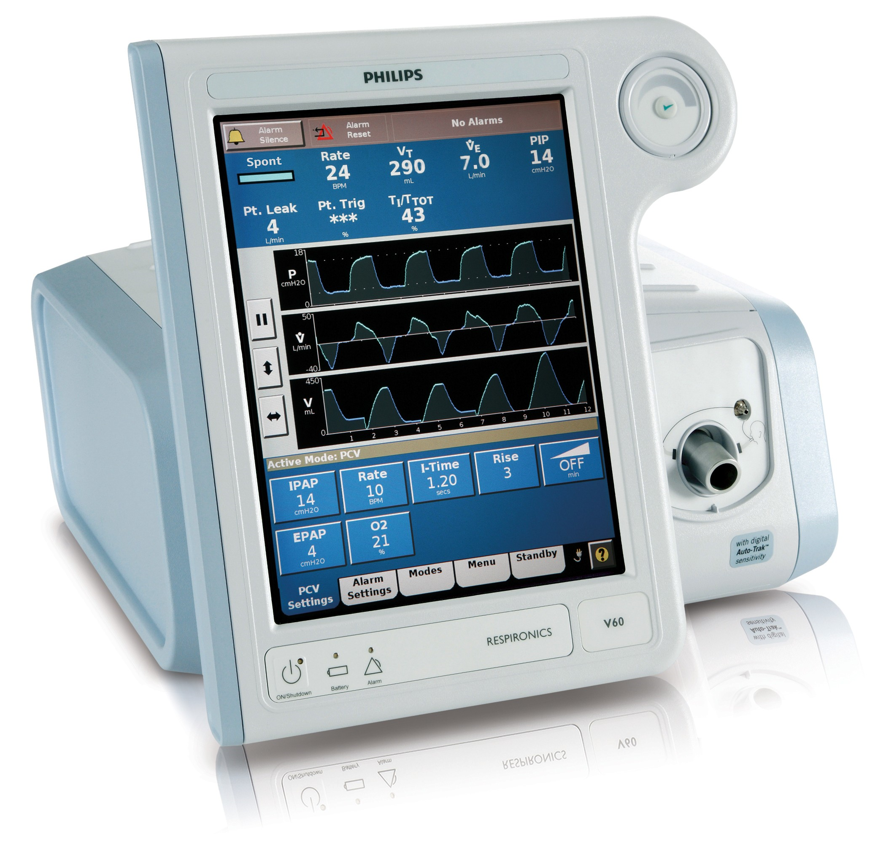
Typical Ventilator User Interface
Mode
IPAP/EPAP
Rate
F_{I}O₂
Tidal volume
Pressure, flow, volume
Alarm messages

Slide 27
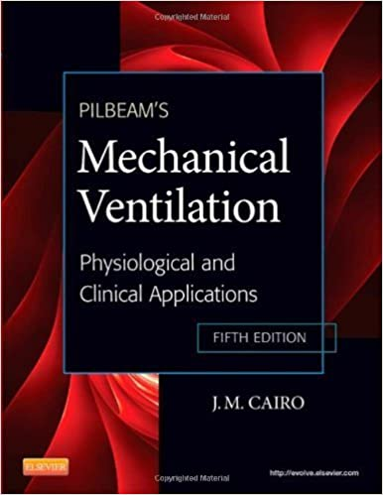
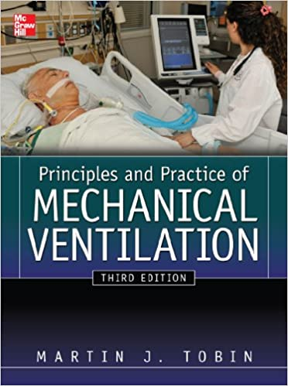
Recommended Further Reading
J.M. Cairo, Pilbeam's Mechanical Ventilation: Physiological and Clinical Applications, 5th Ed., Elsevier, 2012.
Martin J. Tobin, Principles And Practice of Mechanical Ventilation, 3rd Ed., McGraw Hill Medical, 2012.

Slide 28
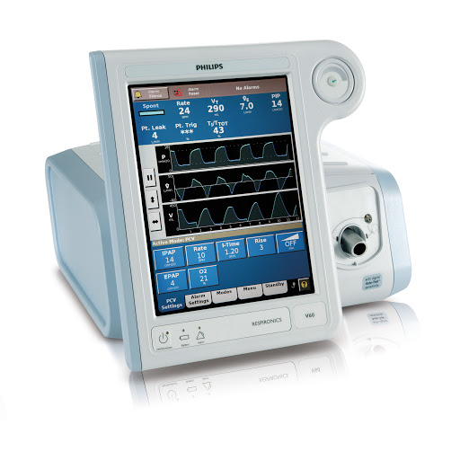
Thank You

