Slide 1
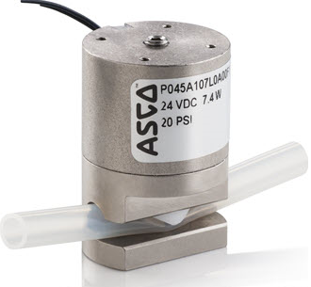
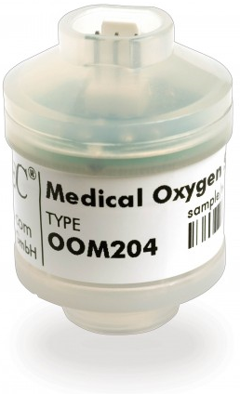
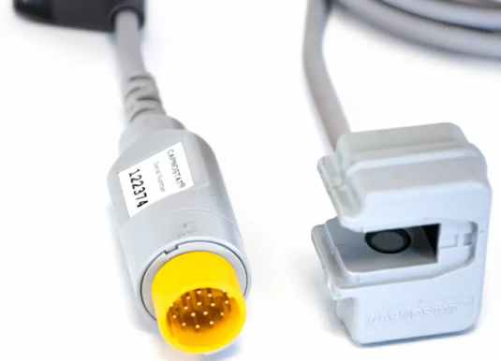
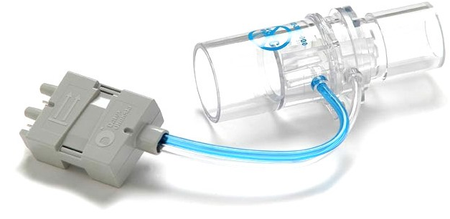
Mechanical Ventilator: Sensors and Actuators
Professor Yasser Mostafa Kadah

Slide 2
Mechanical Ventilator Functional Diagram
Sensors
  Pressure
  Flow
  Oxygen
  Carbon dioxide
Actuators
  Valves
  Air blower

Slide 3
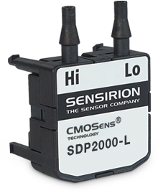
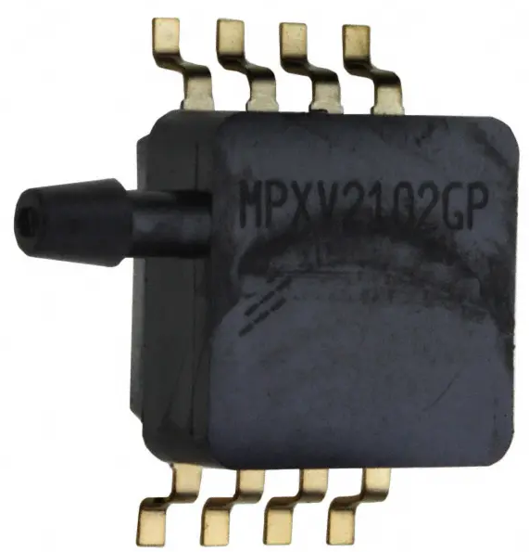
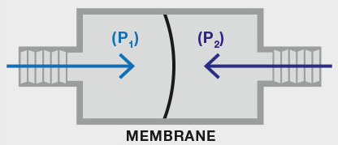
Pressure Sensor
Piezoresistive Sensor
  Solid-state device whose electrical resistance depends on strain of membrane (and hence, pressure)
  Can be designed to be absolute or differential
  Can be selected to have very fast response time
Resistive strain gauge

Slide 4
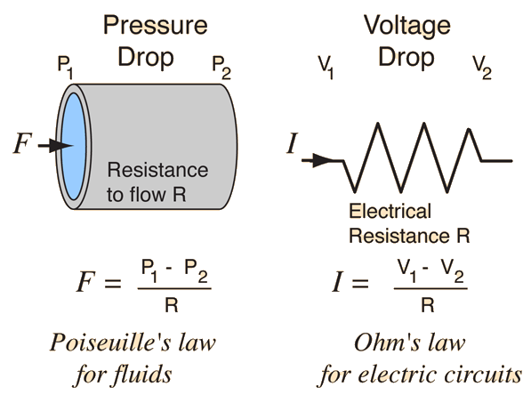
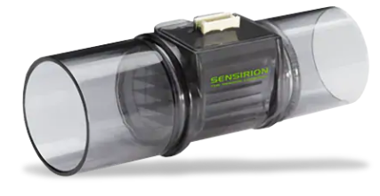
Flow Sensor: Pneumotachograph
Sensing change in pressure across fixed resistance through which gas flow is laminar to calculate flow rate
  Analogous to measuring current through resistance in electric circuits
  Bidirectional operation

Slide 5
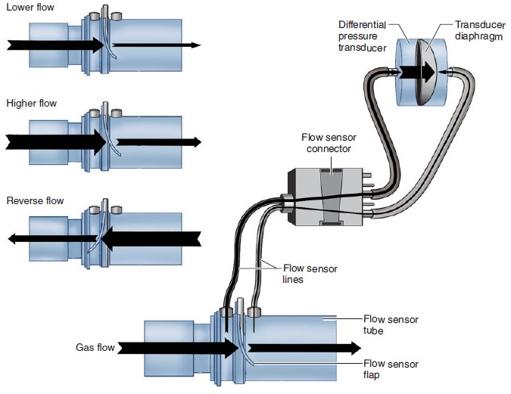
Flow Sensor: Variable Orifice Flowmeter
Pressure measurement across flow-dependent resistance (flap)
  As gas flow increases, flap opens more, reducing resistance to gas flow
  One-to-one correspondence between flow rate and pressure drop
  Bidirectional operation

Slide 6
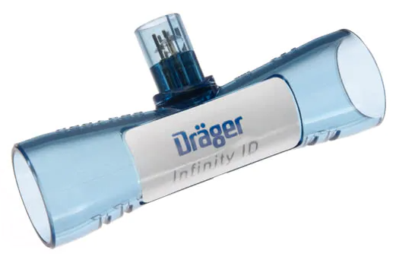
Flow Sensor: Hot-Wire Anemometer
Resistive wire is placed in flow path and heated using electric current
  Resistance increases linearly with temperature
Flow cools down wire and changes its resistance
  Resistance change can be measured and used to estimate flow rate
Fast and accurate but direction insensitive

Slide 7
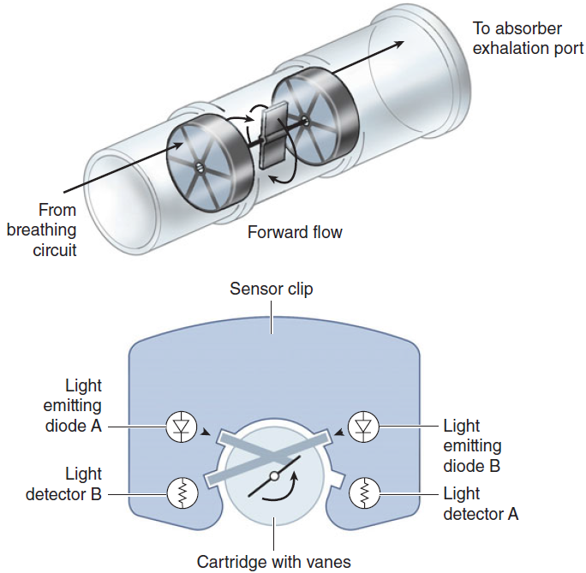
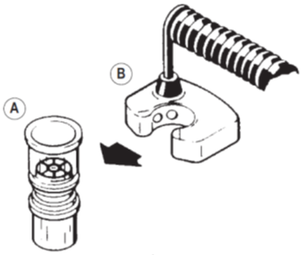
Flow Rate Sensor: Vane Anemometer
Used to measure exhaled tidal volume in breathing circuit near exhalation valve

Slide 8
Oxygen Sensor: Fuel Cell or Galvanic Cell
Diffusion of oxygen starts chemical reactions
Flow of current depends on uptake of oxygen at the anode (Faraday’s first law of electrolysis)
  Voltage output is proportional to oxygen partial pressure
Response time (~20-30 s) and depleted by continuous exposure to oxygen because of exhaustion of the cell (less than 1 year lifespan)

Slide 9
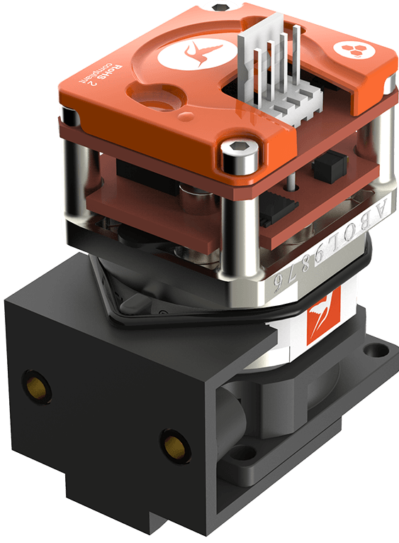
Oxygen Sensor: Paramegnetic
Oxygen is paramagnetic while other gases are diamagnetic
Magnetic field causes oxygen molecules to be attracted and agitated
  Pressure difference proportional to oxygen partial pressure
Very accurate, highly sensitive and fast response
  Allows continuous monitoring
Long lifespan with no service requirements

Slide 10
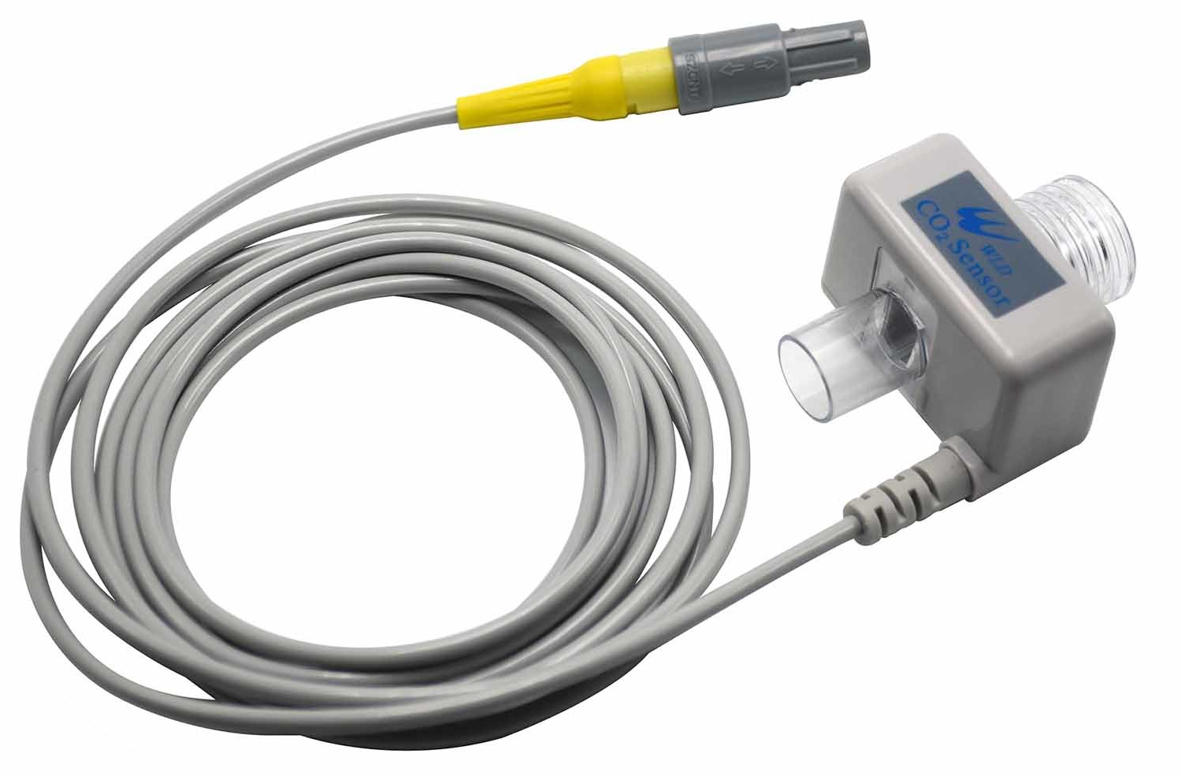
CO₂ Gas Sensor (Capnography)
Infrared absorption spectroscopy
  Based on physical principle that gases absorb infrared radiation at characteristic frequencies
  Level of absorption depends on concentration of molecules according to Beer-Lambert law: Concentration = Absorption constant × ln(I₀/I )
Measures End-Tidal Carbon Dioxide (EtCO₂)
I_{o}
I

Slide 11
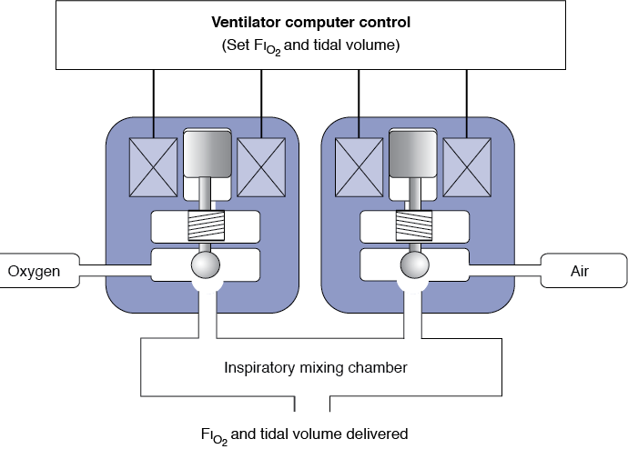
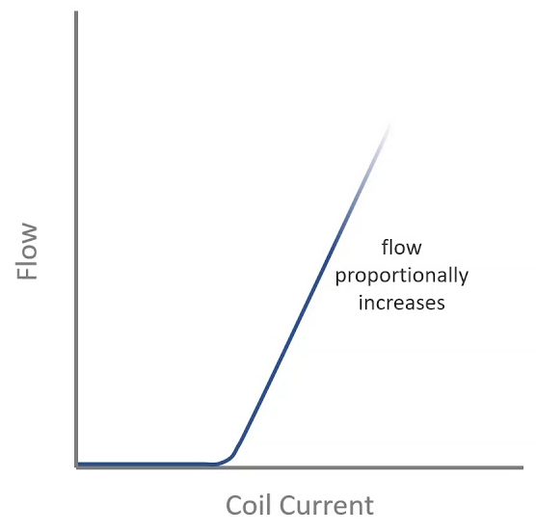
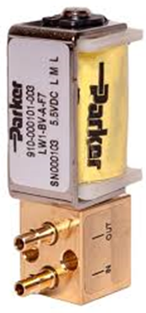
Proportional Solenoid Valves
Idea: constriction causes significant pressure drop
Control of pressure/flow of gases
  Inspiratory valve (control of ventilation mode delivery)
  Expiratory valve (Control of PEEP)

Slide 12
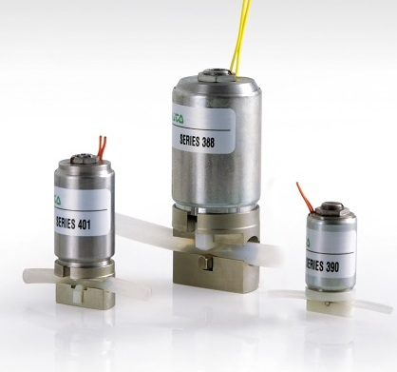
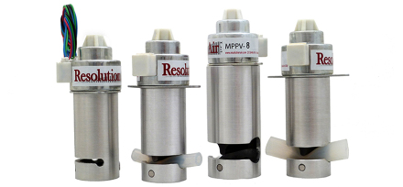
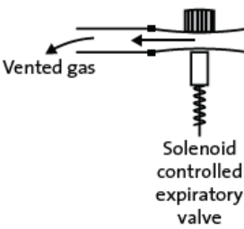
Solenoid Pinch Valves
No contact with air
  No need for sterilization after use
  Particular application: expiratory valve
Proportional control of flow

Slide 13
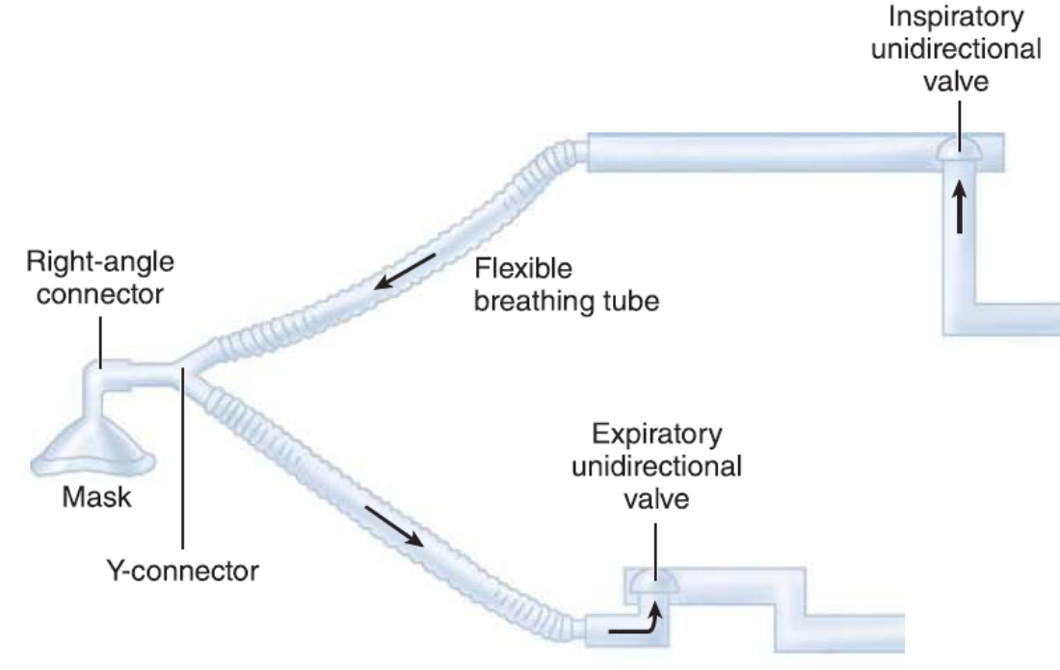
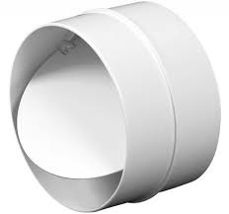
Check Valves
Ensure unidirectional flow in both inspiratory and expiratory limps
Mechanical operation

Slide 14
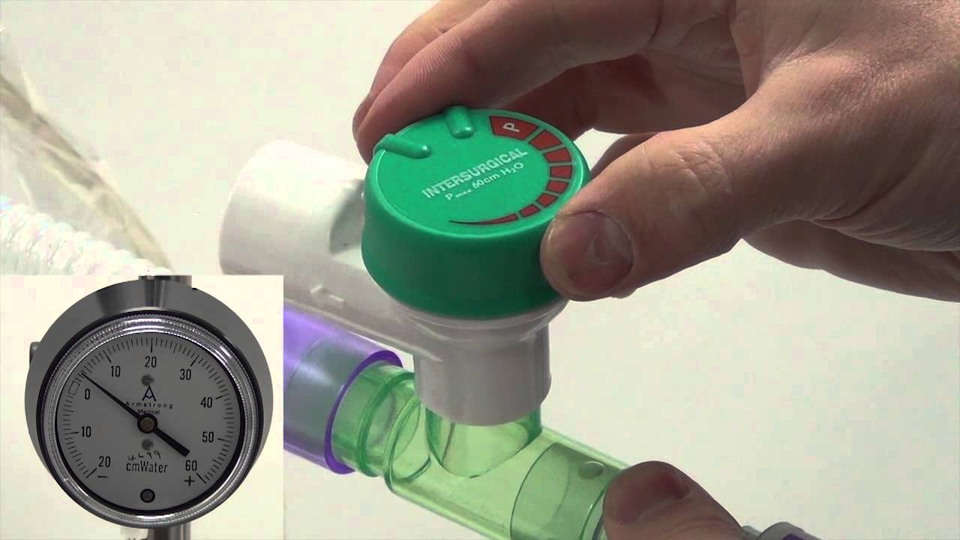
Adjustable Pressure Limiting (APL) Valve
Safety of airway pressure during positive pressure ventilation to avoid barotrauma
Usually a mechanical device but can be implemented as a solenoid valve

Slide 15
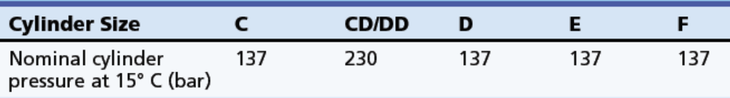
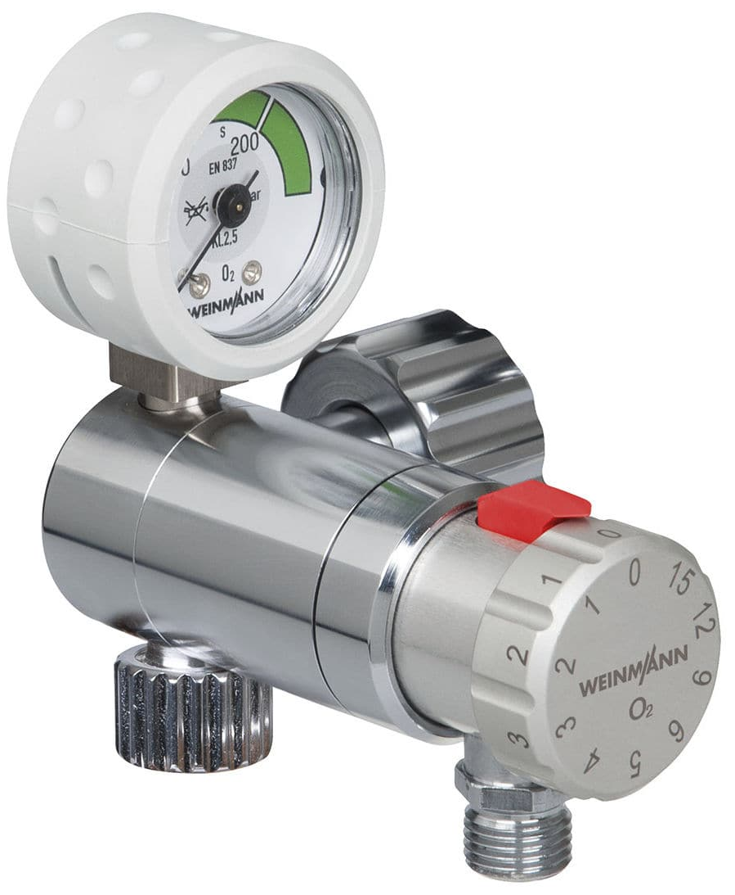
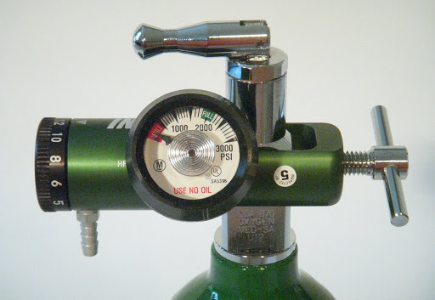
Pressure Reduction Valve
Essential for oxygen cylinder interface to ventilators
  Reduction of pressure to 4.1 bar
Mechanical operation

Slide 16
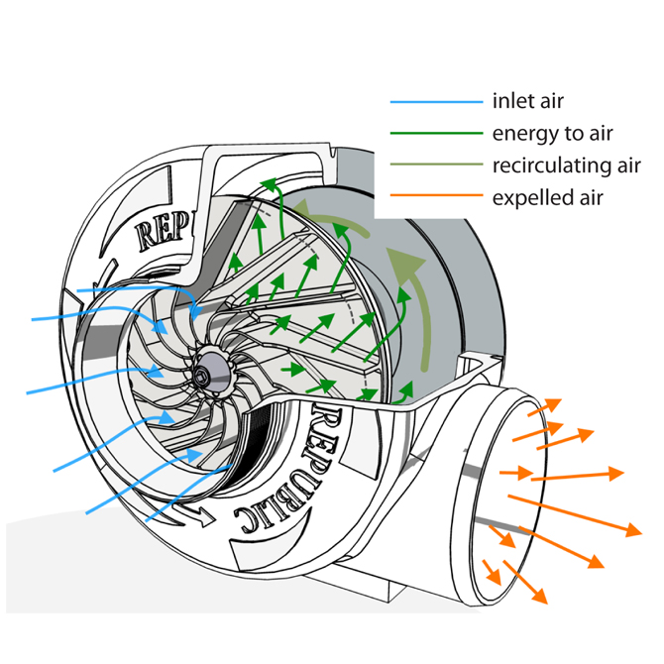
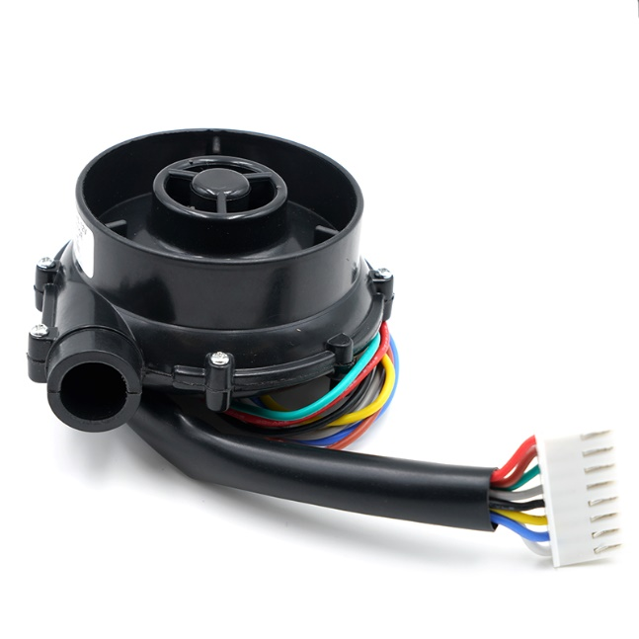
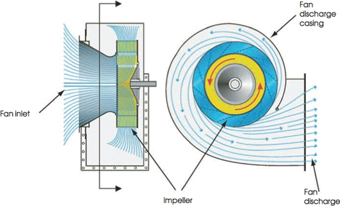
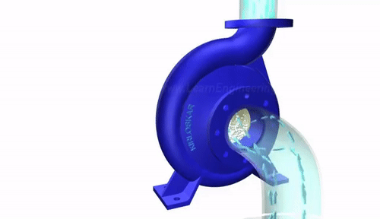
Air Blower
Common technology: Centrifugal Blowers
  Ideal to maintain continual gas transfer and for creating high pressure from small volumes of air
Speed controllable
Silent operation

Slide 17
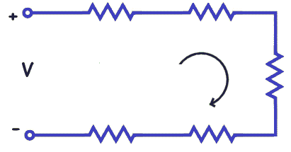
Practical Issues: Pressure Measurement
Pressure measurements differ by location
  Each circuit part has a resistance
Pressure measurements should not be affected by temperature or humidity
Mechanics Electricity
Pressure ➔ Voltage
Flow ➔ Current
Volume ➔ Charge
Resistance ➔ Resistance Compliance ➔ Capacitance
Valve ➔ Switch
Valves
Sensors
HME
Patient Airway
Breathing Circuit

Slide 18
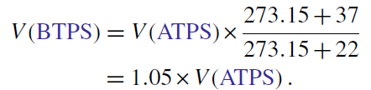
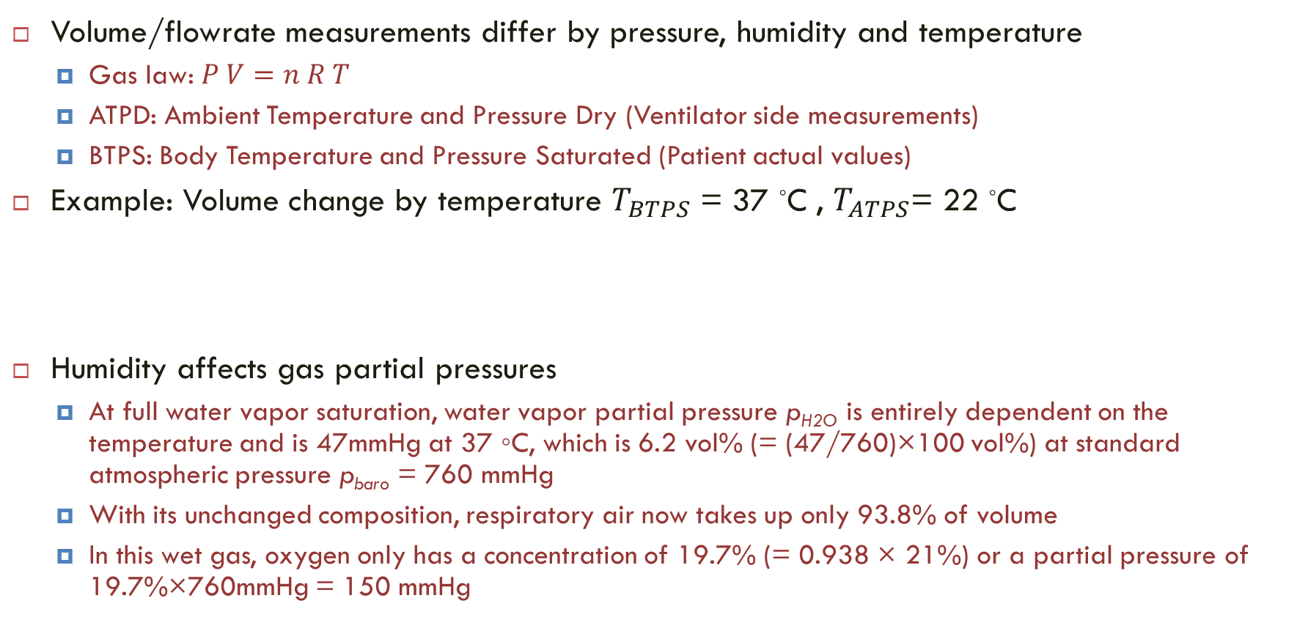
Practical Issues: Volume Measurement
Volume/flowrate measurements differ by pressure, humidity and temperature
  Gas law: $P V=n R T$
  ATPD: Ambient Temperature and Pressure Dry (Ventilator side measurements)
  BTPS: Body Temperature and Pressure Saturated (Patient actual values)
Example: Volume change by temperature $T_{BTPS}$ = 37 ◦C , $T_{ATPS}$= 22 ◦C
Humidity affects gas partial pressures
  At full water vapor saturation, water vapor partial pressure p_{H2O} is entirely dependent on the temperature and is 47mmHg at 37 ◦C, which is 6.2 vol% (= (47/760)×100 vol%) at standard atmospheric pressure p_{baro} = 760 mmHg
  With its unchanged composition, respiratory air now takes up only 93.8% of volume
  In this wet gas, oxygen only has a concentration of 19.7% (= 0.938 × 21%) or a partial pressure of 19.7%×760mmHg = 150 mmHg

Slide 19

Recommended Textbooks
Daniel Aston, Angus Rivers, Asela Dharmadas, Equipment in Anaesthesia and Critical Care: A Complete Guide for the FRCA, Scion Publishing, 2014.
Jan Ehrenwerth, James B. Eisenkraft, James M. Berry, Anesthesia Equipment: Principles and Applications, Elsevier Saunders, 2013.

Slide 20
Thank you

