Slide 1

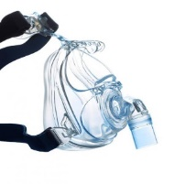
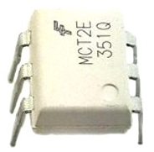

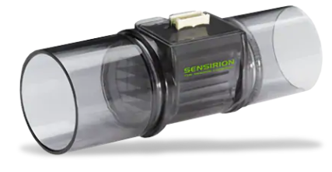
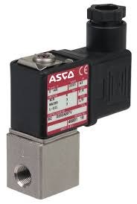
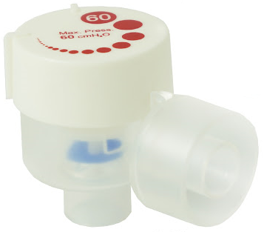
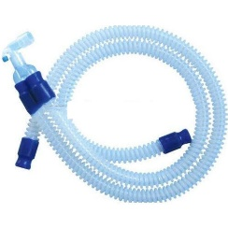
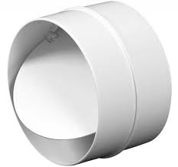
Mechanical Ventilator: Design and Implementation
Patient Mask
Control Signal
Isolated Driver
Pressure Sensor
Flow Sensor
HME
APL Valve
Check Valve
Breathing Circuit
Proportional Valve
Professor Yasser Mostafa Kadah

Slide 2
Mechanical Ventilator Functional Diagram
Gas mixing
Inspiratory Limb
Patient Interface
Expiratory Limb
Pressure and Flow
Control
HME

Slide 3
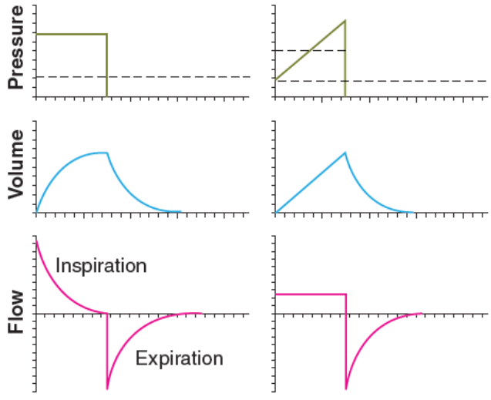
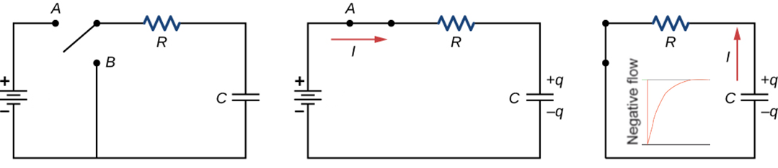
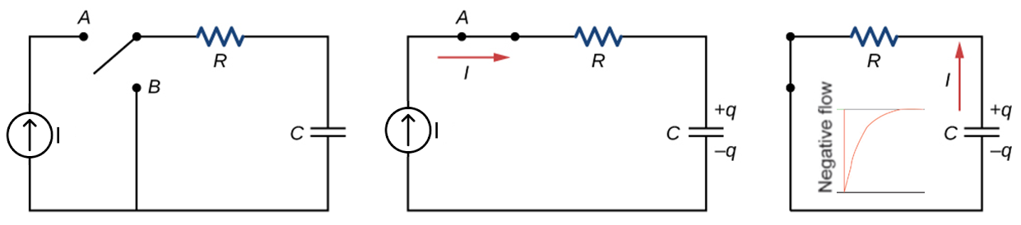
Ventilator Waveforms: Control Variable
Pressure-Control
Pressure-Control
Volume-Control
Inspiration
Expiration
Volume-Control

Slide 4
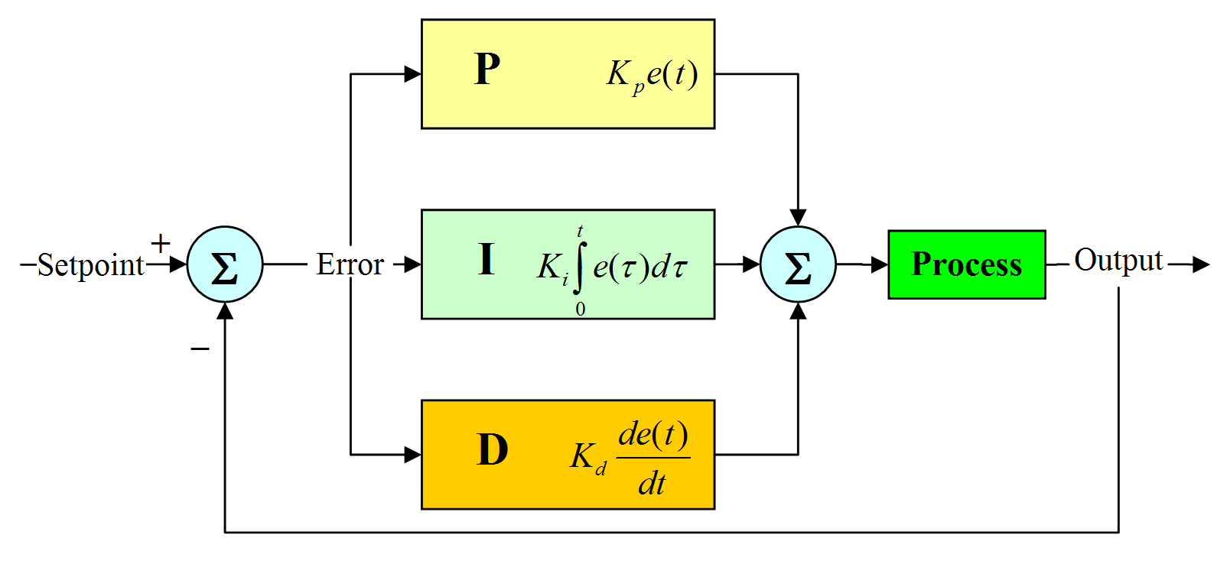
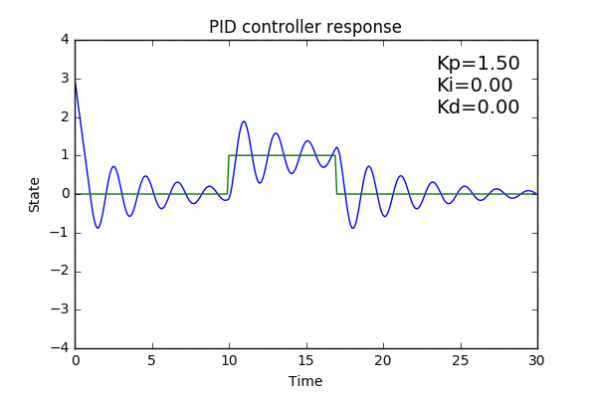
Generalized Control System
PID Controller

Slide 5
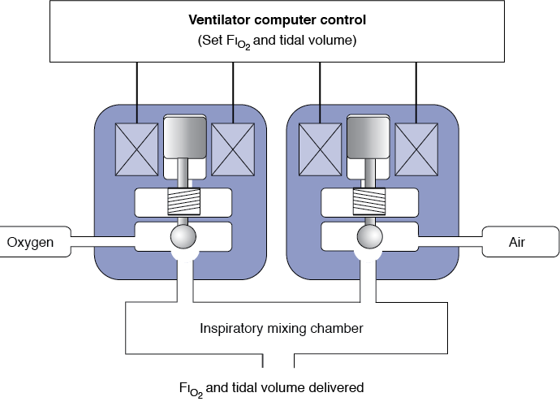
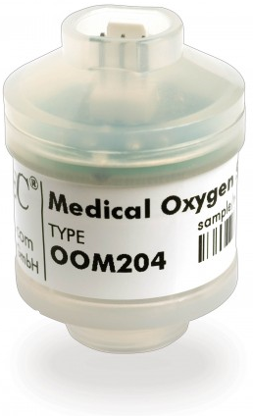

Electronic Gas Blender
Set values: F_{I}O₂ and tidal volume
Proportional valves for both air and oxygen
  Flowrate in each is proportional to its control signal
Measure pressure and temperature for each to compensate for volume changes
  Gas law: PV= nRT
Solve 2 equations in 2 unknowns to determine flowrates of oxygen and air
Use feedback from oxygen sensor to correct
Target tidal volume = (Flowrate(O₂)+Flowrate(air)) x Inspiratory time
$$\text{Target} \text{FIO}\text{2}\text{ = }\frac{\text{F}\text{lowrate}\text{(}\text{O}\text{2}\text{) }\text{x}\text{ 1 + }\text{F}\text{lowrate}\text{(}\text{air}\text{) }\text{x}\text{ 0.21}}{\text{Fl}\text{owrate}\text{(}\text{O}\text{2}\text{) + }\text{F}\text{lowrate}\text{(}\text{air}\text{)}}$$
Oxygen Sensor
Control Signal 1
Air
Isolated Drivers
Control Signal 2
O₂
Feedback

Slide 6

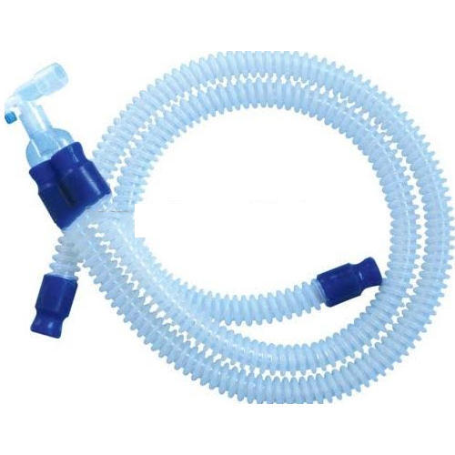
Inspiratory Circuit
Patient Mask
Feedback
Control Signal
Isolated Driver
Pressure Sensor
Flow Sensor
HME
Breathing Gas
APL Valve
Check Valve
Breathing Circuit
Mixed Gas
Proportional Valve

Slide 7
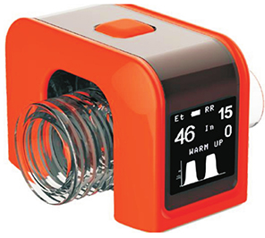
Expiratory Circuit
Feedback
Expired Gas
Control Signal
Pressure Sensor
Flow Sensor (Optional)
EtCO₂ (Optional)
Isolated Driver
Breathing Circuit
Check Valve
Vented Gas
Proportional Valve

Slide 8
CPAP/PEEP and BiPAP Implementation
Continuous Positive Airway Pressure (CPAP) and Positive End-Expiratory Pressure (PEEP or EPAP)
  User: selection of CPAP pressure (DC offset)
  Machine: control of proportional valve to maintain selected airway pressure
    Inspiratory valve: control of airway pressure baseline to selected CPAP pressure
BiLevel Positive Airway Pressure (BiPAP)
  User: selection of IPAP and EPAP pressures
  Machine: detection of inspiration start and end, control valves to maintain selected pressures
    Detect negative pressure from patient to indicate start of inspiration
    Inspiratory valve: control of airway pressure baseline during inspiration to be IPAP
    Detect end of inspiration using flow sensor
    Expiratory valve: control of airway pressure baseline during expiration to be EPAP
CPAP/PEEP
BiPAP

Slide 9
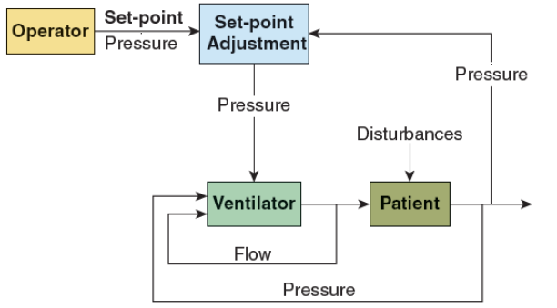
Supported Ventilation Implementation
User: selection of Support Pressure and PEEP pressures
Machine: detection of inspiration start and end, control valves to maintain selected pressures
    Detect negative pressure from patient to indicate start of inspiration
    Inspiratory valve: control of airway pressure baseline during inspiration to be Support Pressure
    Detect end of inspiration using flow sensor and close inspiratory valve
    Expiratory valve: control of airway pressure baseline during expiration to be PEEP
Pressure-Support (PS)

Slide 10
Continuous Mandatory Ventilation Implementation
User: selection of Target Pressure (PC) or Target Volume (VC) and PEEP, Rate and I:E ratio
Machine: start and cycle using time, control valves to maintain selected pressures
    Start of inspiration in its preselected time
    Inspiratory valve: control of airway pressure baseline during inspiration to meet target pressure or volume during inspiration phase
    End of inspiration after its preselected duration ends and close inspiratory valve
    Expiratory valve: control of airway pressure baseline during expiration to be PEEP
Continuous Mandatory Ventilation (CMV)

Slide 11
Ventilator Alarm System
Level 1 events include life-threatening situations
  Loss of input power or ventilator malfunction (e.g., excessive or no flow of gas to the patient)
  Alarms in this category should be mandatory (not subject to operator choice), redundant (multiple sensors and circuits), and non-canceling (alarm continues to be activated, even if event is corrected, and must be reset manually)
Level 2 events can lead to life-threatening situations if not corrected in a timely fashion
  Such things as blender failure, high or low airway pressure, auto-triggering, and partial patient circuit occlusion, and may include suspicious ventilator settings such as an inspiratory-to-expiratory timing (I:E) ratio greater than 1:1
  Alarms for level 2 may not be redundant and may be self-canceling (i.e., alarm inactivated if event ceases to occur)
Level 3 events affect patient– ventilator interface and may influence the level of support
  Such events as changes in patient compliance and resistance, changes in patient respiratory drive, and auto-PEEP
Level 4 events reflect the patient condition alone rather than ventilator function
  Usually detected by stand-alone monitors, such as oximeters, cardiac monitors, and blood-gas analyzers
  Some ventilators are able to incorporate such readings (e.g., capnography) in their displays and alarm systems

Slide 12
Example Practical Alarm System

Slide 13
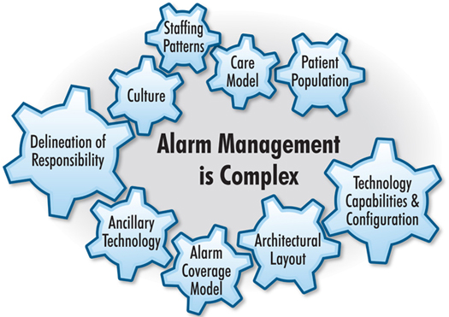
Alarm User Interface
Alarm Setting
Alarm Fatigue
“While device alarms can improve medical care by arming clinicians with valuable information about their patient’s health, most are false or nonactionable, often resulting in a sensory clutter that overwhelms clinicians and caregivers, desensitizing them to the alerts”, AAMI

Slide 14
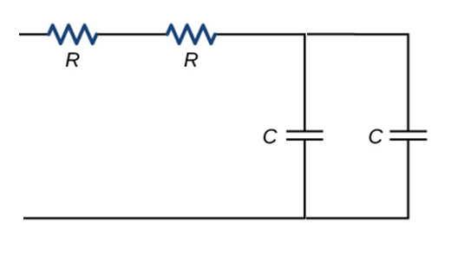
Advanced Issues: Breathing Circuit Model
Weak link in patient–ventilator system is patient breathing circuit
  Expensive ventilator with state-of-the-art computer control is connected to patient (priceless) with $2 piece of plastic tubing whose design has not changed appreciably in 20 years
  Resistance and compliance of delivery circuit make flow control and volume delivery more difficult
Breathing Circuit
Patient
Mechanics Electricity
Pressure ➔ Voltage
Flow ➔ Current
Volume ➔ Charge
Resistance ➔ Resistance Compliance ➔ Capacitance
Breathing Circuit
Patient

Slide 15
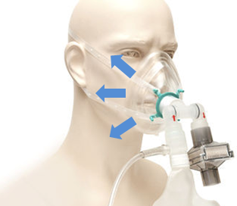
Advanced Issues: Leakage Compensation
Leaks are inherent to patient interfaces and circuits in NIV
  Monitoring and compensating for leaks associated with NIV is critical for maintaining the appropriate trigger and cycle levels for the ventilator
  This is critical to assessing mask seal efficacy and preventing overtightening of the mask that may result in pressure sores
Uncompensated leaks generate auto-triggering, prolonged cycling, ineffective inspiratory efforts, and poor pressurization capacity of ventilator

Slide 16
Challenge of Computer Control of Mechanical Ventilation
Human operator considers a wide range of physiological variables
  Include more abstract evaluations of such things as metabolic, cardiovascular, and psychological states
  Various environmental factors may affect operator judgment
Truly complex control problem

Slide 17
Future of Computer Control of Mechanical Ventilation
Basic tactical control of the individual breath
Longer-term strategic control that adapts to changing load characteristics
  Mathematical models for parameters
  Expert rules to ensure lung protection
Sampling physiologic parameters and use intelligence to establish patient condition
  Decide best response based on database of both human expert rules and actual patient responses to various ventilator strategies
  Ventilator not only learns from interaction with current patient but also contribute to database
Networking of intelligent ventilators
  Increase learning capacity exponentially

Slide 18
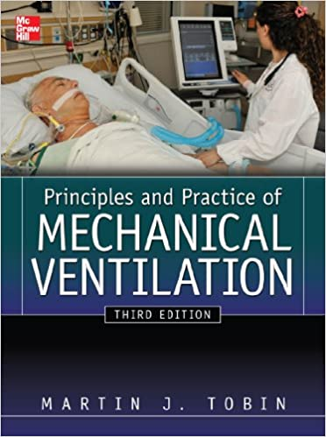
Recommended Textbook
Martin J. Tobin, Principles and Practice of Mechanical Ventilation, 3rd ed., McGraw-Hill Medical, 2013.

Slide 19
Thank you
Patient Mask
Control Signal
Isolated Driver
Pressure Sensor
Flow Sensor
HME
APL Valve
Check Valve
Breathing Circuit
Proportional Valve

