Slide 1
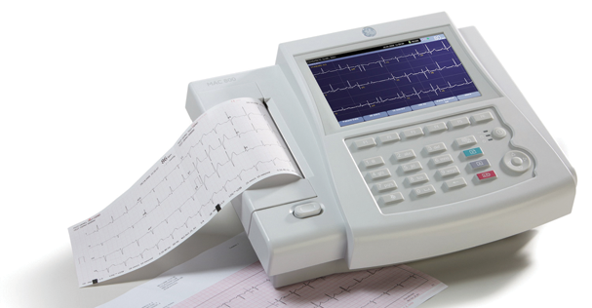
Electrocardiography (ECG)
Prof. Yasser Mostafa Kadah

Slide 2
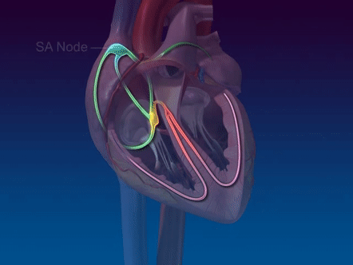

Cardiac Physiology
The heart is a synchronized double pump
  Right part pumps blood with low O₂ and high CO₂ to lungs
  Left part pumps blood with high O₂ and low CO₂ to body organs
Rhythmic contractions of myocardium are triggered by electrical impulses generated within heart and conducted via special conductive system embedded in myocardium
  Thus, heart cells are characterized by rhythmic autonomy or autorhythm

Slide 3
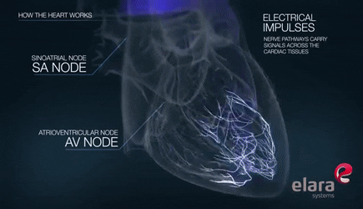
Diagnostic Signals: Vectorcardiogram (VCG)
As excitations spread via fibers in 3D, net magnitude and angle of all electrical excitations in the heart muscle changes
  Vector sum is a 3D vector whose trajectory with time is called VCG

Slide 4
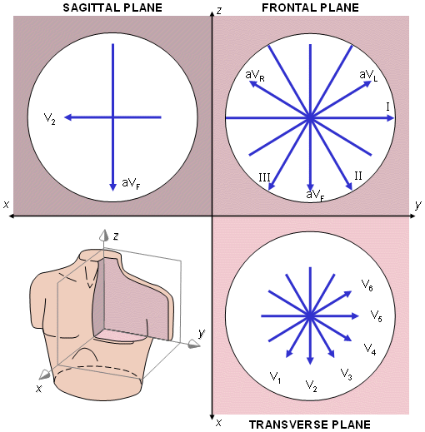
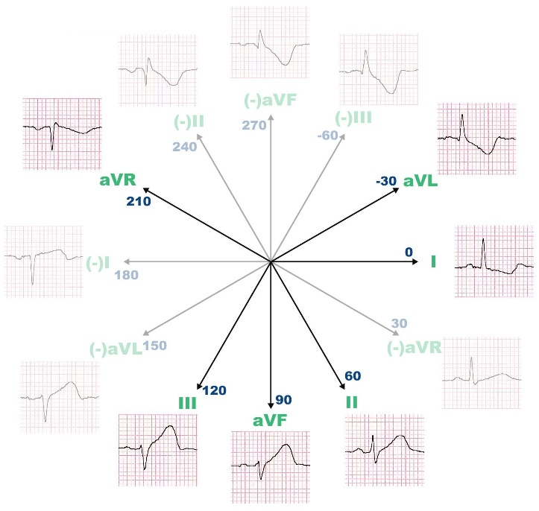
ECG from VCG: ECG Leads
3D VCG can be projected on one axis (lead direction) and represented as a function of time and get ECG
  ECG is 1D projection of VCG onto lead direction as a function of time
  First loop of VCG (atrial excitation): P-wave in ECG
  Second large loop of VCG (ventricular excitation): QRS-complex in ECG
  Third loop (repolarization) in VCG: T-wave in ECG

Slide 5
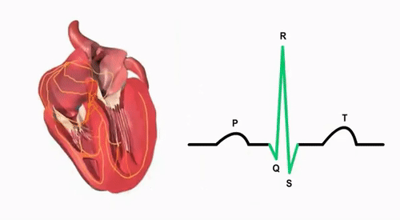
Diagnostic Information in ECG
Each section in ECG waveform corresponds to particular event
  P-wave: atrial excitation
  PQ-segment: conduction of excitation to ventricles
  QRS-complex: spreading of excitation within ventricles up to complete excitation
  ST-segment and T-wave: repolarization of ventricles

Slide 6
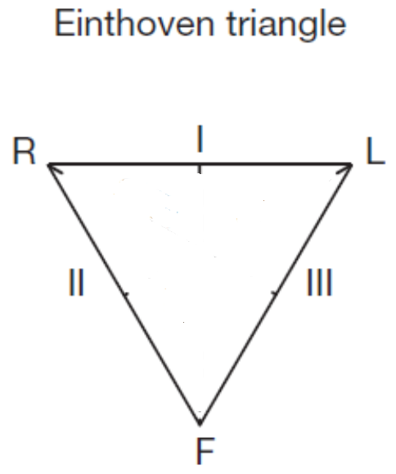
Einthoven Leads (Bipolar Limb Leads)
Positioning two electrodes at transition from thorax to arms (or on wrists) and third one near umbilicus (or on left ankle) yields three recording directions forming triangle in frontal plane of body
  Form Einthoven Triangle leads I, II, and III
  Additional lead, usually right leg, for grounding purposes

Slide 7
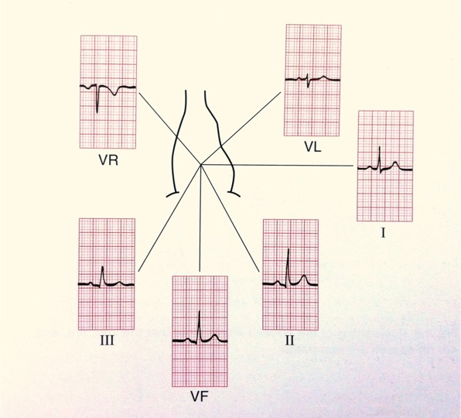
Goldberger Leads (Unipolar Limb Leads)
To ensure easier and more accurate detection of certain pathophysiological conditions, three further limb leads, also in the frontal plane, are often used: Goldberger leads
  Obtained by connecting pairs of Einthoven leads via two equal resistors and recording between third Einthoven lead and mid-point of resistors
  New leads: aVR (augmented voltage right), aVL (augmented voltage left), and aVF (‘augmented’ voltage foot)

Slide 8
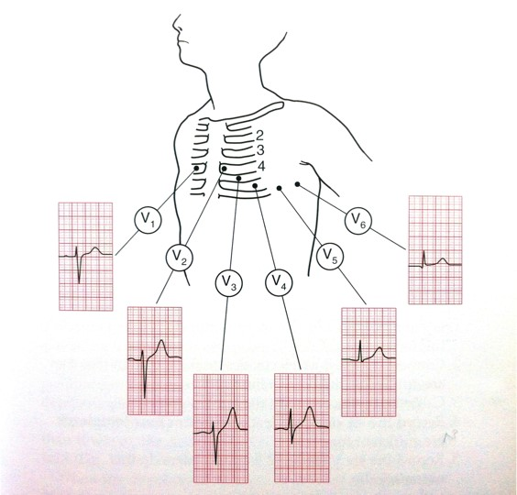
Wilson Leads (Unipolar Chest Leads)
Six further leads termed V1–V6 are used
  Potentials of six definite precordial points on chest surface measured against central reference point, achieved by connecting the three Einthoven electrodes via three identical resistors
  Recordings from Wilson leads are in horizontal plane and supplement information from other six frontal leads

Slide 9
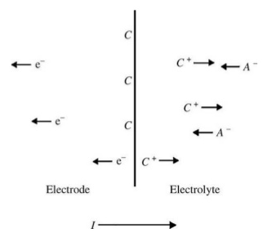
Electrode Operation
Electrode-electrolyte interface: double layer
  Local change in ion concentration near metal surface
  Charge neutrality is not maintained: half-cell potential at no current
Polarizable electrodes pass current between electrode and electrolyte by changing the charge distribution near electrode
  Serious limitations when movement is present and with low frequency biosignals
Non-polarizable electrodes allow current to pass freely across interface without changing charge distribution near electrode
  Preferred in most biomedical applications (e.g., Ag-AgCl electrodes)

Slide 10
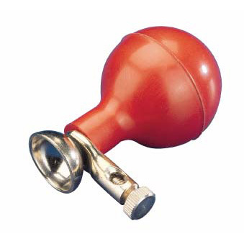
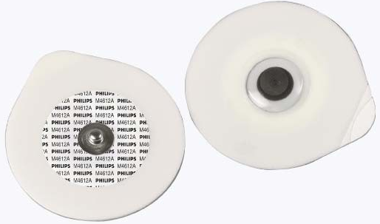
ECG Electrodes
General requirements
  Low electrical interface impedance
  High mechanical resistance
  Low interface (‘reversible’ or ‘half-cell’) potential
  Low distortion of signal
  Low polarization
Different types
  Suction electrodes (reusable)
  Floating/hydrogel electrodes (disposable)

Slide 11
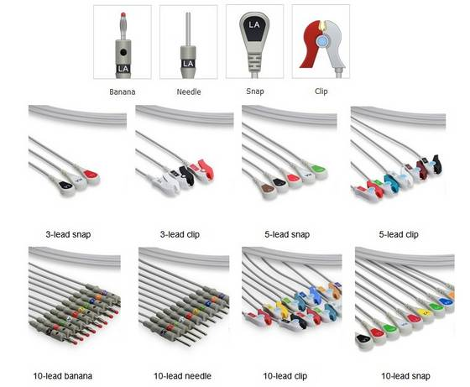
ECG Lead Definitions and Color Code

Slide 12
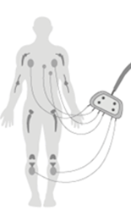
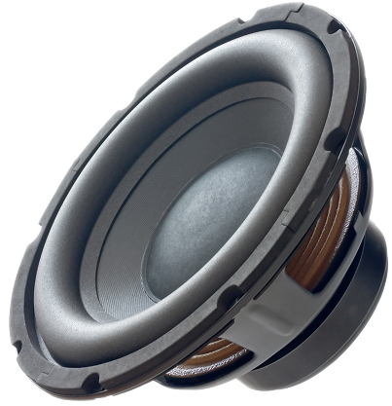
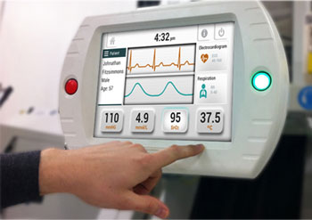
Typical ECG Signal Processing Chain
Inputs
Signal Selection
Signal Isolation
Electrode #1
Protection
Electrode #2
Protection
Signal Conditioning
Analog Filters
…
…
Analog
Signal
Electrode #N
Protection
Selection Lines
Analog
Output
…
ADC
DAC
Control Signals
Computer
Digital
Signal
User
Interface

Slide 13


Protection Circuit
Circuit 1: Limits voltage to within ±0.6 Volts
Circuit 2: Limits voltage to within ±V_{zener} Volts
Current- Limiting Resistance
Current- Limiting Resistance

Slide 14
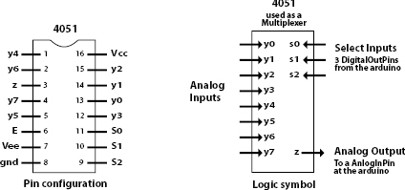
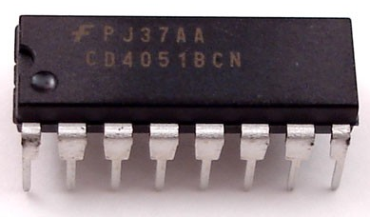
Signal Selection (Multiplexing)
Multiple signals to measure with only one chosen for display
  Example: ECG
Analog multiplexer (MUX) device allows desired signal to be selected from multiple inputs for further processing
  Example: 4051 8-Channel MUX/DeMUX

Slide 15
Signal Conditioning (Analog Front-End)
Biosignals are very weak
  Very low amplitude
  Very High output impedance
Biosignals are differential
  Instrumentation amplifier is required

Slide 16
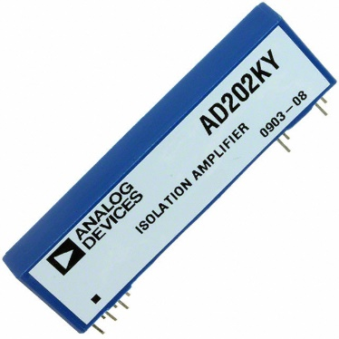
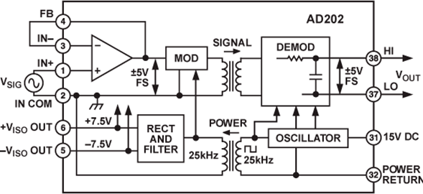
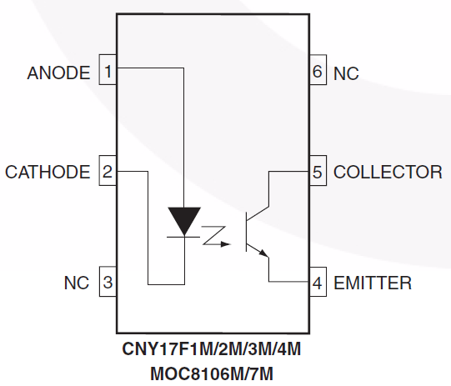
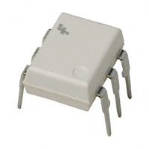
Signal Isolation
Isolation breaks ohmic continuity between patient and AC mains
  Requirement: isolation of both signal and DC power supply and ground
Transformer isolation
Optical isolation

Slide 17
Electric Fields Artifacts
Electric field coupling from nearby power lines to body is frequent cause of unwanted common-mode voltage
  Common-mode voltages UG >100 mV possible with 220–240 V power lines – underlines necessity of common-mode rejection in amplifiers
  Unbalance of electrode contact impedances and existence of common-mode voltage generate differential 50/60 Hz disturbance inputs UD to biopotential amplifier
Minimize by:
  High amplifier input impedance
  Care with selection and application of electrodes
    Cleaning of skin and use of electrode gel to avoid impedance mismatch

Slide 18
Electromagnetic Fields Artifacts
Alternating magnetic fields from power lines and from high frequency sources (e.g., communication or therapeutic devices) induce parasitic currents
  In combination with imbalanced impedances result in unwanted differential inputs
Minimize by:
  Wires tightly twisted to avoid aerial effect due to large area inductive loops
  Increasing distance from disturbing source
  Shielding magnetic fields
  Optimally choosing position of patient
  Optimally choosing orientation of leads

Slide 19
Motion Artifacts
Artifacts are largely due to deformation of skin under electrode
Minimize by:
  Nonpolarizable Ag–AgCl electrodes with low stable contact potentials
  Electrode gel to minimize skin impedance and stabilize skin potential
  Use of amplifiers with input current <10 pA
  Use of lightweight connections, leads, and wires
  Restricting patient movement
    If necessary, for short-term diagnostic applications, resting patient can stop breathing for few seconds during measurement

Slide 20
Resistor Noise
All resistors between biosignal source and instrumentation amplifier contribute to noise
  Amplitude of noise is proportional to square of product of bandwidth and resistor value
Amplifier itself may constitute additional noise component
  Depends heavily on applied amplifier technology
Minimize by:
  Larger surface of electrode and use of conductive electrode gel reduce resistances at skin and electrode interface
  Use of low noise amplifiers

Slide 21
Interference from Other Biosignals
Electrical signals underlying muscle activity (EMG) can disturb ECG as muscles are generally located near ECG recording electrodes
  If possible, patient should not move and should be relaxed during ECG
  If patient movement is required or unavoidable, great care should be taken to choose electrode positions that are minimally influenced by muscle movement
Elimination of EMG-components may be achieved by adequate filtering
  ECG and EMG bandwidths overlap: such filtering can remove important ECG features

Slide 22
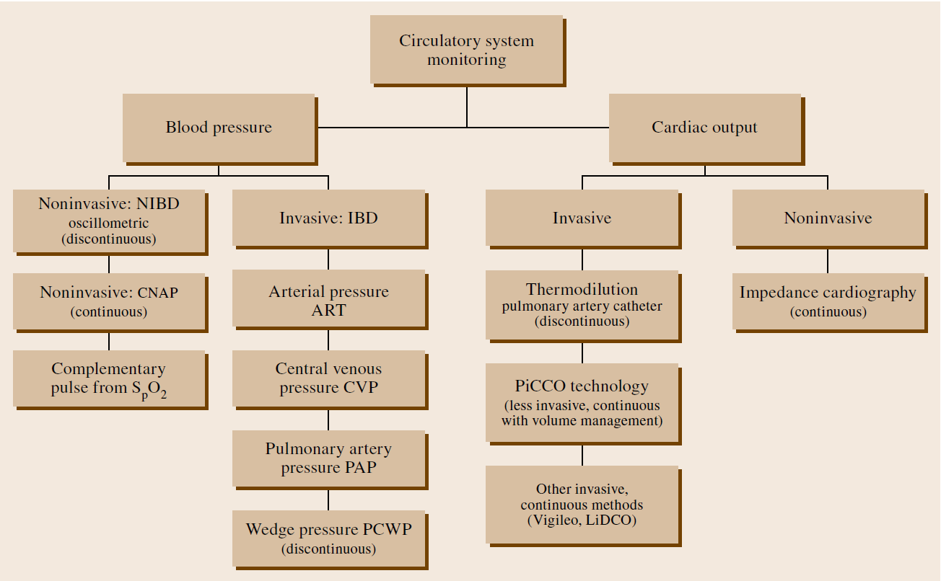
Final Remark: ECG in Context of Cardiovascular Monitoring
ECG provides information about electrical activity in the heart
  No direct information about pumping capacity (mechanical cardiac function)

Slide 23

Recommended Reference
Anders Brahme (ed.), Comprehensive Biomedical Physics, Elsevier, 2014. (ISBN: 978-0444536327)

